Slide 1

Security Controls in Shared Source Code Repositories
Samuel Sidzyik
CSD-380
10/4/2026

Slide 2
Why Is This Needed?
Shared repositories contain critical code, history, and automation.
Strong security controls prevent unauthorized access and tampering.
A single leaked secret can cause a breach or production outage
Repositories are high-value target for supply chain attacks

Slide 3

What can we Do?

Slide 4

Access Control & Authentication
This is the first line of Defense
Enforce multi-factor authentication for all contributors.
Apply least privilege roles and restrict admin access.
Use short-lived, scoped tokens instead of broad personal tokens.
Integrate identity with SSO/SAML.
Regularly review and remove stale accounts.

Slide 5
Secret Management & Prevention
Second, Keep Unwanted Users out of Repository
Use automated secret scanning on commits and server-side.
Add .gitignore entries for environment files and credentials.
Store secrets in a dedicated secrets manager.
Treat any committed secret as compromised and rotate immediately.
Just don’t commit secrets and keys!!!

Slide 6

Branch Protection & Code Review
Branch protection ensures that only verified, reviewed, and tested changes reach critical code paths. By requiring pull requests, enforcing signed commits, and mandating CI checks, teams prevent unauthorized modifications and catch mistakes early.
Disabling force pushes and restricting who can merge into main branches adds another layer of safety. These controls create a predictable, auditable workflow that strengthens code integrity and reduces the risk of accidental or malicious changes being introduced into the repository.

Slide 7
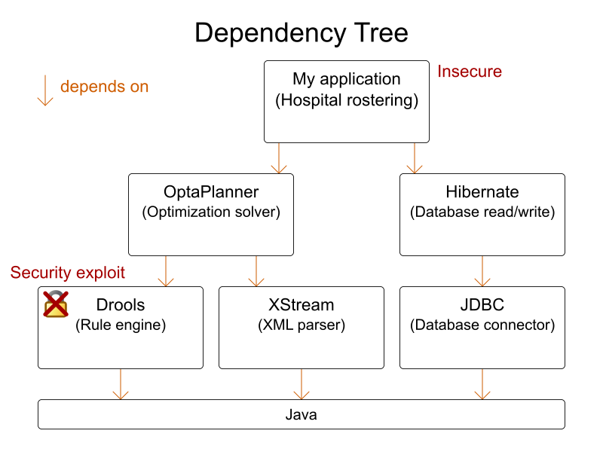
Dependency & Supply Chain Security
Find your dependencies and lock them down and out. Third-party libraries, frameworks, and tools are targets for malicious code injection and must be used safely, with restrictions on what the dependent software is allowed to do.
Attackers increasingly target open‑source ecosystems, injecting malicious updates, hijacking maintainers’ accounts, or exploiting known vulnerabilities that teams fail to patch.

Slide 8
Monitoring, Logging & Auditing
Security is not a one-time configuration. It is a continuous march forward.
“The people that are making this world worse don’t take a day off, how can I?” ~Bob Marley
Enable audit logs for pushes, merges, and permission changes.
Monitor for suspicious activity (unexpected pushes, new tokens, etc.).
Use automated tools to detect secret leaks and misconfigurations.
Maintain backups and test recovery procedures.
Perform recurring security reviews of repo settings and workflows.

Slide 9
Some References
Good breakdown of practices and things to look out for.
https://www.harness.io/harness-devops-academy/secure-code-repositories-best-practices
This is on GitHub and seemed comprehensive. Too much to read at once, but I took some time to pick ideas to put in here.
https://github.com/iAnonymous3000/GitHub-Hardening-Guide

