Slide 1
The Technology Value Stream
CSD-380
Sam Sidzyik
08/16/2026

Slide 2
What is the Technology Value Stream?
The Technology Value Stream describes how an idea moves from initial request → development → testing → deployment → customer value.
It highlights every step where work can wait, get stuck, or flow smoothly.
DevOps focuses on improving this stream so teams deliver value faster, with fewer delays and less rework.

Slide 3
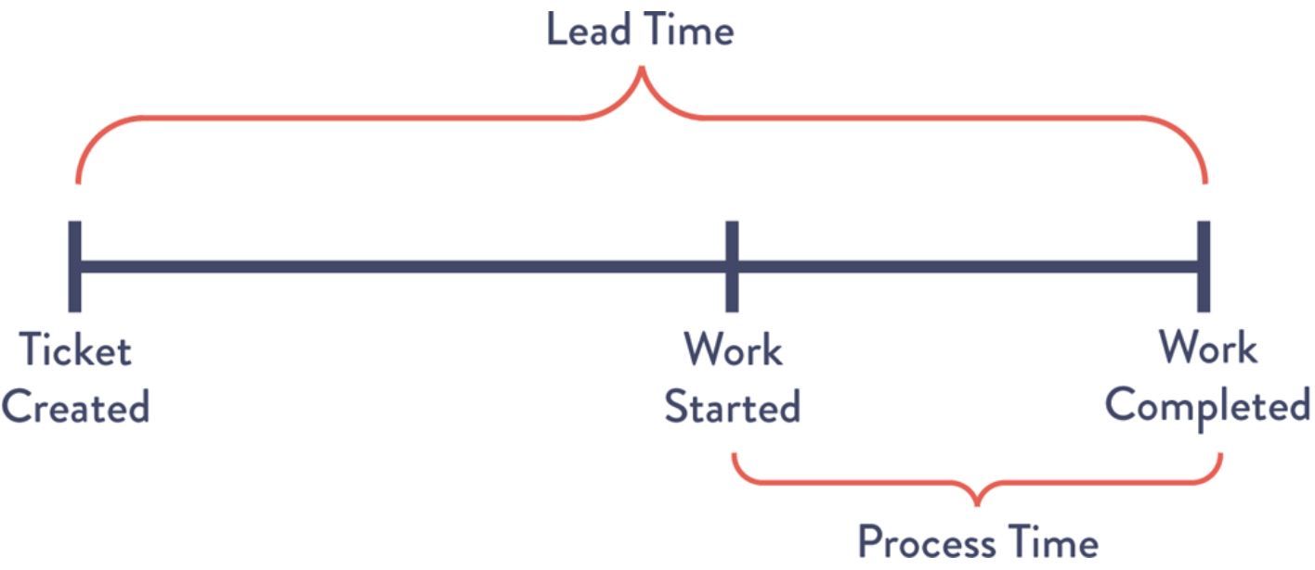
Lead Time vs. Processing Time
Lead Time:
Processing Time:
Total time from when a request is made until it is delivered to the customer.
Includes waiting, approvals, handoffs, delays, and actual work.
The time spent actively working on the task itself.
Usually much shorter than lead time.

Slide 4
Common Scenario: Deployment Lead Times of Months
Many traditional organizations deploy infrequently — sometimes only every few months
Causes include:
  Manual testing and approvals
  Siloed development and operations teams
  Unpredictable environments
  Large, risky releases
Result: slow feedback, higher failure rates, and frustrated teams.
This describes my company to a ‘T’

Slide 5
Why Months‑Long Deployment Lead Times Cause Problems
Bugs accumulate and become harder to diagnose.
Releases become “big events” that teams fear.
Customers wait longer for fixes and new features.
Teams spend more time firefighting than improving systems.
Work piles up, increasing stress and reducing quality.

Slide 6
How Teams Achieve Deployment in Minutes
Automation: CI/CD pipelines handle builds, tests, and deployments.
Infrastructure as Code: Environments are consistent and reproducible.
Automated Testing: Ensures quality without manual bottlenecks.
Monitoring & Observability: Teams detect issues quickly.
Culture: Dev + Ops collaborate instead of working in isolated phases.

Slide 7
Benefits of Short Deployment Lead Times
Faster delivery of customer value.
Lower risk due to smaller changes.
Teams spend less time fixing recurring issues.
Improved morale and reduced burnout.
Ability to respond quickly to market changes or incidents.

Slide 8
Citations
My book shows pages 49-50? Not page 9-10. Don’t know if that is a web viewing thing.
But mostly just the book: The DevOps Handbook

