Slide 1

BEM & SMACSS
“SMACSS is becoming one of the most useful contributions to front-end discussions in years” - Paul Smith
BEM (Block Element Modifier) is a popular CSS class naming convention that makes CSS easier to maintain. This article assumes that you are already familiar with the naming convention.

Slide 2
SMACSS
Smacss
SMACSS (pronounced “smacks”) is more style guide than rigid
framework. There is no library within here for you to download or
install. SMACSS is a way to examine your design process and as a
way to fit those rigid frameworks into a flexible thought process. It
is an attempt to document a consistent approach to site development
when using CSS. And really, who isn’t building a site with CSS
these days?! Feel free to take this in its entirety or use only the
parts that work best for you. Or don’t use it at all. I understand
that this won’t be everybody’s cup of tea. When it comes to web development,
the answer to most questions is “it depends”.
I like to use a prefix to differentiate between Layout, State, and Module
rules. For Layout, I use l- but layout- would work just as
well. Using prefixes like grid- also provide enough clarity to separate
layout styles from other styles. For State rules, I like is- as in
is-hidden or is-collapsed. This helps describe things in a very
readable way.
Modules are going to be the bulk of any project. As a result, having
every module start with a prefix like .module- would be needlessly
verbose. Modules just use the name of the module itself.

Slide 3
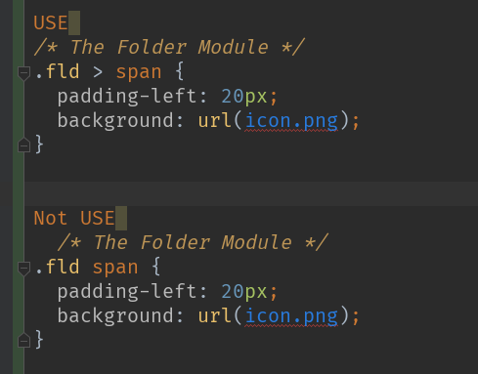
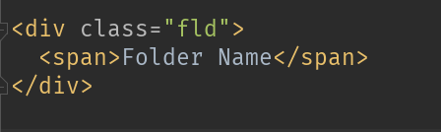
SMACSS
Avoid element selectors
Use child or descendant selectors with element selectors if the element
selectors will and can be predictable. Using .module span is
great if a span will predictably be used and styled the same way
every time while within that module.
Exemple:

Slide 4
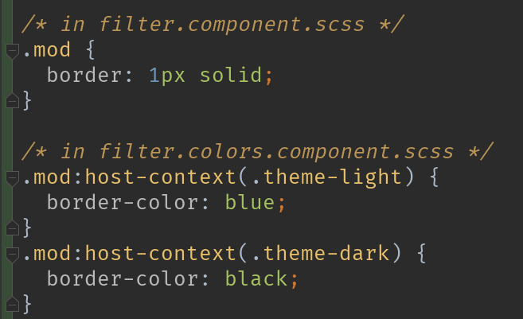
SMACSS
separate scss files for colors, fonts and architect
Very helpful when you building big enterprise app with a lots of functionality like color themes control and fonts change in the settings of our app
:host-context()
Sometimes it's useful to apply styles based on some condition outside of a component's view. For example, a CSS theme class could be applied to the document <body> element, and you want to change how your component looks based on that.
Use the :host-context() pseudo-class selector, which works just like the function form of :host(). The :host-context() selector looks for a CSS class in any ancestor of the component host element, up to the document root. The :host-context() selector is useful when combined with another selector.
The following example applies a background-color style to all <h2> elements inside the component, only if some ancestor element has the CSS class theme-light.

Slide 5
BEM
Block
Encapsulates a standalone entity that is meaningful on its own. While blocks can be nested and interact with each other, semantically they remain equal; there is no precedence or hierarchy. Holistic entities without DOM representation (such as controllers or models) can be blocks as well.
Element
Parts of a block and have no standalone meaning. Any element is semantically tied to its block.
Modifier
Flags on blocks or elements. Use them to change appearance, behavior or state.

Slide 6
BEM
Block
Naming
Block names may consist of Latin letters, digits, and dashes. To form a CSS class, add a short prefix for namespacing: .block
HTML
Any DOM node can be a block if it accepts a class name.
<div class="block">...</div>
CSS
Use class name selector only
No tag name or ids
No dependency on other blocks/elements on a page
.block { color: #042; }

Slide 7
BEM
Element
Naming
Element names may consist of Latin letters, digits, dashes and underscores. CSS class is formed as block name plus two underscores plus element name: .block__elem
HTML
Any DOM node within a block can be an element. Within a given block, all elements are semantically equal.
<div class="block">
...
<span class="block__elem"></span>
</div>
CSS
Use class name selector only
No tag name or ids
No dependency on other blocks/elements on a page
Good
.block__elem { color: #042; }
Bad
.block .block__elem { color: #042; }
div.block__elem { color: #042; }

Slide 8
BEM
Modifier
Naming
Modifier names may consist of Latin letters, digits, dashes and underscores. CSS class is formed as block’s or element’s name plus two dashes: .block--mod or .block__elem--mod and .block--color-black with .block--color-red. Spaces in complicated modifiers are replaced by dash.
HTML
Modifier is an extra class name which you add to a block/element DOM node. Add modifier classes only to blocks/elements they modify, and keep the original class:
Good
<div class="block block--mod">...</div>
<div class="block block--size-big
block--shadow-yes">...</div>
Bad
<div class="block--mod">...</div>
CSS
Use modifier class name as selector:
.block--hidden { }
To alter elements based on a block-level modifier:
.block--mod .block__elem { }
Element modifier:
.block__elem--mod { }

Slide 9
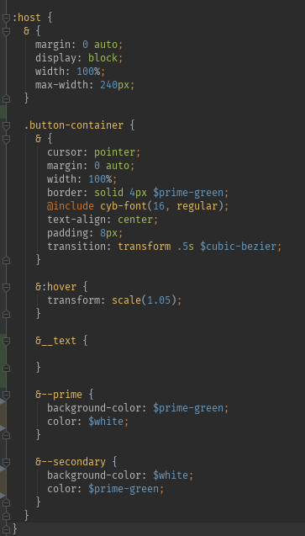
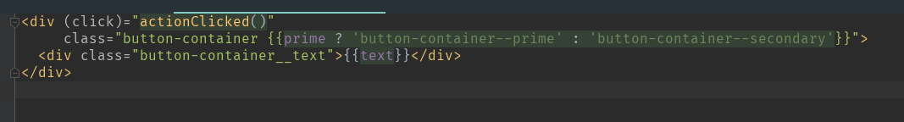
BEM
Example :

