Slide 1
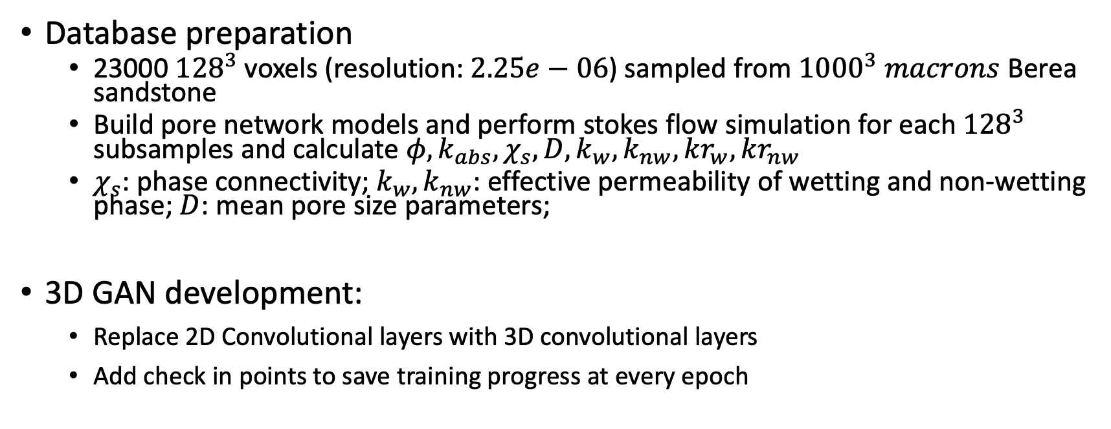
3D development
Database preparation
23000 ${128}^{3}$voxels (resolution: $2.25e−06$) sampled from ${1000}^{3} macrons$Berea sandstone
Build pore network models and perform stokes flow simulation for each ${128}^{3}$ subsamples and calculate $φ, k_{abs},χ_{s}, D, k_{w},k_{nw},kr_{w}, kr_{nw}$
$χ_{s}$: phase connectivity; $k_{w},k_{nw}$: effective permeability of wetting and non-wetting phase; $D$: mean pore size parameters;
3D GAN development:
Replace 2D Convolutional layers with 3D convolutional layers
Add check in points to save training progress at every epoch

Slide 2
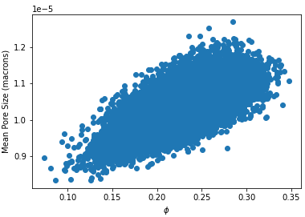
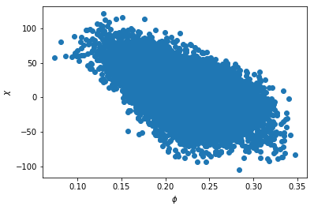
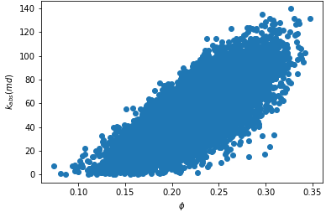
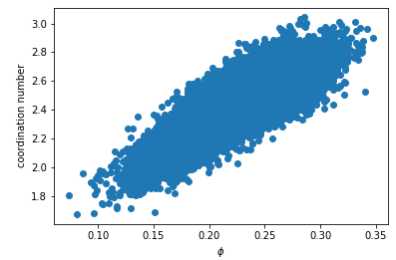
Correlation table
 | phi | kabs | coord | psd
phi | 1 | 0.77843526 | 0.81036771 | 0.66078823
kabs | 0.77843526 | 1 | 0.67175128 | 0.56338504
coord | 0.81036771 | 0.67175128 | 1 | 0.69415659
psd | 0.66078823 | 0.56338504 | 0.69415659 | 1
Porosity, permeability, coordination number and mean pore size are linearly correlated with each other
The scale of absolute permeability is small: just realized a tiny mistake in calculating absolute perm after simulation. I’ll fix this in next week.

Slide 3
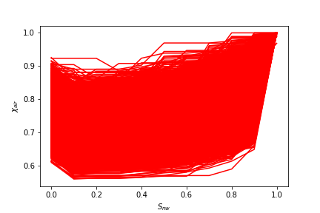
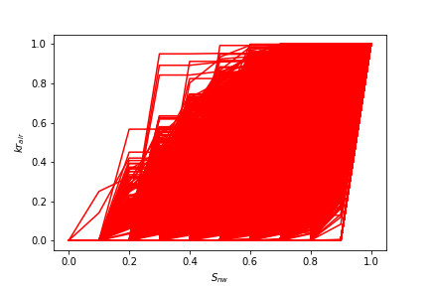
Collection of phase connectivity curves
Collection of relative perm curves

Slide 4
Improvement thoughts
Preprocess geological features as PCA components
The generation process may still be dominated by porosity instead of multi modal features unless we add our own physical loss functions

