Slide 1
PinchPilot
Small hand movements for webcam desktop control
PRS Practice Module · First Project Presentation · Group 15
HE ZIHANG · WEI YI · CHI YONGJUN
6 October 2026

Slide 2
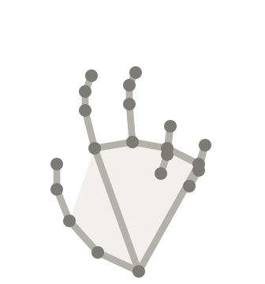
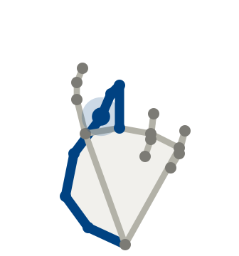
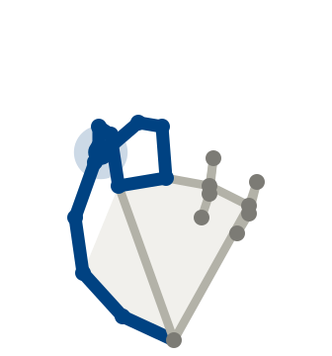
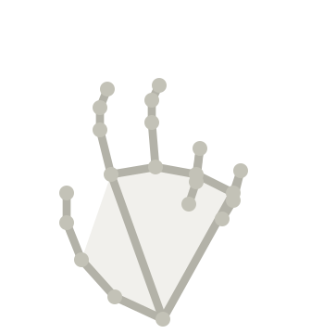
What PinchPilot will do
A webcam can see a hand, but that does not make it a comfortable pointer. PinchPilot will let laptop users point, click, drag and scroll with small hand movements and finger pinches.
1
Show the hand
2
Pinch to move
3
Click or drag
4
Let go to pause
Clear in the preview, forearm resting on the desk
Thumb and middle finger together; small hand or wrist motion
Index joins briefly: click. All three held: drag
The pointer stays where it is; rest or reposition
re-grip to continue
An ordinary laptop webcam · macOS and Windows · used alongside the mouse or trackpad
1 Objectives · 2 Scope · 3 Data · 4 Technical approach · 5 Done so far

Slide 3
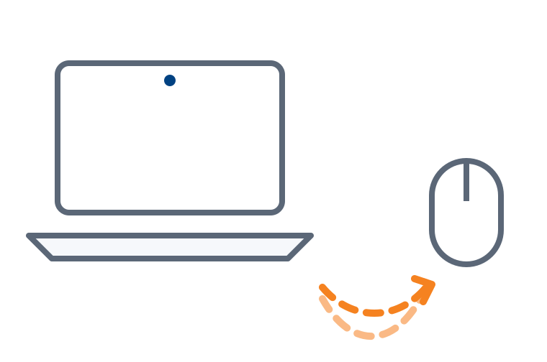
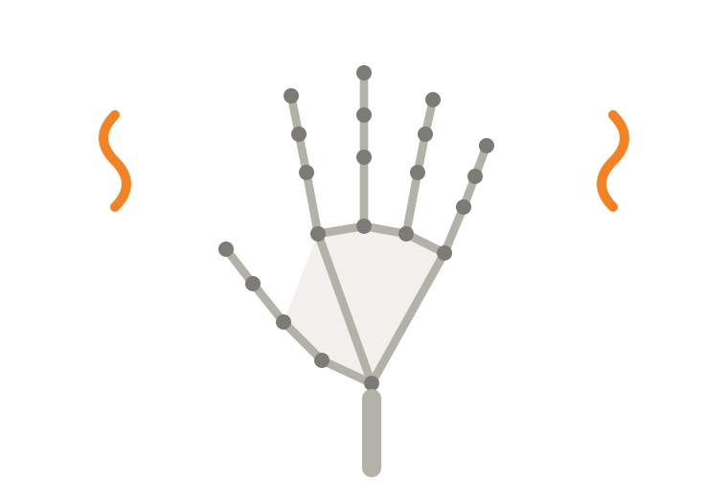
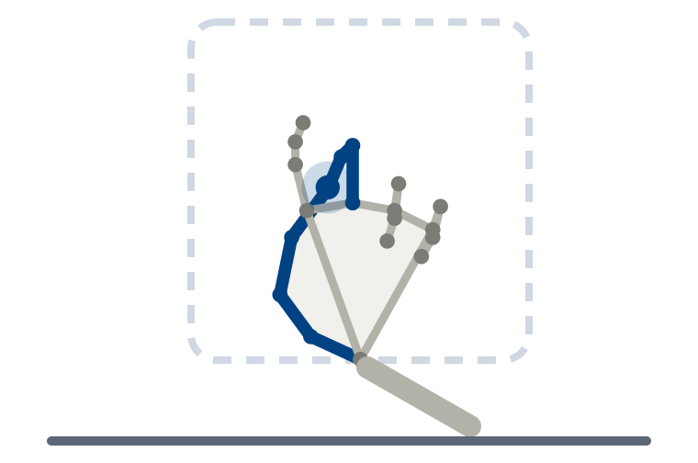
Why webcam pointing is hard to use today
A student is reading lecture notes on a laptop. They want to follow a link, scroll on and keep reading, without reaching for the mouse each time.
With a webcam today | What goes wrong | Why
Moving the pointer across the screen | The arm gets tired | Large movements held in the air [1]
Making a small correction | The pointer shakes | Tracking jitter can be as large as the correction
Pinching to click | The click lands off target | The click gesture itself moves the hand
Reach for the mouse, again and again
Hand in the air: tiring and shaky
Goal: forearm supported, small pinch
A gesture demo is not yet a daily tool: users must be able to correct, click, rest and resume without the pointer jumping.
[1] Hincapié-Ramos et al., Consumed Endurance: a metric to quantify arm fatigue of mid-air interactions, CHI 2014
1 Objectives · 2 Scope · 3 Data · 4 Technical approach · 5 Done so far

Slide 4
Project objectives
1
DESIGN
2
BUILD
3
LEARN
4
EVALUATE
A low-effort interaction
Supported forearm and small movements; the pointer moves only while thumb and middle finger touch.
A desktop tool
One application for macOS and Windows: preview, sensitivity, gesture switches, practice area and a stop control.
Reliable contact recognition
Record our own gesture data and compare tuned rules, a random forest and a temporal CNN.
Stability, errors and effort
Recognition on a person the model has never seen, then an internal usability pilot.
OUR MAIN QUESTION
Does learned contact recognition stay reliable when the hand is relaxed or turned, where fixed distance rules tend to fail?
Planned outputs: a working product and reproducible evidence from a small usability pilot.
1 Objectives · 2 Scope · 3 Data · 4 Technical approach · 5 Done so far

Slide 5
Related products and our focus
Existing option | What it offers | PinchPilot's focus
Mouse and trackpad | Familiar, direct desktop input | A complementary touch-free option for short tasks; the mouse stays available
Pawvis (macOS) | Webcam control with configurable and trained gestures | Explicit pinch roles, small hand and wrist motion, and support for macOS and Windows
MediaPipe hand tracking | A building block: 21 hand keypoints per frame | A usable interaction, a contact decision and a desktop experience built around the tracking
This is a positioning comparison. How well each option works will be established with matched user tasks; Pawvis is an optional product reference on the same Mac.
1 Objectives · 2 Scope · 3 Data · 4 Technical approach · 5 Done so far

Slide 6
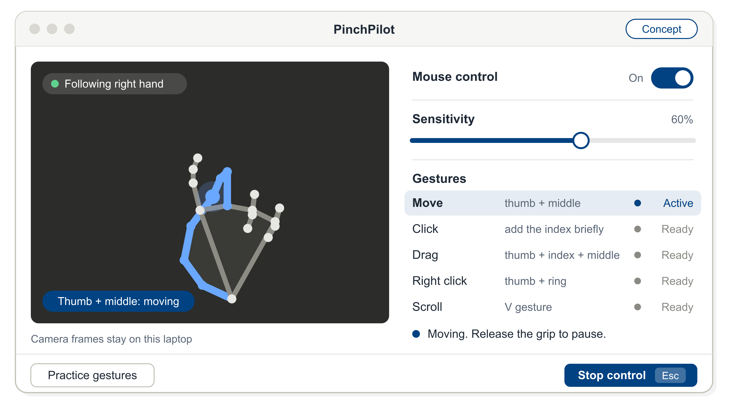
Project scope
IN SCOPE
One control hand, the primary screen, short seated use
Point, click, double click, right click, drag, scroll, pause
An ordinary laptop webcam, on macOS and Windows
Camera frames are processed on the laptop
1
3
2
OUT OF SCOPE
Tracking the hand at every angle, or replacing the mouse
Retraining MediaPipe's hand-tracking model
Recruited participants: the three of us record the data
4
1
The hand being followed
2
The current action
3
Sensitivity and gestures
4
Stop control and Esc
Concept interface: a design drawing, not a screenshot
1 Objectives · 2 Scope · 3 Data · 4 Technical approach · 5 Done so far

Slide 7
Data required and available
What we need
REQUIRED
AVAILABLE NOW
What each recording session will cover
Hand keypoints
From each camera frame
21 points
per frame
Yes
pretrained MediaPipe
GESTURES
Contact and release
Short taps
Grip plus click
Near-contact (no touch)
Hand adjustments
Team recordings
Train and test contact models
3 people
3+ sessions, ~15 min
Not yet
starts 7 Oct
VARIED ON PURPOSE
Supported posture
Hand orientation
Distance
Lighting
Different days
Own laptop camera
Unlabelled usage records
Pretraining; keypoints only
Keypoints
no video saved
Not yet
after recording starts
Public gesture datasets such as HaGRID label static hand poses, not finger contact over time, so we record our own.
Synthetic examples
Software checks only
Checks
never results
Yes
generated
So we will test on a member whose recordings were never used for training, and report the limits of a three-person dataset.
1 Objectives · 2 Scope · 3 Data · 4 Technical approach · 5 Done so far

Slide 8
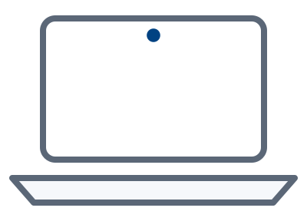
From recordings to training data
ONE MOMENT OF USE
HAND KEYPOINTS
FEATURES (SHORT SEQUENCE)
LABELS (THREE CONTACTS)
Keypoints relative to the palm
Thumb and middle
move
Thumb and index
click
Thumb and ring
right click
Contacts can be on together: a drag is the first two, held.
Three fingertip distances
Laptop camera frames
About 30 per second
Processed locally
21 keypoints per frame
from pretrained MediaPipe, used as it is
Time between frames
EXAMPLE The index tip moves to the thumb → the thumb–index distance falls over a few frames → thumb and index: touching
Labels prompts organise each trial · the team reviews every label · uncertain moments are marked, not guessed
Labels are never copied from the rules' own output; a second member checks a sample
1 Objectives · 2 Scope · 3 Data · 4 Technical approach · 5 Done so far

Slide 9

System design
Camera
Hand keypoints
Where to point
Smoothing and sensitivity
Interaction layer
Desktop
Click
Drag
Which fingers touch
Tuned rules or learned contact models
Scroll
Ordinary webcam; frames stay on the laptop
21 points per frame, pretrained MediaPipe
macOS and Windows mouse events
Pause and release
trained on team recordings with reviewed labels
One shared interaction layer
Recognisers can be swapped and compared without changing the gesture design.
Safe by default
One control hand will be locked; losing the hand will pause control and release held buttons.
Tools
Python, PySide6, MediaPipe, scikit-learn and PyTorch; one control engine for macOS and Windows.
1 Objectives · 2 Scope · 3 Data · 4 Technical approach · 5 Done so far

Slide 10
Pattern recognition techniques
SUPERVISED / UNSUPERVISED
Labels and reconstruction
Reviewed contact labels train the recognisers. An autoencoder learns features from unlabelled keypoint sequences.
MACHINE / DEEP LEARNING
Random forest and temporal CNN
Both read the same short keypoint sequence and output three contact decisions.
HYBRID / ENSEMBLE
Combined methods
A tree ensemble; pretraining followed by supervised fine-tuning; learned contact with rule-based interaction.
INTELLIGENT SENSING
From camera to action
Camera frames become hand keypoints, hand states, stable movement and desktop actions.
WHAT WE WILL COMPARE, ON THE SAME RECORDINGS
Tuned rules
the baseline and the fallback
Random forest
a classical learner
Temporal CNN
learns from the sequence
CNN + autoencoder pretraining
second priority
MediaPipe itself is not retrained. If learning adds little, tuned rules remain a valid fallback.
1 Objectives · 2 Scope · 3 Data · 4 Technical approach · 5 Done so far

Slide 11
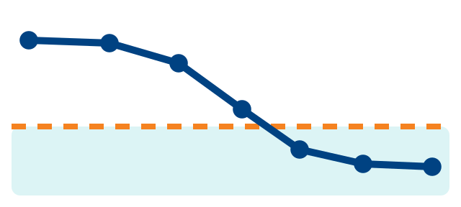
How one click will be recognised
Worked example
1
Frames
2
Keypoints
3
Recogniser
4
Interaction
5
Desktop
The thumb and middle finger are together; the index finger moves to the thumb.
MediaPipe gives 21 keypoints per frame; the thumb–index distance shrinks.
Reads the last few frames and outputs three contact decisions.
Touch, then release: a click at the held position. Held with the grip: a drag.
The operating system receives an ordinary mouse click.
THUMB WITH
middle · touching
short touch → click
index · touching
all three held → drag
distance over time (sketch)
ring · apart
“The camera supplies keypoints, the recogniser decides which fingers touch, and the interaction layer turns that into a deliberate mouse action.”
1 Objectives · 2 Scope · 3 Data · 4 Technical approach · 5 Done so far

Slide 12
Evaluation plan
1
Contact recognition
2
Pointer control
3
User value
Three-fold leave-one-person-out: test on a member never seen in training
Random forest and CNN against tuned rules, on the same recordings
Precision, recall, F1; missed and false events; latency
Basic position mapping against stabilised hand and wrist control
The same recogniser on both sides
Jitter, click displacement, re-grips and corrections
Internal pilot: three members, three conditions, rotated order
Models trained without the tester's own recordings
Time, errors, effort, preference and NASA-TLX (a standard workload questionnaire)
Autoencoder pretraining (second priority): the same CNN with and without it, at 25%, 50% and all labels; results by hand orientation
The test member never guides training or tuning · settings are frozen before each test · three developer-testers give an internal pilot only
1 Objectives · 2 Scope · 3 Data · 4 Technical approach · 5 Done so far

Slide 13
Main risks and how we will handle them
RISK
Three people are a small dataset
HOW WE WILL HANDLE IT
Test on the member left out of training, report each person separately, and state person and camera effects as limits
1
RISK
Brief contacts are hard to label
HOW WE WILL HANDLE IT
Prompts organise the trials, uncertain moments are marked instead of guessed, and a second member checks a sample
2
RISK
Learning may not beat tuned rules
HOW WE WILL HANDLE IT
Tuned rules remain the fallback; if data collection slips, the autoencoder experiments are deferred first
3
Limits we will state: three developer-testers; one hand and one screen; MediaPipe's tracking errors are inherited.
1 Objectives · 2 Scope · 3 Data · 4 Technical approach · 5 Done so far

Slide 14
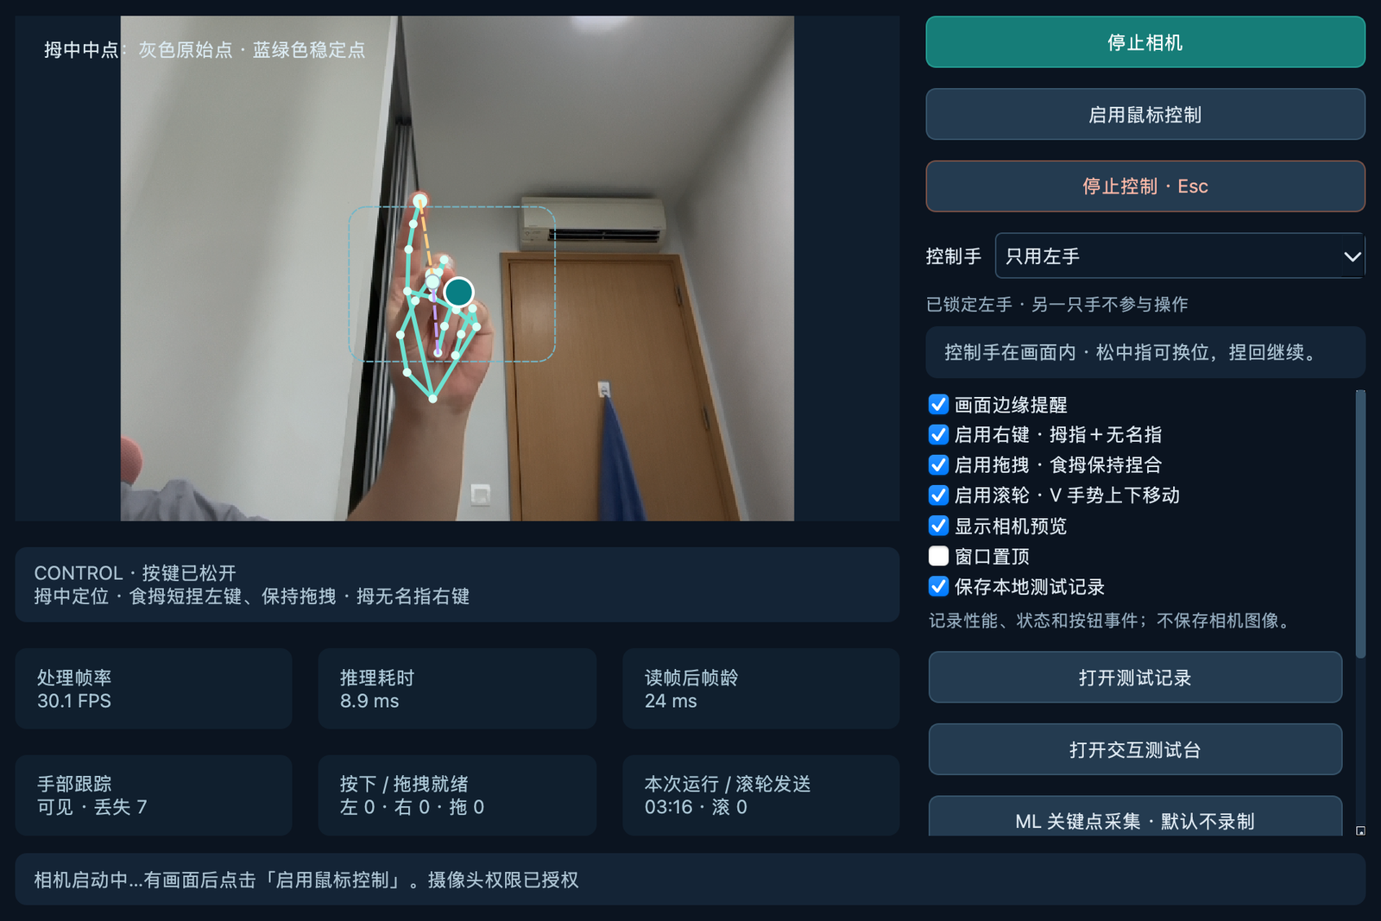
What we have done so far
DONE
mostly design
1
✓
Interaction concept: supported forearm, small movements, pause and re-grip
✓
Gesture set (provisional): move, click, right click, drag, scroll, pause; tried in an early prototype
✓
Tools and methods chosen: MediaPipe keypoints; Python and PySide6; rules, random forest, temporal CNN
3
✓
Training and evaluation method designed: leave-one-person-out; checked on synthetic samples only
2
4
NOT YET
no accuracy numbers are claimed today
Team recordings: three members, at least three sessions each; recording starts on 7 October
1
Live hand tracking
2
State: grip engaged
Reviewed labels: the recording protocol is piloted first; a second member checks a sample
3
Gesture switches
4
Practice and recording tools
Model results on real data: tuned rules, random forest, temporal CNN; autoencoder second
Screen from our early prototype with the live camera. The interface text is in Chinese for now.
Learned control and internal pilot: a learned recogniser in live use; three members, three conditions
1 Objectives · 2 Scope · 3 Data · 4 Technical approach · 5 Done so far

Slide 15
Work plan and next steps
By 6 Oct
By 16 Oct
By 23 Oct
By 27 Oct
By 31 Oct
Demo and protocol
DONE WHEN
Basic desktop demo; pilot recording protocol
Control and data
DONE WHEN
Refined hand and wrist control; team recordings collected, labels reviewed
Models
DONE WHEN
Rules, random forest and CNN compared; configurations frozen
Internal pilot
DONE WHEN
Three members, three conditions; results per person
Deliverables
DONE WHEN
macOS and Windows builds, dataset, report, slides and video
Demo reached
We would welcome your feedback on the data plan and these priorities.
1 Objectives · 2 Scope · 3 Data · 4 Technical approach · 5 Done so far

Slide 16
AI tool declaration
OpenAI Codex and Anthropic Claude assisted with source research, proposal drafting, translation, review, figure design and document layout, and with preparing this presentation. The interface on slide 6 is a concept drawing; the screen on slide 14 is captured from our own early prototype, which was also developed with AI coding assistance.
The team is responsible for all content.

Slide 17
Appendix A: evaluation details
Area | Baseline or comparison | Main measures
Contact recognition | Random forest and CNN against tuned geometric rules, on the same held-out recordings | Precision, recall, F1; missed and false events; unavailable input
Autoencoder pretraining | The same CNN with and without pretraining, at three label budgets | F1, missed and false events, latency; results by posture group
Pointer control | Basic mapping against stabilised hand and wrist control; same recogniser | Jitter, click displacement, movement, re-grips and corrections
User tasks | Basic rules; stabilised rules; stabilised control with learned recognition | Completion, time, errors, effort, NASA-TLX and preference
Product reference | Mouse or trackpad; optional Pawvis on the same Mac | Task performance and experience across products
Recognition: three-fold leave-one-person-out; pretraining uses only the training partition; settings are frozen before each test.

Slide 18
Appendix B: proposed gestures
Function | Proposed gesture | Design purpose
Point | Hold thumb and middle finger together, then move the hand or wrist slightly | Small movements with deliberate control
Click and double click | Touch thumb and index finger, then release; repeat for a double click | Active clicks with less target displacement
Right click | Briefly pinch thumb and ring finger | A distinct action for context menus
Drag | Keep the thumb–middle grip and add the index to the thumb; after a short hold, move; release the index to drop | A familiar hold, move and release sequence
Scroll | Form a V with index and middle fingers and move slightly up or down | Read long pages while the pointer stays still
Pause and reposition | Release the thumb–middle grip, reposition and re-grip | Rest, or return inside the camera view

