Slide 1



UX RESEARCH PROJECT
Tinder Engagement & Subscriptions
Analysis of user behavior, emotional drivers, and monetization opportunities
PROJECT LEAD: ZIHAO HUANG
DECEMBER 2025

Slide 2







Presentation Outline
Background & Methodology
Executive Summary
Key Insights & Recs
Top-line takeaways covering conversation depth, habits, and premium value perception.
Deep dive into 7 core insights with supporting data, user quotes, and design solutions.
Project context, research objectives, and overview of the participant sample.

Slide 3


1. Background & Methodology
Understanding the sample and research goals

Slide 4


Context & Objectives
Research Context
Core Objectives
Research Question
Focus on engagement depth and subscription intentions.
Retention: Why do users drift into passive use?
How do emotional barriers in the messaging process impact user engagement and retention
Investigating the gap between "matching" and "meaningful conversation."
Emotion: What drives initiation anxiety and fear of ghosting?
What factors drive the perceived value of premium subscriptions, and how can AI assistance increase their desirability among users?
Understanding the "habitual swiper" psychology.
Monetization: How is "premium" perceived vs. what users actually value?

Slide 5



Research Methodology
Quantitative Survey
Follow-up Interviews
Data Analysis
Measured user sentiment, feature awareness, subscription intentions, and usage frequency patterns.
Five in-depth qualitative sessions to uncover emotional drivers and hidden pain points.
Sorted quantitative data into visible patterns. Synthesized qualitative data into core behavioral themes and actionable design recommendations.

Slide 6
Participant Snapshot
45 Total Participants
38 Current/Recent Users
23 Male
15 Female
GENDER (RECENT USERS)
Orientation Mix: 9 Gay, 26 Straight, 3 Bisexual | Relationship Status: 25 Single, 12 In Relationship, 1 Married

Slide 7
Engagement Patterns
~50% of users do not open the app daily.
~44% open 1–10 times/day (Casual checking).
Usage Intensity
Most sessions are short (5–10 mins).
Insight: Not just power users; many are "casual experimenters" or "mid-level veterans".

Slide 8

2. Executive Summary
Top takeaways and strategic opportunities

Slide 9
Top Takeaways: Engagement
1. Depth > Breadth
2. The "Habit Swiper"
Users strongly agree (4.25/5) that they value deeper topics beyond small talk. The current model optimizes for "matching volume," but users are craving "conversation quality."
A specific segment exists that swipes out of boredom with no intention to message (3.75/5). Roughly half don't open daily, but when they do, it's passive.
So What?
Opportunity to convert habitual swiping into conversations with lightweight nudges.
So What?
Design for conversation depth (prompts, cards) not just swipe volume.

Slide 10
Top Takeaways: Barriers
3. Initiation Anxiety
4. Premium Value Gap
5. AI as "Social Co-Pilot"
Confidence in starting conversations is low (3.1/5). Users are sensitive to ghosting and reply quality. A lot of engagement is lost in the gap between "Match" and "Talk."
Users understand the functional benefits of Gold/Platinum (e.g., unlimited swipes), but emotionally they don't feel compelling (Desirability: 2.44/5).
Interest in AI is moderate but highly targeted (rewriting bios and openers). Those open to AI are also more likely to subscribe. It's viewed as a confidence booster, not a toy.
So What?
Users need low-stakes openers and "scaffolding" to bridge the gap.
So What?
Reframe premium value from "More Reach" to "Better Connection" and "Certainty."
So What?
Position AI features as confidence or efficiency tools in premium tiers.

Slide 11

Strategic Opportunities
Design for Conversation: Move beyond "It's a Match!" to structured interaction modes (Deep dive prompts, Shared-interest tags).
Nudge the Habit: Detect "mindless swiping" and inject friction or gamification ("Start 1 conversation today") to shift behavior.
AI Scaffolding: Productize AI not as a generator, but as an assistant that helps anxious users draft authentic messages.
Redefine Premium: Shift the value proposition from "Volume" (Infinite swipes) to "Quality" (Compatibility boosts, "Serious" badges).

Slide 12
3. Key Insights & Recommendations
Detailed analysis of 10 core insights

Slide 13
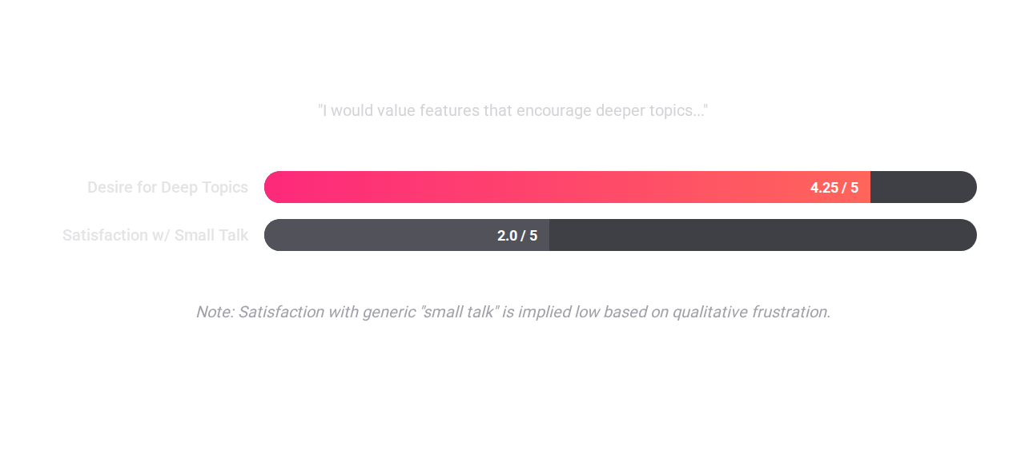

INSIGHT 1
People crave deeper, more intentional conversations.
Qualitative Interview Responses
Recommendations
"I’m tired of surface-level banter. I want the product to help us get to the ‘real’ conversation faster."
"Deep Dive" Prompts: Add optional cards in chat (e.g., "Travel dreams," "Dealbreakers") to skip small talk.
"If people said my pics were pretty, then I respond and we talk. I need that spark."
Shared-Topic Starters: Highlight overlapping interests (music, hobbies) with one-tap opener suggestions.
"I appreciate playful but specific first messages, not just a generic 'Hey.'"
Conversation Mode: Experiment with a mode that pauses new swipes to focus strictly on existing matches.
Quantitative data

Slide 14
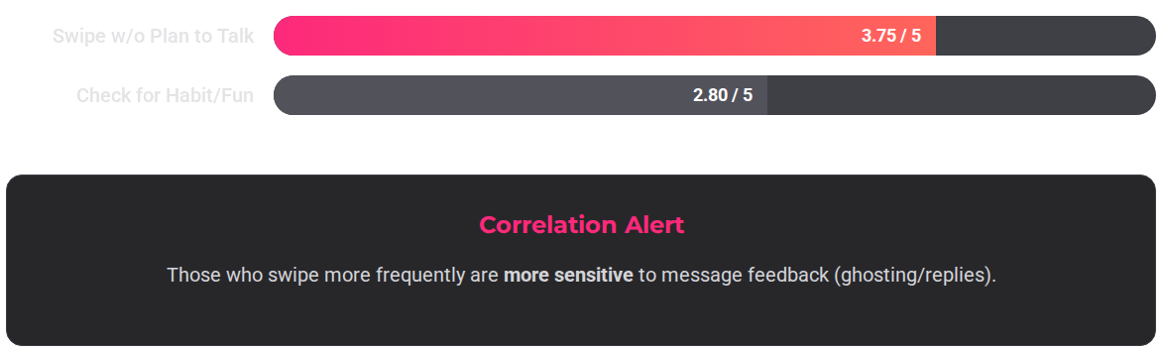
INSIGHT 2
A "habit swiping" pattern risks empty engagement.
Qualitative Interview Responses
Recommendations
"I swipe a lot, but half the time I don’t even intend to talk. It’s just something to do."
"Send This?" Prompt: When a match happens, show a pre-filled opener referencing a profile tag immediately.
"Every day, I open it 5–6 times and swipe... but I'm not trying to talk to people."
"It feels like a magic box, you know. When I'm lonely, I just go to the app."
Conversation Goals: Replace "X New Matches" stats with "Start 1 Real Conversation" goals.
"Swiping is fun, but messaging feels like work."
Gentle Friction: "You have 5 unmatched chats. Want to say hi before swiping more?"
Quantitative data
Design Goal: Intentionality
Shift users from "mindless swiping" to "mindful connecting" without destroying the fun factor.

Slide 15
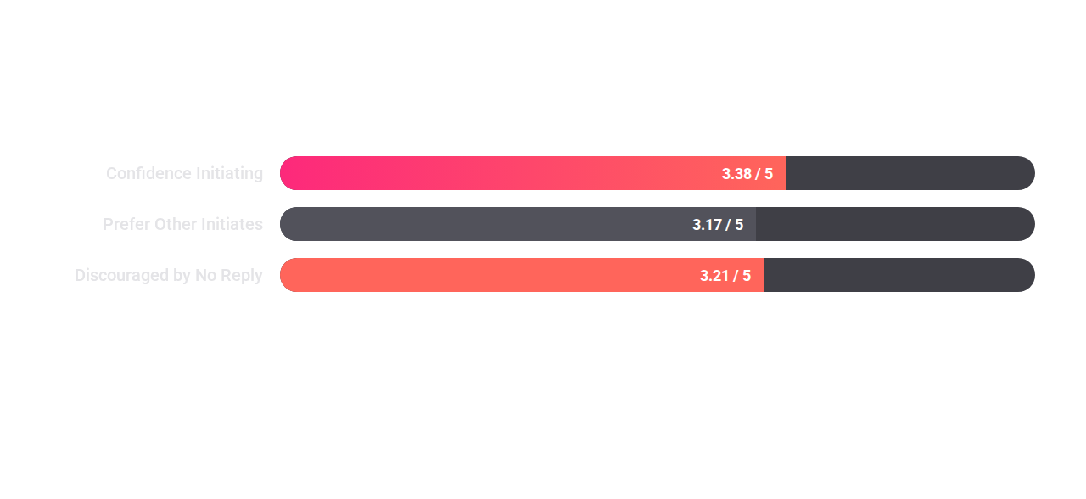
INSIGHT 3
Initiation anxiety & fear of ghosting hold people back.
Qualitative Interview Responses
Recommendations
"Starting is nerve-wracking because if I mess it up or they ignore me, it feels bad enough to make me not try again."
Provide pre-generated, playful openers users can customize to reduce "blank page" fear.
"I feel anxious about myself when people I like don’t like me back."
Micro-feedback: "Ghosting happens to everyone. Want to try a different opener?"
“I don't really message first… because I'm afraid they won’t respond.”
Nudge both sides to reply if they matched, framing it as "Don't leave them hanging."
Quantitative data
Design Goal
Reduce the emotional risk of initiating conversations by creating features that increase reply likelihood, provide supportive messaging scaffolds, and normalize non-response.
Swiping is often a coping mechanism for boredom or loneliness, rather than a strategic search for connection. High swiping volume often correlates with low follow-through.

Slide 16
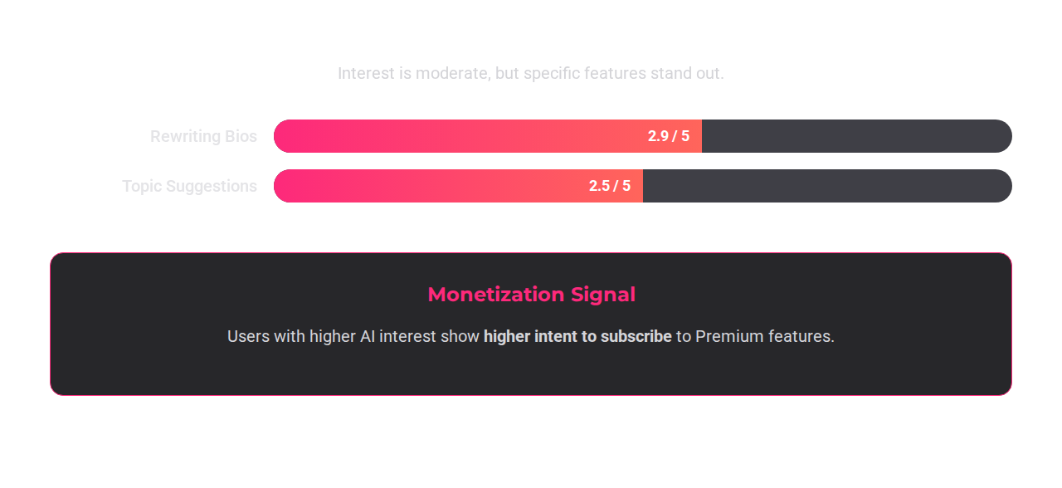
INSIGHT 4
AI is a niche but high-leverage co-pilot.
Qualitative Interview Responses
Recommendations
"I don’t want AI to date for me, but it can help me not sound boring or awkward."
Premium Bundle: Bundle AI Bio Optimization and "Rescue Replies" into Gold/Platinum tiers.
"Help me stand out, not sound like everyone else."
"Suggesting emojis or catchphrases popular among Gen Z."
Human-in-the-Loop: Always allow users to approve/edit AI suggestions to maintain authenticity.
"AI can gather info and summarize the vibe."
Vibe Check: AI summary of a match's profile to suggest 2-3 tailored openers.
Quantitative data
Design Goal
"Make your message more YOU." Avoid framing AI as a robot doing the work. Frame it as an efficiency and confidence tool.

Slide 17
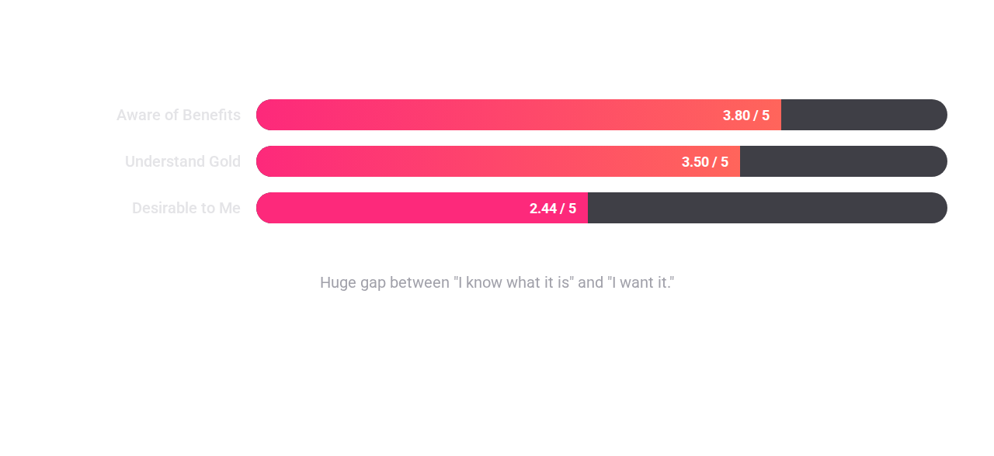
INSIGHT 5
Premium is understood but emotionally underwhelming.
Qualitative Interview Responses
Recommendations
"I wish premium could indicate who is more likely to get back to you."
Outcome Language: Change "See who likes you" to "Spend less time guessing, more time talking."
"I feel like premium costs too much, and the hierarchy is unfair to regular users."
“I know Gold lets you see who likes you, but I don't think it’s worth the price.”
Compatibility Boosts: Prioritize showing profiles that are algorithmically likely to reply, not just nearby.
“I understand the different tiers, but the benefits don’t feel special.”
"Serious" Intent Badges: Premium-exclusive badges that signal "I'm here for a relationship," filtering out noise.
Quantitative data
Strategy: Reframe Values
Move from "Power User Tools" to "Quality & Clarity Tools."
.

Slide 18
INSIGHT 6
Qualitative Interview Responses
Users request filters (race, interests, LGBTQ roles) to find "relevance."
"For LGBTQ users, [we need] more categories (top/bottom)."
"Algorithms can be improved to feed people with the same hobbies."
"I wish we could filter race on Tinder." (Participant noted ethical concern.)
Recommendations
USERS WANT POWER OVER RELEVANCE. THE CHALLENGE IS PROVIDING THIS WITHOUT ENCOURAGING DISCRIMINATION.
Tailored for Queer Users: Ensure matching/prompts feel relevant to queer dating norms (not just hetero scripts).
"Vibe" Filters: Allow filtering by "Communication Style" or "Love Language" rather than just physical traits.
Highlight Safety: For women and queer users, emphasize control features as safety tools.

Slide 19
INSIGHT 7
Qualitative Interview Responses
Performance glitches erase emotional wins.
"A super-matched girl was gone because the screen froze and that was the reason I turned to Hinge."
“Sometimes it takes a few minutes for a single message to be sent out.”
“When I try to use Tinder in a different country, it seems to have bad connections all the time.”
Recommendations
THE SCREEN WOULD FREEZE WHEN SWITCHING THE MESSAGING PAGE.
Prioritize fixing navigation bugs. A lost match due to a glitch is a severe trust-breaker.
Ensuring Tinder operates properly across different mobile devices
Examine usability across a global context.

Slide 20
INSIGHT 8
Qualitative Interview Responses
Experienced daters want efficiency. Newbies want guidance.
Experienced: "I know how these apps work. I want tools that make it more efficient."
Newbies: "I’m still learning how to use this; I don’t want to overcommit yet."
Recommendations
DIFFERENT GUIDANCES AND FEATURES SHOULD BE TAILORED TO USERS WITH DIFFERENT “DATING APP EXPERTISE.”
Gentle flow for first-timers explaining safety and conversation starters. Delay aggressive upsells.
Establish a brief onboarding tutorial that guides newbies.
For experienced users (3+ apps), highlight time-saving controls and filtering in upsell messaging.

Slide 21
INSIGHT 9
Qualitative Interview Responses
Gamification (streaks) motivates more than premium status.
"I think it will be really interesting to do friend streaks like Duolingo, I will definitely log on more frequently.”
"When I used a dating app platform, ‘Tantan,’ in China, matched partners can play games embedded in the DM page.”
"I wish there could be more interaction types other than simply texting.”
Recommendations
MORE THAN THREE INTERVIEWEES INDICATED THAT THE INTERACTION CAN BE MORE INTERESTING THROUGH GAMIFICATION.
'Reply Streaks': Reward 3-day conversation streaks with free Super Likes.
Incorporating simple games to facilitate interactions.

Slide 22
INSIGHT 10
Qualitative Interview Responses
Users find bio writing tedious but fear AI inauthenticity.
"To me, it feels like constructing a profile is very time-consuming.”
"I don’t need an AI to help me with writing my bios because AI doesn’t know me at all.”
"AI can give suggestions for filling out information, but I don’t want it to write it for me."
Recommendations
WHEN ASKED ABOUT USING AI TO CUSTOMIZE BIOS, PARTICIPANTS ARE SUSPICIOUS ABOUT IT AND THINK IT IS UNNECESSARY TO RECEIVE HELP FROM AI WHILE ADMITTING CONSTRUCTING A PROFILE IS VERY TIME-CONSUMING.
Use autofilling to improve efficiency of making a profile.
AI suggestions on how to improve the profiles in order to attract new matches.

Slide 23

4. Conclusion
Roadmap and next steps

Slide 24



Strategic Roadmap
Short Term
Mid Term
Long Term
Fix "match-loss" glitches.
"Send This?" opener suggestions.
Launch "AI Co-Pilot" Premium tier.
Add "Deep Dive" prompt cards in chat.
Nudges for habitual swipers ("Start 1 conversation").
Reframe Gold/Platinum value prop to "Certainty & Connection".
Implement "Ghosting" micro-feedback.
Queer-specific tag updates.

Slide 25
Risks & Limitations
Limitations
Next Research Steps
Sample Size: N=45 (38 recent). Small sample allows for qualitative depth but limits statistical generalization.
Usability test of an AI messaging prototype.
Diary study on ghosting impact over 2 weeks.
Self-Report Bias: Users may under-report passive usage or over-report "noble" intentions (desire for deep talk).
A/B test of "Conversation Mode" vs. Standard Swipe Mode.
Convenience Sampling: Most participants are recruited via researcher’s own social network, and the results may be biased based on ethnicity, location, interests, or economic status

Slide 26

Thank you for your time

