Slide 1
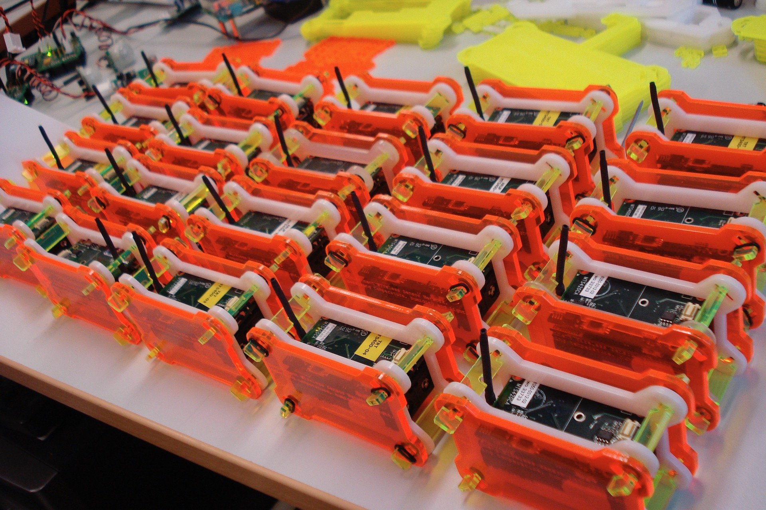



CASA0004/10/12: Dissertation
How to write a dissertation proposal
Martin de Jode

Slide 2
Module Schedule
 | Provisional Schedule
1 | 13-Jan | Andy MacLachan | Module introduction
2 | 20-Jan | Martin de Jode | Proposal writing
3 | 27-Jan | Melda Salhab and Philip Wilkinson | Former MSc student session
4 | 03-Feb | Prof. Sir Alan Wilson | Research - tricks of the trade 1
5 | 10-Feb | Prof. Sir Alan Wilson | Research - tricks of the trade 2
 | 17-Feb | READING WEEK
6 | 24-Feb | Jens Kandt | UCL research ethics
7 | 03-Mar | All staff | Drop in meetings during week
8 | 10-Mar | Andy MacLachan | Thesis structure / study skills
9 | 17-Mar | Duncan Smith | How to write a publication (MRes)
10 | 24-Mar | Andy MacLachan | Thesis study tips /Q and A

Slide 3
Session Contents
Why write a proposal?
Prerequisites
Structure of proposal
Submission logistics
Example proposals

Slide 4
Purpose of the Proposal
Helps you plan and design your research
  Arrive at a suitable topic and research question
  Explore prior work
  Identify relevant data sets and methods
  Consider ethics issues
  Plan you time
Helps academic staff allocate an appropriate supervisor
Helps you “hit the ground running”

Slide 5
Prerequisites for Writing a Proposal
By the time you write your proposal you should have:
  A clear idea of the topic you want to explore
    Ideation (coming up with an idea) will be covered by Prof. Alan Wilson in Sessions 4-5 (03-10 Feb)
  Identified relevant data sources
  Know if there are any external collaborators
  Know if there is any field work involved

Slide 6
Anatomy of a Proposal
Working Title
Research objectives and research question
Background / Preliminary Literature Review
  Brief background to the topic (including reference citations)
  Highlighting its significance and the wider research problem
Research Design
  Research Methodology
  Data sources
  Ethics
Timetable
  GANTT Chart can be helpful
References
  From your preliminary Literature Review
It will be helpful to create a draft of your proposal in a Word document

Slide 7
Working Title

Slide 8
Working Title
Try to keep it concise and engaging, but sufficient to convey the general topic
It’s not critical so don’t waste hours on it
You can change it later as your dissertation evolves
But it will help in allocating appropriate supervisor
Example
“Healthcare access in Vietnam: A climate vulnerability study”
“Crowdsourced mapping for all? An empirical investigation into gender bias in OpenStreetMap”

Slide 9
Research Question and Objectives

Slide 10
Research Question
The central question to the thesis that you will try to answer
Whereas the title can be concise and ‘catchy’*, the research question should be more ‘scholarly’
Examples:
  Which parts of Vietnam and its population are most vulnerable to climatic shocks in the form of floods affecting access to healthcare?
  How has the gendered bias in OSM contributors impacted the quality of data on OSM?
  What has been the impact of the UK sugar tax on obesity levels?
*appealing, memorable, engaging

Slide 11
Research Objectives – Example (i)
  What has been the impact of the UK sugar tax on obesity levels?
Review existing work and the political landscape that led to the new levy.
Provide a statistical and spatial comparison between obesity levels prior to and after the implementation of the 2018 Soft Drinks Levy. (As you develop the work this objective could become measurable, by specifying a certain method or technique).
Establish the spatial distribution of influence and explore any regional variations through spatial analysis. (Has the law had similar or different effects across the UK and explore potential reasons why, again this could also become measurable as the research develops).
Evaluate the effectiveness compared to levies implemented in other similar countries of the UK levy and produce recommendations for targeted evidenced based policies or actions.

Slide 12
Research Objectives SMART
Consider SMART in writing your objectives
  Specific: state exactly what you need to achieve
  Measurable: consider how you will know if you have achieved the objective
  Achievable: set objectives that you think you probably will be able to complete based on your experience acquired from the programme so far
  Realistic: establish if you will be able to fulfil the objective in the time available. Whilst research often attempts to push the boundary of knowledge it only needs to be a tiny advancement, not a massive leap forward in science that would often be unrealistic of an MSc thesis
  Time constrained: identify when objectives should be completed to ensure the project is finished on time – add to your time plan (see later)
But don’t get too hung up about M when writing down your objectives as not all objectives are easily measurable
But M becomes important for quantitative objectives and becomes relevant for your Methodology (see later)
Ensure objectives are relevant to answering your research question and are logical and clearly expressed
“Reference to Figure 20 clearly shows the linear dependence of y on x“
  “chi by eye” is not a statistical test – not a good example of M

Slide 13
Research Objectives – Example (ii)
  Which parts of Vietnam and its population are most vulnerable to climatic shocks in the form of floods affecting access to healthcare?
Establish an accessibility measure for hospitals in Vietnam
Based on this measure see which areas have low access to healthcare provision
Forecast how floods may disrupt the transport network
Relate the disrupted transport network to hospital accessibility
Show which areas are most vulnerable to climate shocks
Use this information to help inform mitigation and response policies

Slide 14
Background/Preliminary Literature Review

Slide 15
Background/Preliminary Literature Review (400-500 words)
Not a full literature review
Provides background and context to your research topic
Should contain a few credible sources (academic papers, books, policy documents)
Use Harvard format
Use Google Scholar perhaps to find key resources
Blog posts/Wikipedia are not generally regarded as a credible sources, although they may have a place
  Can be useful, but your reference list should mainly contain credible sources
  True also for your final dissertation report!

Slide 16
Preliminary Literature Review – Harvard Format
In text citations:
  “According to Smith and Jones (2020) the moon is made of cheese…”
  “Some workers have asserted that the moon is made of cheese (Smith and Jones, 2020) however …”
  For multiple authors (more than two) use “et al” e.g.
  “According to Williams et al (2019)…”
Reference list citations:
  Provide full citation and complete author list here (not “et al”)
  For example:
  Smith, A. and Jones, B. (2020). Is the moon made of cheese? Journal of Astronomy, 10 (1), 300-310.
  Williams, J., Smith, A. and Jones, B. (2019). The geological composition of the moon. Journal of Astronomy, 9 (10), 215-220.
For more info on Harvard Referencing see:
  https://www.citethisforme.com/harvard-referencing

Slide 17
Research Design

Slide 18
Research Design - Data
Identify appropriate data sources
Are they ‘open’ (freely accessible)
Open data sources have minimal ethical issues and research using open data shouldn’t require Ethics Committee approval
Is data preparation required
Some open data stores:
  UK Data Store: https://data.gov.uk/
  London Data Store: https://data.london.gov.uk/
  UK Data Archive: https://www.data-archive.ac.uk/
  Office of National Statistics: https://www.ons.gov.uk/
  EU data store: https://data.europa.eu/

Slide 19
Research Design - Methodology
Generally most students will be performing quantitative analysis
Some discussion of the methods that will be applied to the data or models that will be created (if known) e.g.
  linear regression
  k means cluster analysis
  agent Based Models
  …
Statistical tests to be applied (remember M Measurability)
All these may evolve over the course of your dissertation which is normal and not a problem
But helps allocating supervisor

Slide 20
Research Design - Ethics
Lecture 6 (24 February) will be devoted to Ethics so make sure you attend
You should include some discussion of ethics even if formal Ethics Committee approval is not required e.g.
  “All the data sets used in this work are open access and no personal identifiable information is included in the data sets”
Research involving human participants will likely require Ethics Committee approval (including face to face surveys, interviews etc)
Research involving data that includes Personal Identifiable information will require Ethics Committee approval and data protection registration
Field work is likely to require Ethics Committee approval

Slide 21
Time Plan

Slide 22
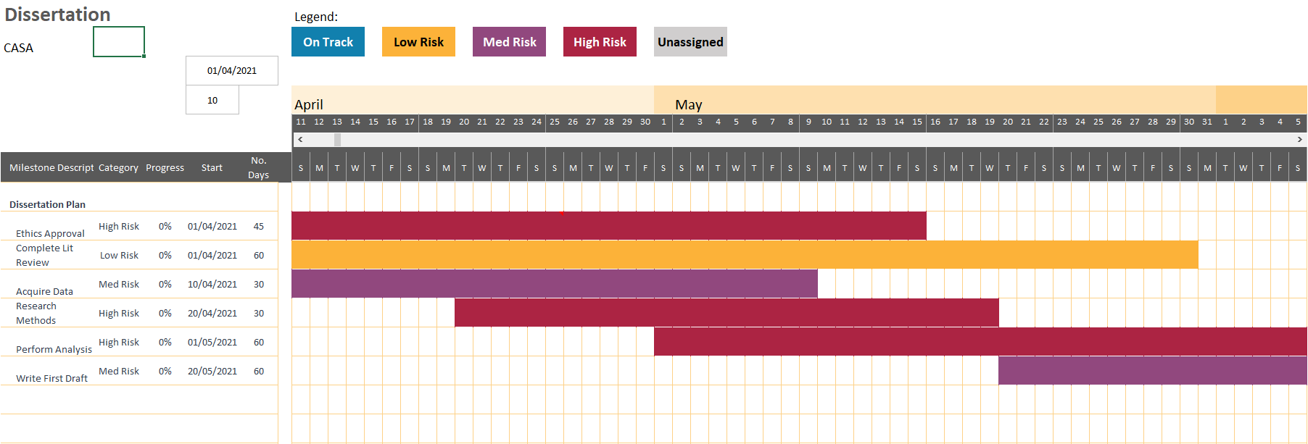
Time Plan
Draw up a time plan
  You may think August 2021 is a long way away
  But by the time you have completed your last CW it will be a lot closer!
  Can use a Gantt chart
Set milestones for you dissertation
  Ethics application (if required) submitted (April 2021)
  Complete literature review (May 2021)
  Acquire data (May 2021)
  Research and decide on methods (May 2021)
  Analysis complete (July 2021)
  First dissertation draft complete for review (01 Aug 2021)
  Final dissertation submitted (22 Aug 2021)
Tasks can overlap – i.e. proceed simultaneously (in parallel)
Can and should iterate certain tasks e.g.
  Lit Rev
  Dissertation drafts

Slide 23
Reference List

Slide 24
Reference List
List of references cited in your Background/Preliminary Lit Rev
Include full citation in Harvard style
  Bangalore, M., Smith, A. & Veldkamp, T., 2019. Exposure to Floods, Climate Change, and Poverty in Vietnam. Economics of Disasters and Climate Change, Volume 3, pp. 79-99.
At this stage 6-10 references would be appropriate
Start using a Reference Manager (available from UCL ISD software database)
  Endnote
  Mendeley

Slide 25
Further Information

Slide 26
Proposal is not ‘Set in Stone’
It is common for research projects to take different direction as they proceed
  if it was easy to predict the exact direction and outcome of a research investigation is it really research?
Research objectives and question may evolve as you undertake your project
  Not a problem!
Same with Titles
  the final title of your dissertation may be different from your original proposal
And Methodology

Slide 27
Next stages/Submitting your proposal
Working Title
Research objectives and research question
Background / Preliminary Literature Review
  Brief background to the topic (including reference citations)
  Highlighting its significance and the wider research problem
Research Design
  Research Methodology
  Data sources
  Ethics
Timetable
  GANTT Chart can be helpful
References
  From your preliminary Literature Review
Start thinking of research topic of interest over the next few weeks
Draw up a Word document using basic structure outline here
  can be an Appendix in your final report
When to submit proposal – end of Term 2
How to submit proposal– via online form (URL to be advised)

Slide 28
Example Proposals
The Moodle page for this module contains a couple of proposals kindly made available by last year’s students
Cheyne Campbell
https://moodle.ucl.ac.uk/mod/resource/view.php?id=2675631
Philip Wilkinson
https://moodle.ucl.ac.uk/mod/resource/view.php?id=2675479
Hannah Kerr
https://moodle.ucl.ac.uk/mod/resource/view.php?id=2692742

Slide 29
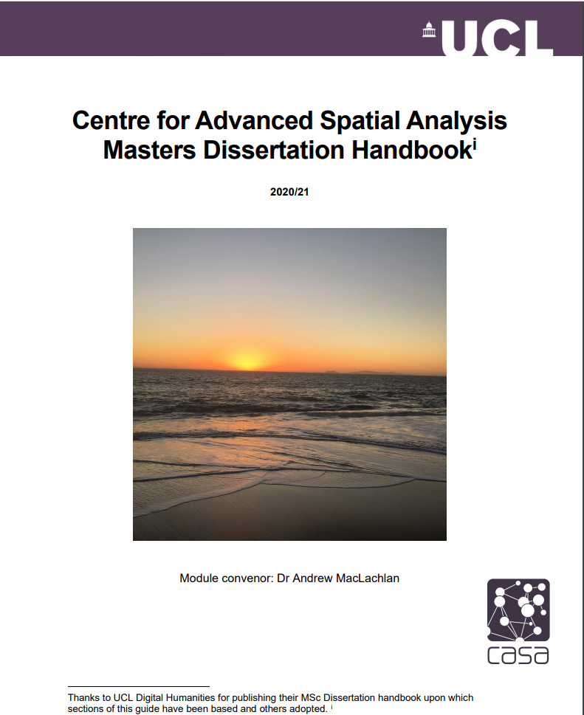
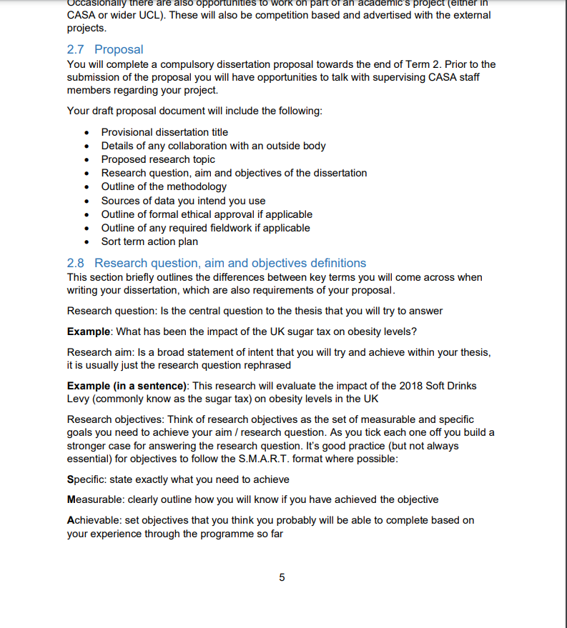
Dissertation Handbook – essential resource
https://moodle.ucl.ac.uk/mod/resource/view.php?id=2607614

Slide 30
Any Questions?
?

