Slide 1
Two-Wheel Differential Drive Invertible Ant-Weight Battlebot
Haoru Li, Ziheng Qi, Ziyi Wang
Team 12
TA: Zhuoer Zhang
ECE 445 Final Presentation

Slide 2
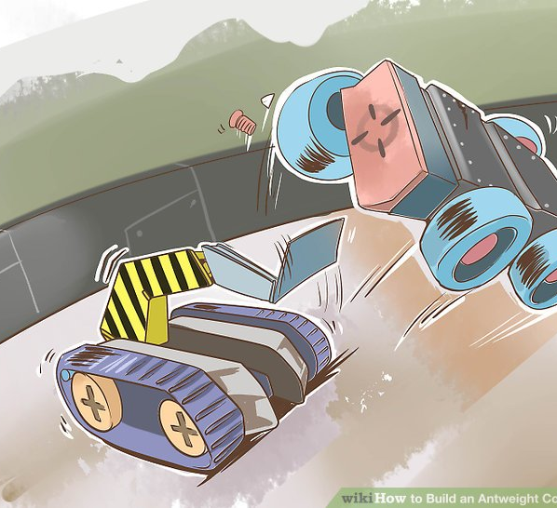
Objective
• Ant-weight class: < 2 lbs, 3D-printed, 4S LiPo max (switched to 3S LiPo later)
• Every gram trade-off: weapons vs. structure vs. battery
• Lose mobility > 10 s = knockout
• Core challenge: balance mobility, offense, and electrical reliability
Source: How to Build an Antweight Combat Robot
Computer Engineering

Slide 3
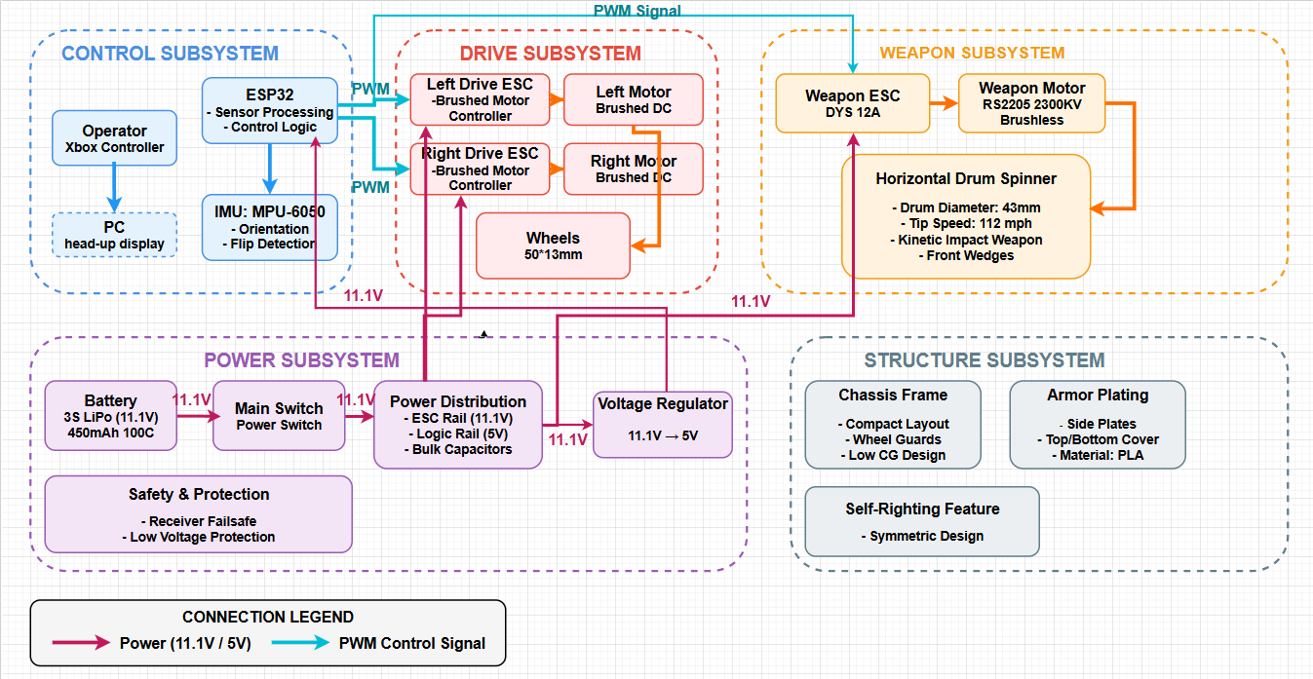
Block Diagram
Computer Engineering

Slide 4
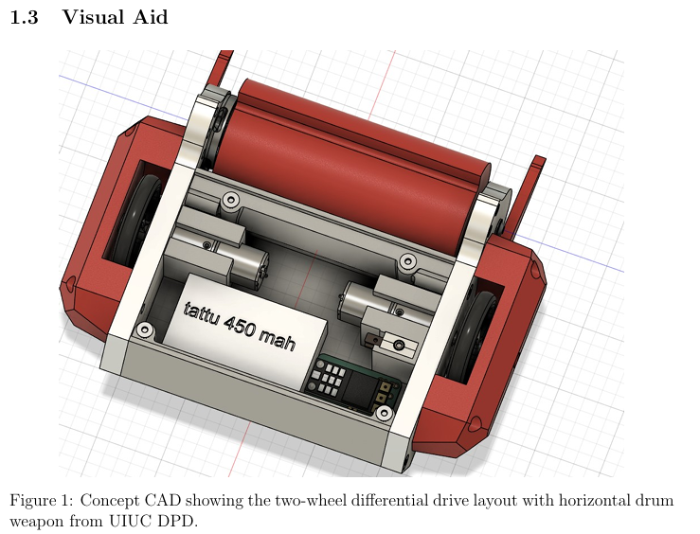
Initial Design
• Two-wheel differential drive → lightweight, almost zero-radius turns
• Horizontal drum spinner + dual front wedges
• Symmetric top/bottom → invertible
• ESP32-S3 Bluetooth control, MPU-6050 IMU
• Dual power rails: 14.8V motor / 5V logic (decoupled)
Computer Engineering

Slide 5
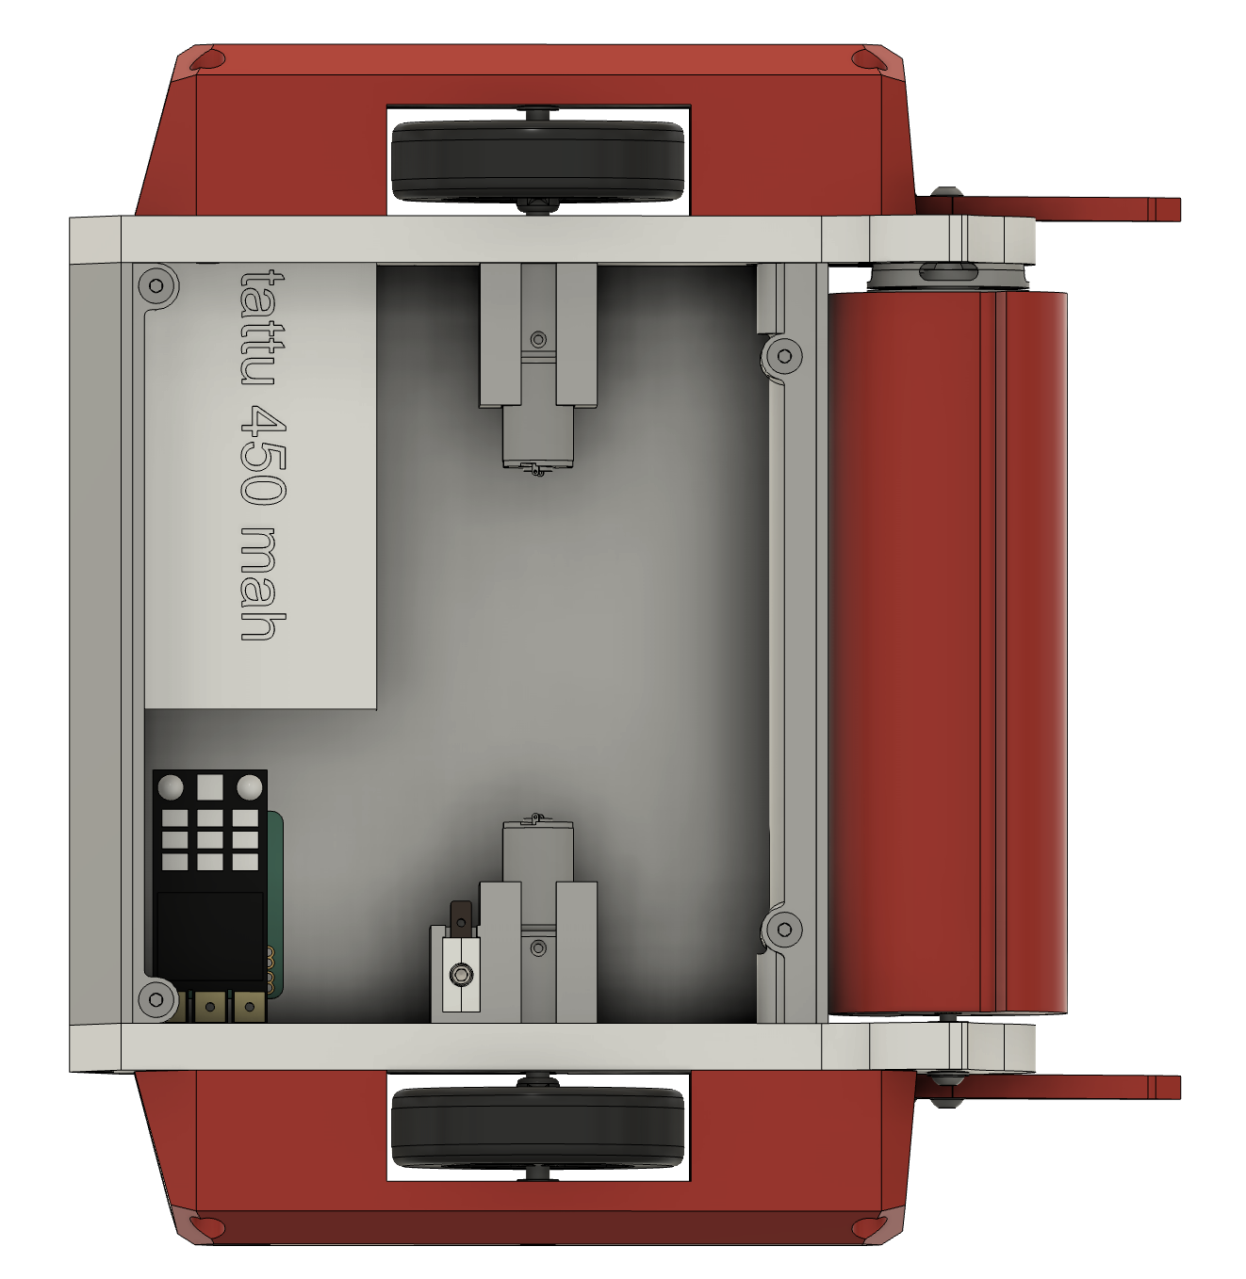
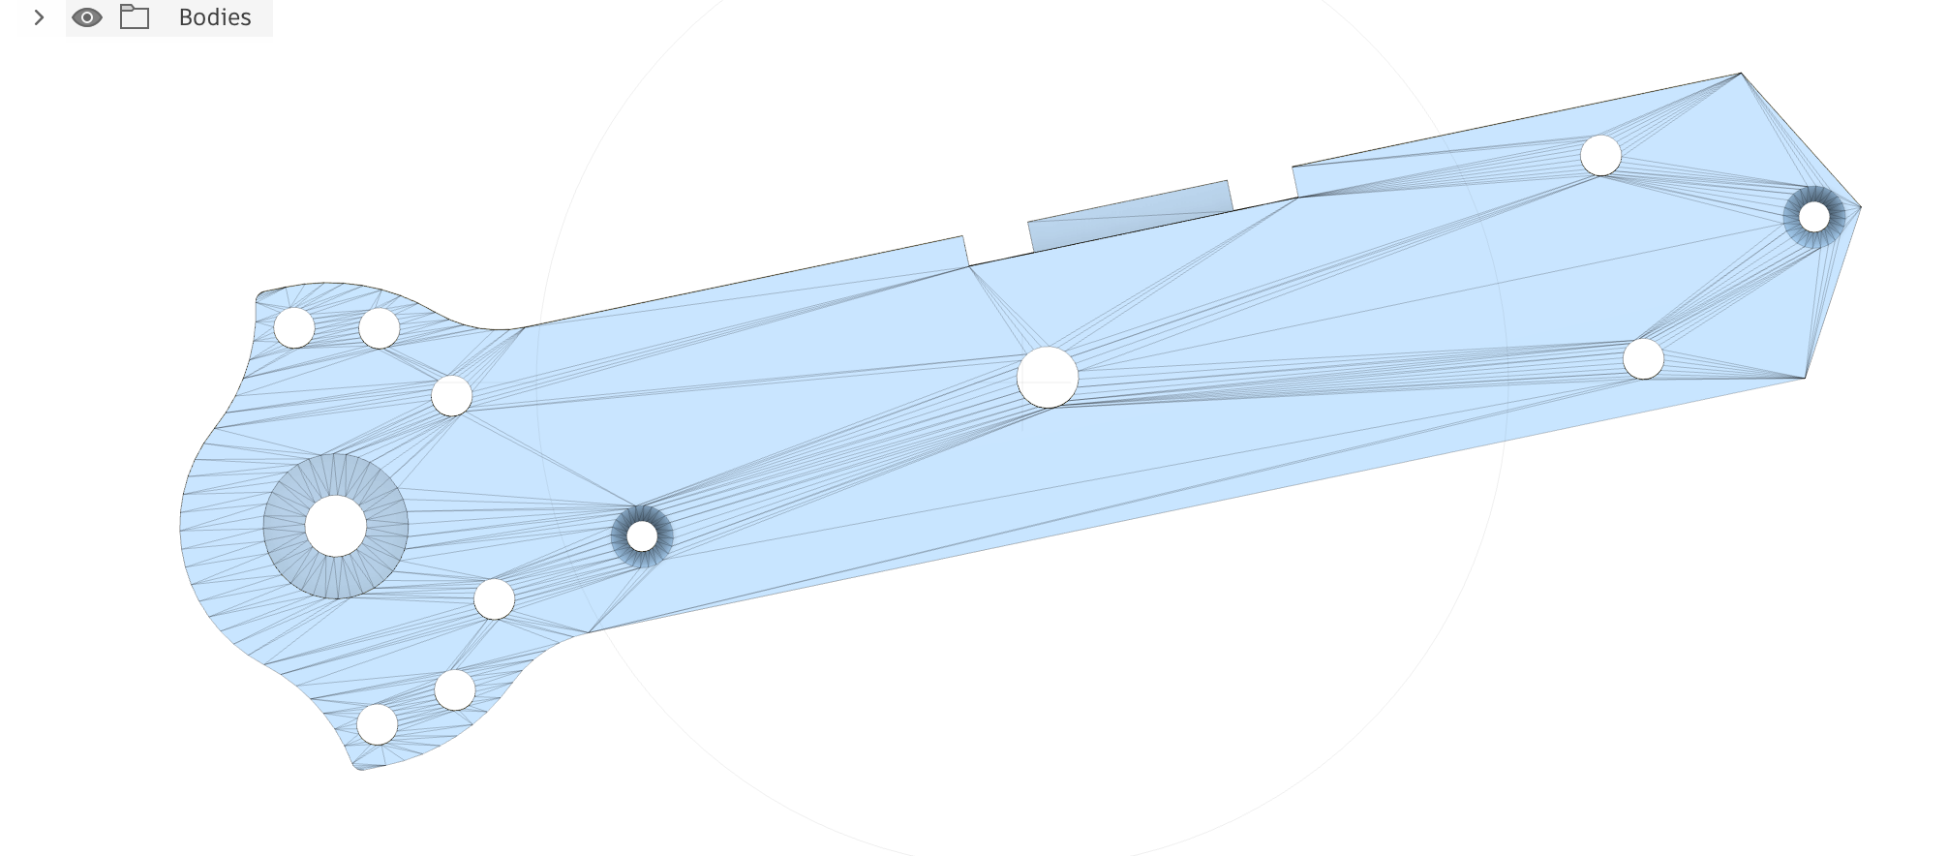
Updated Design
• Dual power rails: 11.1V motor / 3.3V logic
• Enlarged inner space (after finalizing PCB design)
• Other Traits Remained: Two wheel differential drive + Horizontal drum spinner + Dual front wedges+ Symmetric Body
Figure 2: Updated CAD of side plate
Figure 3: Updated Concept CAD
Computer Engineering

Slide 6
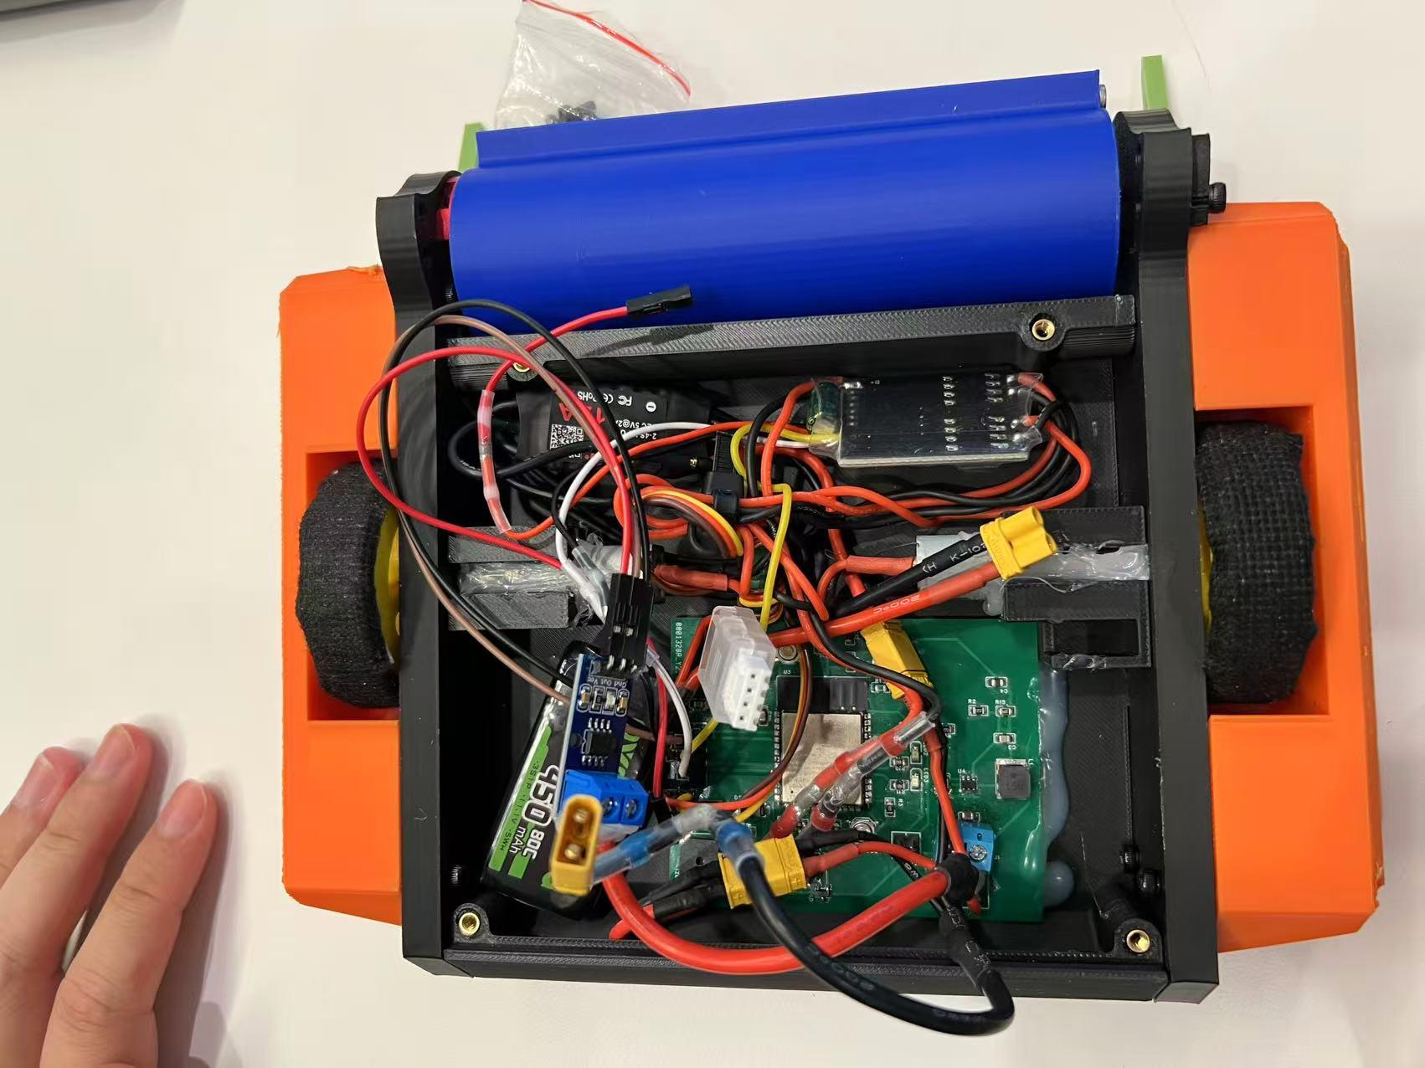
Meet Our BattleBot
Figure 4: Picture of Our Battlebot
Computer Engineering

Slide 7
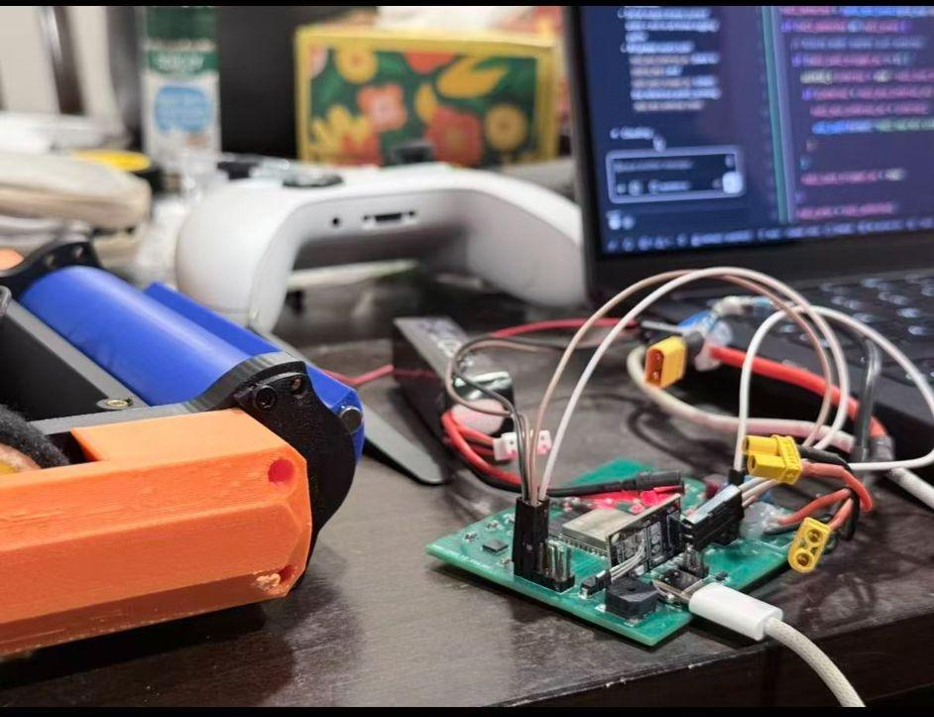
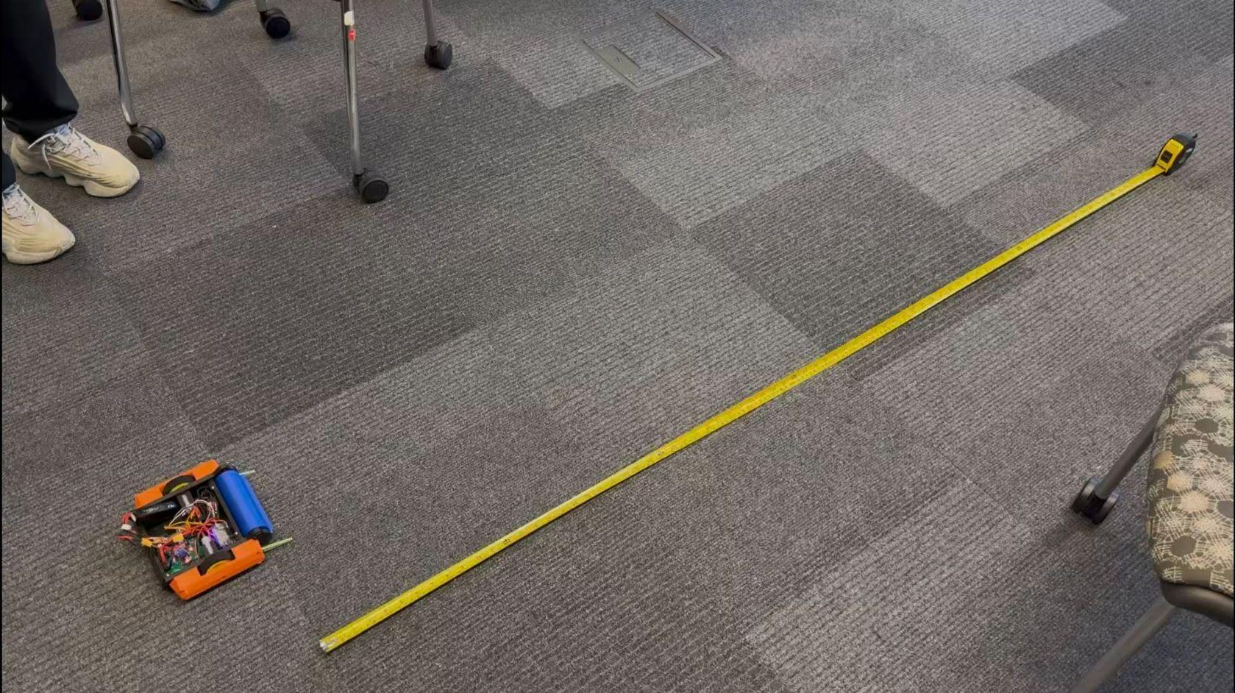
High-Level Requirements
Mobility: Linear acceleration ≥ 1.5 m/s² from rest
Weapon: Tip speed ≥ 150 mph within 10s
Stability & Safety: Invertible mobility, emergency shutdown ≤ 2 s, latency ≤ 150 ms
Figure 5&6: High-Level Requirement Testing
Computer Engineering

Slide 8
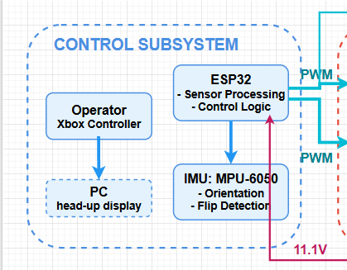
1. Control Subsystem - Hardware
1. ESP32-S3: integrated BT 5.0 + WiFi
2. Controller → Bluetooth → ESP32 → PWM to 3 ESC
3. Failsafe: no packet in 2 s → all motors zero
Computer Engineering

Slide 9
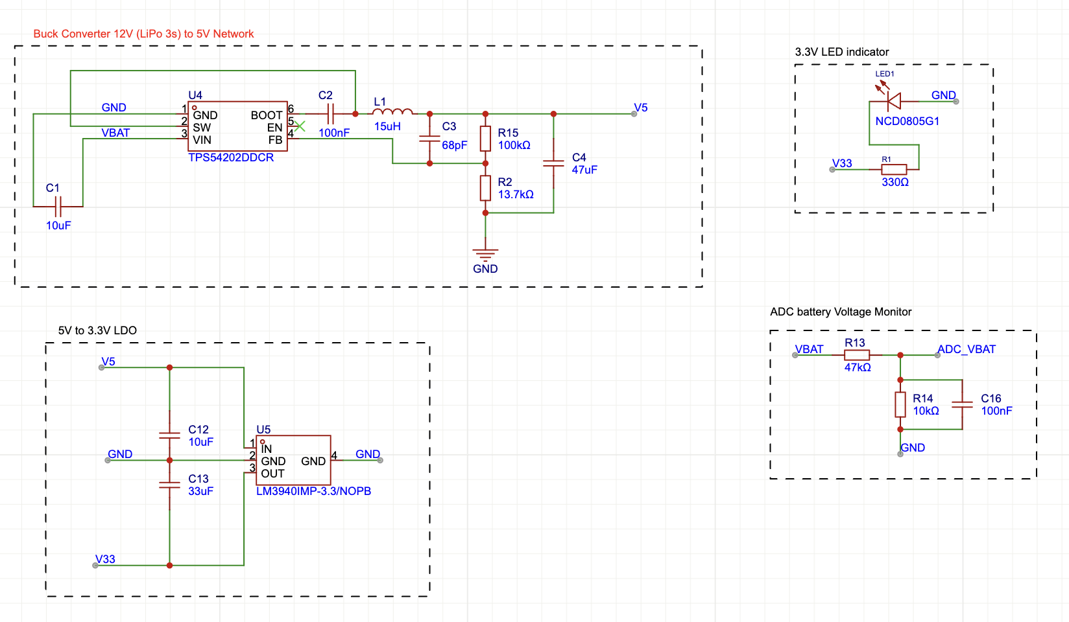
ESP32 S3 Carrier Board Power Networks
Computer Engineering

Slide 10
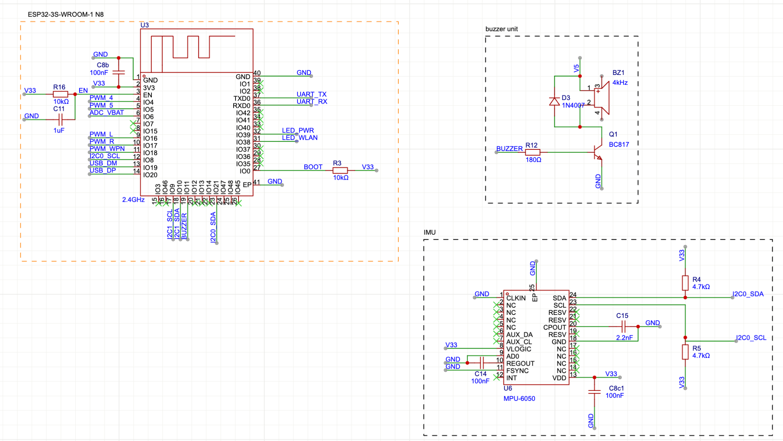
ESP32 S3 Carrier Board MCU Peripherals
Computer Engineering

Slide 11
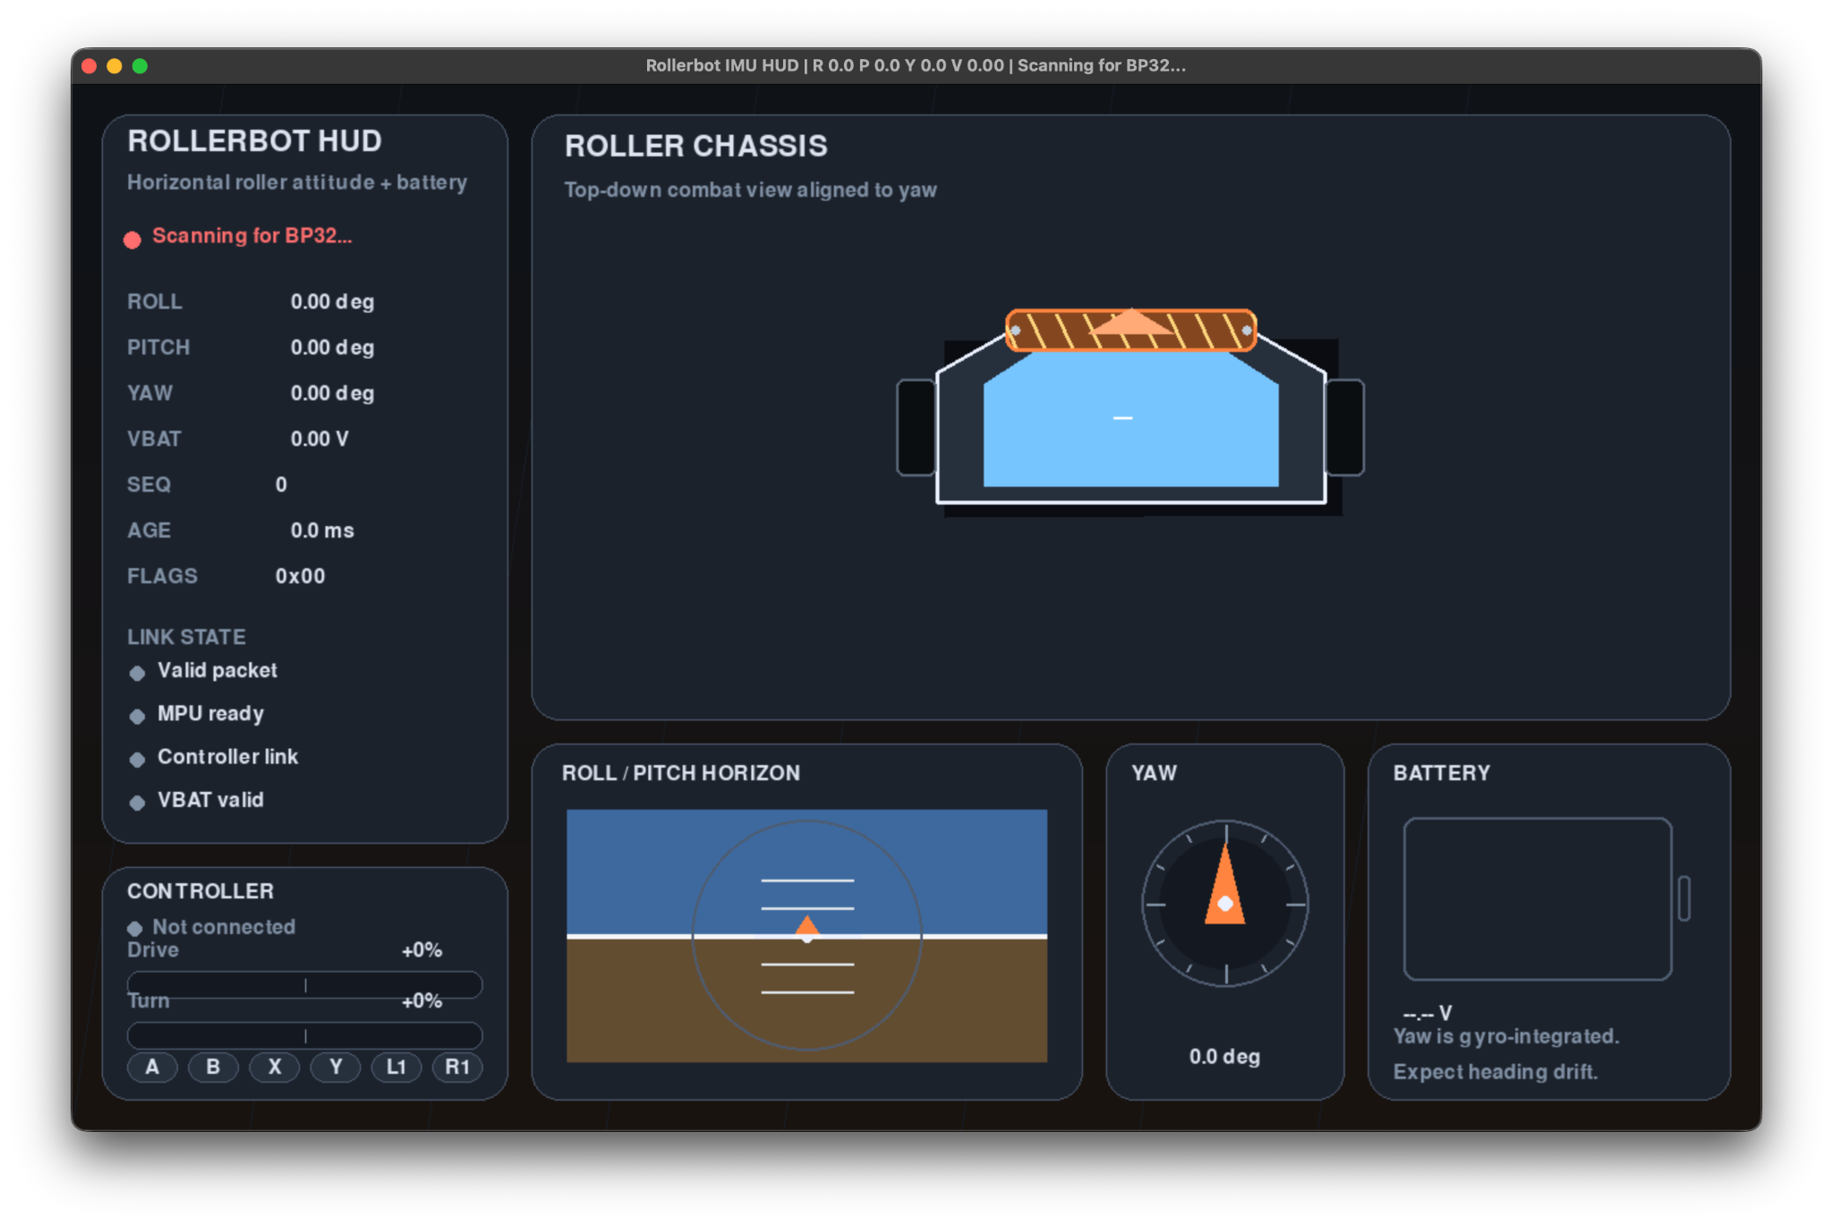
1. Control Subsystem - HUD on PC
Help visualize
Pose detection
Figure 7: HUD on our PC
Computer Engineering

Slide 12
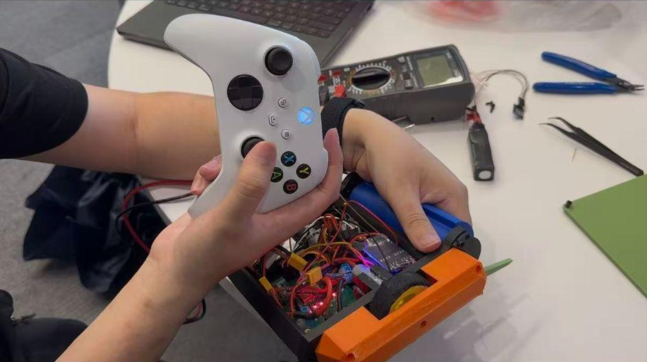
1. Control Subsystem - RV parts
Requirements | Verifications
Bluetooth connection with end-to-end latency ≤ 150 ms. | Yes. We used the iPhone slow motion camera to test connection delay = 50ms
Detect communication loss and initiate emergency shutdown within 2 seconds. | Yes. The battlebot is successfully shut down within 2 s of communication lost.
Figure 8: Connection Delay testing
Computer Engineering

Slide 13
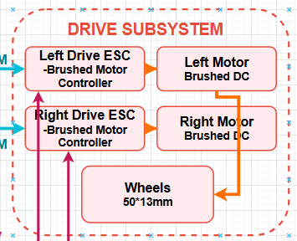
2. Drive Subsystem
1. 2× brushed DC gearmotors
2. 2× ESC (bidirectional PWM)
3. 3D Printed tires
4. Independent L/R control
5. Wheels extend beyond chassis → mobile when inverted
Computer Engineering

Slide 14
2. Drive Subsystem - RV parts
Requirements | Verifications
Linear acceleration ≥ 1.5 m/s^2 from rest on a flat surface. | Yes. Used a stopwatch to test & calculate its linear acceleration: 3.6 m/s².
Robots can drive in both upright and inverted orientations. | Yes. It can drive in both directions with self-adapting control logic.
Drive wheels extend beyond chassis height to ensure bidirectional ground contact | Yes. Drive wheels have a diameter of 50 mm, and chassis height is only 46 mm.
Computer Engineering

Slide 15
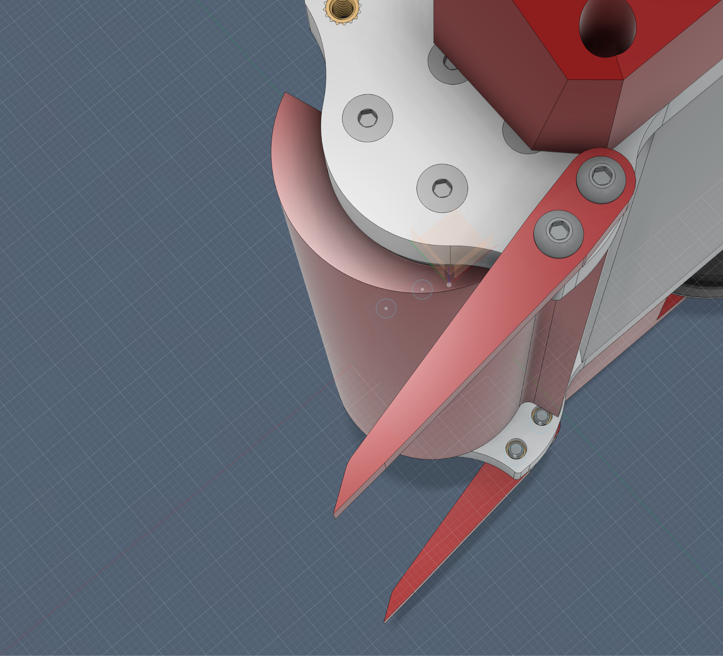
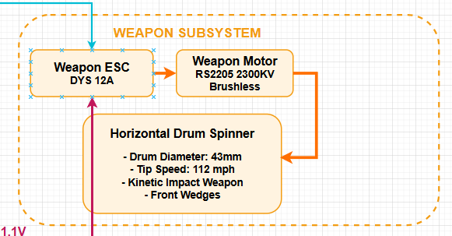
3. Weapon Subsystem
1. Horizontal drum spinner -> Now PLA 3D printing
2. 2300KV BLDC outrunner motor
3. 30A brushless ESC, PWM from ESP32
4. Front wedges -> scoop opponents
Computer Engineering

Slide 16
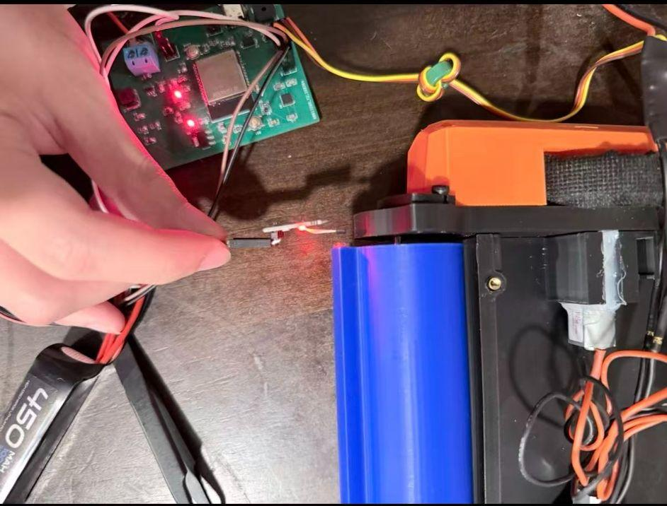
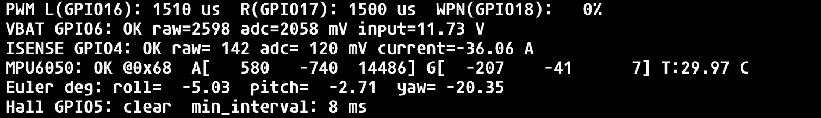
3. Weapon Subsystem - RV parts
Requirements | Verifications
Tip speed ≥ 150 mph within 10 seconds of full throttle. | Our measured tip speed was 112 mph using Hall Effect Sensor and magnetic.
Notice: Under actual operating load and due to safety concerns, we decided to lower the requirement to ≥ 100 mph
Figure 9&10 : Hall Effect Sensor for tip speed measurement
Computer Engineering

Slide 17
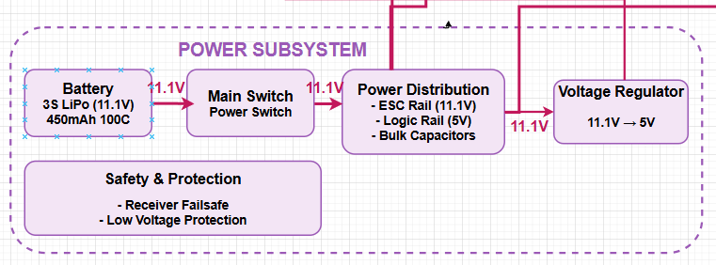
4. Power Subsystem
3S 450mAh 100C Battery
Dual-rail design:
11.1V motor rail
3.3V logic rail
3. XT30 polarized connector
Computer Engineering

Slide 18
4. Power Subsystem - RV parts
Requirements | Verifications
Battery provides ≥ 2 minutes of continuous operation under typical combat loading | Yes. We tested its durability.
Computer Engineering

Slide 19
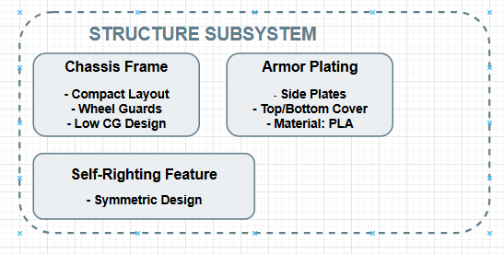
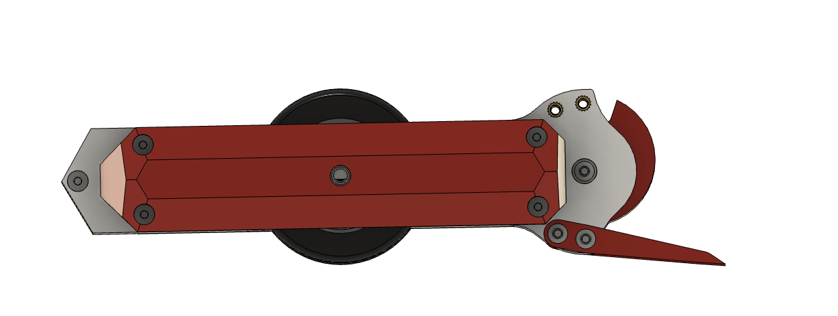
5. Structure Subsystem
1. All parts are 3D printed using PLA
2. Symmetric top/bottom → invertible
3. Wheel guards protect wheels from side impacts
4. Angled outer edges to minimize effective contact area
Figure 11: Design CAD of our wheel guard
Computer Engineering

Slide 20
5. Structure Subsystem - RV parts
Requirements | Verifications
Total assembled weight < 2.0 lbs | Yes. 640g in total.
Notes: In competition next monday, maybe we can add mass to optimize the CoG at the same time.
Computer Engineering

Slide 21
Current Progress & Conclusion
✓ Mechanical Progess: Revise the inner space to fit in a larger PCB and battery,
Revise the side plate to fit in new weapon motor, Use screw insert to connect components
✓ Weapon: Now Using 2300 KV drum spinner instead
✓ Safety: Invertible, 2-s failsafe, ≤ 150 ms latency
✓ Software: Battlebot status display
Computer Engineering

Slide 22
Future Work: Recovery Subsystem
Primary: IMU-based gyroscopic correction
Flip detection: pitch/roll rate > 5 rad/s threshold
Action: modulate weapon speed → gyroscopic counter-torque
Expected: 5–15° correction (theoretical, to be validated)
Verification :
1. Gyroscopic correction algorithm activates when IMU detects flip motion
Computer Engineering

Slide 23


Thank You!
Thank you Professor Viktor Gruev, our TA Zhuoer Zhang, and all the TAs and classmates who helped us along the way.
Source : Reddit: r/ECEProfessionals
Computer Engineering

Slide 24
Appendix A - Block Diagram
Computer Engineering

Slide 25
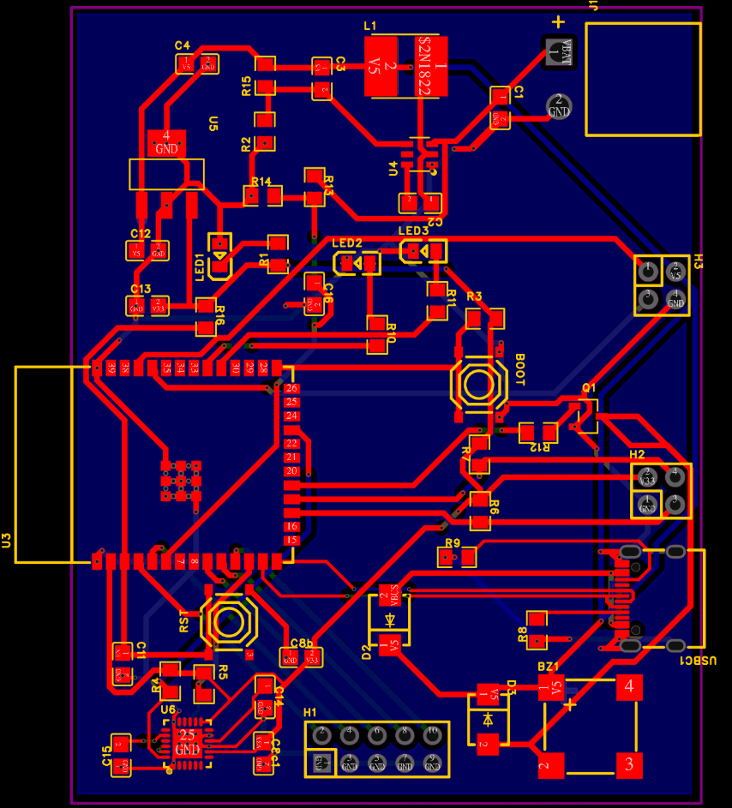
Appendix B - PCB Design
Computer Engineering

Slide 26
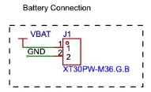
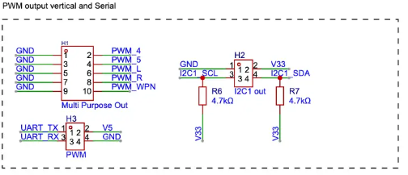
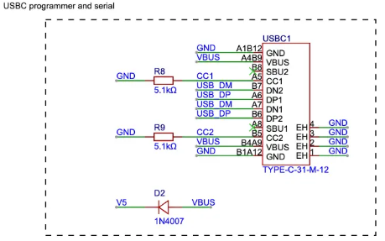
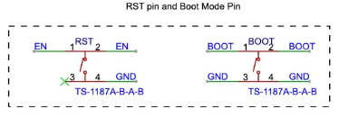
Appendix C - External Connection
Computer Engineering

Slide 27
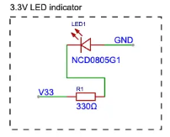
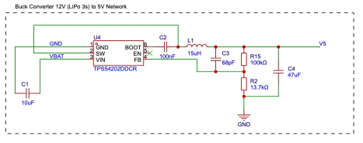
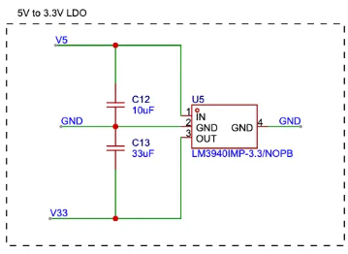
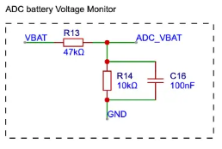
Appendix D - Power Networks
Computer Engineering

Slide 28
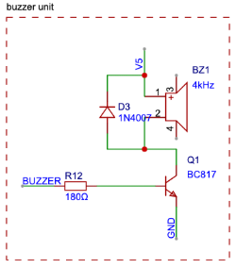
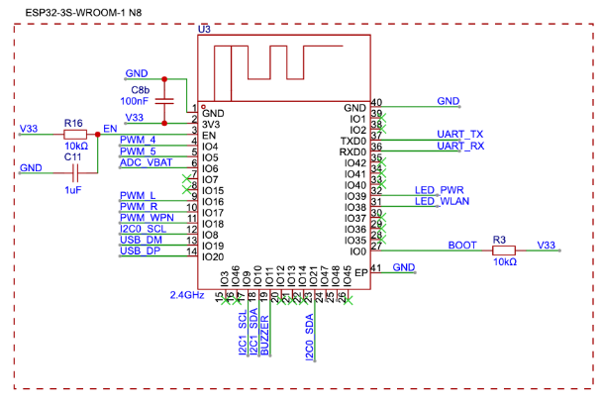
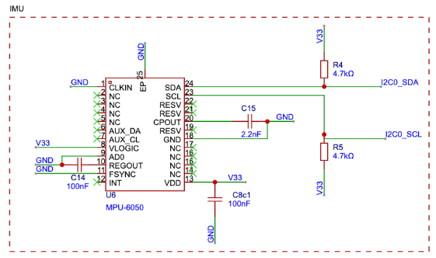
Appendix E - MCU Peripherals
Computer Engineering

