Slide 1
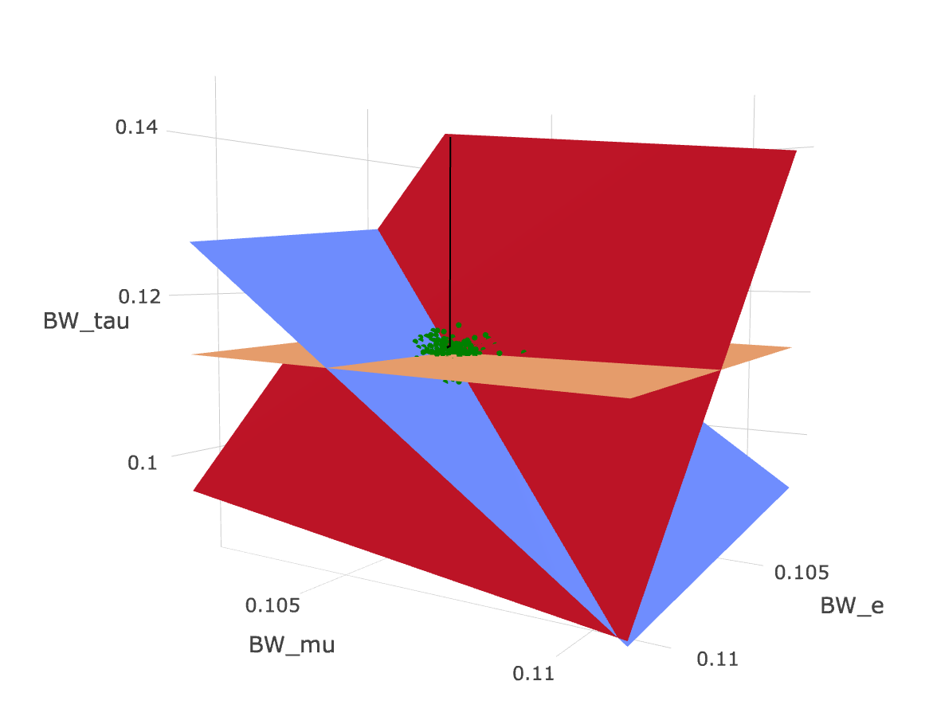
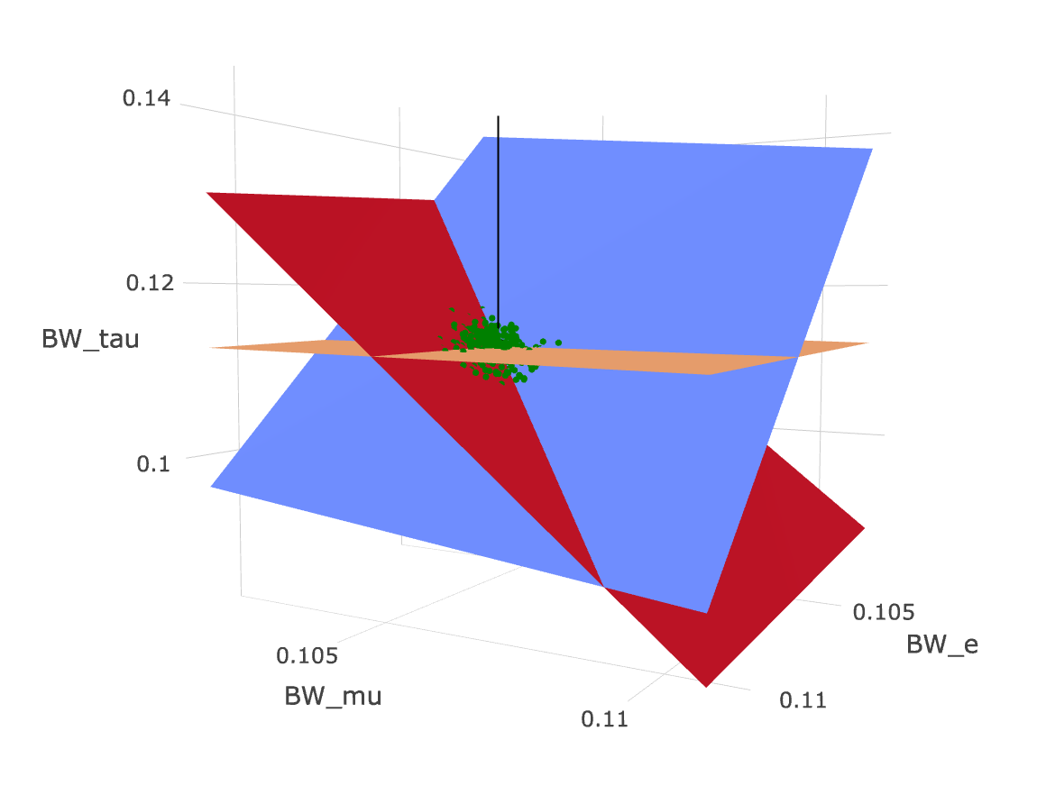
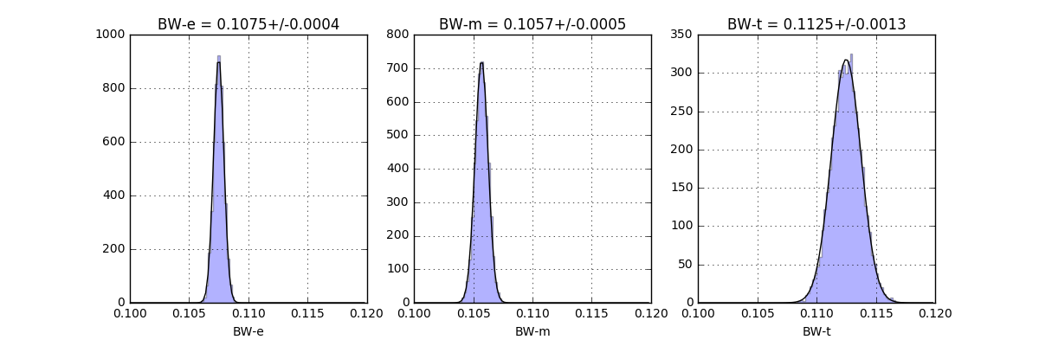
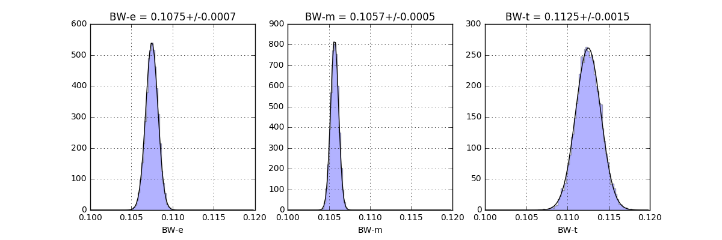
Single muon trigger
Single electron trigger
x₁
x_{ee}
x₂
x_{em}
Solutions
considering
StatUnc
Solutions of toys
x₃
x_{et}
Solutions of 10000 toys
Solutions of 10000 toys

