Slide 1
Analysis of the island of Ireland
Ziheng Li

Slide 2
Outline
Introduction
Data Exploration
Map of Ireland
Weather Characteristics
Comparison with Other Region Island States
SWOT Analysis
Conclusion

Slide 3
Introduction
Purpose: This program provides users with comprehensive information about the island of Ireland. It consists of a number of main sections, facilitating the client's ability to gain a complete understanding of the island.

Slide 4
General Description
Geographical Location: Understanding Ireland's physical and strategic position.
Political Situation: Insights into governance and administrative structure.
Population: Demographics and urbanization patterns.
Weather Conditions: Key climate characteristics of the island.
Economy: Economic activities and business environment.

Slide 5
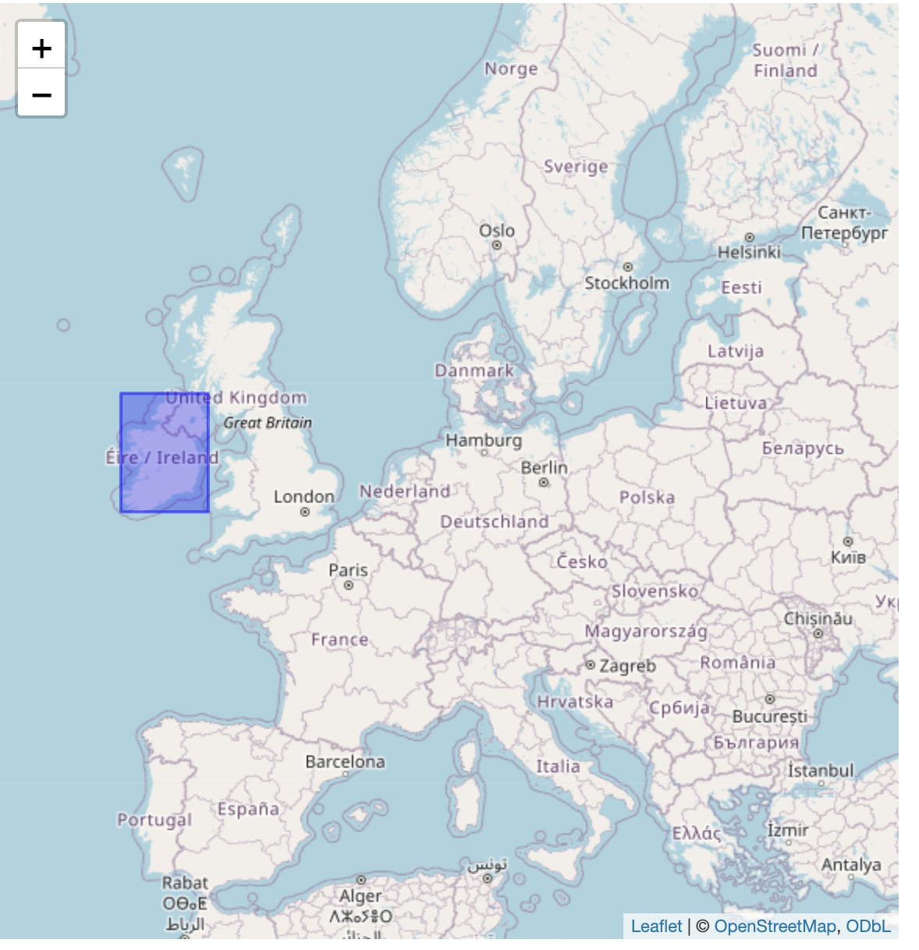
Map of Ireland
This map shows the exact location on the world map, and I've used the blue areas to HIGHLIGHT Ireland's location on the world map.

Slide 6
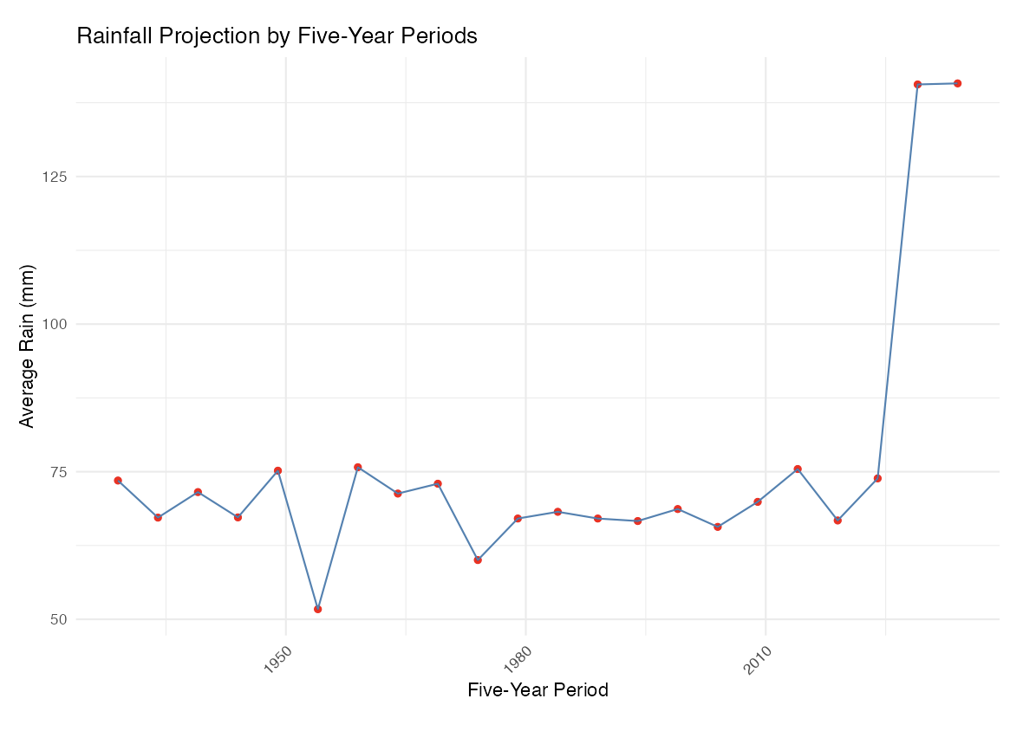
Weather Characteristics
This section focuses on the average rainfall for each five-year period on the island of Ireland, and allows the user to predict rainfall trends for the next five years based on previous rainfall trends.

Slide 7
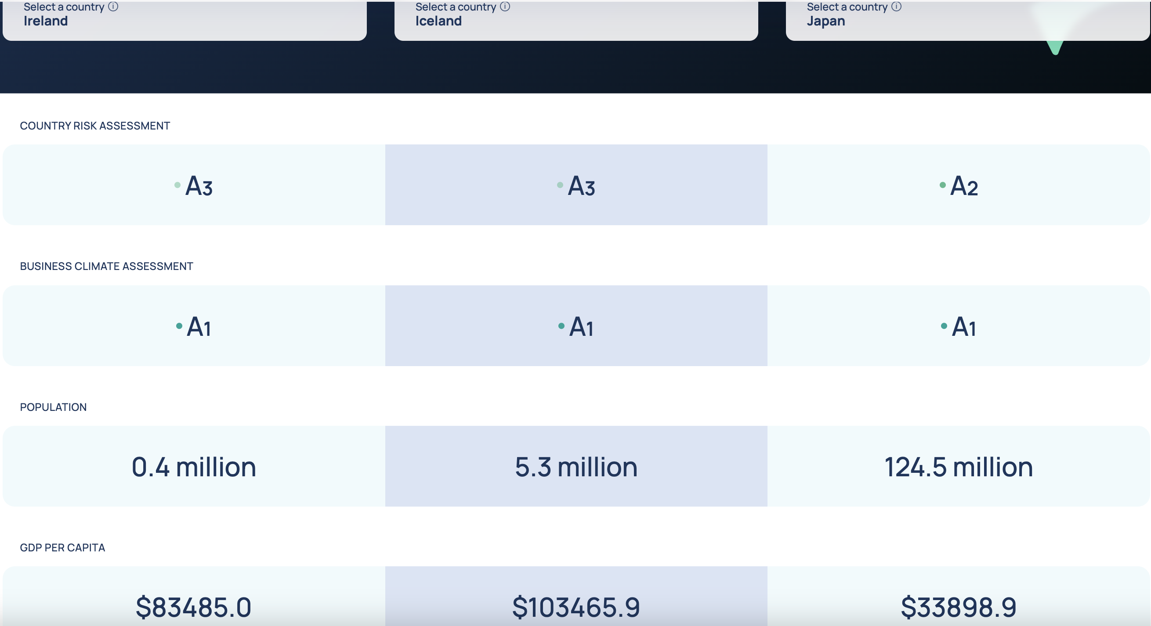
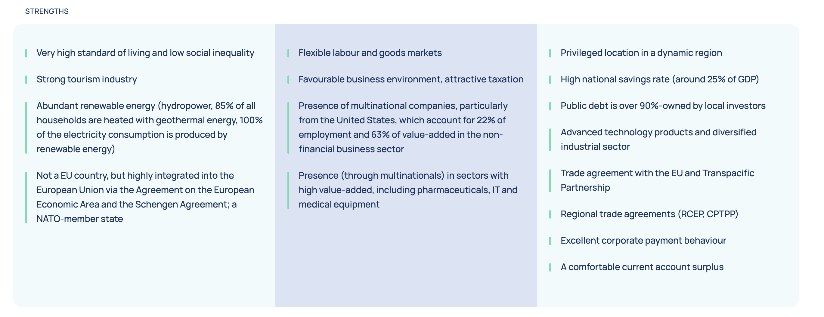
Comparison with Other Regional Island States

Slide 8
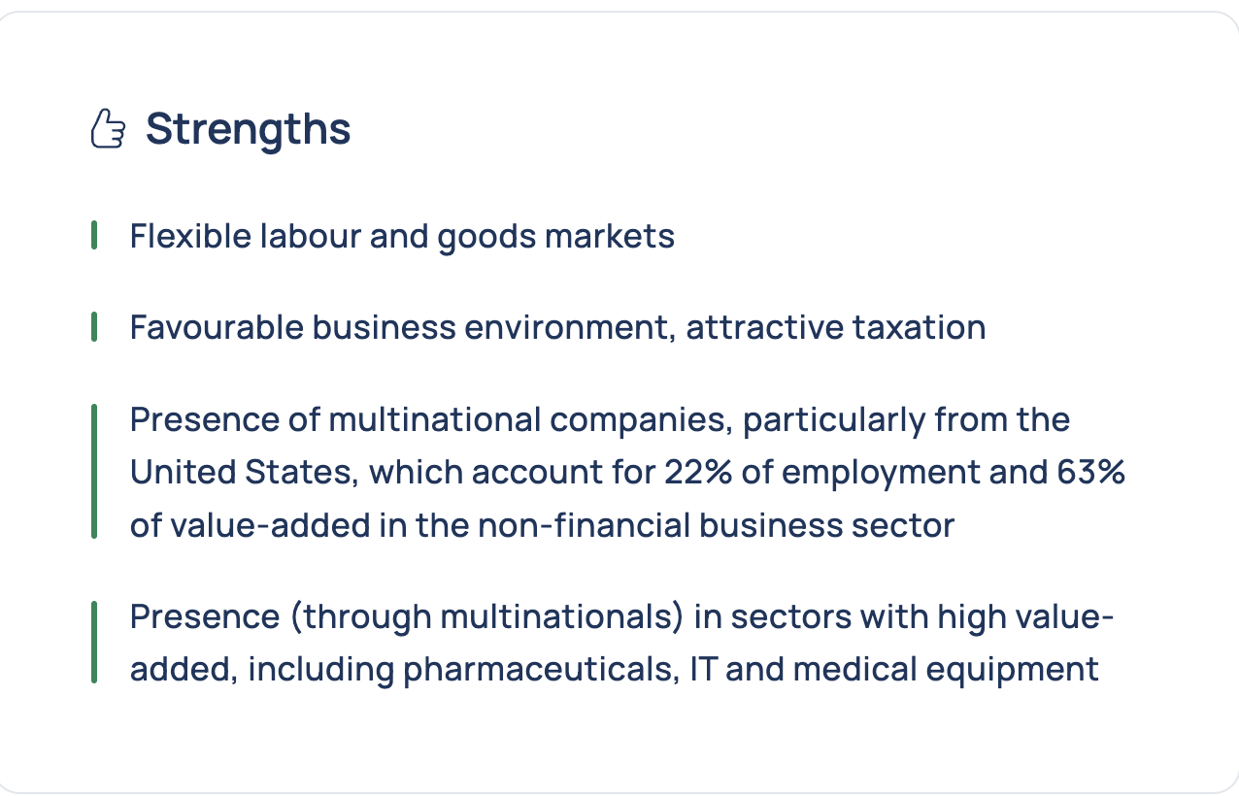

SWOT Analysis

Slide 9
Conclusion
Ireland's competitive edge in high-value industries makes it an attractive hub for global investors.
Recognizing potential vulnerabilities can guide policy improvements and economic stability.
The insights offer a foundation for strategic planning in business, government, and academia.

Slide 10
Thank You

