Slide 1
Stock Market Sentiment Analysis
Predicting Market Returns Using Online Investor Sentiment
Presented by: Chuxuan Ma, Zijian Wang
Date: March 3, 2025

Slide 2
Background & Motivation
Investor Sentiment Matters: Investor emotions and sentiment have been shown to affect market momentum and price fluctuations.
Stock Market as a Barometer: The Shanghai Composite Index reflects overall market sentiment and economic conditions in China.
Problem Context:
How online opinions, posts, and comments aggregate into measurable market sentiment.
Can we quantify sentiment and improve predictions of next-day returns?

Slide 3
Project Goals
Data Integration: Integrate labeled Chinese financial sentiment data from Github, Kaggle, and Hugging Face.
Modeling Approach: Fine-tune a Chinese pre-trained BERT model with an added fully connected layer; train for 10 epochs.
Sentiment Quantification: Use Beautiful Soup to crawl posts/comments from EastMoney-SSEC forum (2018/12/1–2025/1/1) and predict sentiment scores with the BERT model.
Index Construction: Calculate a monthly sentiment index with a rolling window.
Investment Strategy: Incorporate the sentiment index into a regression model to predict next-day returns and design a trading strategy.

Slide 4
Approach: Data Collection & Model Training
Step 1: Labeled Data Acquisition
Sources: Github, Kaggle, Hugging Face
Labels: ‘Positive’ (1), ‘Neutral’ (0.5), ‘Negative’ (0)
Step 2: BERT Sentiment Score Model
Model: Chinese pre-trained BERT + Fully Connected layer
Training: Fine-tune on the collected dataset for 10 epochs
Objective: Predict sentiment probability for each financial post/comment
Mathematical Formulation:

Slide 5
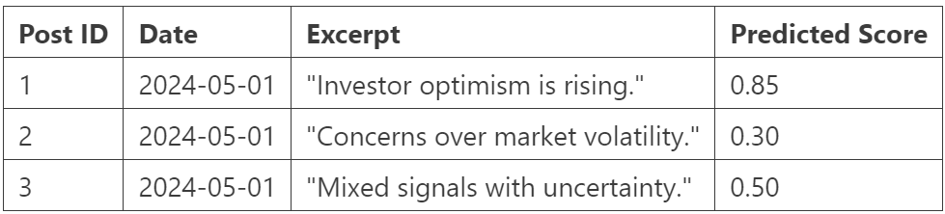
Approach: Web Scraping with Beautiful Soup
Data Source: EasyMoney - Shanghai Securities Composite Index forum
Time Period: 2018/12/1 – 2025/1/1
Target Data: All available posts and comments
Process:
• Utilize Beautiful Soup for HTML parsing.
• Extract text data, timestamp, and metadata.
• Apply the BERT model to obtain sentiment scores.
Example Data Table:

Slide 6



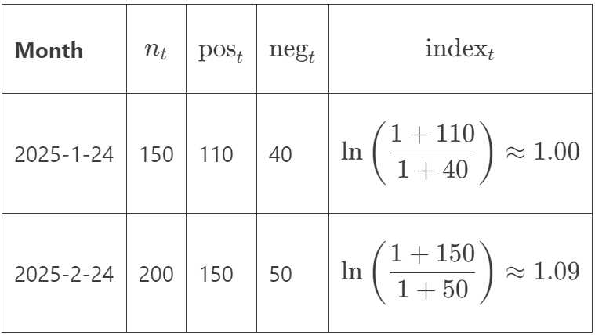
Approach: Monthly Sentiment Index Calculation
Rolling Window Method: For each month t (2019-01-01 to 2025-01-01), use data from [t-1, t].
Aggregation Process for posts/comments:
• Positive sentiment sum:
• Negative sentiment sum:
• Sentiment Index:
Example Calculation Table:

Slide 7



Approach: Predictive Regression Model
Original Regression Model:
Incorporating Sentiment Index:
where
Trading Signal: If predicted , then Buy; otherwise, No Buy.
Example Investment Strategy Table:

Slide 8

Approach: Backtesting & Strategy Performance
Backtesting Period: January 2, 2025 – March 1, 2025
Approach: Use regression model with sentiment index to predict returns and simulate trading strategy.
Evaluation: Total return over the period & comparison of R² with/without sentiment factor.
Observation: Significant improvement in R² and statistically significant indicate a meaningful predictor.

Slide 9
Discussion of Existing Solutions
Existing Approaches:
• Lexicon-based sentiment analysis methods
• Machine learning models combining news sentiment with price data
• Social media data can suffer from future bias (e.g., likes/upvotes)
Our Improvements and Perspectives:
• Novel Data Source: Use forum posts from EastMoney without future likes/upvotes.
• Rolling Window Sentiment Index that incorporates a forgetting effect.
• Integration with traditional financial factors.
• Future Work: Explore weighted sentiment and compare with deep learning models.

Slide 10
Conclusion
Summary:
• Pipeline: Labeled sentiment data, fine-tuning BERT, and crawling forum data.
• Monthly Sentiment Index: Computed using a rolling window and integrated into a regression model for next-day return prediction.
• Backtesting shows potential improvements in investment decisions.
Final Thoughts:
• A novel quantitative approach capturing the human element in market behavior.
• Further improvements and comparative studies are needed.

