Slide 1

Exploratory Data Analysis
<G2M insight for Cab Investment firm>
<05/20/2023>

Slide 2
Agenda
Executive Summary
Problem Statement
Approach
EDA
EDA Summary
Recommendations

Slide 3
Executive Summary
This analysis aims to provide actionable insights to XYZ, a private firm in the US, in their decision-making process for investment in the Cab industry.
The analysis is based on multiple datasets provided, which include：
Transaction details for two cab companies
Customer demographic information
Transaction-to-customer mapping
City and population data
The analysis involves:
exploring relationships across the datasets
performing data transformations
identifying duplicates
investigating various hypotheses.
Additionally, third-party data, such as US holiday and weather data, has been leveraged to enhance the analysis. The presentation summarizes the findings, recommendations, and identifies the better performing cab company for investment.

Slide 4
Problem Statement
XYZ is seeking to invest in the Cab industry and needs to identify the right company to make their investment. They require a thorough understanding of the market and insights derived from the provided datasets to support their decision-making process.

Slide 5
Approach
Approach:
1. Review the Source Documentation: Understand the field names, data types, and relationships across the files.
2. Data Intake: Assess the properties of the provided datasets, identify data transformations required, and determine which files should be joined or appended. Create a master dataset to establish relationships.
3. Exploratory Data Analysis (EDA): Perform in-depth analysis of the data, investigate multiple hypotheses, and derive insights. Leverage third-party data to enhance the analysis.
4. EDA Summary: Summarize the findings from the EDA, highlight key insights, and present actionable recommendations.

Slide 6
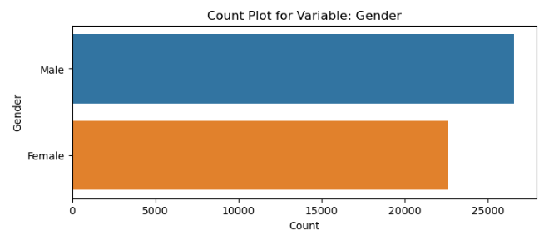
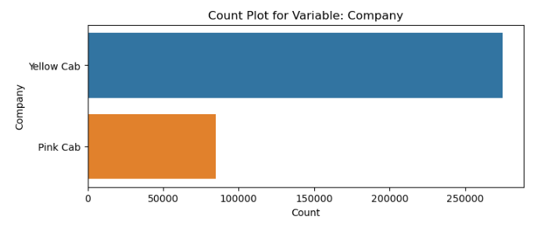
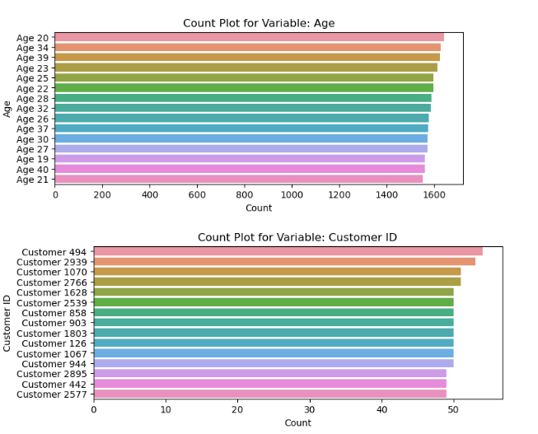
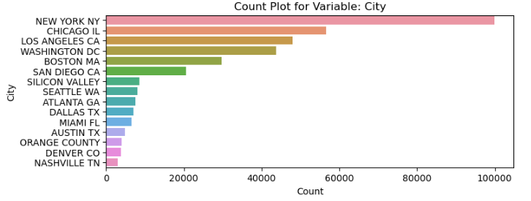
EDA
EDA- 1- Count Plot for Some Categorical Variables

Slide 7
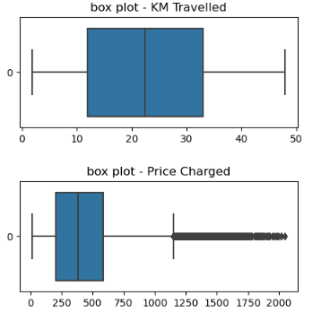
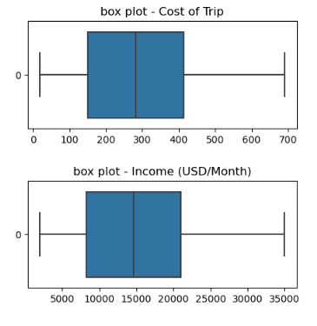
EDA
EDA- 2- Box plot for Numerical Variables

Slide 8
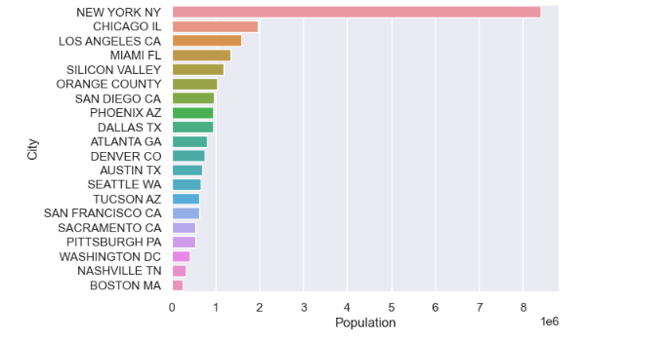
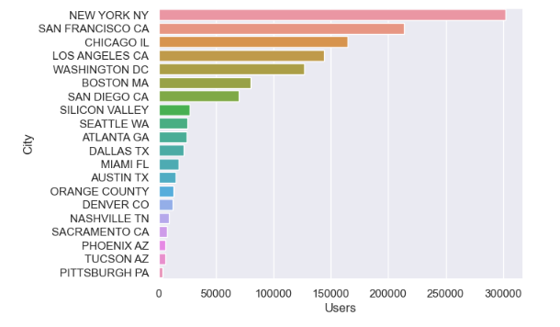
EDA
EDA- 3- Corresponding Relationship
City and Population City and User

Slide 9
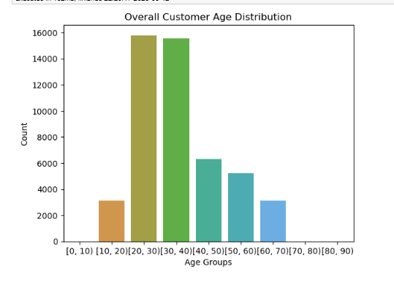
EDA - Hypothesis and Investigate
Hypothesis 1 - Are customers mainly concentrated in a few specific age groups?
Findings:
From this analysis, we can conclude that our target market consists primarily of customers in the age groups of 20-30 and 30-40. These age groups typically comprise young adults and young families, making them potential target markets. Given their age range, these segments tend to have higher transportation needs and may rely more frequently on taxi services.
Customers in the 20-30 and 30-40 age groups share certain characteristics and preferences. For example, they may prioritize convenience, affordability, mobile payment options, and comfortable travel experiences. Understanding these user traits can help determine the key areas of focus in terms of service and operations.

Slide 10
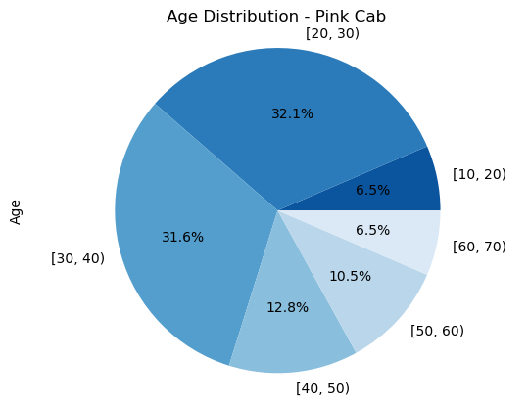

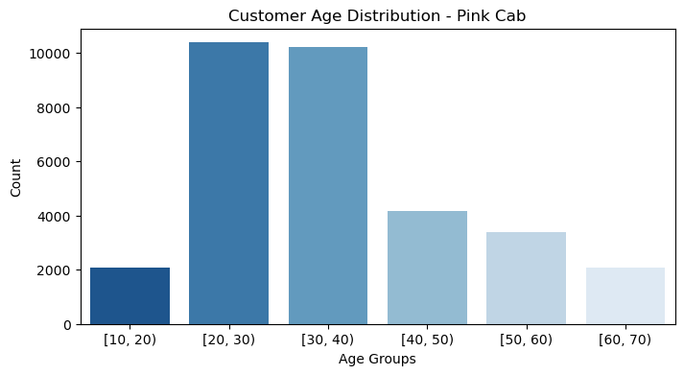

EDA - Hypothesis and Investigate
Hypothesis 2 - Are the user groups of these two companies different?
Let’s consider user age first
The age distribution of the user groups of the two taxi companies is similar, but Yellow Cab has a larger presence than Pink Cab in every age group.
This suggests that Yellow Cab holds a market share advantage and has a broader user base. By increasing investment in Yellow Cab, we can further expand your market share and acquire more users.

Slide 11
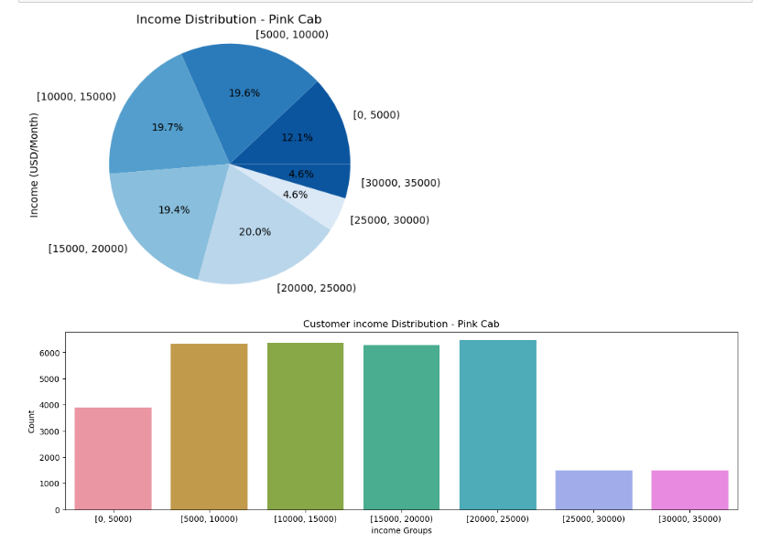
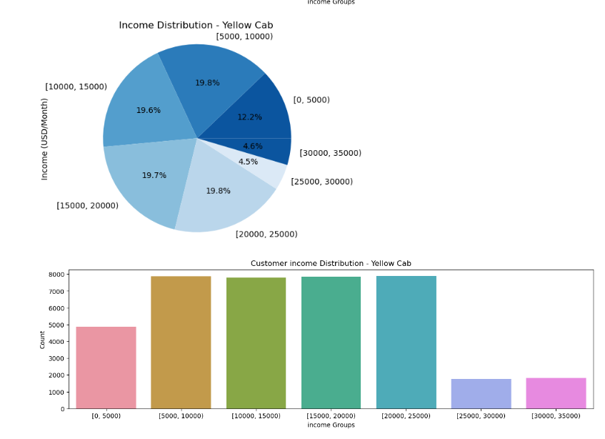
EDA - Hypothesis and Investigate
Hypothesis 2 - Are the user groups of these two companies different?
Let’s see the income distribution for the two companies next.
The user groups' income distribution of the two taxi companies is similar, but Yellow Cab has a higher income among the main income segments compared to Pink Cab. This suggests that Yellow Cab has an advantage in the high-income。 demographic.

Slide 12
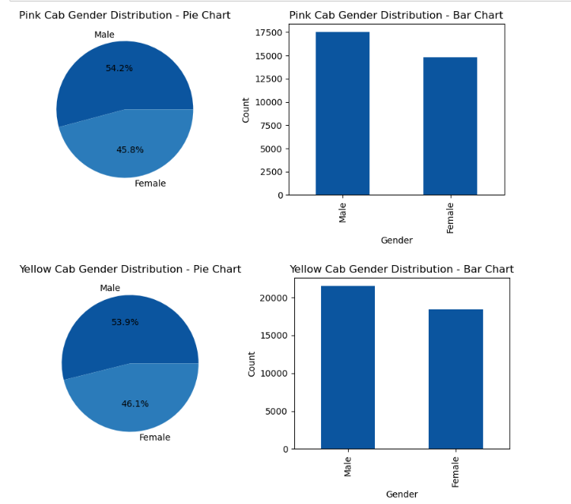
EDA - Hypothesis and Investigate
Hypothesis 2 - Are the user groups of these two companies different?
How about gender?
The user gender distribution of the two taxi companies is similar, but Yellow Cab company has more passengers than Pink Cab company, regardless of gender. This may indicate that Yellow Cab company enjoys higher brand recognition and popularity in the market, thus attracting more passengers.

Slide 13
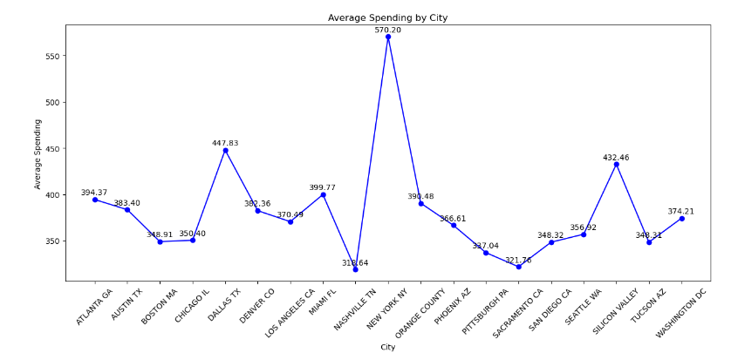
EDA - Hypothesis and Investigate
Hypothesis 3: Are there differences in the consumption habits of taxi customers in different cities？
Findings
Based on the provided average spending data, we can draw some preliminary conclusions:
There are variations in the average spending levels across different cities. For example, New York NY has a higher average spending of 570.20, while Nashville TN has a lower average spending of 318.64.
Some cities exhibit higher average spending, such as Dallas TX and Silicon Valley, with average spendings of 447.83 and 432.46, respectively.
Certain cities have lower average spending, like Pittsburgh PA and Sacramento CA, with average spendings of 337.04 and 321.76, respectively.
Cities with higher average spending may not necessarily be the best investment choice, as other factors such as market potential and competitive environment need to be considered.
In conclusion, the average spending data provides insights into the consumer habits across different cities to consider. However, further analysis of other datasets and consideration of additional key factors are necessary before making a final investment decision.

Slide 14
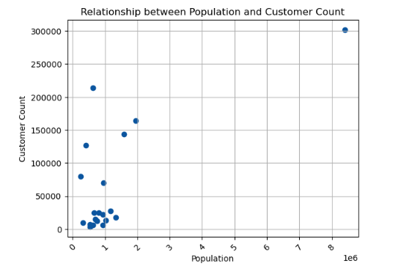
EDA - Hypothesis and Investigate
Hypothesis 4：Does a larger city population mean more users?
Findings
There is a positive correlation between population and users: The overall trend shows that cities with larger populations tend to have more users. This suggests that cities with larger populations provide a larger user base and potential market.
Some cities have a higher number of users than expected: In cities with smaller populations, there are a few cities that have relatively high numbers of users, surpassing other cities of similar size. For example, cities like "NEW YORK NY," "SAN FRANCISCO CA," and "BOSTON MA" have relatively high numbers of users, potentially due to their significant roles in technology, innovation, and culture.
Some cities have relatively lower numbers of users: Despite having larger populations, there are several cities with relatively lower numbers of users. For instance, cities like "MIAMI FL," "SILICON VALLEY," and "ORANGE COUNTY" have smaller user populations despite their larger populations. This could be attributed to other factors such as economic conditions, internet penetration rates, and more.

Slide 15
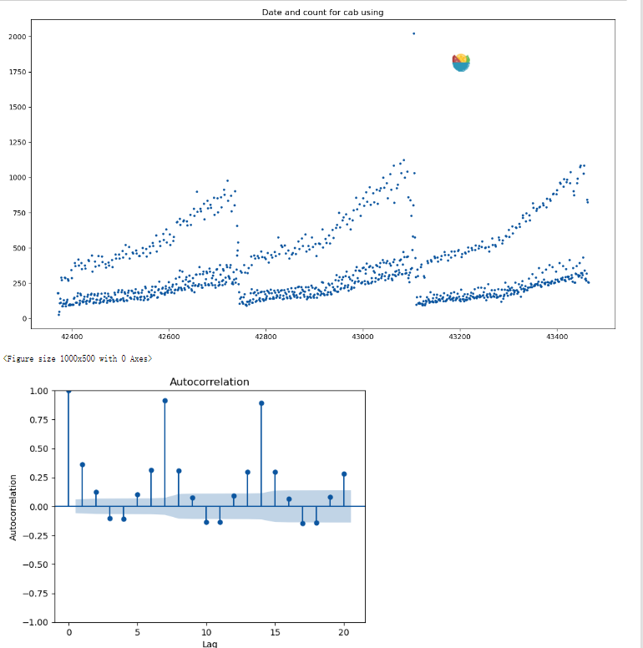
EDA - Hypothesis and Investigate
Hypothesis 5：Is there any seasonality in number of customers using the cab service?¶
Findings
We can observe that the usage of taxis exhibits clear seasonality because there are distinct periodic peaks in the ACF (Autocorrelation Function) plot.
The significant values of the autocorrelation coefficients at specific lags indicate the presence of repetitive patterns in the data across different time intervals. The occurrence of these periodic peaks suggests fluctuations in the demand for taxi services between different seasons, which may be influenced by factors such as seasonal changes, holidays, weather conditions, and other relevant factors.

Slide 16
EDA Summary
1. Population and User Correlation: Cities with larger populations tend to have more cab users, indicating a potential market opportunity.
2. Varied User Distribution: Some smaller cities have higher numbers of cab users compared to cities of similar size, potentially due to factors like technological advancements and cultural significance.
3. Lower User Numbers in Certain Cities: Despite larger populations, some cities have relatively lower numbers of cab users, possibly influenced by economic conditions and internet penetration rates.
4. Seasonality in Cab Usage: There is clear seasonality in the demand for taxi services, with fluctuations influenced by seasons, holidays, and weather conditions.
5. Average Spending Variations: Average spending levels vary across cities, but other factors beyond spending should be considered for investment decisions.
6. Gender and Company Preference: Yellow Cab attracts more passengers overall, suggesting higher brand recognition and popularity compared to Pink Cab.
7. User Groups and Income: Yellow Cab has a higher concentration of higher-income users compared to Pink Cab.
8. Target Market Age Groups: The primary target market consists of customers in the age groups of 20-30 and 30-40, indicating potential opportunities in catering to their preferences and characteristics.
These findings provide insights into the cab industry and can guide XYZ's investment decision. Further analysis and consideration of additional factors are necessary to determine the better performing company and the optimal investment opportunity.

Slide 17
Recommendations
Focus on High-Population Cities: Given the positive correlation between population and the number of cab users, XYZ should consider targeting cities with larger populations. These cities provide a larger user base and potential market for cab services.
Explore Potential in Smaller Cities: While smaller cities may have lower overall user numbers, some cities stand out with higher user counts relative to their size. XYZ should investigate these cities further to understand the reasons behind their popularity and evaluate the potential for growth and market penetration.
Consider Seasonal Demand: The analysis reveals clear seasonality in cab usage, indicating fluctuations in demand based on seasons, holidays, and weather conditions. XYZ should factor in these seasonal patterns when planning operations, promotions, and pricing strategies to optimize service delivery and maximize profitability.
Capitalize on Brand Recognition: Yellow Cab company has shown higher brand recognition and popularity compared to Pink Cab. XYZ should consider leveraging Yellow Cab's established brand presence to attract more passengers and gain a competitive edge in the market.
Target High-Income Demographics: Yellow Cab has a higher concentration of users in the high-income segments compared to Pink Cab. XYZ should focus on targeting and providing premium services to these high-income demographics, as they are more likely to have higher spending capabilities and may contribute to higher margins.
Tailor Services to Target Age Groups: The analysis highlights the age groups of 20-30 and 30-40 as the primary target market for cab services. XYZ should customize their services to cater to the preferences and characteristics of these age groups, such as emphasizing convenience, affordability, mobile payment options, and providing comfortable travel experiences.
Assess Competitive Landscape: It is crucial for XYZ to conduct a thorough analysis of the competitive landscape in the cab industry. Consider factors such as the market share of different companies, their service quality, pricing strategies, and customer satisfaction levels. This assessment will help XYZ understand the market dynamics and make informed decisions regarding their investment.
Consider Additional Data and Factors: While the provided datasets offer valuable insights, it is essential to incorporate additional data sources and factors for a comprehensive analysis. This may include considering market trends, regulatory factors, technological advancements, and customer feedback.

Slide 18
Thank You

