Slide 1


Single-Cell Bioinformatics
Week 7

Slide 2
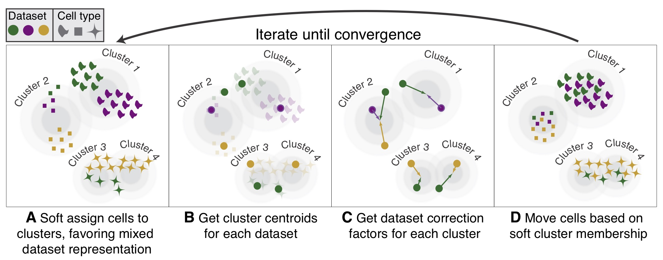

HARMONY
Notes:
Harmony simultaneously accounts for multiple experimental and biological factors. The Harmony algorithm inputs a PCA embedding (Z) of cells, along with their batch assignments (ϕ), and returns a batch corrected embedding.

Slide 3
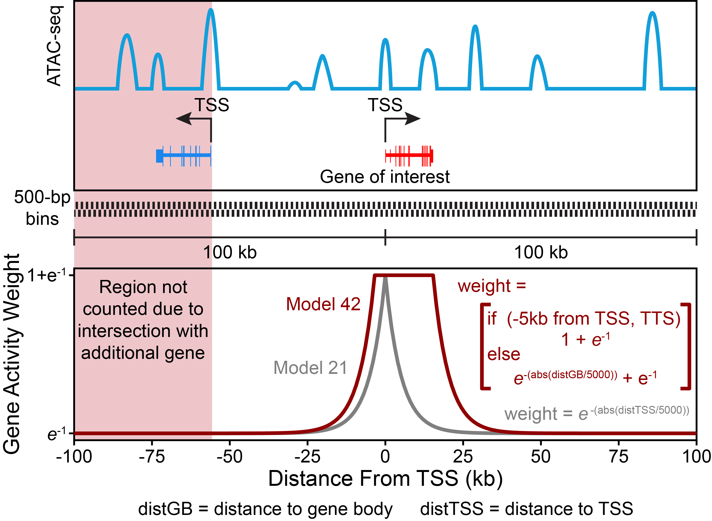
Gene Score
archrproject.com
Notes:
, ArchR creates a tile matrix using a user-defined tile size that is not pre-computed (default is 500 bp), overlaps these tiles with the user-defined gene window (default is 100 kb on either side of the gene), and then computes the distance from each tile (start or end) to the gene body (with optional extensions upstream or downstream) or gene start. ArchR identifies the subset of tiles that are within the gene window and do not cross another gene region. The distance from each tile to the gene is then converted to a distance weight using a user-defined accessibility model (default is e(-abs(distance)/5000) + e-1). hen the gene body is included in the gene region (where the distance-based weight is the maximum weight possible), we found that extremely large genes can bias the overall gene scores. In these cases, the total gene scores can vary substantially due to the inclusion of insertions in both introns and exons. To help adjust for these large differences in gene size, ArchR applies a separate weight for the inverse of the gene size (1 / gene size) and scales this inverse weight linearly from 1 to a user-defined hard maximum (default of 5). Smaller genes thus receive larger relative weights, partially normalizing this length effect.

Slide 4
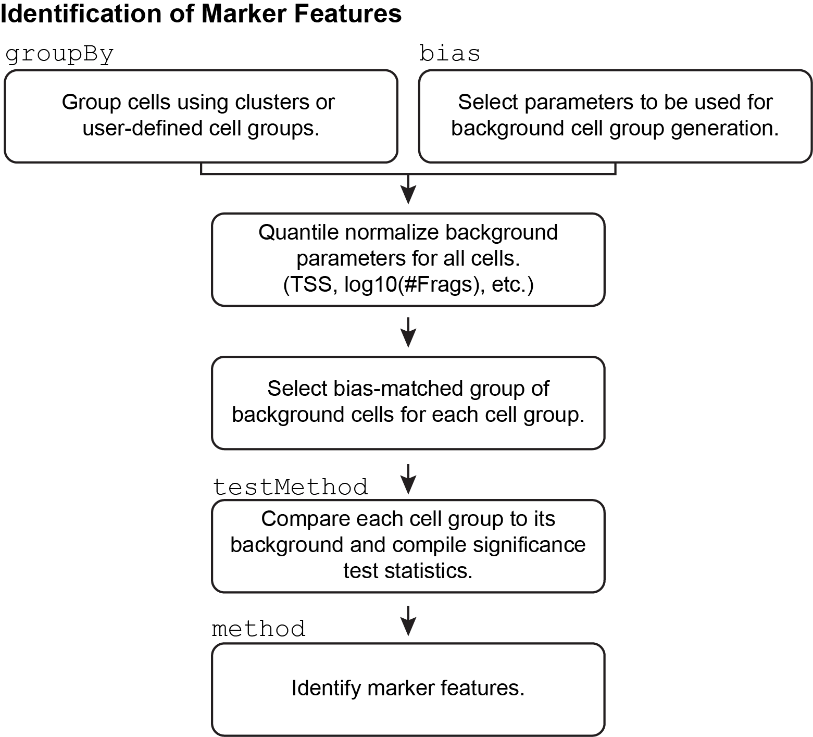
archrproject.com

Slide 5
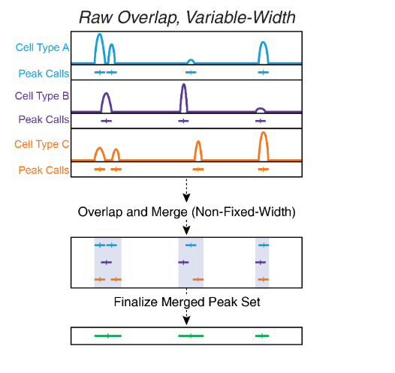
Peak Calling
archrproject.com
Notes:
Because per-cell scATAC-seq data i. In this scheme, daisy-chaining becomes a large problem because peaks that dont directly overlap each other get included in the same larger peak because they are bridged by a shared internal peak. Another problem with this type of approach is that, if you want to keep track of peak summits, you are forced to either pick a single new summit for each new merged peak or keep track of all of the summits that apply to each new merged peak.s essentially binary (accessible or not accessible), we cannot call peaks on an individual cell basis. For this reason, we defined groups of cells, typically clusters

Slide 6
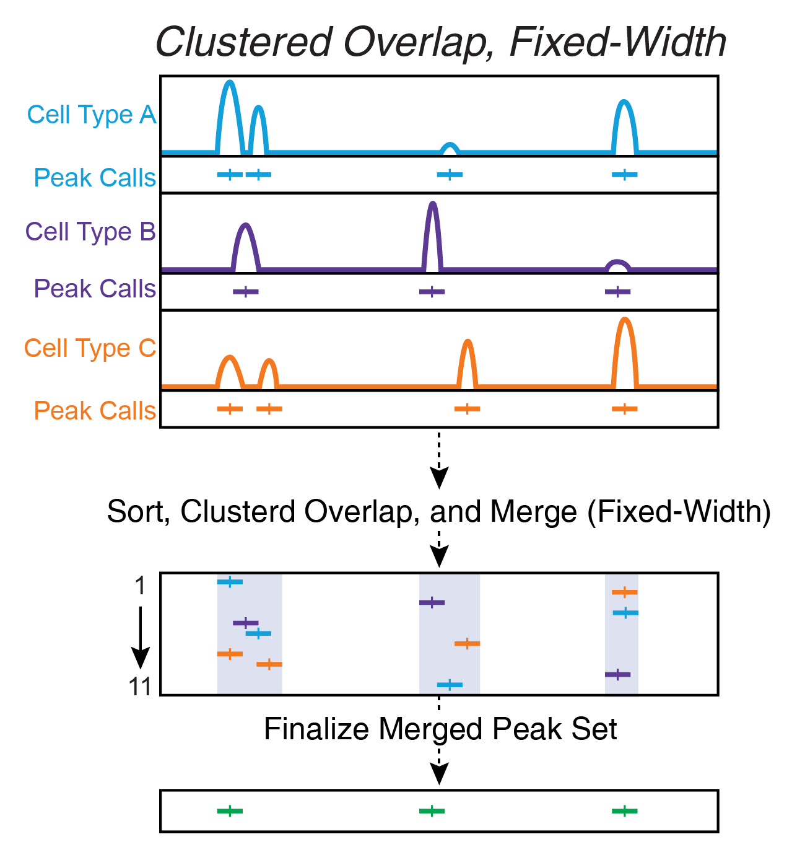
Peak Calling
archrproject.com
Notes:
Clustered overlap takes peaks that cluster together and picks a single winner. this ends up under-calling peaks and misses smaller peaks located nearby.

Slide 7
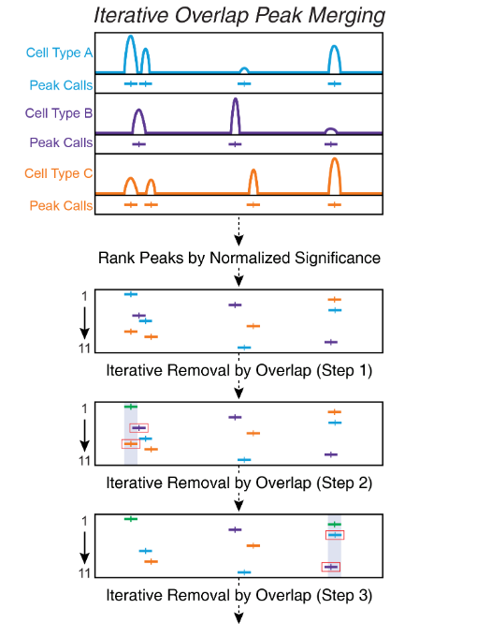
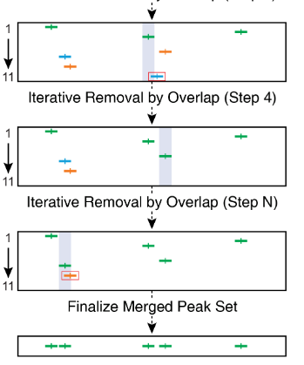
Peak Calling
archrproject.com

Slide 8
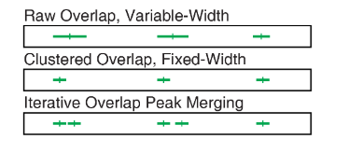
Peak Calling
archrproject.com
Notes:
Imagine a situation where you had 3 cell types, A, B, and C, and each cell type had 3 pseudo-bulk replicates. iterative overlap peak merging procedure. First, ArchR would call peaks for each pseudo-bulk replicate individually. Then, ArchR would analyze all of the pseudo-bulk replicates from a single cell type together, performing the first iteration of iterative overlap removal. It is important to note that ArchR uses a normalized metric of significance for peaks to compare the significance of peaks called across different samples. ArchR checks to see the reproducibility of each peak across pseudo-bulk replicates and only keeps peaks that pass a threshold indicated by the reproducibility parameter. At the end of this process, we would have a single merged peak set for each of the 3 cell types, A, B, and C.
Then, we would repeat this procedure to merge the A, B, and C peak sets. To do this, we re-normalize the peak significance across the different cell types, and perform the iterative overlap removal. The final result of this is a single merged peak set of fixed-width peaks.

Slide 9
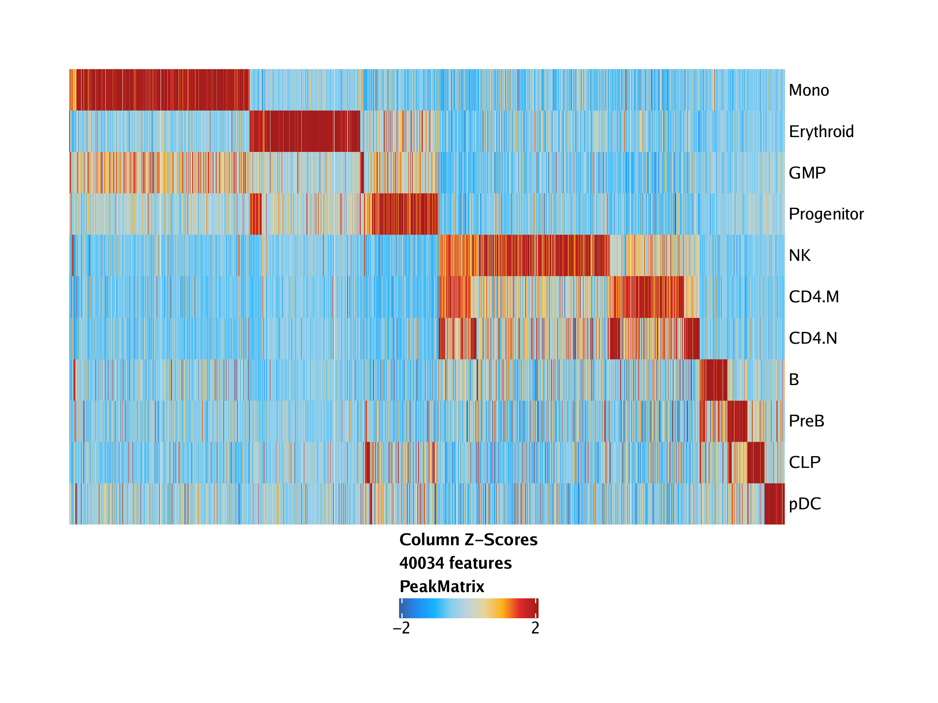
Marker Peaks
archrproject.com
Notes:
we are interested to know which peaks are unique to an individual cluster or a small group of clusters.

Slide 10
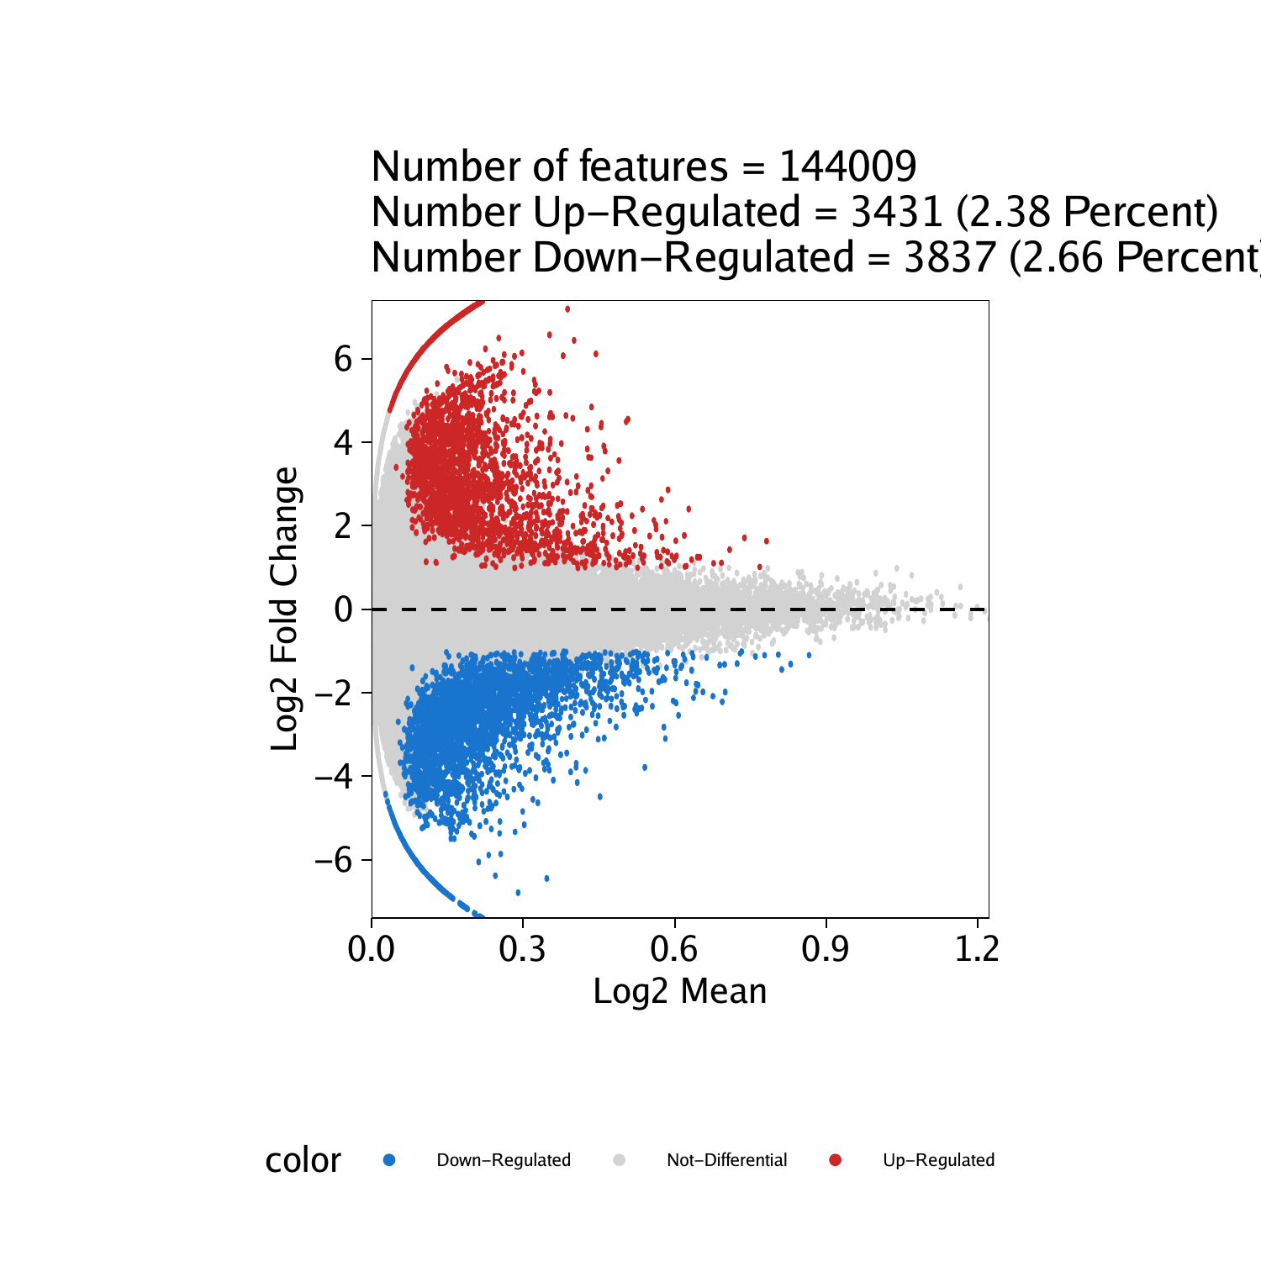
Differential Peaks
archrproject.com
Notes:
we are interested to know which peaks are unique to an individual cluster or a small group of clusters. useGroups = "Erythroid", bgdGroups = "Progenitor"

Slide 11
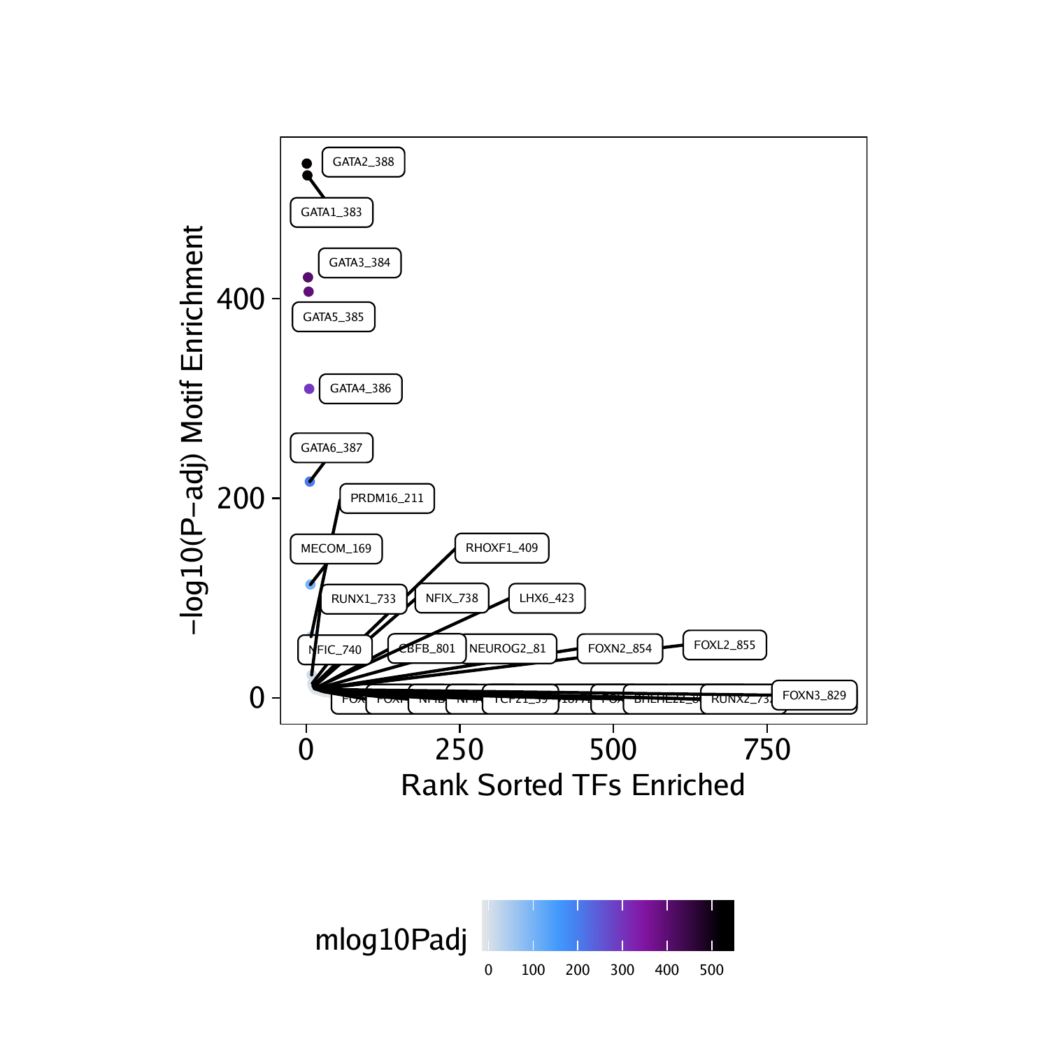
Motif and Feature Enrichment
archrproject.com
Notes:
After identification of a robust peak set, we often want to predict what transcription factors may be mediating the binding events that create those accessible chromatin sites. This can be helpful in assessing marker peaks or differential peaks to understand if these groups of peaks are enriched for binding sites of specific transcription factors.

Slide 12
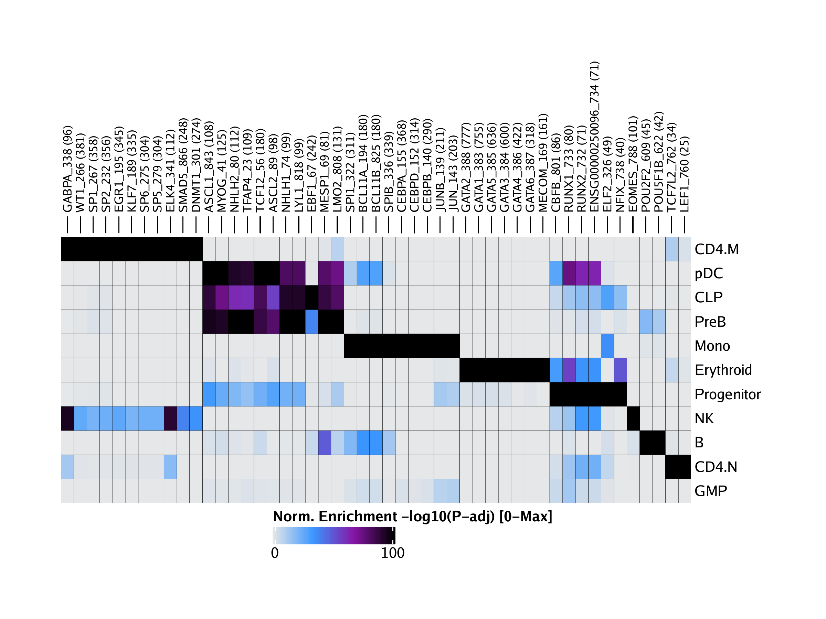
Motif and Feature Enrichment
archrproject.com
Notes:
For example, we often find enrichment of key lineage-defining TFs in cell type-specific accessible chromatin regions. In a similar fashion, we might want to test various groups of peaks for enrichment of other known features. For example, we might want to know if cell type-specific ATAC-seq peaks for cell type A are enriched for another set of genomic regions such as ChIP-seq peaks.

Slide 13
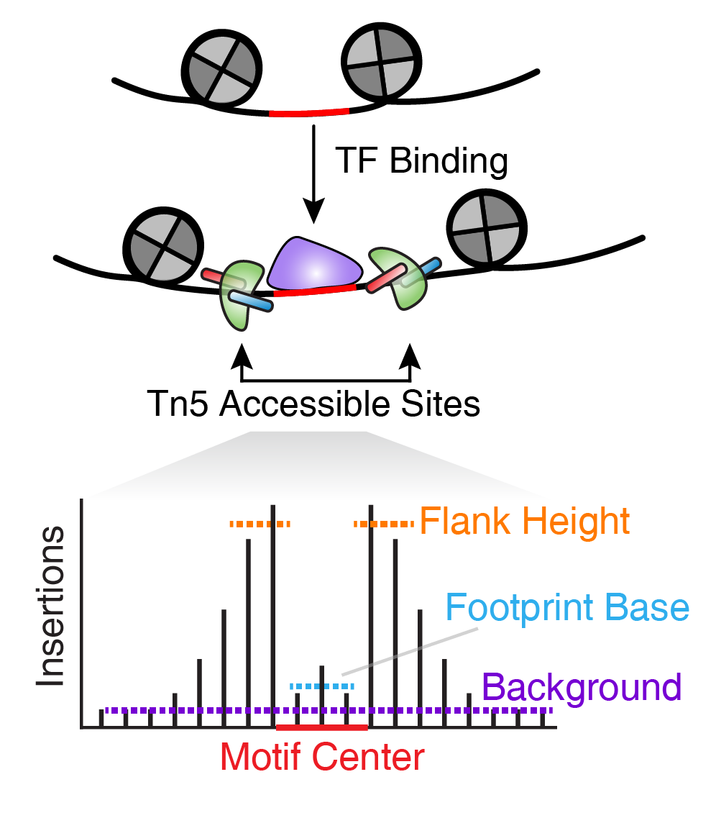
Footprinting
archrproject.com
Notes:
Transcription factor (TF) footprinting allows for the prediction of the precise binding location of a TF at a particular locus. This is because the DNA bases that are directly bound by the TF are actually protected from transposition while the DNA bases immediately adjacent to TF binding are accessible. Ideally, TF footprinting is performed at a single site to determine the precise binding location of the TF.

Slide 14
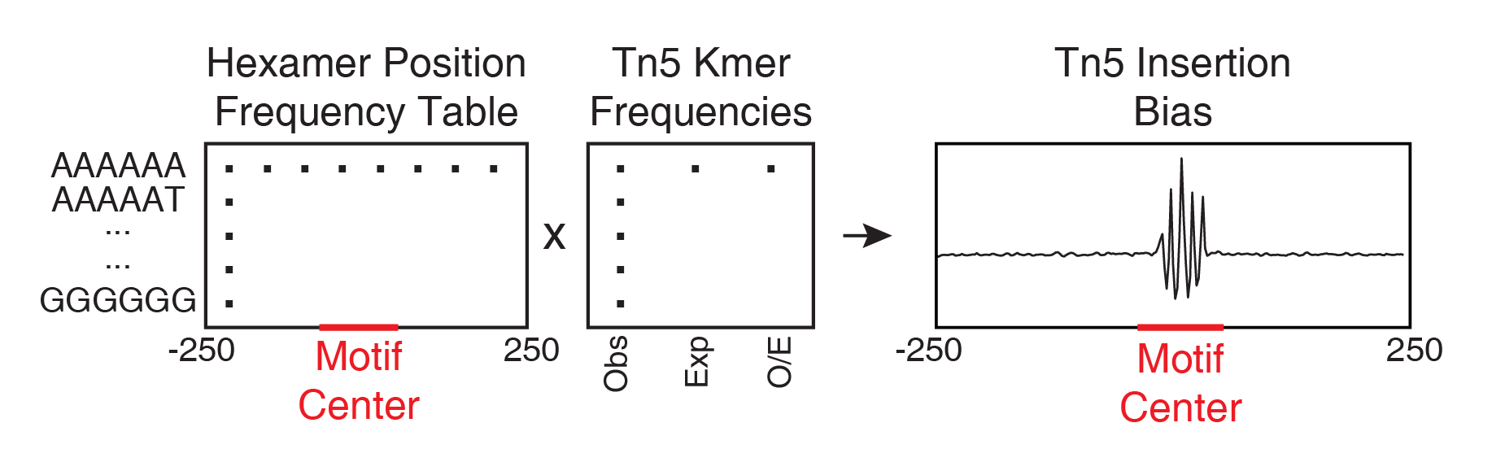
Footprinting
archrproject.com
Notes:
However, in practice, this requires very high sequencing depth, often much higher depth than what most users would obtain from either bulk or single-cell ATAC-seq. To get around this problem, we can combine Tn5 insertion locations across many instances of predicted TF binding. For example, we can take all peaks that harbor a CTCF motif and make an aggregate TF footprint for CTCF across the whole genome.
The accuracy of this footprint relies on generating a reliable curated list of predicted binding sites for the TF of interest. Perhaps most importantly, the footprinting analyses in ArchR account for known Tn5 insertion sequence bias. To do this, ArchR uses a matrix of hexamer position frequencies and a matrix of k-mer frequencies at Tn5 insertion sites: All put together, this workflow generates footprint plots that take into account Tn5 insertion bias.

Slide 15
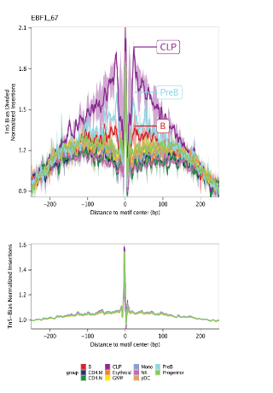
Footprinting
archrproject.com
Notes:
The accuracy of this footprint relies on generating a reliable curated list of predicted binding sites for the TF of interest. Perhaps most importantly, the footprinting analyses in ArchR account for known Tn5 insertion sequence bias. To do this, ArchR uses a matrix of hexamer position frequencies and a matrix of k-mer frequencies at Tn5 insertion sites: All put together, this workflow generates footprint plots that take into account Tn5 insertion bias.

