Slide 1

Single-Cell Bioinformatics Course Tutorial 5
Trajectory inference and cell-cell communication

Slide 2
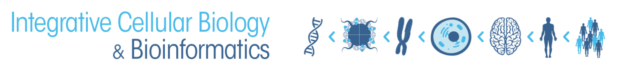
scRNA-Seq Downstream Analysis Workflow
Load Data
QC
Normalize & Scale
PCA & Nearest Neighbor Graph
Clustering
Advanced:
Cluster Marker Analysis
Cell Type Identification
Sub-clustering
Trajectories
Cell Cycle Analysis
Cluster DGE
Low Dimensional Embedding
bigbioinformatics.org/intro-to-scrnaseq

Slide 3
scRNA-Seq Downstream Analysis Workflow
Load Data
QC
Normalize & Scale
PCA & Nearest Neighbor Graph
Clustering
Advanced:
Cluster Marker Analysis
Cell Type Identification
Sub-clustering
Trajectories
Cell Cycle Analysis
Cluster DGE
Low Dimensional Embedding
bigbioinformatics.org/intro-to-scrnaseq

Slide 4
scRNA-Seq Downstream Analysis Workflow
Load Data
QC
Normalize & Scale
PCA & Nearest Neighbor Graph
Clustering
Advanced:
Cluster Marker Analysis
Cell Type Identification
Sub-clustering
Trajectories
Cell Cycle Analysis
Cluster DGE
Low Dimensional Embedding
bigbioinformatics.org/intro-to-scrnaseq

Slide 5
scRNA-Seq Downstream Analysis Workflow
Load Data
QC
Normalize & Scale
PCA & Nearest Neighbor Graph
Clustering
Advanced:
Cluster Marker Analysis
Cell Type Identification
Sub-clustering
Trajectories
Cell Cycle Analysis
Cluster DGE
Low Dimensional Embedding
bigbioinformatics.org/intro-to-scrnaseq

Slide 6
scRNA-Seq Downstream Analysis Workflow
Load Data
QC
Normalize & Scale
PCA & Nearest Neighbor Graph
Clustering
Advanced:
Cluster Marker Analysis
Cell Type Identification
Sub-clustering
Trajectories
Cell Cycle Analysis
Cluster DGE
Low Dimensional Embedding
bigbioinformatics.org/intro-to-scrnaseq

Slide 7
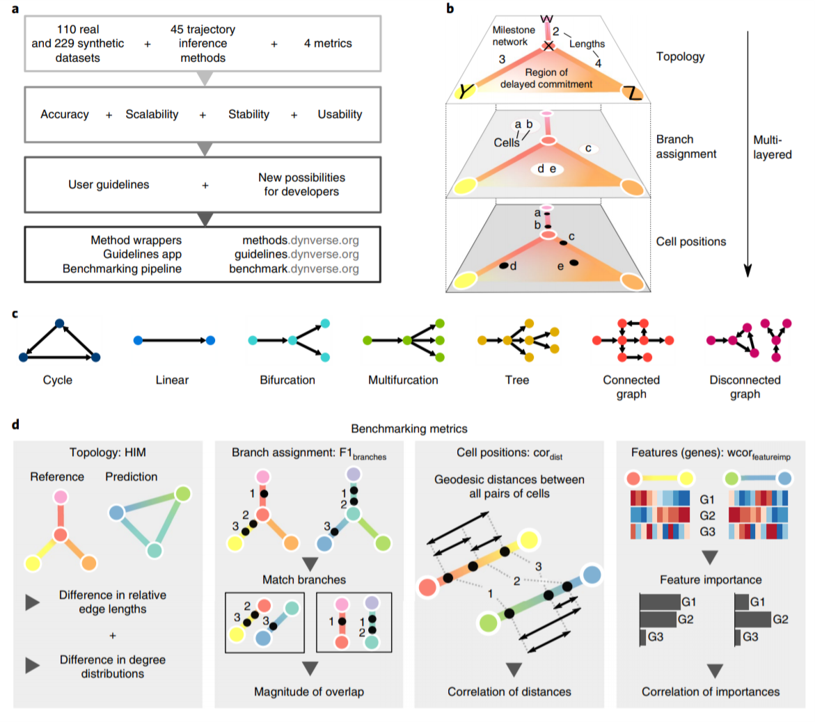
Saelens et al, 2019

Slide 8
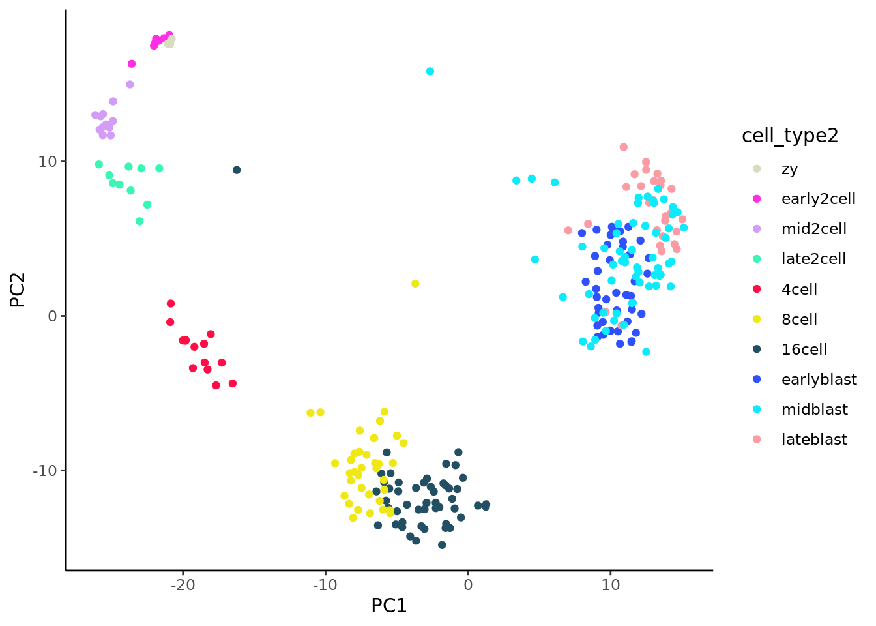
We use statistical methods to order the cells along one or more trajectories which represent the underlying developmental trajectories, this ordering is referred to as “pseudotime”.
Broadinstitute SC workshop 2020

Slide 9
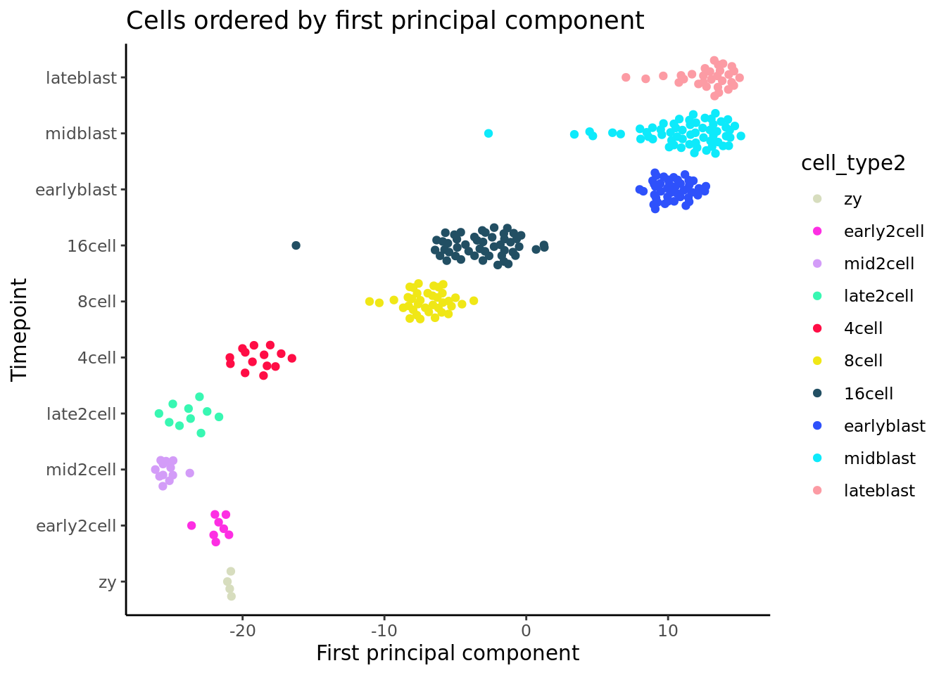
Broadinstitute SC workshop 2020

Slide 10
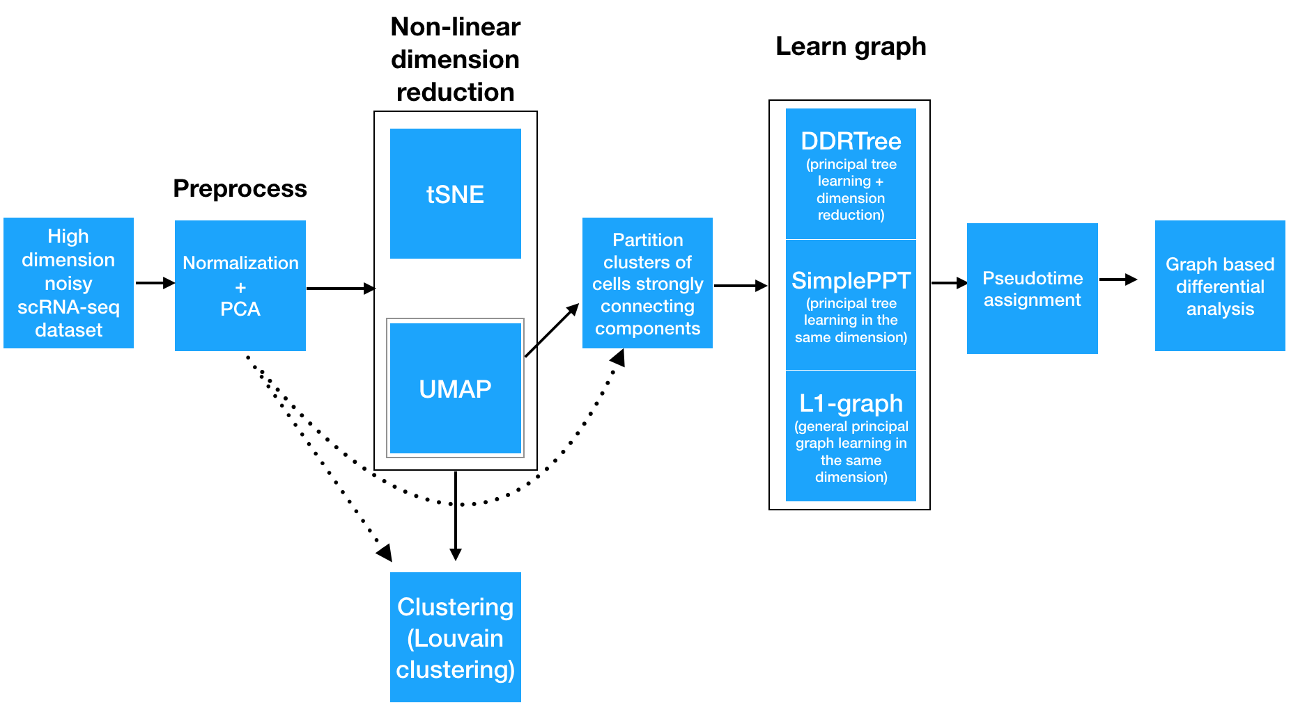
Monocle3
In short, Monocle3 uses UMAP to construct a initial trajectory inference and refines it with learning principal graph.
The pseudotime is calculated for individual cells by projecting the cells to their nearest point on the principal graph edge and measure distance along of principal points to the closest of their root nodes.
cole-trapnell-lab.github.io

Slide 11
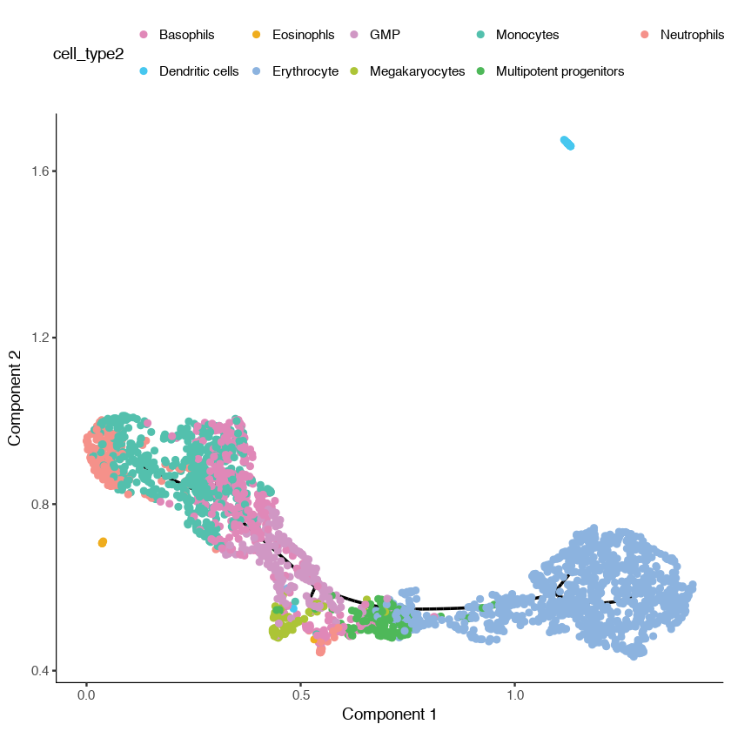
Monocle3
Monocle3 workflow:
Step 1: Normalize and pre-process the data
Step 2: Reduce the dimensionality of the data Step 3: Partition the cells into supergroups Step 4: Learn the principal graph
Step 5: Visualize the trajectory
cole-trapnell-lab.github.io

Slide 12
Monocle3
Monocle 3 allows you to specify an internal part of the tree as the root.
cole-trapnell-lab.github.io

Slide 13
Monocle3
You can specifiy the name of a specific cell or principal graph node as the root by passing it to orderCells().
You can call orderCells() with no root specified and it will open a window for you to select the root(s) with your mouse cursor.
cole-trapnell-lab.github.io
Notes:
Once you select one or more roots, orderCells() computes the shortest path from each cell's location on the princiapl graph to the nearest root node. That is, a cell's pseudotime value is the geodesic distance from it to the nearest root, traveling over the graph. Any cell that is not reachable from some root will be assigned a pseudotime value of infinity.

Slide 14
Monocle3
Or you can do manual selection of root node
cole-trapnell-lab.github.io

Slide 15
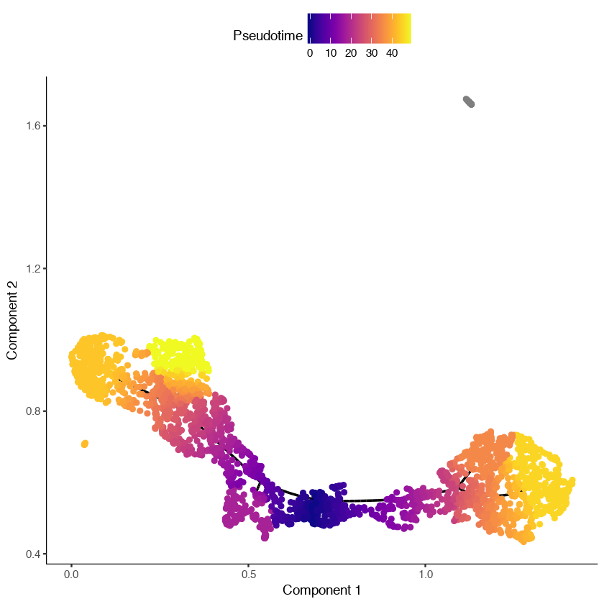
Monocle3
MPP_node_ids = get_correct_root_state(cds,
cell_phenotype = 'cell_type2’,
"Multipotent progenitors")
cds <- orderCells(cds, root_pr_nodes = MPP_node_ids) plot_cell_trajectory(cds)
cole-trapnell-lab.github.io
Notes:
we can see that the dendritic cells have a pseudotime value of infinity (shown in gray) because they are not reachable through the graph from the root we selected.

Slide 16
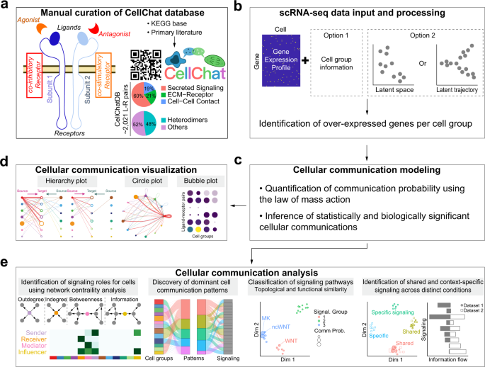
CellChat
nature.com/articles/s41467-021-21246-9

Slide 17

CellChat
CellChat requires two user inputs:
one is the gene expression data of cells,
the other is either user assigned cell labels (i.e., label-based mode) or a low-dimensional representation of the single-cell data (i.e., label-free mode).
nature.com/articles/s41467-021-21246-9

Slide 18
CellChat
CellChat workflow:
Load data and create a CellChat object
Set the ligand-receptor interaction database
nature.com/articles/s41467-021-21246-9

Slide 19
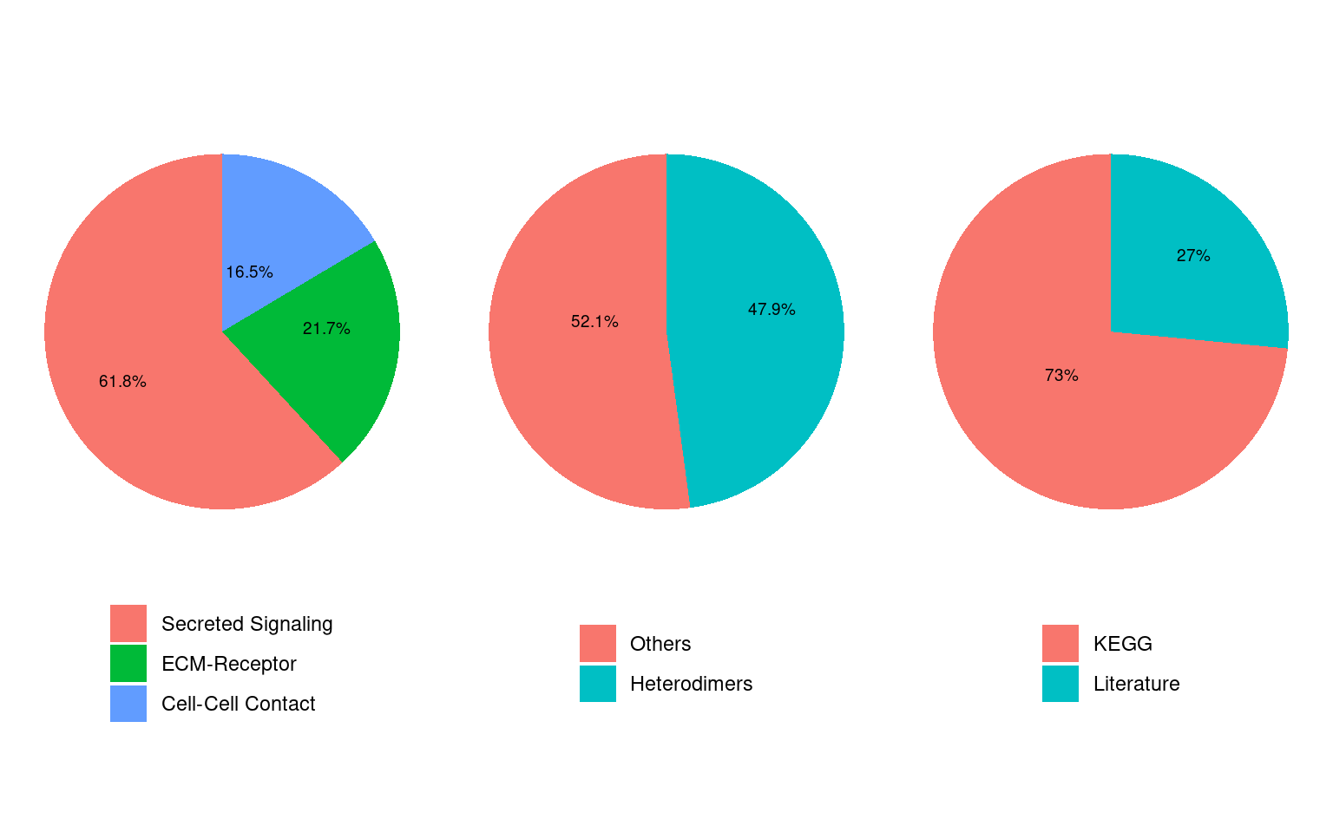
CellChat
CellChat workflow:
Load data and create a CellChat object
Set the ligand-receptor interaction database
CellChatDB <- CellChatDB.human
showDatabaseCategory(CellChatDB)
nature.com/articles/s41467-021-21246-9
Notes:
The database CellChatDB is a manually curated database of literature-supported ligand-receptor interactions in both human and mouse.
CellChatDB in mouse contains 2,021 validated molecular interactions, including 60% of secrete autocrine/paracrine signaling interactions, 21% of extracellular matrix (ECM)-receptor interactions and 19% of cell-cell contact interactions. CellChatDB in human contains 1,939 validated molecular interactions, including 61.8% of paracrine/autocrine signaling interactions, 21.7% of extracellular matrix (ECM)-receptor interactions and 16.5% of cell-cell contact interactions.

Slide 20
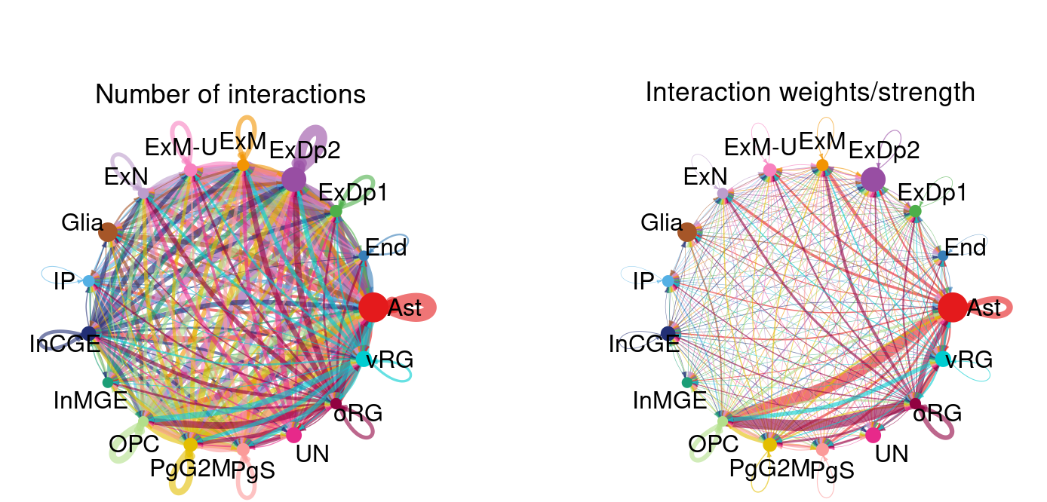
CellChat
CellChat workflow:
Load data and create a CellChat object
Set the ligand-receptor interaction database
Compute the communication probability and infer cellular communication network
nature.com/articles/s41467-021-21246-9
Notes:
CellChat infers the biologically significant cell-cell communication by assigning each interaction with a probability value and peforming a permutation test. CellChat models the probability of cell-cell communication by integrating gene expression with prior known knowledge of the interactions between signaling ligands, receptors and their cofactors using the law of mass action.
The number of inferred ligand-receptor pairs clearly depends on the method for calculating the average gene expression per cell group. By default, CellChat uses a statistically robust mean method called ‘trimean’, which produces fewer interactions than other methods.

Slide 21
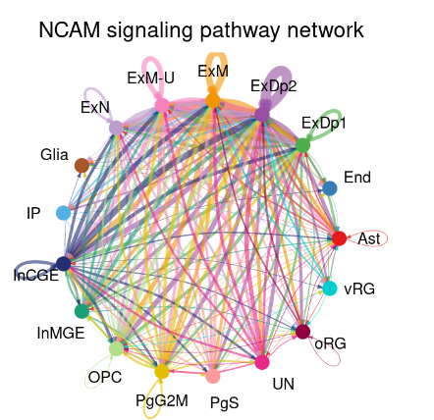
CellChat
CellChat workflow:
Load data and create a CellChat object
Set the ligand-receptor interaction database
Compute the communication probability and infer cellular communication network
Visualize each signaling pathway using Hierarchy plot, Circle plot or Chord diagram
pathways.show <- c("NCAM")
par(mfrow=c(1,1))
netVisual_aggregate(cellchat, signaling = pathways.show, layout = "circle")
nature.com/articles/s41467-021-21246-9
Notes:
It provides several ways for visualizing cell-cell communication network, including hierarchical plot, circle plot, Chord diagram, and bubble plot.
It can quantitatively characterize and compare the inferred cell-cell communication networks using an integrated approach by combining social network analysis, pattern recognition, and manifold learning approaches.

Slide 22
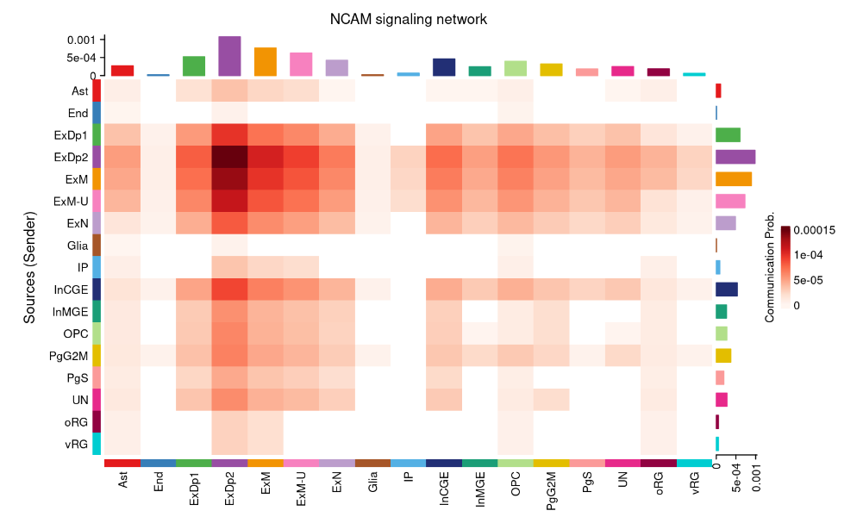
netVisual_heatmap(cellchat, signaling = pathways.show, color.heatmap = "Reds")
CellChat
nature.com/articles/s41467-021-21246-9

