Slide 1

Single-Cell Bioinformatics Course Tutorial 3
QC, Batch effects

Slide 2
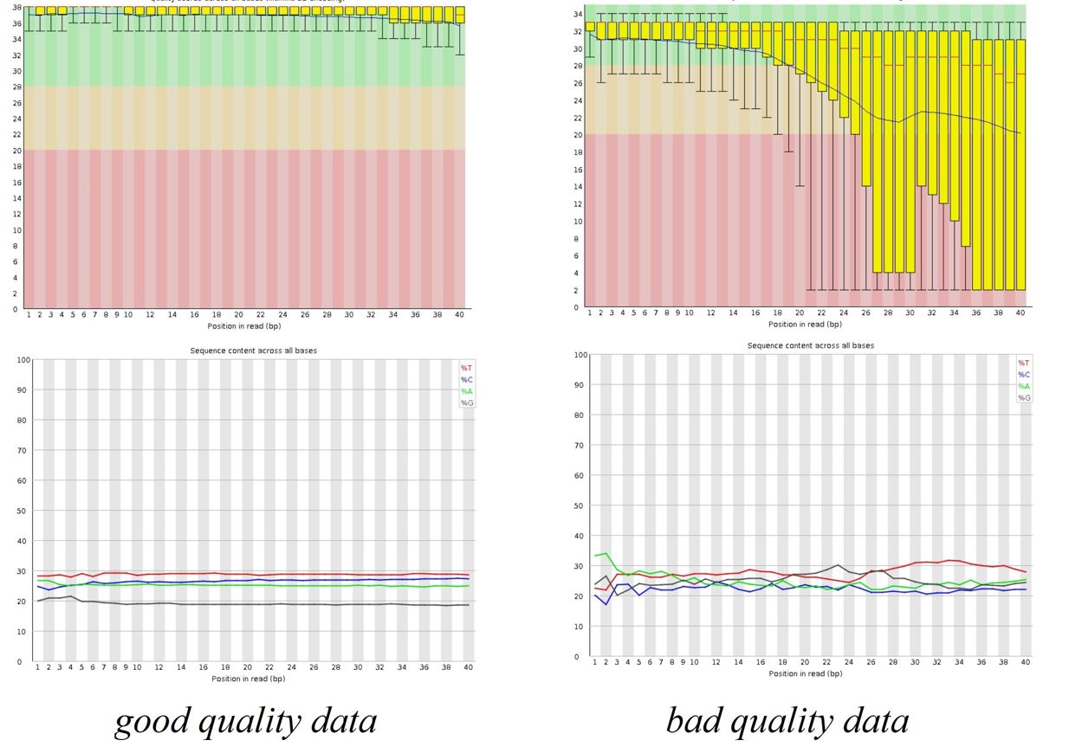

FASTQC

Slide 3
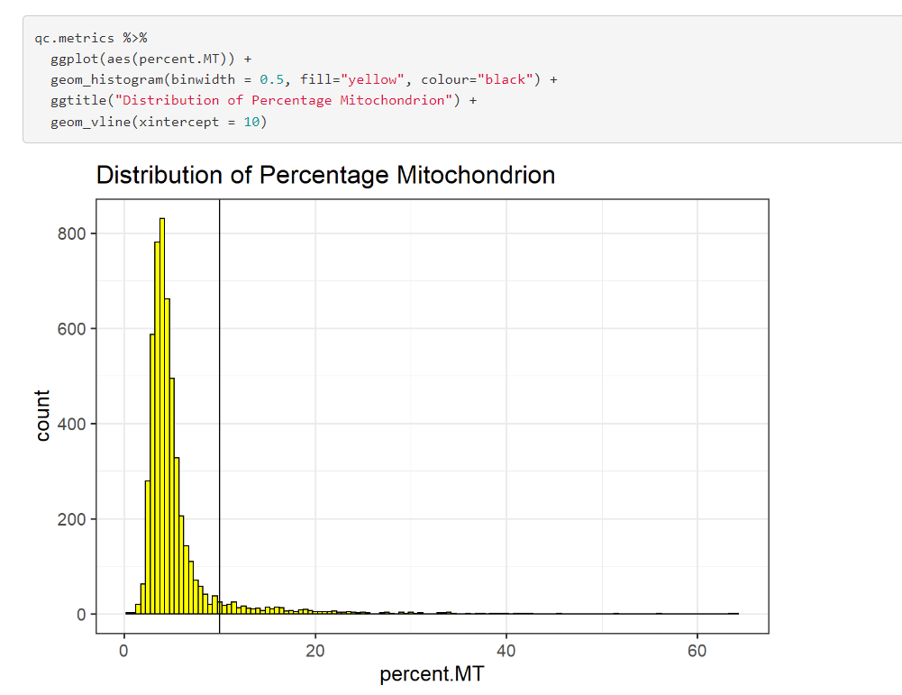
We might consider cells to be low quality if they have library sizes below 100,000 reads; express fewer than 5,000 genes; have spike-in proportions above 10%; or have mitochondrial proportions above 10%.

Slide 4
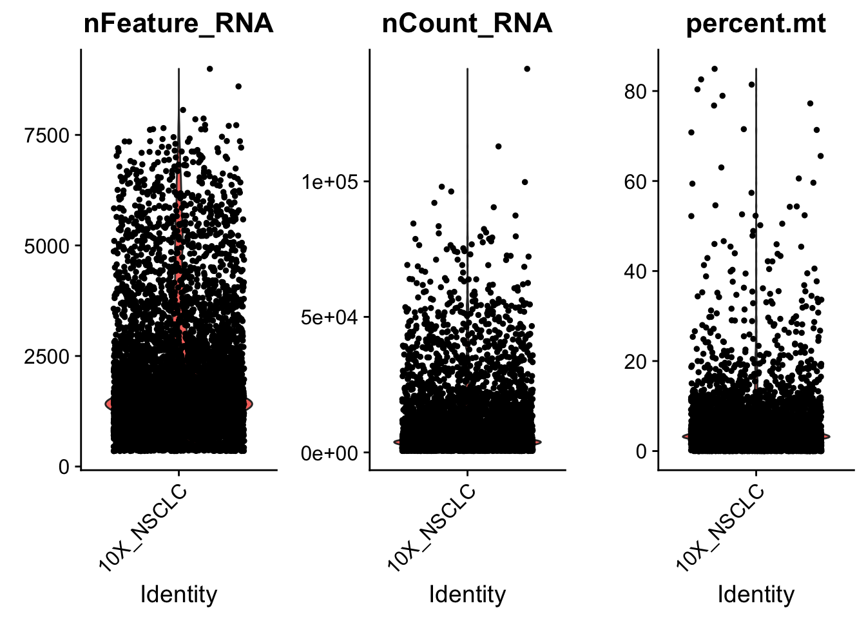
nCount_RNA the total number of reads (or more correctly UMIs) in the dataset
nFeature_RNA the number of observed genes (anything with a nonzero count)
Broadinstitute SC workshop 2020

Slide 5
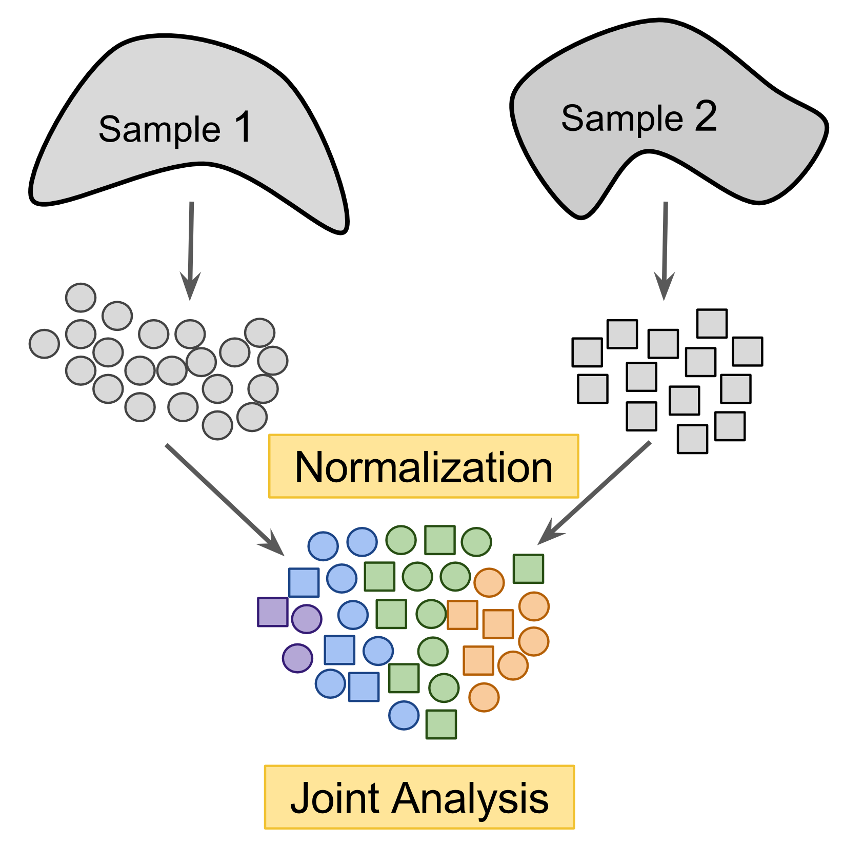
Broadinstitute SC workshop 2020

Slide 6

Batch Correction
10xgenomics.com

Slide 7
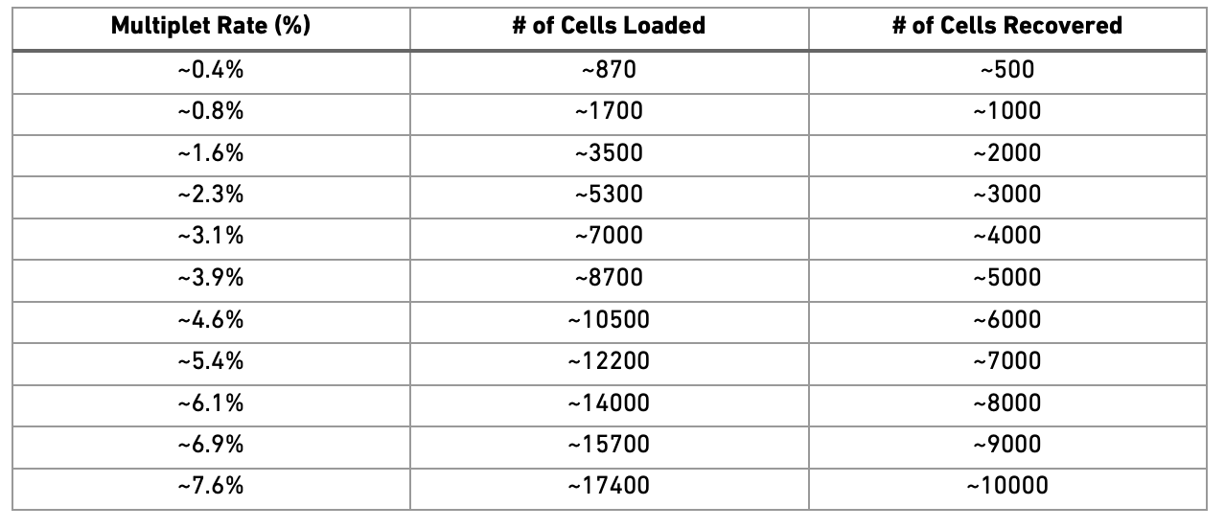
Doublet Detection

Slide 8
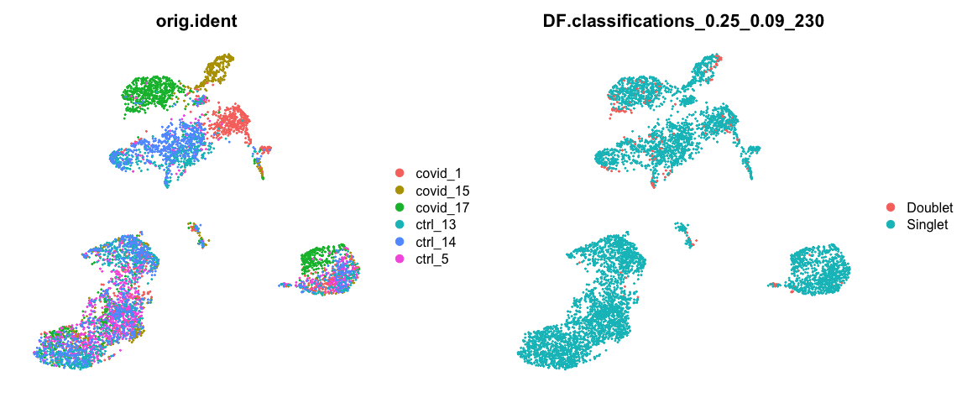
Doublet Detection

