Slide 1
Single-Cell Bioinformatics Tutorial : 11

Slide 2
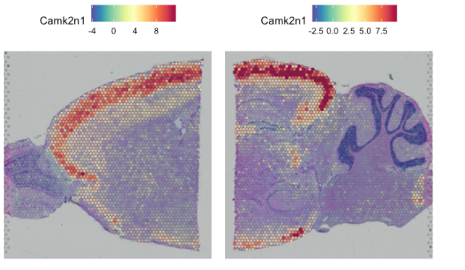
Identification of Spatially Variable Features
2
markers <- FindMarkers/ FindAllMarkers
#find top 3 markers intermediate step
# plot top markers
SpatialFeaturePlot(object = slice1, features = markers alpha = c(0.1, 1), ncol = 3)

Slide 3
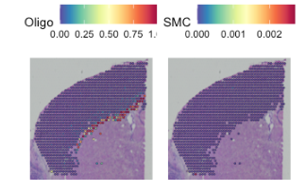
Deconvolution
Most deconvolution methods does a prior gene selection and there are different options that are used:
Use variable genes in the SC data.
DE genes between clusters in the SC data.
Notes:
For SCDC we want to find a we unique markers per cluster, so we select top 20 DEGs per cluster. Ideally you should run with a larger set of genes, perhaps 100 genes per cluster to get better results. However, for the sake of speed, we are now selecting only top20 genes and it still takes about 10 minutes to run.

Slide 4
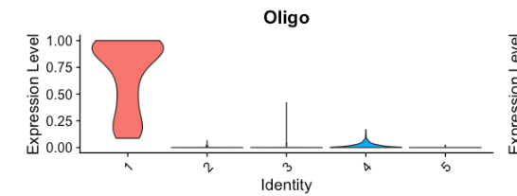
Deconvolution
Notes:
Keep in mind that the deconvolution results are just predictions, depending on how well your scRNAseq data covers the celltypes that are present in the ST data and on how parameters, gene selection etc. are tuned you may get different results.

Slide 5
Thank you ☺

