Slide 1
Tricks in SytheticAngio

Slide 2
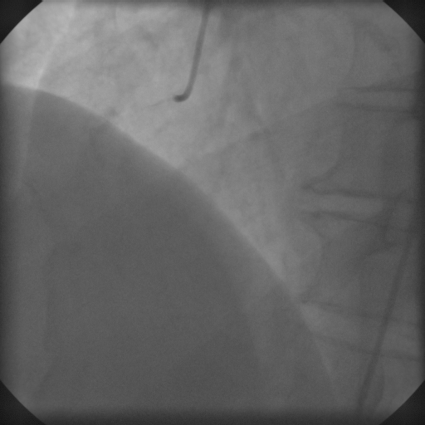
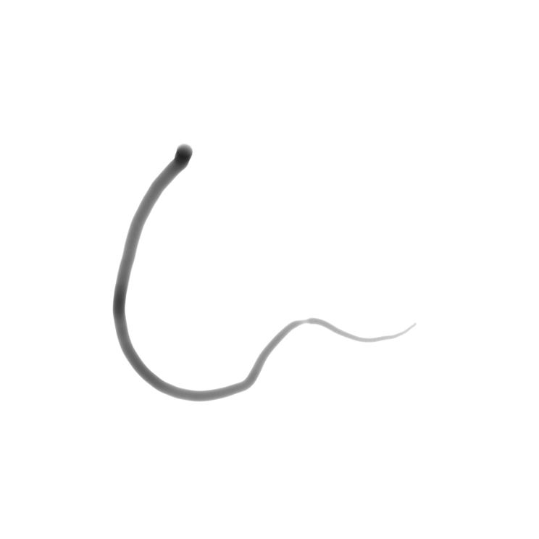
y
t
x
s

Slide 3
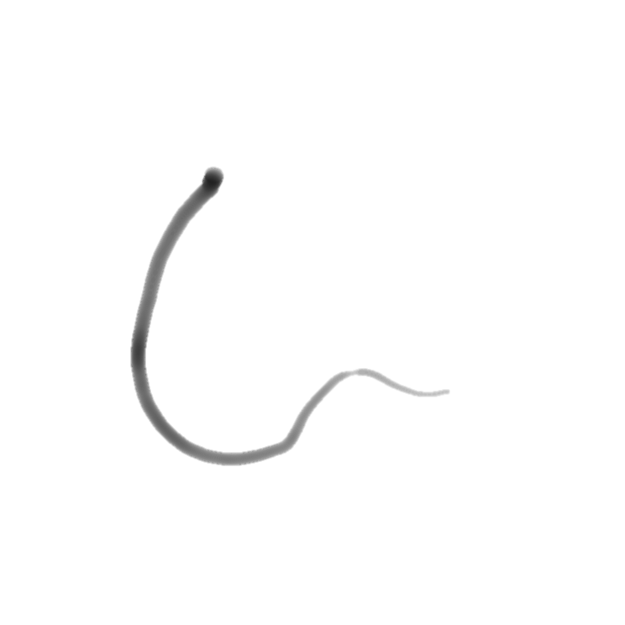
First, initiate an empty (512, 512) image with all 1 (white), resize the rhino vessel image to (512, 512).
t
y
x
s
Second, crop the rhino vessel image.
Third, assign the cropped image to the empty image.

Slide 4
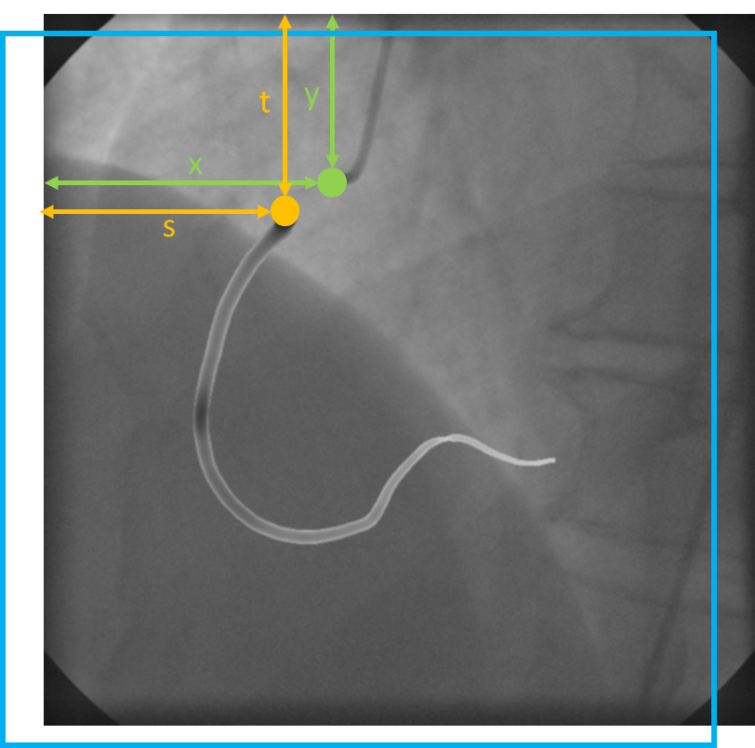
y
x
width
height
Crop rectangular = [x, y, width, height]
Should be [max(s-x,0)+1 max(t-y, 0)+1 512-abs(x-s) 512-abs(y-t)]

Slide 5
y_start
y_end
x_start
width
height
x_end
Assign Slice Index = (x_start:x_start+height-1, y_start:y_start +weight-1)
(max(0, y-t)+1:512-abs(y-t), max(0, x-s)+1:512-abs(x-s))

Slide 6
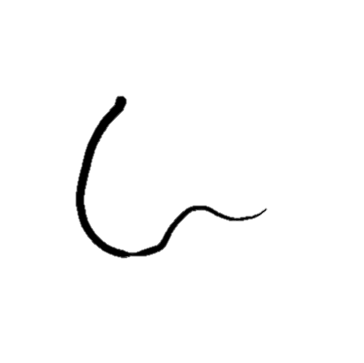
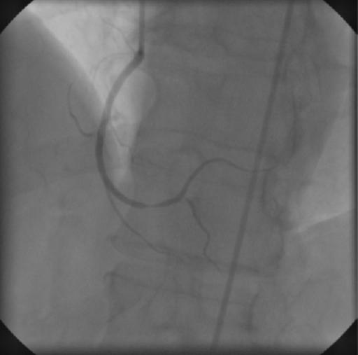
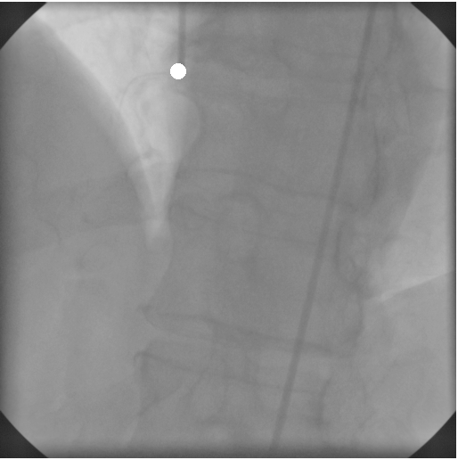
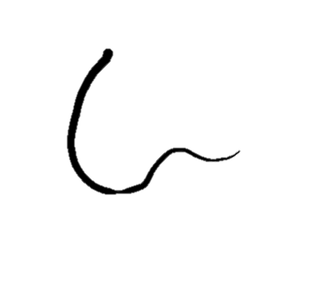
T-Y
Y=79
X=201
T=140
S=170

Slide 7
