Slide 1
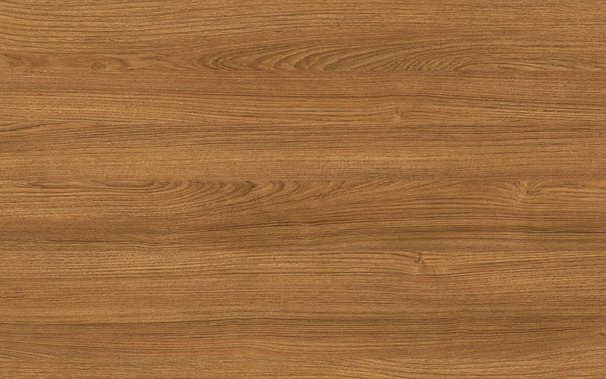
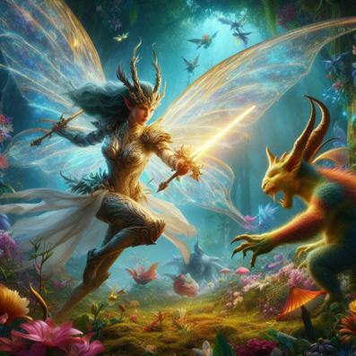
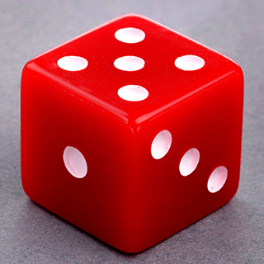
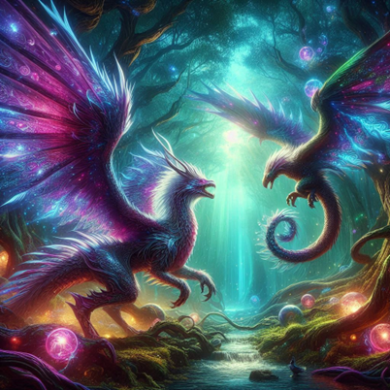
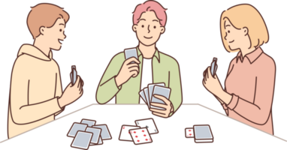
MoodBoard

Slide 2
MoodBoard
Wooden background for the interface. The users would feel like they were playing the card game on an actual table.
We choose a light brown color with a less obvious grain.
Solid red for the buttons, with gray borders and black font
We wanted it to resemble red dices. It was bold because we wanted users to quick recognize where the control buttons were on their screens.
Red(#ff0000), Gray(#546178), Black(#000000)
We chose these bright colors for our cards to amplify the fantasy theme.
Light cornflower blue(#5e91eb), green (#27da25), light red (#e3458c) and dark orange (#fe9d41)
We wanted the game to feel fun, even if it had a high learning curve and was being played against the computer.

