Slide 1
Multi-Horizon Financial Forecasting
with Uncertainty
Track 2 — Time-Series: GRU/LSTM vs Transformer + Ensembles
Student: Yernur Bidollin and Zinetov Alikhan IT-2301 • Course: Deep Learning • Date: 09.02.2026
Notes:
[Sources]
- (none)
[/Sources]

Slide 2
Problem & Contributions
What we predict and why it matters
Problem
What we deliver (Track 2)
Forecast future market movement from historical OHLCV features
Multi-horizon targets: h = {1, 5, 20} trading days
Predict log-returns (more stable than raw prices)
Need uncertainty for risk-aware decisions
Sequence baseline: GRU with temporal attention
Transformer encoder comparison
Regularization: dropout + weight decay
Uncertainty: deep ensembles (K=1 vs K=5)
Ablations + naive baselines + visualizations
Template: replace <...> placeholders; keep slides ≤ 10 minutes.
Notes:
[Sources]
- (none)
[/Sources]

Slide 3
Data
Source, timeframe, and leakage-safe split
Dataset
Asset: SPY (S&P 500 ETF), daily OHLCV
Date range: 2010-01-01 → 2026-02-08 (approx. 4k+ trading days)
Source: Yahoo Finance via yfinance (cached to data/raw)
Time split (no leakage)
Targets
Split
Dates
For each time t and horizon h:
y(t,h) = log( Close(t+h) / Close(t) )
Train
≤ 2022-12-31
Val
2023-01-01 … 2023-12-31
H = {1, 5, 20} days
Output is a 3-dim vector per sample
Test
≥ 2024-01-01
Why: preserves chronology and avoids future information leakage.
fin-ts-forecast-uncertainty
Notes:
[Sources]
- (none)
[/Sources]

Slide 4
Feature Engineering
Inputs, windowing, and scaling
Feature set (examples)
Windowing + scaling
log_ret_1 (daily log-return)
hl_spread, oc_change
RSI(14)
Rolling mean/std of returns (5/10/20/60)
Volume z-score (5/10/20/60)
MA/EMA on Close (5/10/20/60)
Lookback window length: L = 60 days
Input tensor per sample: [L × D]
StandardScaler fit on training windows only
Pipeline
Raw OHLCV → Features → Scale → Window → Model → (µ, σ)
Note: time-based split prevents leakage.
fin-ts-forecast-uncertainty
Notes:
[Sources]
- (none)
[/Sources]

Slide 5
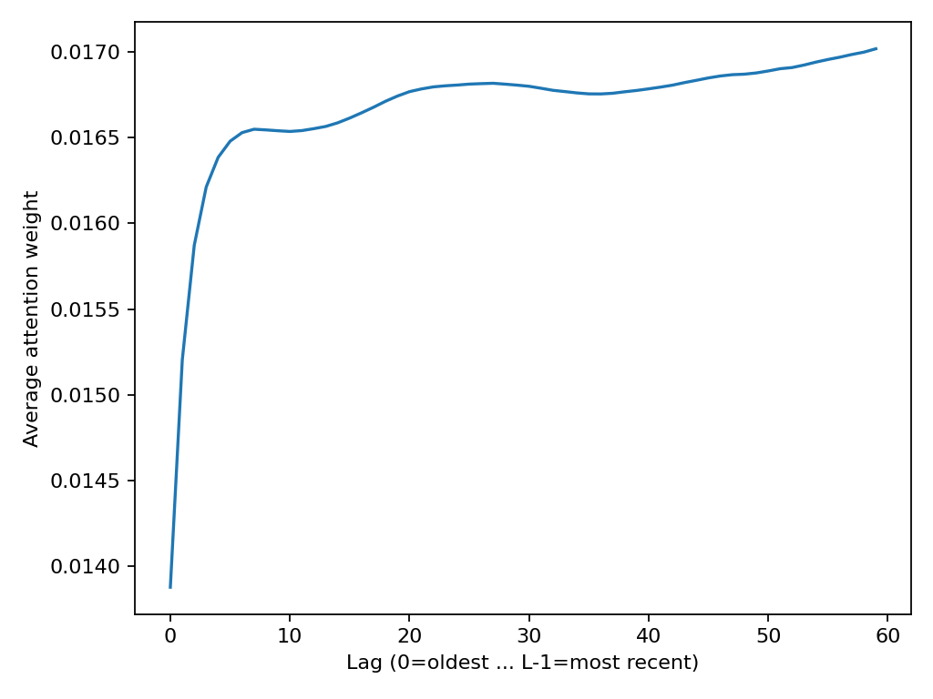
Model 1 — GRU + Temporal Attention
Sequence baseline
Architecture
Interpretability
GRU encoder over L=60 timesteps
Dropout on hidden states
Attention pooling over time (weights α₁…α_L)
Linear head → 3 horizons
Plot average attention weights to see which lags matter
Tip: explain mild preference for recent days.
Output
Insert: attention_avg.png
ŷ = [ŷ₁, ŷ₅, ŷ₂₀] (multi-horizon log-returns)
fin-ts-forecast-uncertainty
Notes:
[Sources]
- (none)
[/Sources]

Slide 6
Model 2 — Transformer Encoder
Self-attention baseline
Architecture
Why compare?
Linear projection to d_model
Positional encoding
N encoder layers (self-attention + FFN)
Pooling (mean) + linear head → 3 horizons
Track requirement: compare sequence model vs Transformer
Self-attention can capture long-range patterns
Often needs careful tuning for noisy returns
Still useful as a strong modern baseline
Note for discussion:
In our run, Transformer degraded at h=20; explain as tuning/pooling issue.
fin-ts-forecast-uncertainty
Notes:
[Sources]
- (none)
[/Sources]

Slide 7
Uncertainty Estimation
Deep ensembles (K models)
Method
Calibration (coverage)
Train K independent GRU models (different seeds)
Prediction mean: μ = average of ŷᵏ
Uncertainty: σ = std across models
90% interval: μ ± 1.645·σ
Horizon
Cov@90
Comment
1
0.943
Good / slightly conservative
5
0.789
Under-coverage
20
0.465
Strong under-coverage
Ablation: K=1 vs K=5
Takeaway: long-horizon returns are noisier → intervals need calibration.
K=1 gives σ≈0 → zero-width intervals; K=5 provides meaningful intervals.
fin-ts-forecast-uncertainty
Notes:
[Sources]
- (none)
[/Sources]

Slide 8
Results
Test-set performance (SPY, horizons 1/5/20)
Model comparison (mean across horizons)
Model
MAE_mean
RMSE_mean
DirAcc_mean
Cov@90
GRU + Attention (single)
0.0231
0.0302
0.6029
—
Transformer Encoder
0.0466
0.0570
0.4425
—
Deep Ensemble (GRU, K=5)
0.0192
0.0252
0.4970
0.7324
Naive mean-return baseline
0.0173
0.0230
0.6410
—
Baselines can be very competitive for returns (low signal-to-noise).
Ensemble improves MAE/RMSE and enables uncertainty intervals.
Transformer needs more tuning for long-horizon (h=20) returns.
fin-ts-forecast-uncertainty
Notes:
[Sources]
- (none)
[/Sources]

Slide 9
Ablations & Baselines
What matters most
Ablations (GRU family)
Naive baselines
Variant
MAE
RMSE
DirAcc
Baseline
MAE
RMSE
DirAcc
Default (p=0.2, wd=1e-4)
0.0231
0.0302
0.6029
Zero return
0.0175
0.0230
0.0000
Dropout=0
0.0216
0.0285
0.5641
Last return
0.0191
0.0263
0.5155
WeightDecay=0
0.0231
0.0302
0.6029
Mean return (lookback)
0.0173
0.0230
0.6410
Ensemble K=5
0.0192
0.0252
0.4970
Interpretation: dropout trades MAE/RMSE vs sign accuracy; WD effect small here.
Important: report strong baselines in finance
Returns are hard → simple mean can be competitive
fin-ts-forecast-uncertainty
Notes:
[Sources]
- (none)
[/Sources]

Slide 10
Conclusion
Key takeaways + next steps
Takeaways
GRU baseline satisfies Track 2 and performs strongly on directional accuracy
Transformer baseline underperformed at long horizon (needs tuning)
Deep ensembles improve MAE/RMSE and provide uncertainty intervals
Long-horizon uncertainty is under-calibrated → calibration is a key future work item
Naive baselines are competitive; always report them in financial forecasting
Thank you!
Notes:
[Sources]
- (none)
[/Sources]

