Slide 1
Provable Robustness of GCN

Slide 2
Outlines
Attack approaches for graph structure perturbation
Problem we want to prove
Optimize on graph structure
Abstract Interpretation
Compare with existing recent work

Slide 3
Deep Learning on Graphs
GNN is the state-of-art on tasks such as
Semi-supervised node classification
Link prediction
Unsupervised representation learning (e.g., node embeddings)
Notes:
GNN is very popular these days.

Slide 4
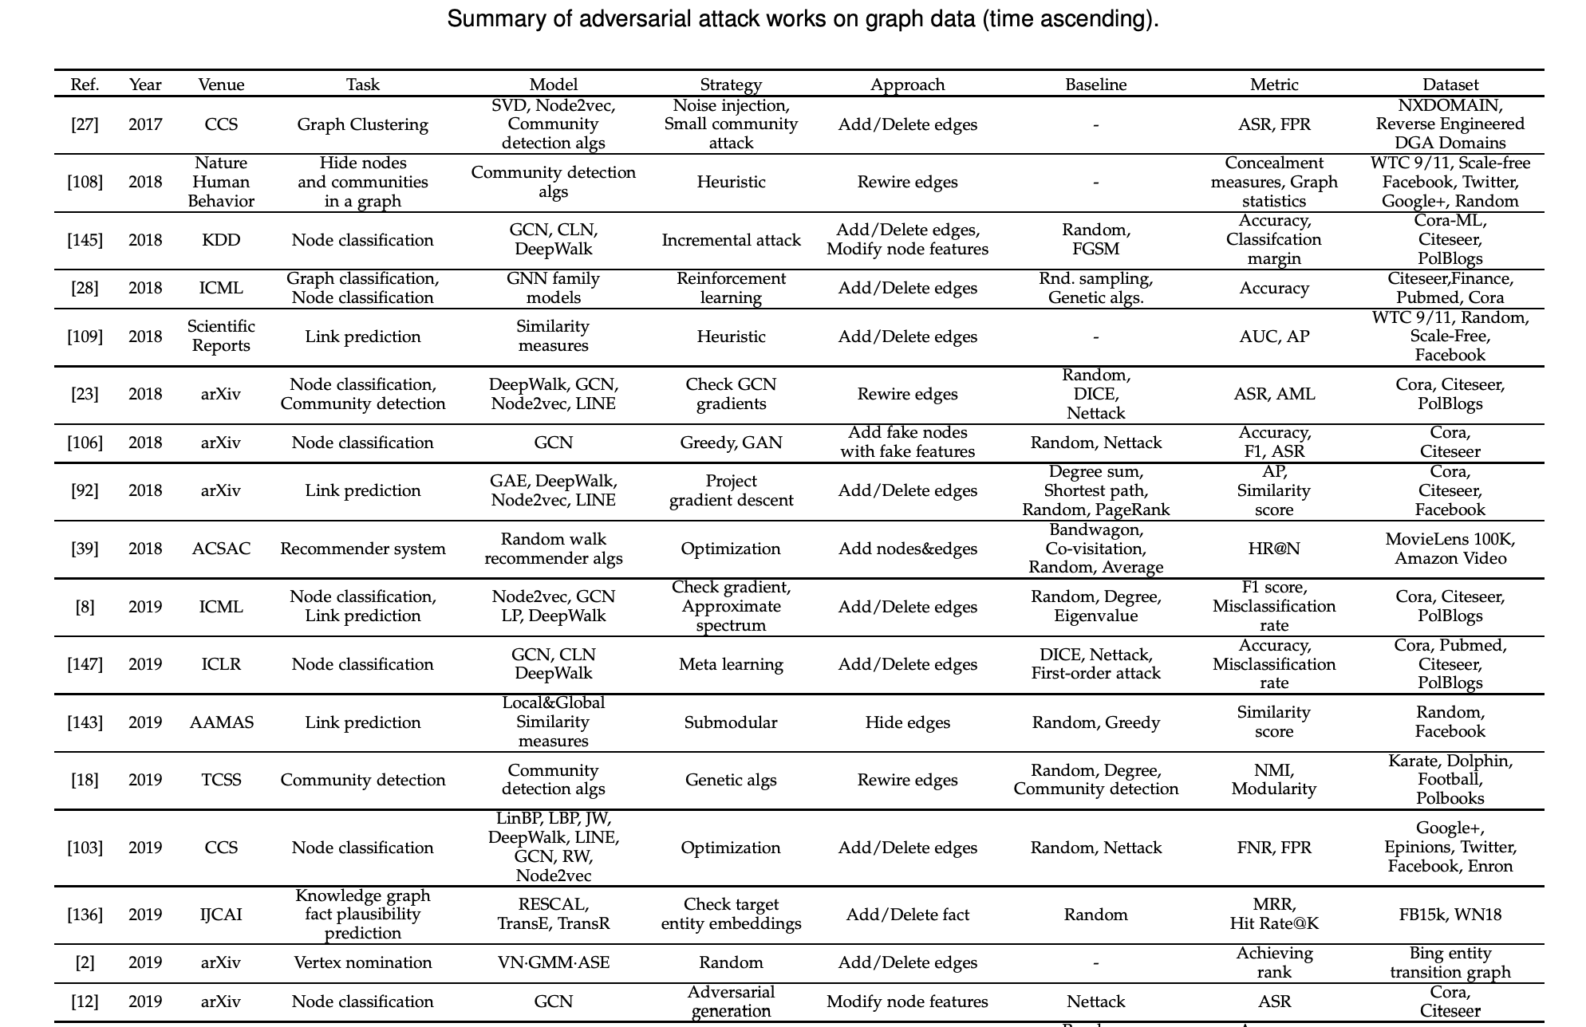
Graph Neural Networks are not robust
Cited from Lichao, Bo et. al.

Slide 5
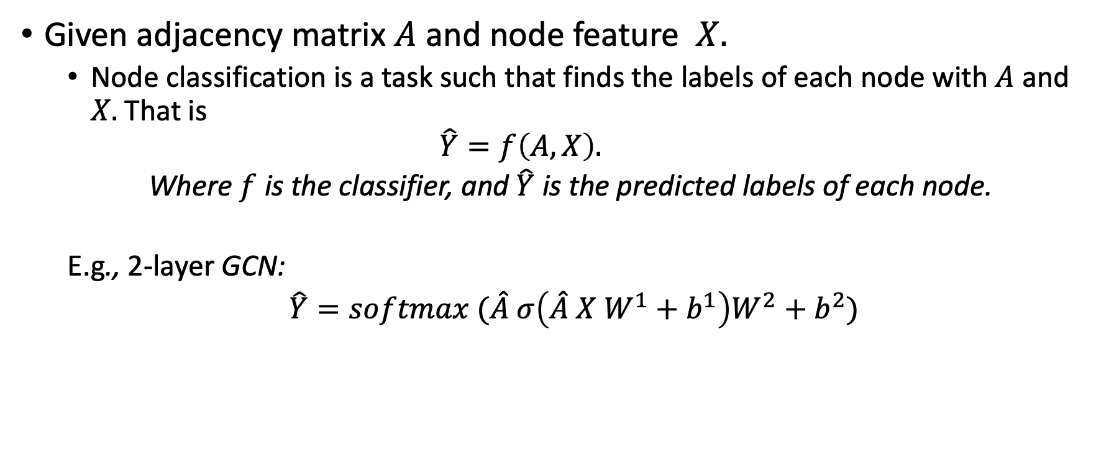
GNN Node Classification
Given adjacency matrix $A$ and node feature $X.$
Node classification is a task such that finds the labels of each node with $A$ and $X.$That is
$$\hat{Y}=f\left(A, X\right).$$
Where $f$is the classifier, and $\hat{Y}$is the predicted labels of each node.
E.g., 2-layer GCN:
$\hat{Y}=softmax (\hat{A} σ\left(\hat{A} X W^{1}+{ b}^{1}\right)W^{2}+b^{2})$
Notes:
Before I introduce the concerate works, I will define the task

Slide 6
Perturbations
?
Node attribute
perturbation
?
?
Graph structure
perturbation
Notes:
Then Iet's see some general ideas on attacking the graph neural network.

Slide 7
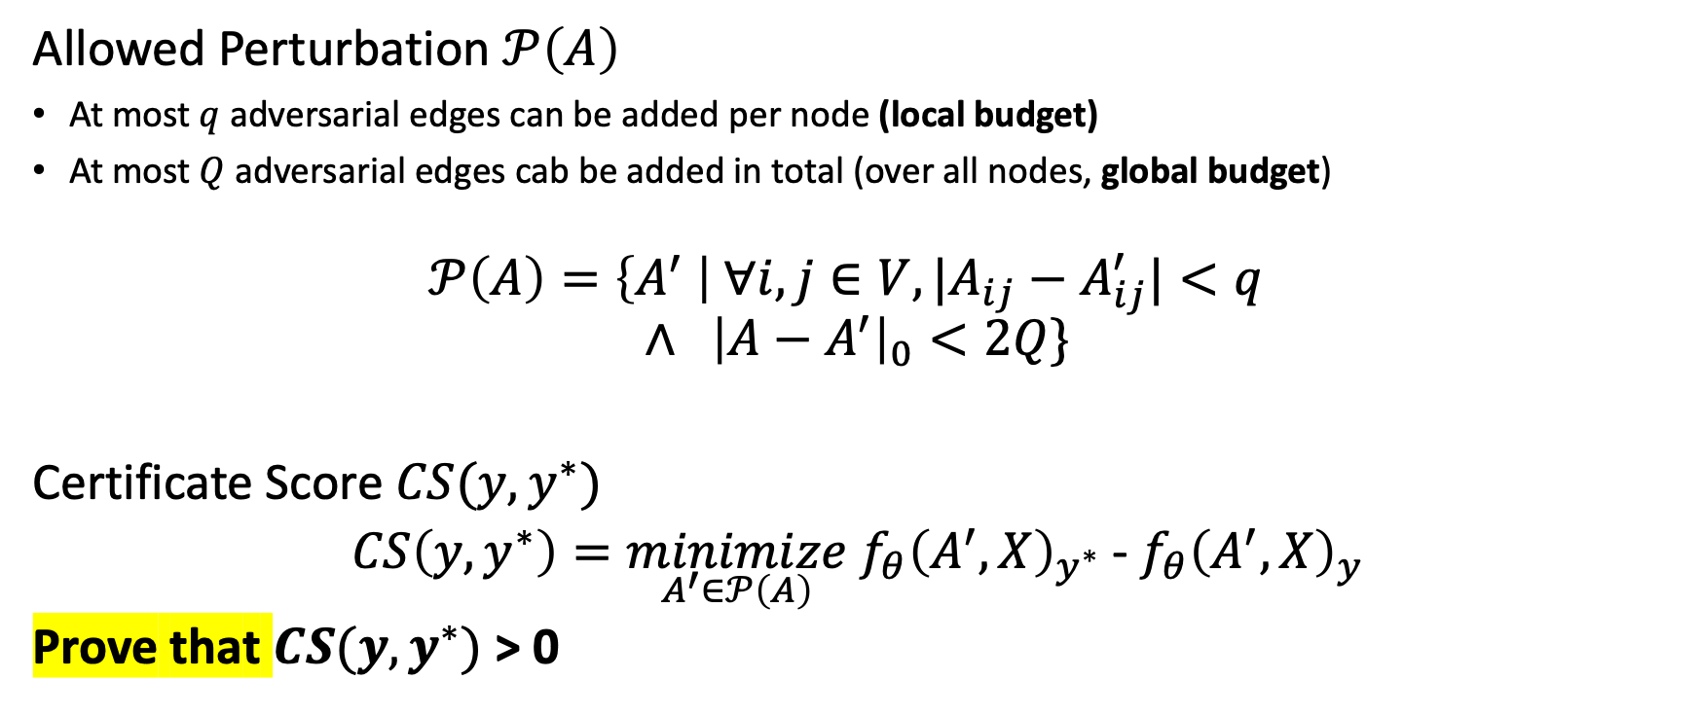
Graph Structure Perturbation
Allowed Perturbation $𝒫\left(A\right)$
At most $q$ adversarial edges can be added per node (local budget)
At most $Q$ adversarial edges cab be added in total (over all nodes, global budget)
$$𝒫\left(A\right)=\left\{A^{′} \right| {∀i, j∈V, |A}_{ij}−A_{ij}^{′}|<q$$
$$∧ {\left|A−A^{′}\right|}_{0}<2Q\}$$
Certificate Score $CS(y, y^{∗})$
$CS\left(y, y^{∗}\right)=\underset{A^{′}∈𝒫\left(A\right)}{minimize} f_{θ}{\left(A^{′}, X\right)}_{y^{∗}}$ - $f_{θ}{\left(A^{′}, X\right)}_{y}$
Prove that $CS(y, y^{∗})$ > 0
Notes:
in this work, I mainly focus on the graph structure perturbation. Actually, you will see this approach can be easily extended to the the node attribute perturbation. But I just run it on the structure perturbation for now. Anyway, let's define the proving problem first.
First, we need to define the allowed pertubation set.
Certificate Score

Slide 8
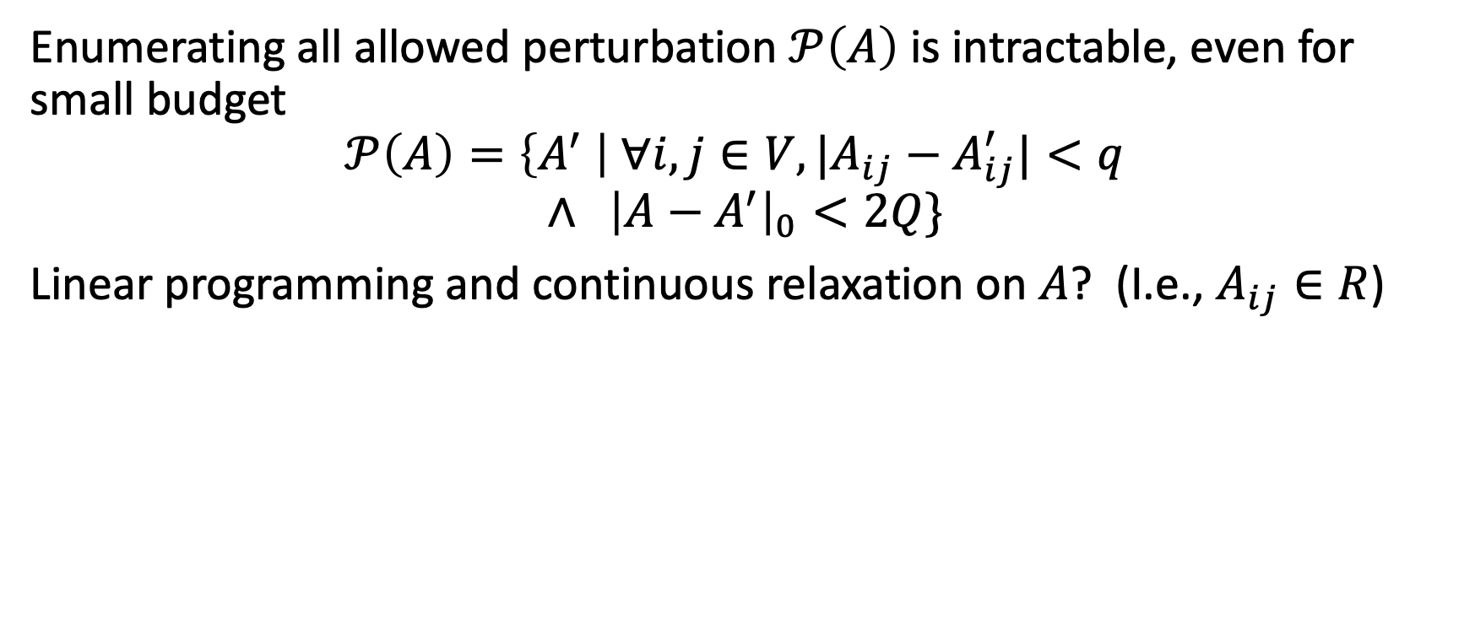
Optimize on Graph Structure
Enumerating all allowed perturbation $𝒫\left(A\right)$ is intractable, even for small budget
$$𝒫\left(A\right)=\left\{A^{′} \right| {∀i, j∈V, |A}_{ij}−A_{ij}^{′}|<q$$
$$∧ {\left|A−A^{′}\right|}_{0}<2Q\}$$
Linear programming and continuous relaxation on $A$? (I.e., $A_{ij}∈R$)

Slide 9
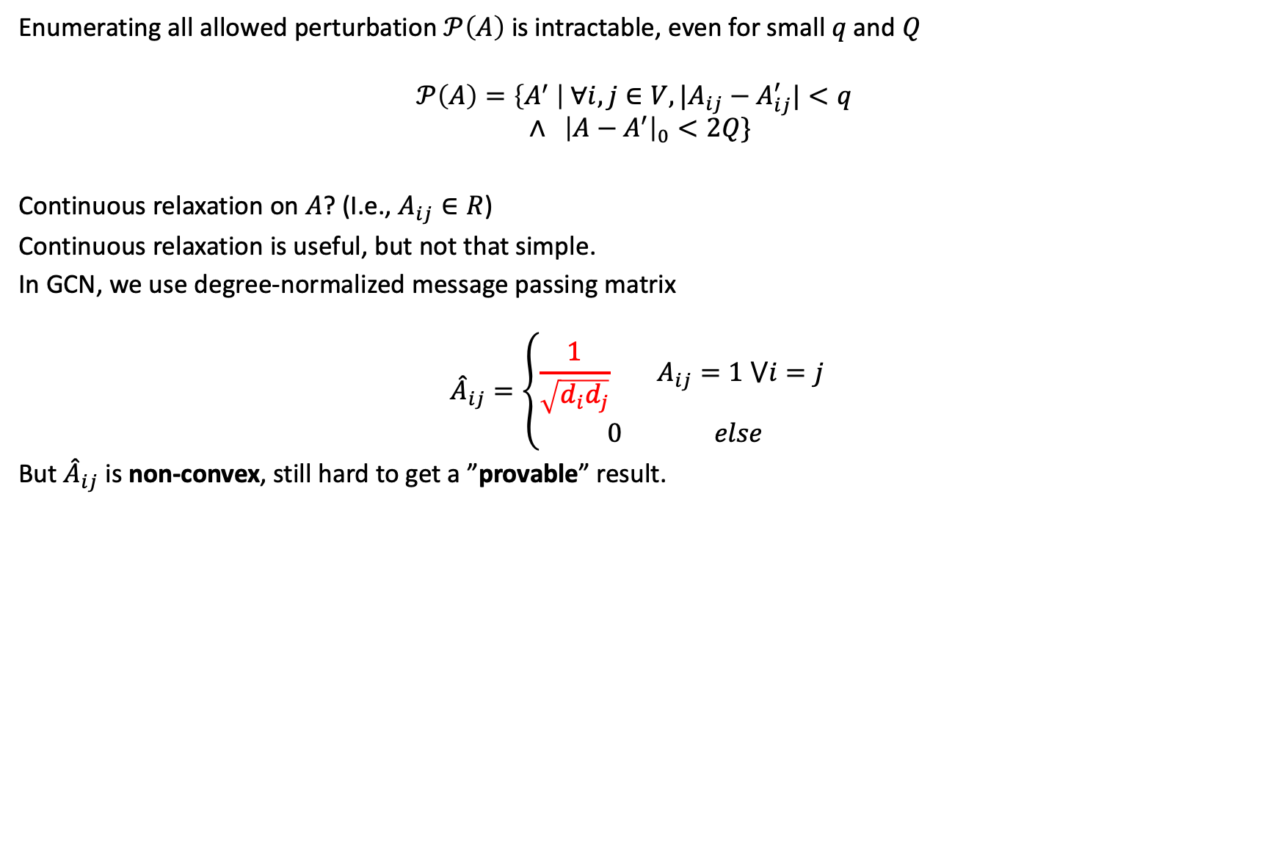
Optimize on Graph Structure
Enumerating all allowed perturbation $𝒫\left(A\right)$ is intractable, even for small $q$and $Q$
$$𝒫\left(A\right)=\left\{A^{′} \right| {∀i, j∈V, |A}_{ij}−A_{ij}^{′}|<q$$
$$∧ {\left|A−A^{′}\right|}_{0}<2Q\}$$
Continuous relaxation on $A$? (I.e., $A_{ij}∈R$)
Continuous relaxation is useful, but not that simple.
In GCN, we use degree-normalized message passing matrix
$${\hat{A}}_{ij}=\left\{\begin{aligned}\frac{1}{\sqrt{d_{i}d_{j}}} A_{ij}=1 ⋁i=j \\ 0 else\end{aligned}\right.$$
But ${\hat{A}}_{ij}$is non-convex, still hard to get a ”provable” result.

Slide 10
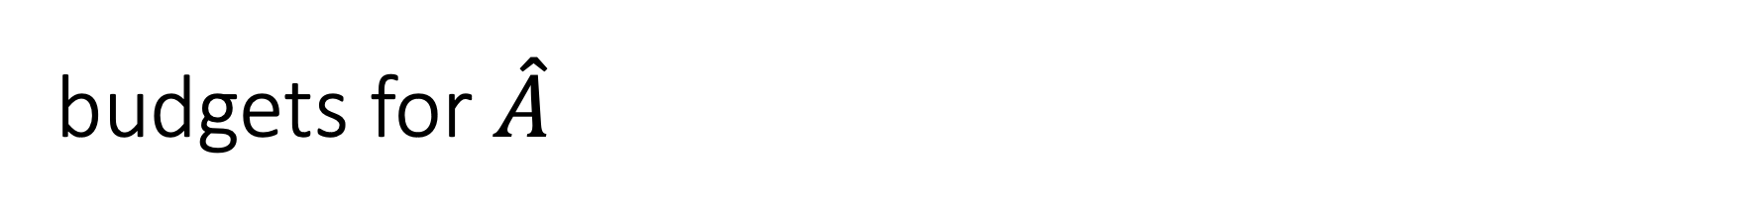
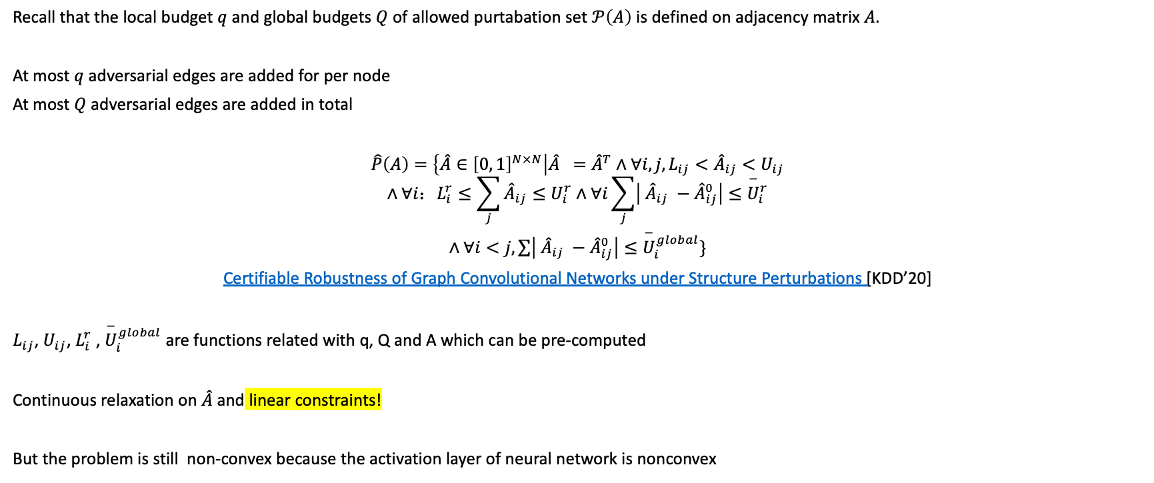
budgets for $\hat{A}$
Recall that the local budget $q$ and global budgets $Q$ of allowed purtabation set $𝒫\left(A\right)$ is defined on adjacency matrix $A.$
At most $q$ adversarial edges are added for per node
At most $Q$ adversarial edges are added in total
$\hat{P}\left(A\right)=\left\{\hat{A}∈{\left[0, 1\right]}^{N×N}\right|\hat{A} ={\hat{A}}^{T}∧∀i, j, L_{ij}<{\hat{A}}_{ij}<U_{ij}$
$$∧∀i：L_{i}^{r}≤\sum_{j}{{\hat{A}}_{ij}}≤U_{i}^{r}∧∀i\sum_{j}{\left| {\hat{A}}_{ij} −{\hat{A}}_{ij}^{0}\right|}≤{\overset{−}{U}}_{i}^{r}$$
$∧∀i<j, \sum{\left| {\hat{A}}_{ij} −{\hat{A}}_{ij}^{0}\right|}≤{\overset{−}{U}}_{i}^{global}\}$
Certifiable Robustness of Graph Convolutional Networks under Structure Perturbations [KDD’20]
$L_{ij}$, $U_{ij}$, $L_{i}^{r}$ , ${\overset{−}{U}}_{i}^{global}$ are functions related with q, Q and A which can be pre-computed
Continuous relaxation on $\hat{A}$and linear constraints!
But the problem is still non-convex because the activation layer of neural network is nonconvex

Slide 11
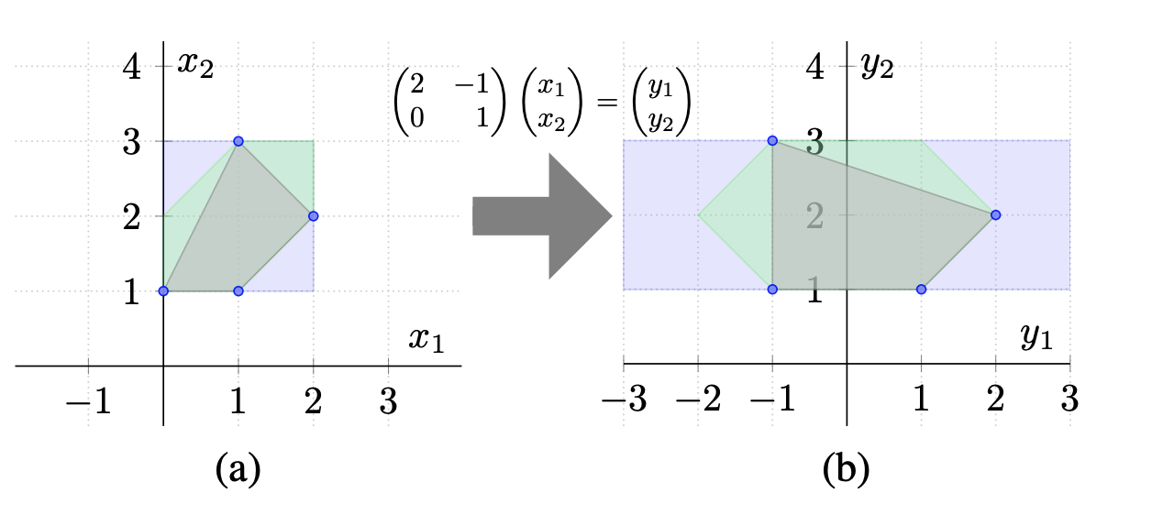
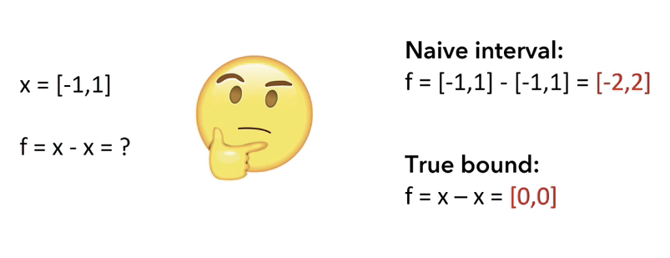
Abstract Interpretation for Neural Network
Only Implemented ReLU for now based on DEEPOLY [POPL 2019].
But theoretically it can support all activate functions.
AI intuition: express all possible inputs with linear constraints and propagate them through different functions, while keep the constraints are linear.
Abstract Interpretation (AI)
How to propagate is tricky.
Notes:
change a set of all possible input into a set of constraints

Slide 12
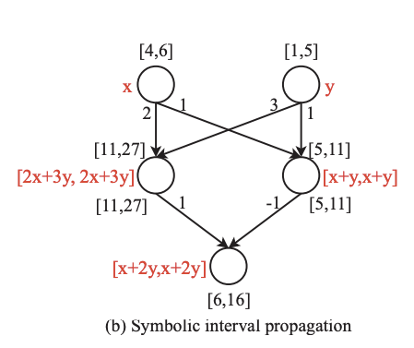
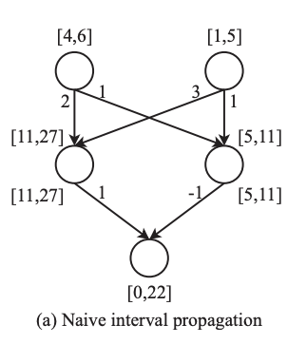
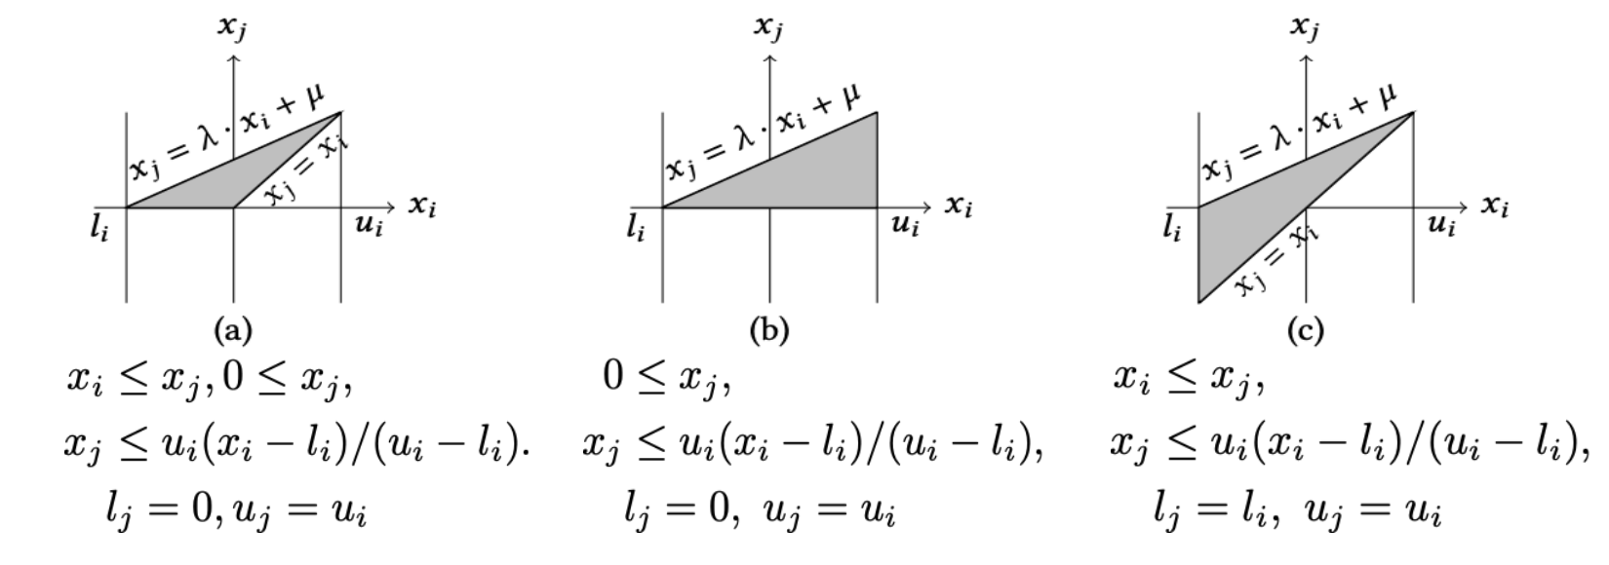
Deepoly Explained
unsafe
Reachable set
Over-approximation

Slide 13
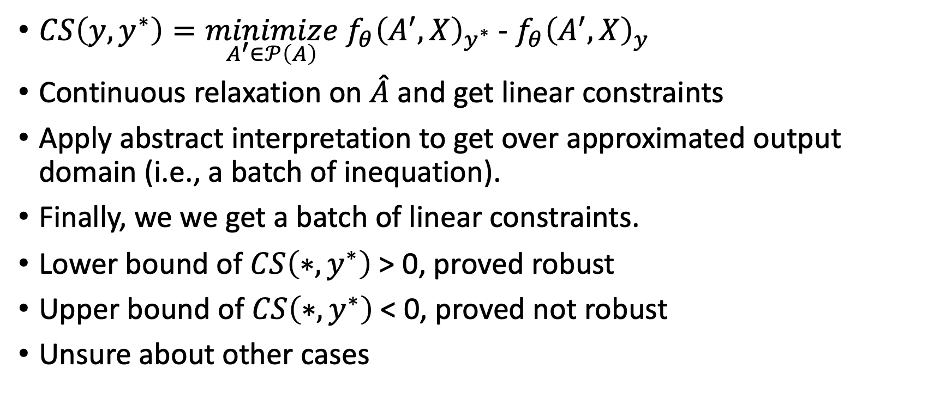
Approach Summary
$CS\left(y, y^{∗}\right)=\underset{A^{′}∈𝒫\left(A\right)}{minimize} f_{θ}{\left(A^{′}, X\right)}_{y^{∗}}$ - $f_{θ}{\left(A^{′}, X\right)}_{y}$
Continuous relaxation on $\hat{A}$ and get linear constraints
Apply abstract interpretation to get over approximated output domain (i.e., a batch of inequation).
Finally, we we get a batch of linear constraints.
Lower bound of $CS\left(∗, y^{∗}\right)$> 0, proved robust
Upper bound of $CS\left(∗, y^{∗}\right)$< 0, proved not robust
Unsure about other cases

Slide 14
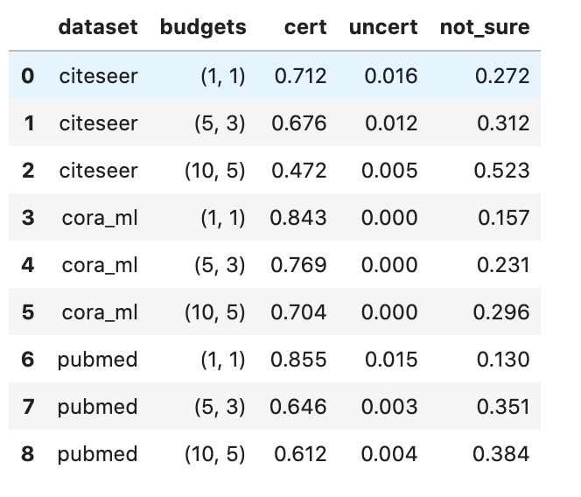
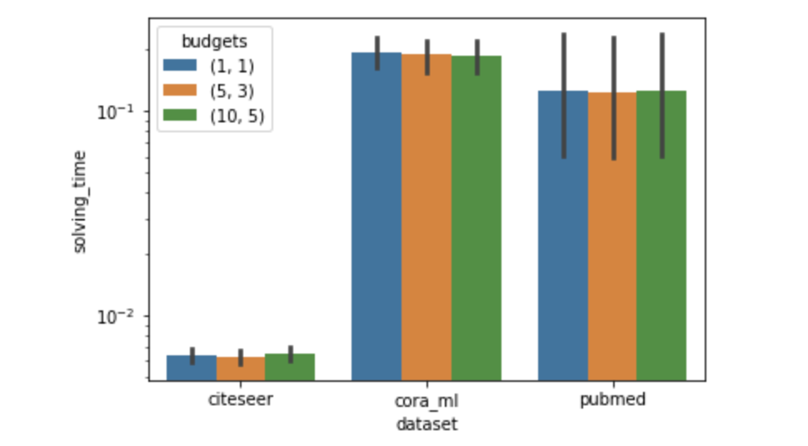
Results
Uncert means any perturbation will make the nodes label change.
Very fast, less then 1 seconds.

Slide 15
Alternative Approach for Abstract Interpretation - B & B
Certifiable Robustness of Graph Convolutional Networks under Structure Perturbations [KDD’20]
Only support ReLU
Running time is significant longer than abstract interpretation.

Slide 16
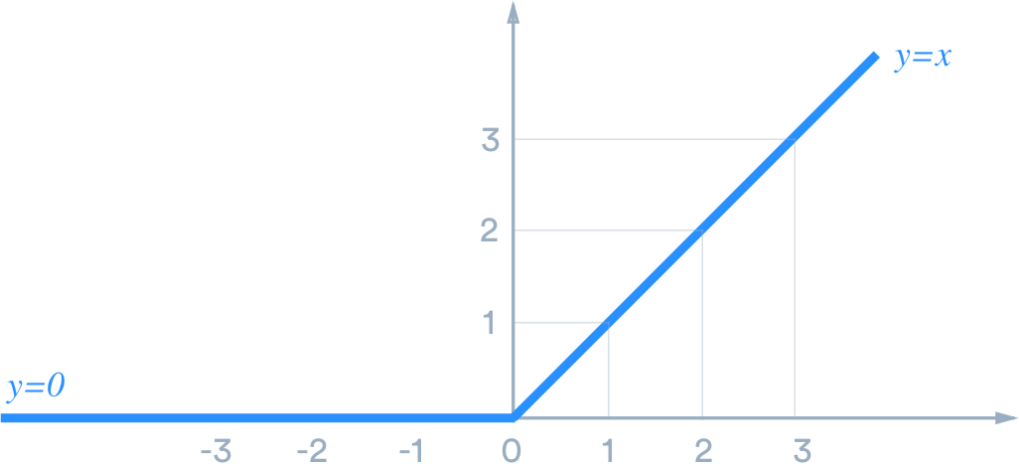
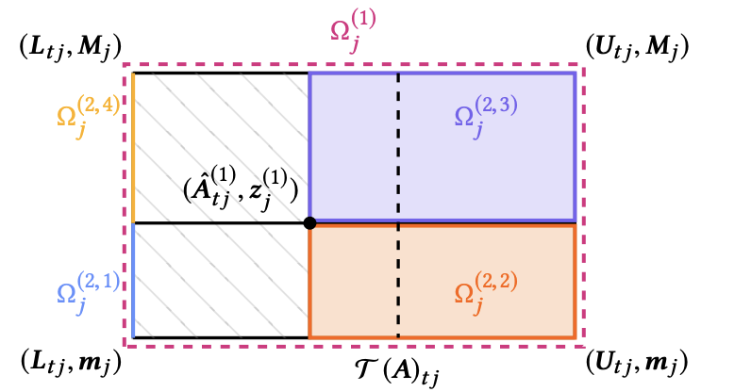
Branch & Bound High-Level Overview
Split ReLU, solve “path-by-path”
When solving LP, we need to check corner points, if any the best case in a region cannot be better than previous results, than pass the rest part.

Slide 17
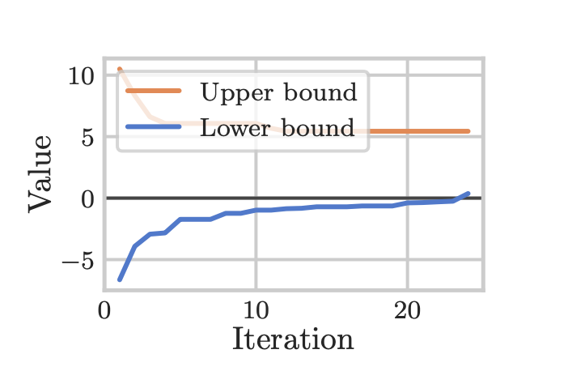

Early Stop
$CS\left(y, y^{∗}\right)=\underset{A^{′}∈𝒫\left(A\right)}{minimize} f_{θ}{\left(A^{′}, X\right)}_{y^{∗}}$ - $f_{θ}{\left(A^{′}, X\right)}_{y}$
Still very very slow…

Slide 18
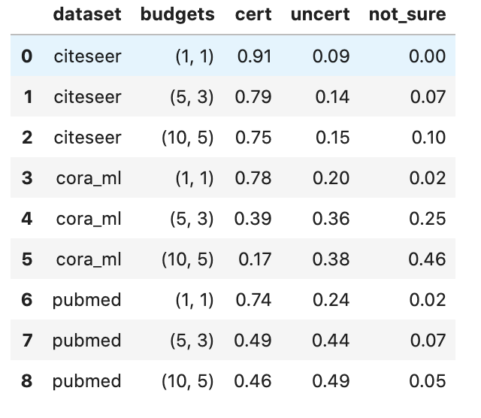
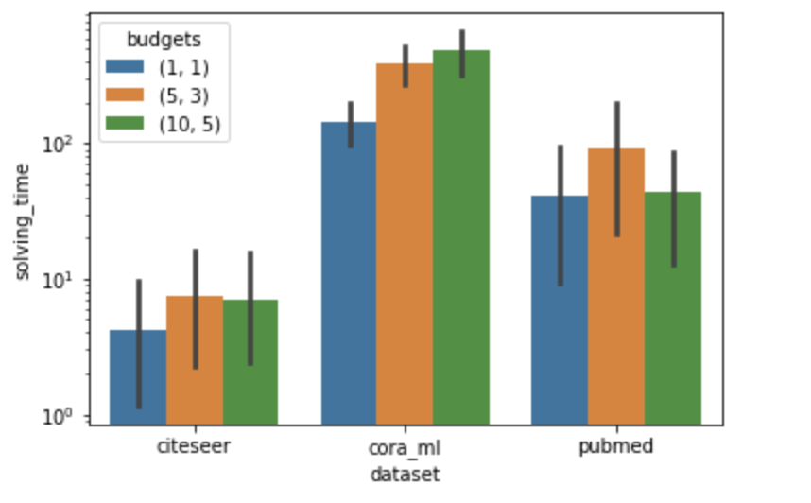
Results
B&B
abstract-interpretation
More than 1000x time spent than abstract-interpretation-based approach

Slide 19
Outlines
Attack approach for graph structure perturbation
Problem we want to prove
Optimize on graph structure
Abstract Interpretation
Compare with existing recent work
Thank you & Questions

