Slide 1
Product Name:Beads Net
Team name: Weavers
Team member names: Zidu Chen, Zhiyue Li
Zike Peng, Project Owner
Jiapei Kuang, Initial Scrum Master
Ge Lu

Slide 2
Beads Net
Our Goals:
Motivation of our app: Extant anime and film ranking websites only display as a list view.
High level goals:
Provide a net-like ranking website
- Be able to find similar movies/animes
- Be able to rank the movies/animes by their rates
- Be able to search with names or tags
- Be able to see information of the movies
- Allocate the most suitable and interesting products to users according to their preferences
-Provide user details of what they found.

Slide 3
Beads Net
Sprint 1:
-As an anime audience, I want a more convenient anime ranking with vivid image and tables.
(Provide a net-like ranking website)
-As an anime audience, I want to find the best in my interested field.
(Allocate the most suitable and interesting products to users according to their preferences)
-As an anime audience, after watching a masterpiece, I quite want to see other similar products.
(Be able to find similar movies/animes)

Slide 4
Beads Net
Sprint2:
- As a user, I want to explore my interests and save my discoveries.
(Allocate the most suitable and interesting products to users according to their preferences)
- As a user, I want to have a quick view of each anime or film without clicking it.
(Be able to see information of the movies)
Sprint3:
- As a producer, I want my work to have more publicity.
(Be able to rank the movies/animes by their rates)
- As a user, I want to find my desired anime or film by searching its name.
(Be able to search with names or tags)
- As a user, I want to have a link direct to my target anime or film.
(Provide user details of what they found.)

Slide 5
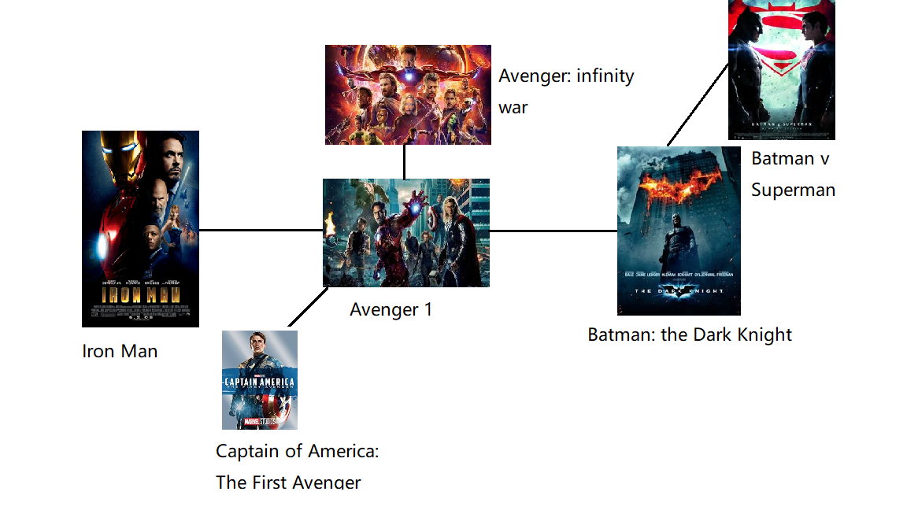
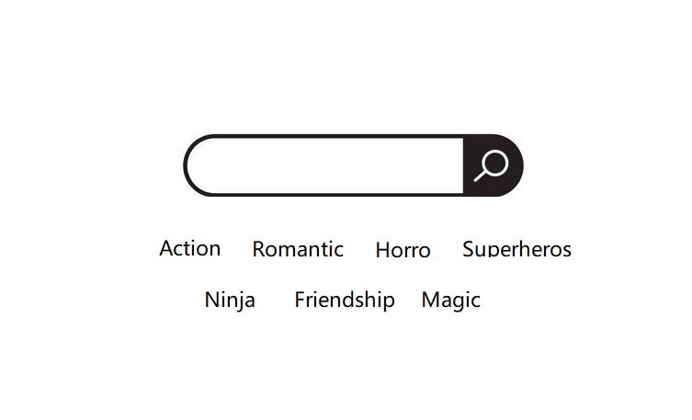
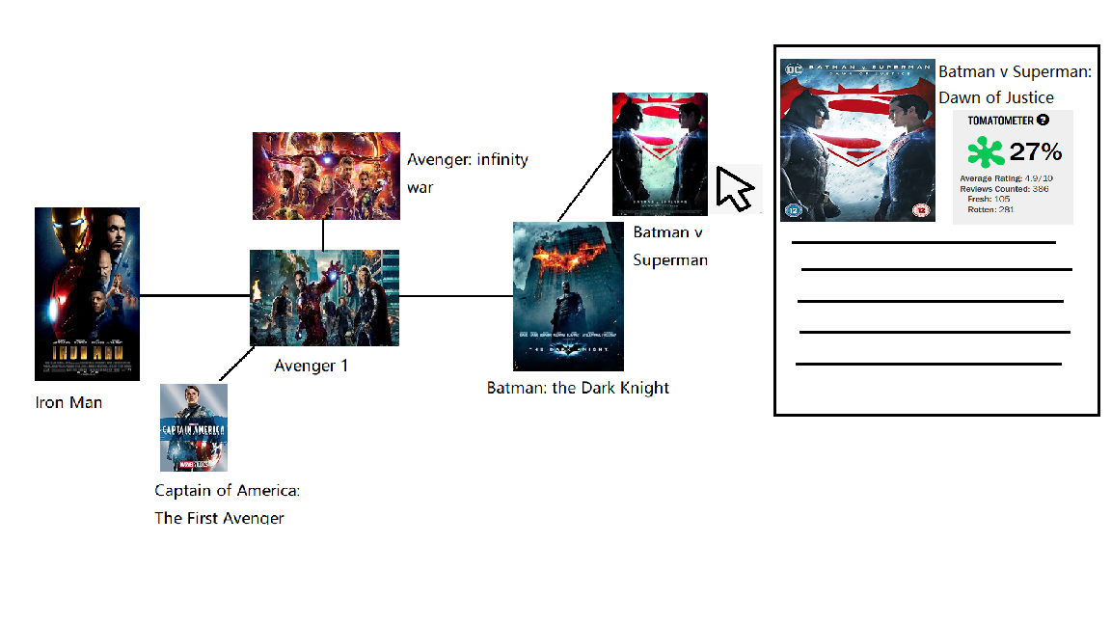
Beads Net
Overall Structure and Major Components
Notes:
Jiapei Kuang

Slide 6
Beads Net
Challenges and Risks We Face:
Challenge 1: Requires a lot of data relating to anime and movies
Challenge 2: Difficult for us to design a UI with great aesthetic pleasure
Challenge 3: Not all of our team members are familiar with web programming.
Risk 1: The ranking cannot content every user.
Risk 2: We might have a small group of users.

Slide 7
Beads Net
Technologies we use:
Programming Language: HTML5, Javascript, CSS
Technology 2 e.g. web framework
Development Environment: Github, MySQL, Visual Studio…

Slide 8
Any Questions?
Thank you all for watching.

