Slide 1
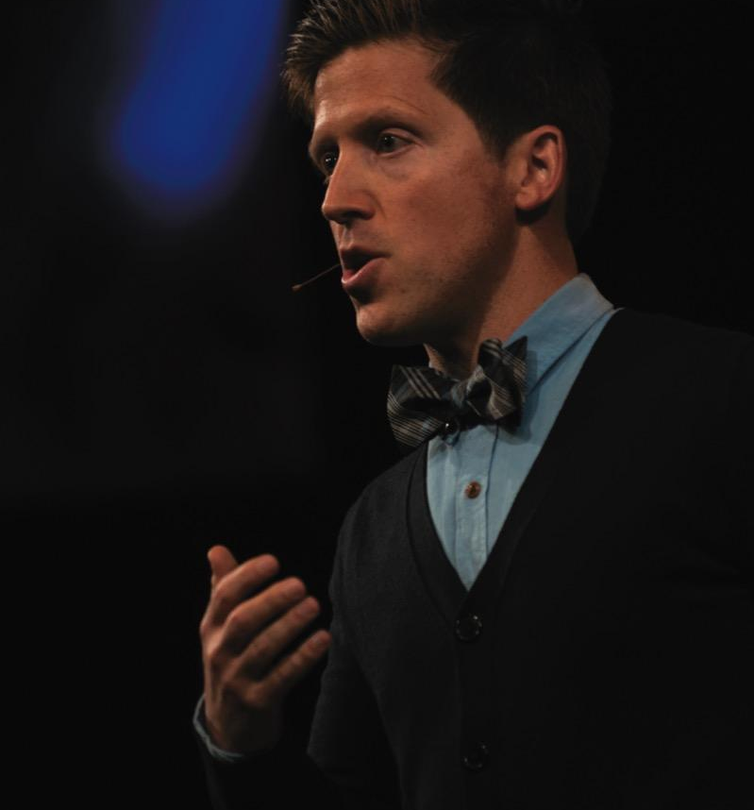
Speaking in Public
Courtesy of Josh Shipp

Slide 2
Power of Public Speaking
Way of making ideas public
Importance for career
Importance for civic engagement

Slide 3
Public Speaking & Conversation
Similarities:
  Organize thoughts logically
  Tailor message to audience
  Tell stories for maximum impact
  Adapt to feedback
Differences:
  Public speaking more highly structured
  Public speaking requires more formal language
  Public speaking requires different method of delivery

Slide 4
Stage Fright
Definition:
Anxiety over prospect of speaking in front of audience
© Christopher Polk/Getty Images

Slide 5
Reducing Speech Anxiety
Acquire experience
Prepare, prepare, prepare
Think positively
Use power of visualization
Don’t expect perfection

Slide 6
Positive Nervousness
Controlled nervousness that energizes speaker for presentation
© Jung Yeon-Je/AFP/Getty Images

Slide 7

Speech Communication Process
Speaker
Message
Channel
Listener
Feedback
Interference
Situation
© Ariel Skelley/Getty Images

Slide 8
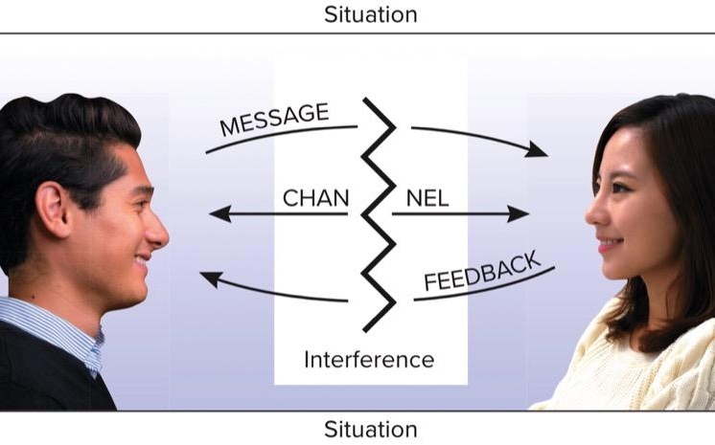
Speech Communication Diagram
(male) © Ranta Images/Shutterstock; (female) © Lan Images/Shutterstock

Slide 9
Ethnocentrism
Believing one’s group or culture is superior to all other groups or cultures

Slide 10
Avoiding Ethnocentrism
Respect listeners’ cultural values
Adapt messages to expectations
Imagine oneself in place of listeners
Be alert to feedback
Listeners also have to avoid ethnocentrism

Slide 11
THE END

