Slide 1

Ethics & Public Speaking
© Drew Angerer/Getty Images

Slide 2
Ethics
Deals with issues of right & wrong in human affairs

Slide 3
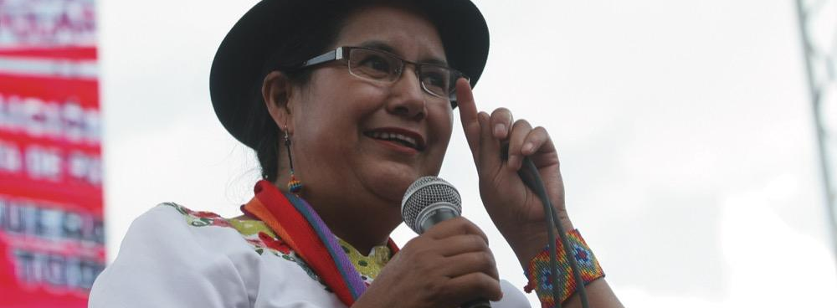
Ethical Decisions
Weighing potential course of action against ethical standards
© NurPhoto/Getty Images

Slide 4
Guidelines for Ethical Speaking
Make ethically sound goals
Be fully prepared
Be honest
Avoid name calling, abusive language
Put principles into practice

Slide 5
Name-Calling
Using language to defame, demean, degrade individuals or groups

Slide 6
Plagiarism
Presenting language, ideas of another as one’s own

Slide 7

Types of Plagiarism
Global
Patchwork
Incremental
© Wavebreak Media Ltd./123RF

Slide 8
Global Plagiarism
Stealing from single source, passing off as one’s own

Slide 9
Patchwork Plagiarism
Stealing ideas, language from two or three sources, passing off as one’s own

Slide 10
Incremental Plagiarism
Failing to give credit for parts borrowed from other sources

Slide 11
Plagiarism & Internet
Cite sources when using Internet materials
Take careful notes

Slide 12
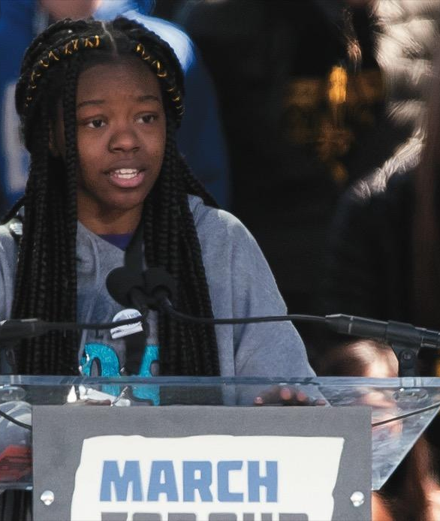
Ethical Listening
Speech-making a two-way street
Listeners
have ethical obligations
© Noam Galai/WireImage/Getty Images

