Slide 1
Sign Language Translation
Presenter: Zilan

Slide 2
Facts & Problems
More than 360 million people are deaf or have hearing loss problems in the world
Delivering information through Sign Language or texts
About 300 different sign languages around the world
Time-costing learning and rare usage for normal people
The Machine learns much fasters than humans, and normal people don’t need to learn any sign language

Slide 3
Design

Slide 4
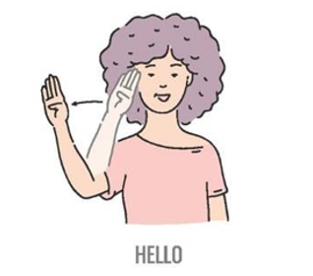
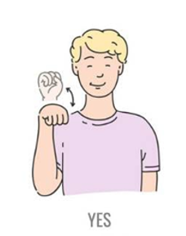
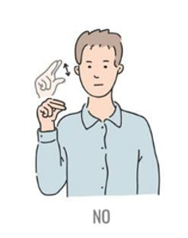
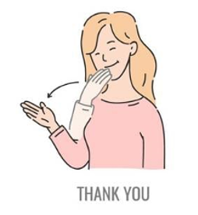
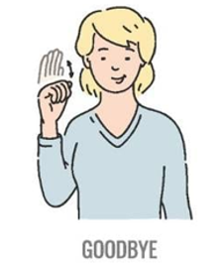
Implementation – Sign Gestures
The Sign Language for the demo is ASL(American Sign Language)
Challenge: Ambiguity/Similarity of gestures
Creativity: Double ended queue to get the probability distribution in each time gap

Slide 5
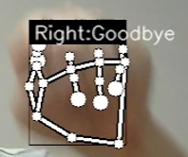
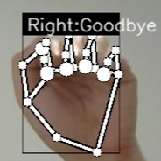
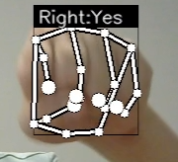
Ambiguity handling - DEQUE
DEQUE: Double ended queue
30fps camera + predict every 0.5s ≈ 15 frames for each prediction
1. How to make ONE prediction based on 15 frames?
2. Sometimes, the model can make wrong predictions! How to deal with some similar gestures?

Slide 6
In each 0.5s…
1. Make predictions for each frame
2. Record the predictions in a deque
-wait! What is deque?
-A fixed-length queue, if a new element is going to be appended into a deque, then the first element in the queue will be kicked out to maintain the fixed length!
3. After every 0.5s, the most frequent prediction in the current deque will be selected as the final prediction!
In this case, 5 ‘YES’ frames vs 10 ‘GOODBYE’ frames, so ‘GOODBYE’ is the final prediction of this 0.5s interval.

Slide 7
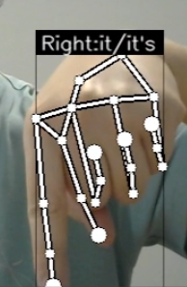
Grammar handling - NLTK
a platform to work with human language
NLTK：a platform to work with human language
“It’s too expensive” vs “I like it” with same sign gesture in ASL
Solution: use NLTK to check if the word before ‘it/it’s’ is a verb/preposition. If yes, then predict as it, otherwise, ‘it’s’.

Slide 8
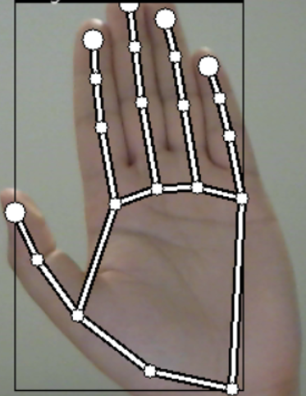
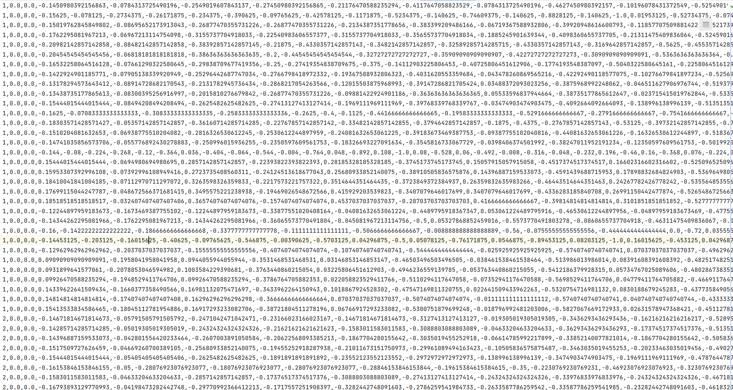
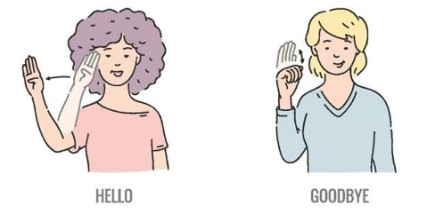
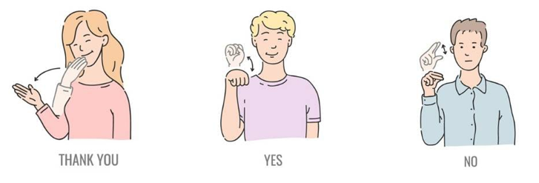
Implementation – Data and Features
Mediapipe
gestures
keypoints
data set
Problem: How to represent the hands gestures by data?
Solution: Record the joints coordatates as keypoints to build the data set

Slide 9
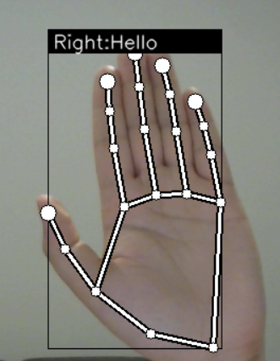
Implementation – CNN Model
Convolutional Neural Network: widely used in computer vision
data set
result
train
predict
CNN model

Slide 10
To do list
Integrate the module with a cool UI
Bring mouth/arms/etc. as new features into the model
Merge the app with Azure/Teams/Edge

Slide 11
Thanks!
Contact: t-zilanzhang

