Slide 1
Sign Language Translation
>hackathon_
DEFINE POSSIBLE.

Slide 2

>hackathon_
DEFINE POSSIBLE.
of
Sign Languages
Diversity
&
Inclusion

Slide 3


>hackathon_
DEFINE POSSIBLE.
Diversity
of
Sign Languages
Hearing impaired people≈600 000 000
The type of Sign Languages(SL) ≈ 300
American SL ≠ British SL
Chinese North SL ≠ Chinese South SL

Slide 4
>hackathon_
DEFINE POSSIBLE.
One day

Slide 5



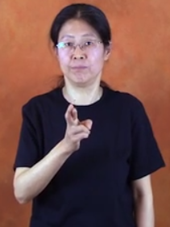

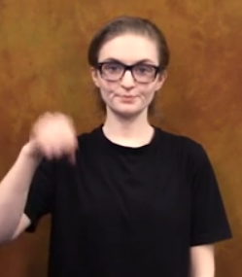
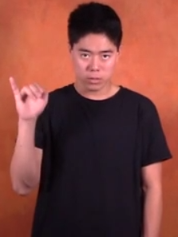



>hackathon_
DEFINE POSSIBLE.
Diversity
of
Sign Languages
- “Yes”
American SL
Chinese SL
Japanese SL
Sign Languages are Not Universal

Slide 6
>hackathon_
DEFINE POSSIBLE.
Our Solution
Inclusion
Sign Languages
Diversity
of

Slide 7
>hackathon_
DEFINE POSSIBLE.
Inclusion
of
Our Solution
1. Across different Sign Languages
A Sign Language
Translation Solution
2. Between
Sign Languages
and
Speaking Languages

Slide 8


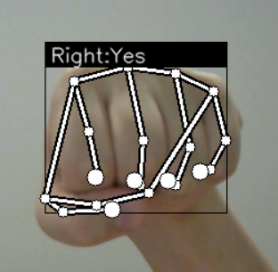
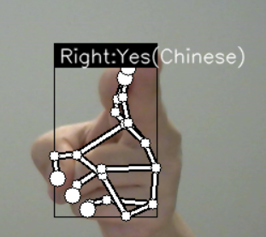
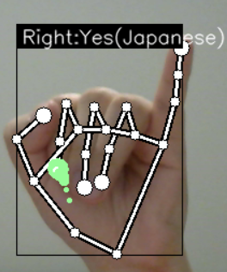
>hackathon_
DEFINE POSSIBLE.
American SL
Chinese SL
Japanese SL
1. Across different Sign Languages
Through our Model

Slide 9
>hackathon_
DEFINE POSSIBLE.
Sign Languages
1. Across different
2. Between
and
Speaking Languages

Slide 10
>hackathon_
DEFINE POSSIBLE.
2. Between
Sign Languages
and
Speaking Languages
One day
A Microsoft Store
……

Slide 11
>hackathon_
DEFINE POSSIBLE.
2. Between
Sign Languages
and
Speaking Languages
With Chatbox Input
……

Slide 12
>hackathon_
DEFINE POSSIBLE.

Slide 13
>hackathon_
DEFINE Sign Language Translation POSSIBLE.
Sign Language Translation
DEFINE
POSSIBLE.

Slide 14
>hackathon_
DEFINE Sign Language Translation POSSIBLE.
How?

Slide 15
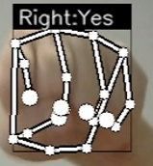
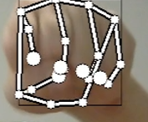
>hackathon_
DEFINE Sign Language Translation POSSIBLE.
Mediapipe
Convolutional Neural Network
Collect data from gestures
Train the model and predict
train
predict
CNN model

Slide 16
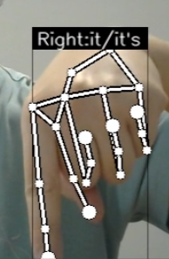

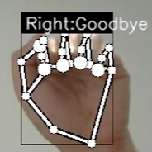
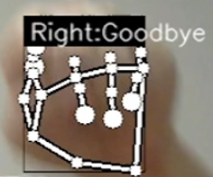
>hackathon_
DEFINE Sign Language Translation POSSIBLE.
Deque
NLTK
pytts
Handle similar gestures
and Make predictions
Handle grammar issue
of Sign Languages
Word to voice!
VS

Slide 17
>hackathon_
DEFINE Sign Language Translation POSSIBLE.
Team Leader
Zilan Zhang
Programming Developer
Qian Lai
Zilan Zhang
Empower
every
person
hearing impaired
and every
organization
concerned
Video
Zilan Zhang
Chen Peng
Yewen Jia
on the planet
achieve
more.
to
communicate
UI Design
Weijia Kou
Product Design Advisor
Wayne Duan
General Supporter
Leslie Jing
BGM: BWV 578 Fugue in G Minor - Bl!indman - The organ of Bach

