Slide 1
Elbit Systems Ltd. Financial Presentation
Analysis for ESLT.TA

Slide 2
Company Overview
Elbit Systems Ltd. is a leading global defense technology company, delivering advanced solutions for a secure and sustainable world.

Slide 3
Key Financial Insights
The company reported as of September 30, 2024, $10.1 billion in revenues, $4.8 billion in net income, and $2.2 billion in cash and cash equivalents.

Slide 4
Risks and Challenges
Key challenges include competition from other defense technology companies, regulatory changes, and market fluctuations.

Slide 5
Actionable Insights
Recommendations include increasing market share, improving operational efficiency, and adapting to changing regulatory requirements.

Slide 6
Financial Ratios
current_ratio: 1.14 quick_ratio: 0.72 immediate_liquidity_ratio: 0.04 cashflow_to_sales_ratio: 0.02 net_profit_margin: 0.04 operating_profit_margin: 0.06 ebitda_ratio: 0.08 roe: 0.07 roa: 0.04 leverage_ratio: 0.01
equity_to_assets_ratio: 0.30 receivables_ratio: 0.41 customers_ratio: 45.70 inventory_ratio: 0.45 inventory_turnover_ratio: 2.21 inventory_days: 151.41 payables_days: 80.63

Slide 7
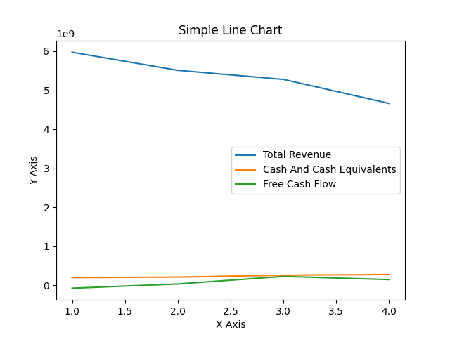
Line Chart

