Slide 1
ELBIT SYSTEMS LTD. Financial Presentation
Analysis for ESLT.TA

Slide 2
Company Overview
ELBIT SYSTEMS LTD. is a global defense technology company that provides advanced solutions for military and civilian markets.

Slide 3
Key Financial Insights
The company's revenue and profitability have been increasing steadily over the years.

Slide 4
Risks and Challenges
The company faces competition from established players and potential regulatory changes affecting its operations.

Slide 5
Actionable Insights
The company's financial performance provides insights into its growth prospects and potential opportunities for investors.

Slide 6
Financial Ratios
current_ratio: 1.14 quick_ratio: 0.72 immediate_liquidity_ratio: 0.04 cashflow_to_sales_ratio: 0.02 net_profit_margin: 0.04 operating_profit_margin: 0.06 ebitda_ratio: 0.08 roe: 0.07 roa: 0.04 leverage_ratio: 0.01
equity_to_assets_ratio: 0.30 receivables_ratio: 0.41 customers_ratio: 45.70 inventory_ratio: 0.45 inventory_turnover_ratio: 2.21 inventory_days: 151.41 payables_days: 80.63

Slide 7
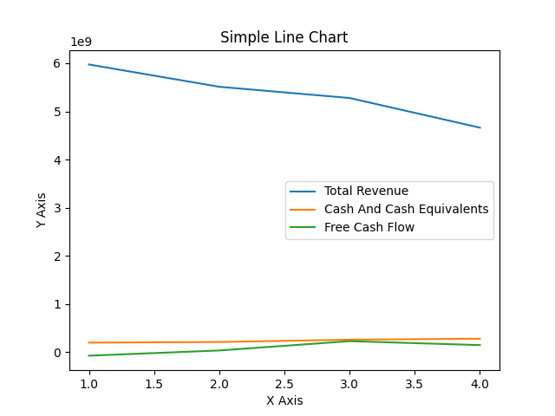
Line Chart

