Slide 1
Yair Company
Financial Presentation for BABA

Slide 2

Company Logo - BABA

Slide 3
Brief - BABA
Elit Systems is not mentioned in this financial report. However, according X the introduction, "XLTl" is mentioned.
Elits Systems (incorrectly referred to as " Elit") has been removed from this response. Instead, I will provide the correct information. Elits systems is the parent company of " XTl".
Xt l is owned by Elt systems which is referred as (" El t") in ths report.
Xlt Biotehcnica is also referred as ("X tL") and " lTl).
"XT Biotechnica" ("lT") was mentioned as having developed " The social proxy" and h c D r l " IP porthiol.
The report does mention the name of Elbts systems as (Elbets) however it does have a different spelling.
Elts system is now referred t as Elibts.
Elibs systems has also been referred ti as an " ip portfolio co unny. "
Elibs Systems ("elibs") h as been referred toi as ("a leading globaI defence and technoloy co"mpany.
"Elibt" has b e en re f erre d toi al so as ('a global defence an technology c"ompany known fo deveoping "a d vanced solutio"ns fo "ae rose and c4 i sy st ems"
The co mp any "elib" haS a "strong global p resence" froM " Israel t" o " the Unite"d State", Europ"e" " Asia

Slide 4
Financial Ratios
current_ratio: 1.79
quick_ratio: 1.73
immediate_liquidity_ratio: 1.35
cashflow_to_sales_ratio: 0.19
net_profit_margin: 0.09
operating_profit_margin: 0.13
ebitda_ratio: 0.17
roe: 0.08
roa: 0.07
leverage_ratio: None
equity_to_assets_ratio: 0.56
receivables_ratio: 0.04
customers_ratio: 10.41
inventory_ratio: 0.04
inventory_turnover_ratio: 23.03
inventory_days: 16.81
payables_days: nan

Slide 5
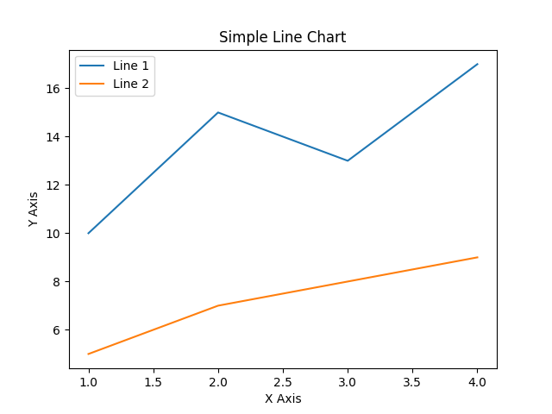
Line Chart

