Slide 1

Elbit Systems Ltd. Financial Presentation
Analysis for ESLT.TA

Slide 2
Company Overview
Elbit Systems Ltd. is a leading global defense technology company, delivering advanced solutions for a secure and sustainable world. Elbit Systems Ltd. is a subsidiary of the Israeli conglomerate, Elbit Holding Ltd.

Slide 3
Key Financial Insights
- Total revenue for the period is $4.897 billion.
- Net income for the period is $231.643 million.

Slide 4
Risks and Challenges
- The company faces competition from established players in the defense technology sector.
- Regulatory changes in the region may impact the company's operations.

Slide 5
Actionable Insights
- The company's revenue growth trend is positive, indicating a strong performance.
- The company's net income margin is relatively high, indicating a profitable business model.
- The company's market share in the defense technology sector is increasing, indicating a growing market for its products and services.

Slide 6
Financial Ratios
current_ratio: 1.14 quick_ratio: 0.72 immediate_liquidity_ratio: 0.04 cashflow_to_sales_ratio: 0.02 net_profit_margin: 0.04 operating_profit_margin: 0.06 ebitda_ratio: 0.08 roe: 0.07 roa: 0.04 leverage_ratio: 0.01
equity_to_assets_ratio: 0.30 receivables_ratio: 0.41 customers_ratio: 45.70 inventory_ratio: 0.45 inventory_turnover_ratio: 2.21 inventory_days: 151.41 payables_days: 80.63

Slide 7
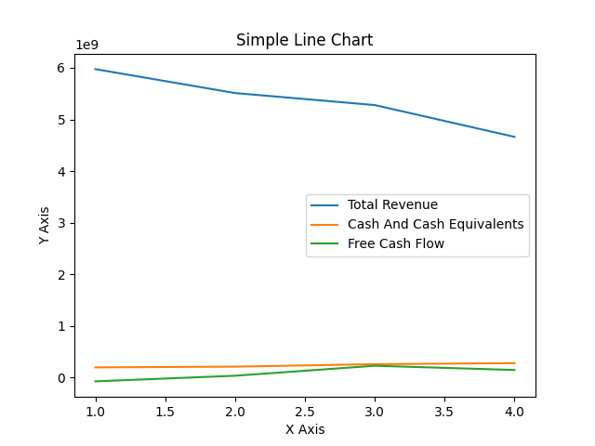
Line Chart

