Slide 1
VBA
Introduction to syntax

Slide 2
Common VBA variables (data types)
Byte
Integer: (2) non-decimal form.
Long (4)
Single: (4)
Double: (8) A longer form of the single variable.
Currency
Date (8)
String (l+10)
Boolean (2)
Variant (16, l+22)
Object (4)

Slide 3


Dot.Notation
Object.Property.Methods
Object
Property
Methods
Object
Property.
Property
Value

Slide 4
Conditional Logic
If
Else
Else If

Slide 5
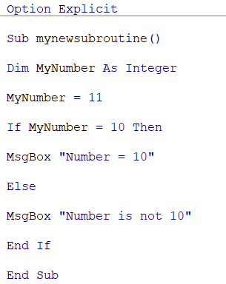
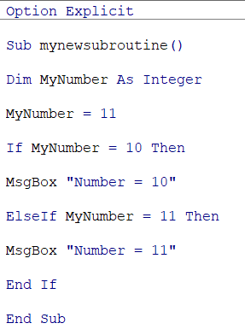

Slide 6
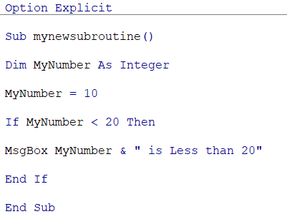
Conditional operators
=, <, >, <>, >=, <=, Is, Like
(Logical operators And, Or, Not, Xor (or A, or B))
(Assign operators =, Let, Set)
(Arithmetic operators +, -, *, /, ^, \, mod)
(Concatenate &, + “10” & 20 = 1020)
an ampersand (&) symbol
Expand if function(…)

Slide 7
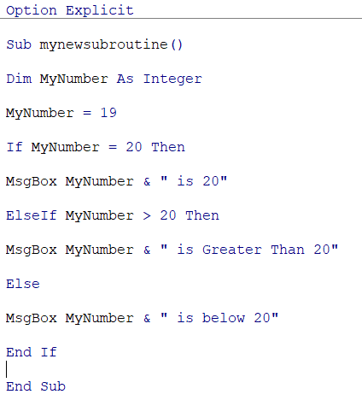

Slide 8
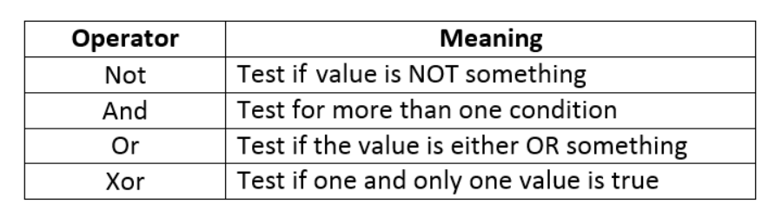
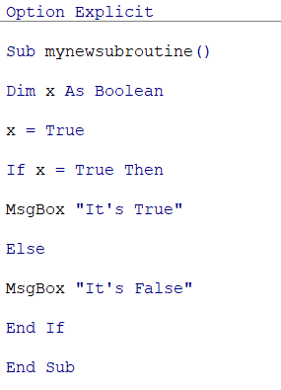
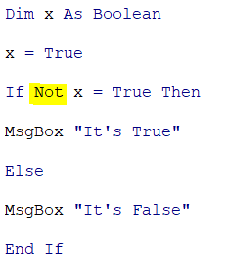
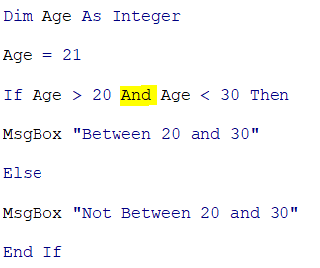
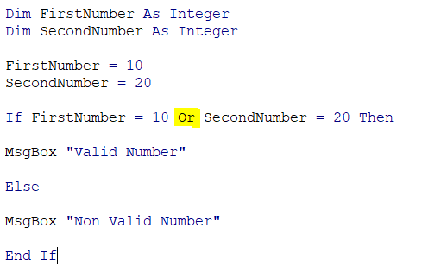
Logical operators

Slide 9
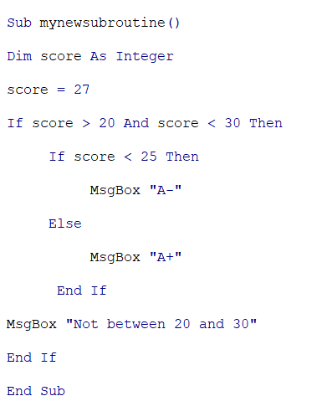
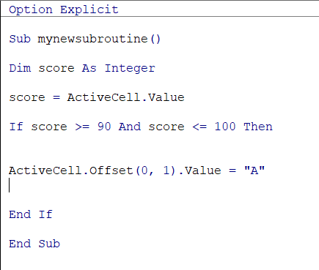
Nested If (+practice)

Slide 10
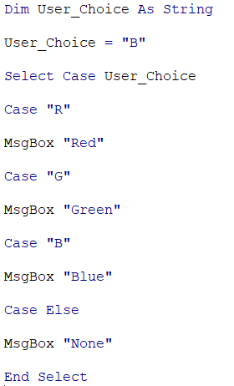
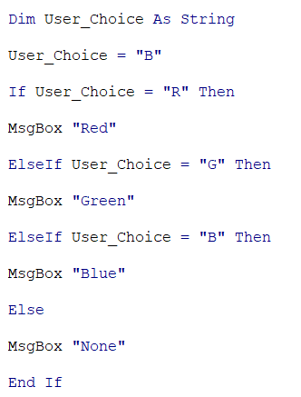


Select Case

Slide 11
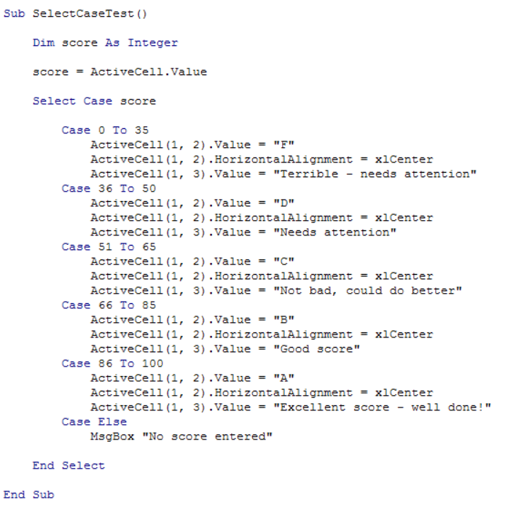
?

Slide 12
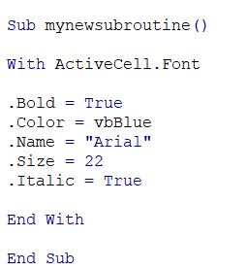
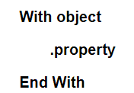
With … And

Slide 13
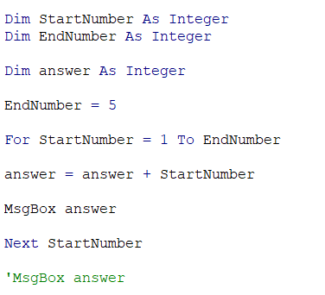

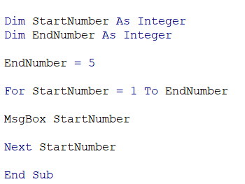
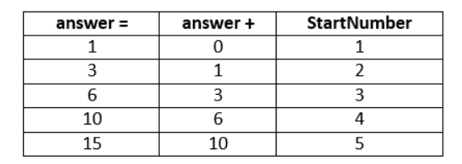
Loops – For loop

Slide 14
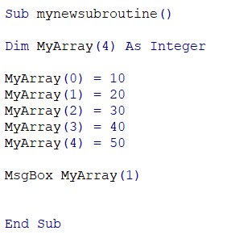
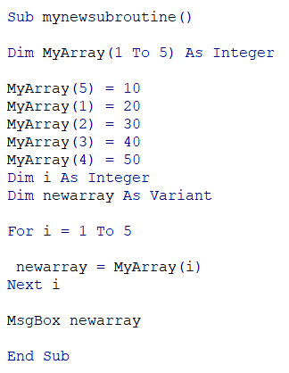
Arrays

Slide 15
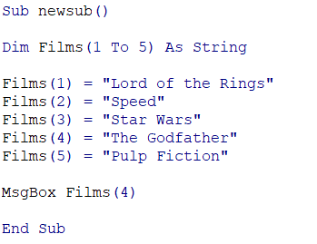

Slide 16
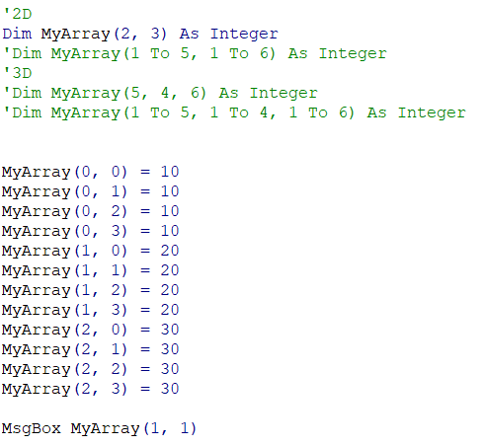
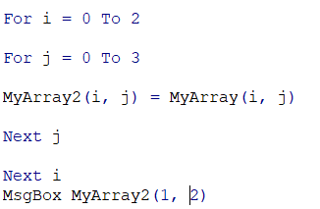
Multidimensional Arrays

Slide 17
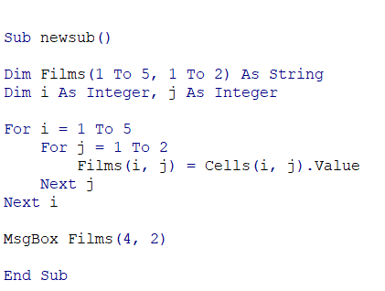

Slide 18
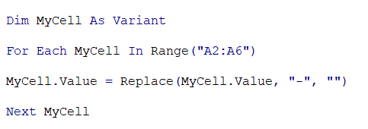
For each … In… Next

Slide 19
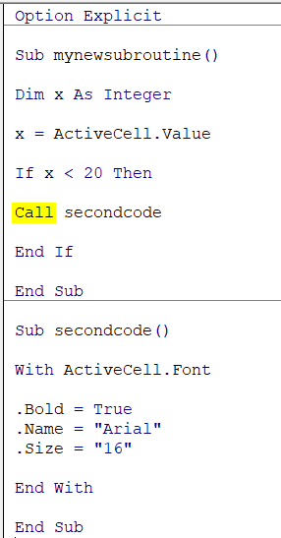
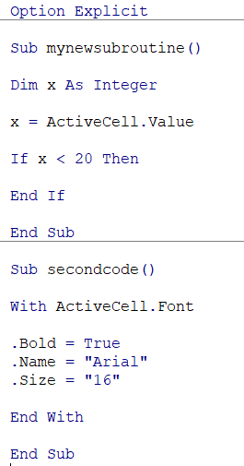
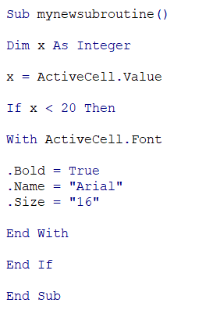
Sub
A Sub is a small chunk of code that you write to do a specific job.

Slide 20
Private Sub SecondCode( )
The reason they both show up is that by default they are Public Subs. This means that they can be seen just about everywhere from Excel. If you don't want a Sub showing up in the Assign Macro dialogue box then you can make it Private. The way you make a Sub Private is by typing the word Private before the word Sub:

Slide 21

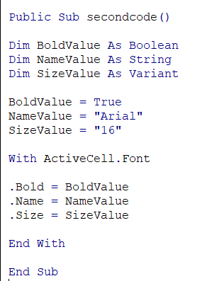
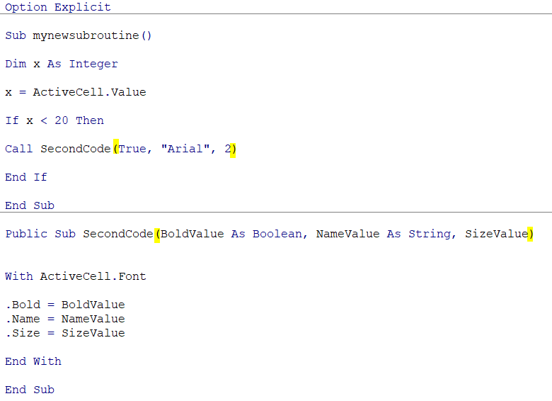
Sub+arguments
Not reusable
Notice that you don't need the Dim word anymore.

Slide 22
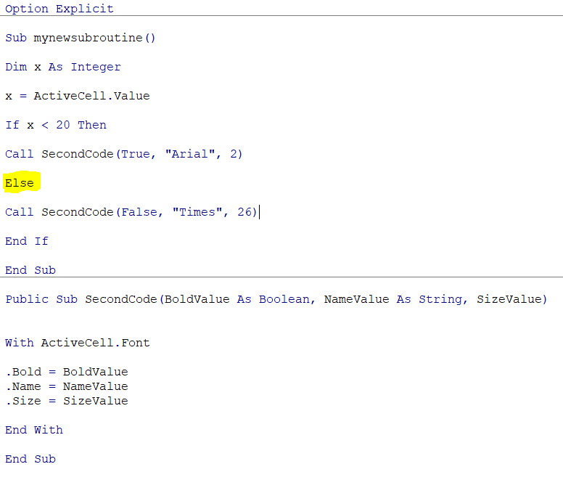

Slide 23
Create a function
Subs don't return a value - they just get on and execute the code. You use a function when you want a chunk of code to return some sort of answer for you.
One of the big differences between setting up a Sub and setting up a Function is the return type at the end. This is exactly the same as setting up a variable type. So you can have As String, or As Boolean, or As Integer - any of the types you can use with ordinary variables can also be used with functions. If you miss off the As Type at the end then the function will be As Variant.

Slide 24
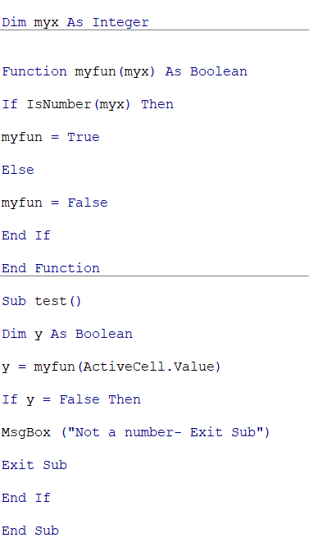

Slide 25
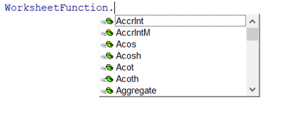
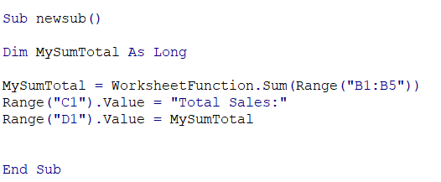
Worksheet function

Slide 26

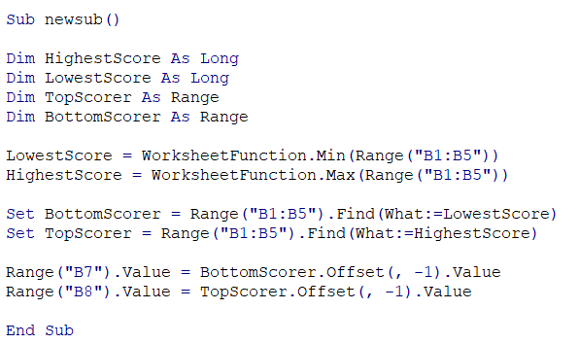
Set
The Set keyword is used to create new objects, creating a new Range, for example.
This object variable type is used to hold a range of cells from your spreadsheet. (Find is method)

Slide 28
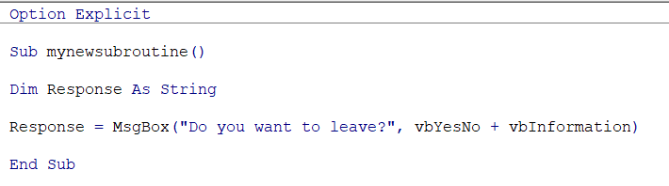
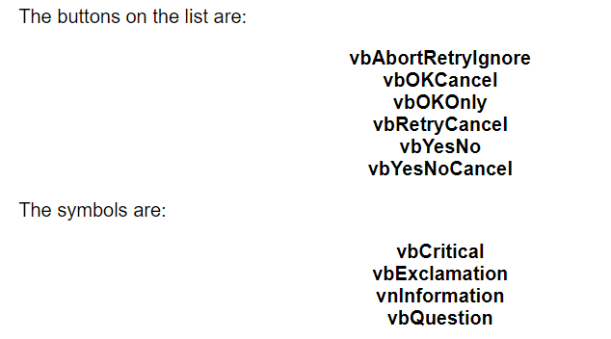
MsgBox(“”)

