Slide 1
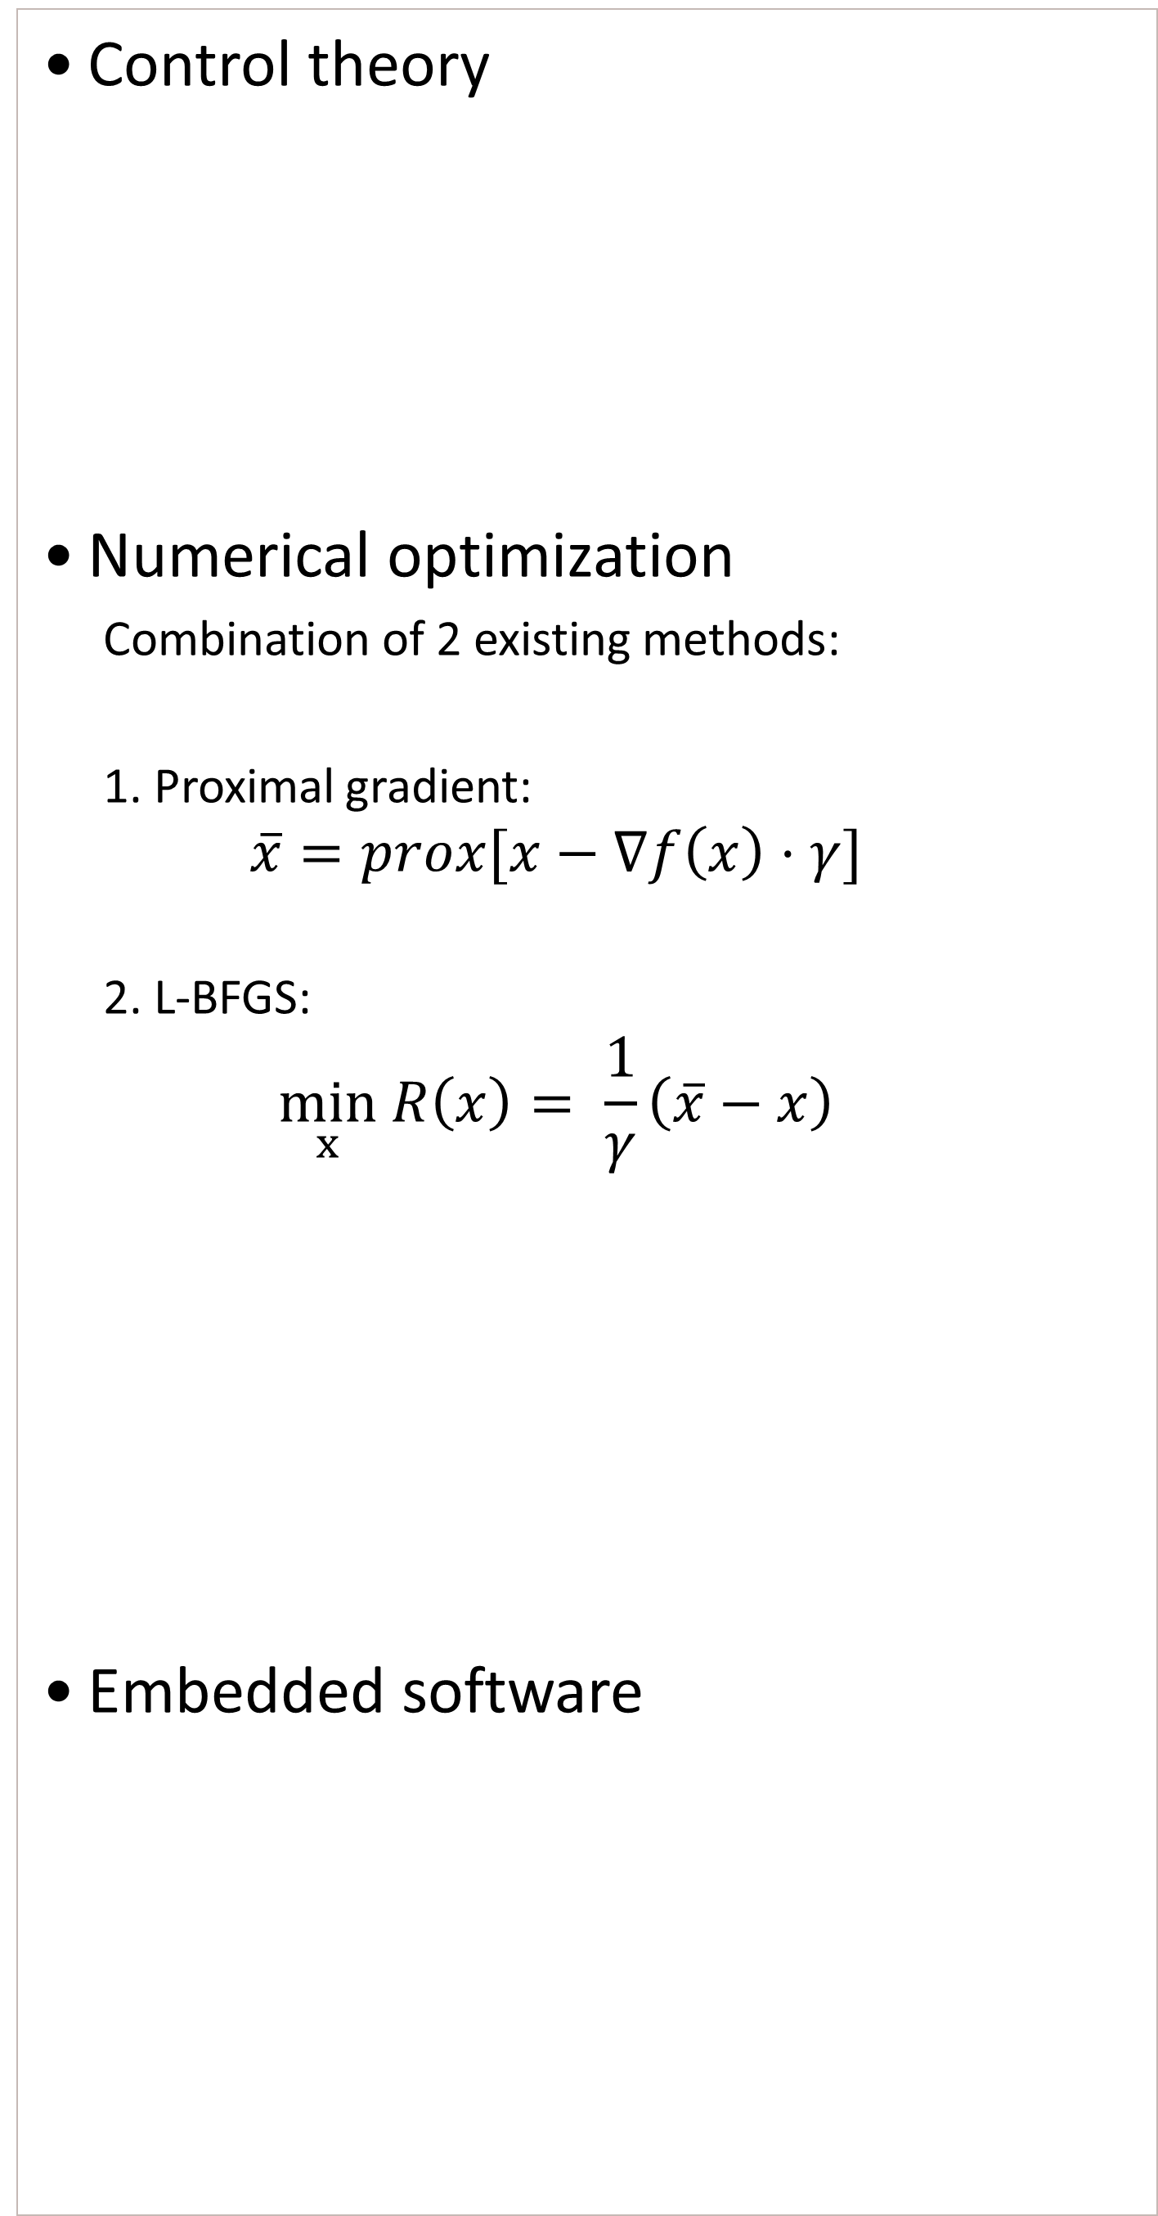
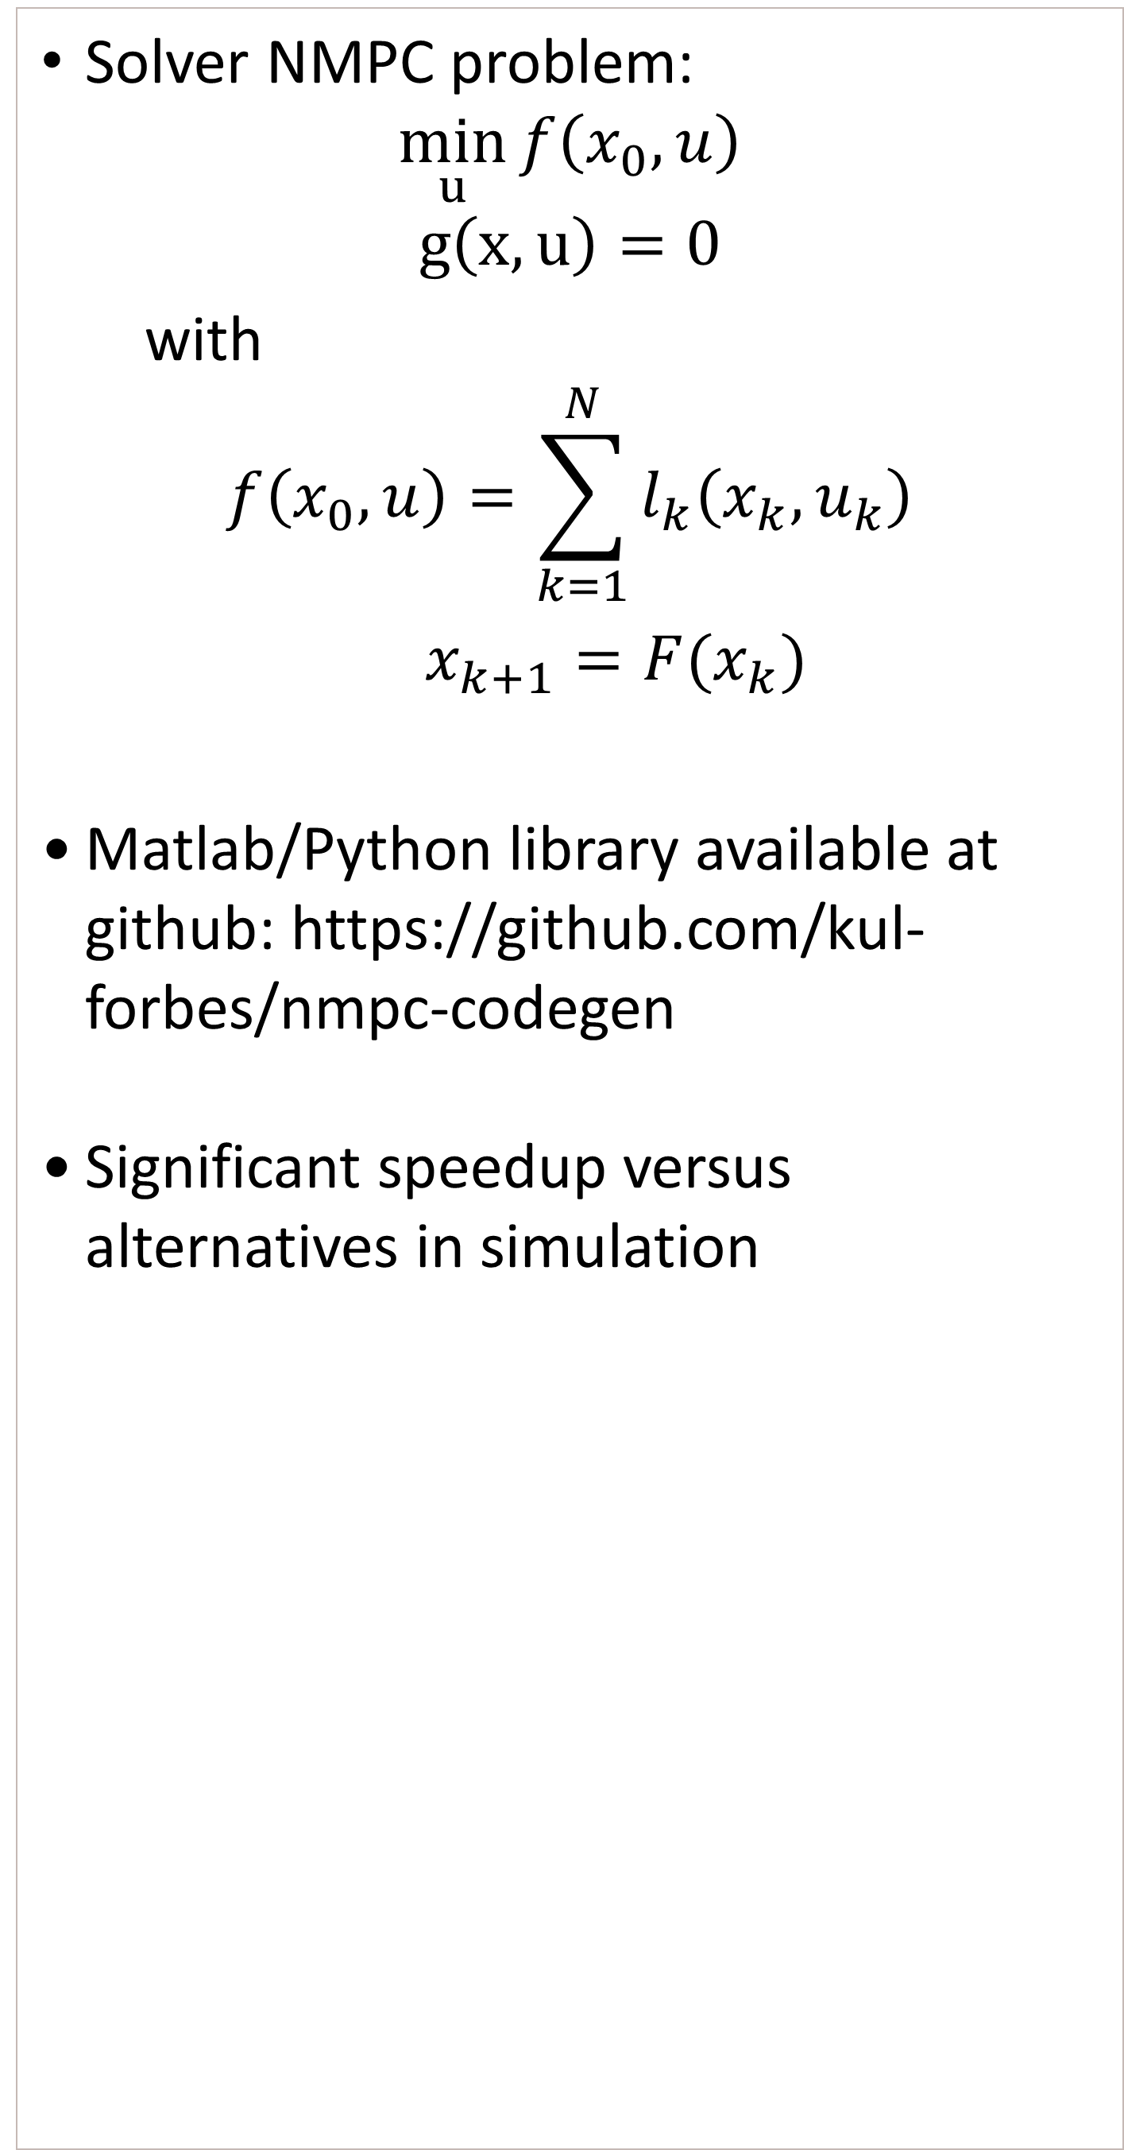
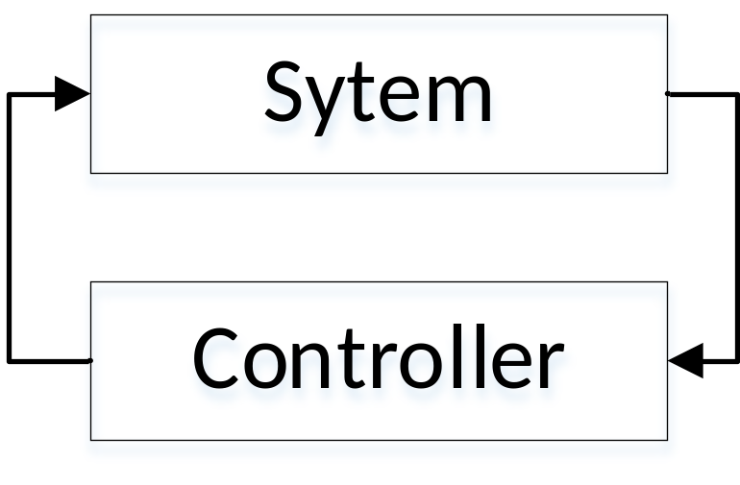

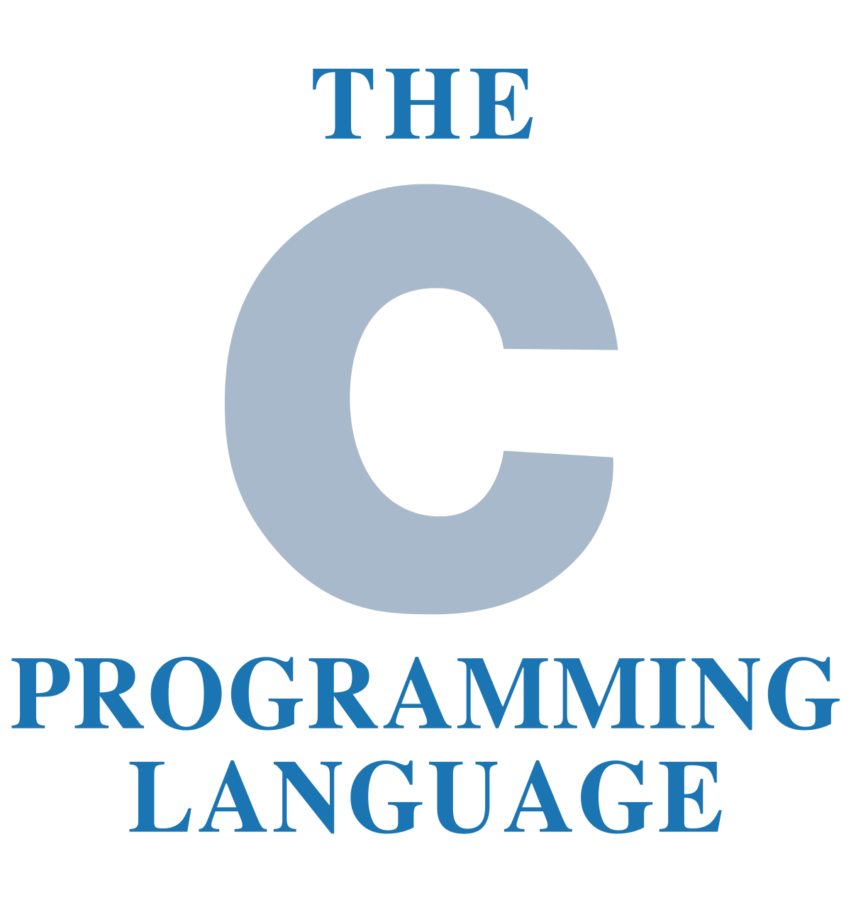


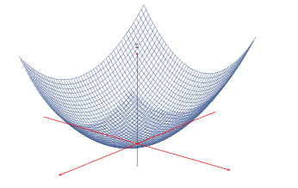
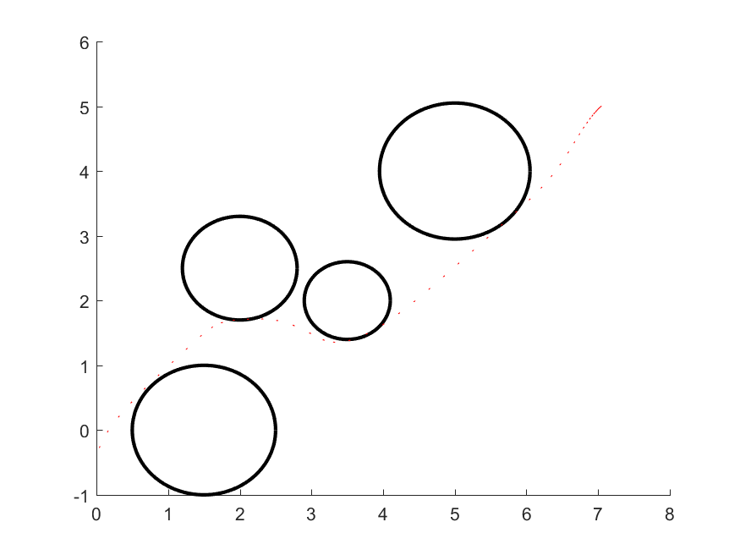
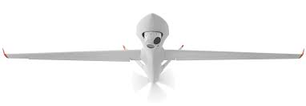
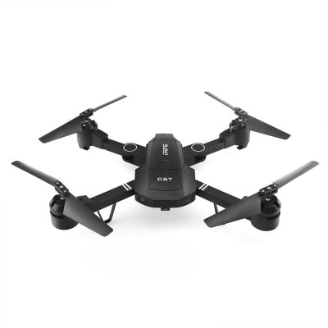
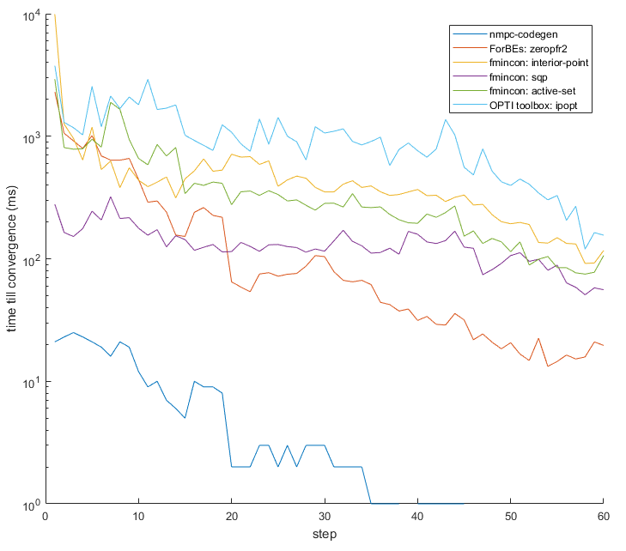

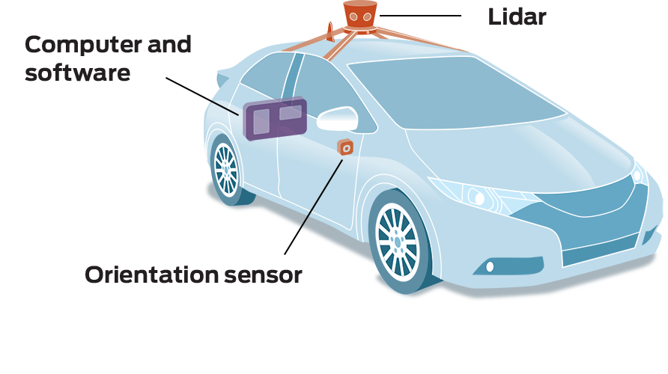
Newton-type operator splitting methods for embedded model predictive control
Context
Objective
Results
Implement a high level software package to generate non linear controllers aimed at embedded devices
Aimed at control engineers
No external C dependencies
Low memory usuage
Matlab and Python interface
Master
Wiskundige ingenieurstechnieken
Masterproef
Willem Melis
Promotor
Panos Patrinos
Results
Applications
Academiejaar
2017-2018
UAV
Quadcopters
Self driving vehicles

