Slide 1
ANALOGY of Evans
by Žilvinas Kučinskas PS1

Slide 2
Content
ANALOGY of Evans
Examples
Algorithm pseudocode
Algorithm implementation
Algorithm testing
Question for the audience
Questions & Answers

Slide 3
What is ANALOGY of Evans
ANALOGY of Evans is program for solving geometric analogy questions from intelligence tests

Slide 4
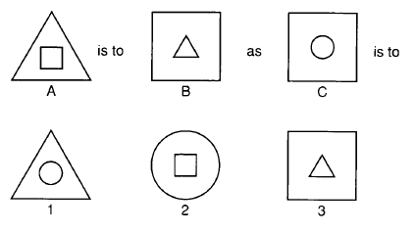
Example
In IQ tests the following question is posed: “A is to B as C is to which one of the ‘answer’ diagrams?”

Slide 5
Algorithm pseudocode
Find an operation that relates A to B
Apply the operation to C to give a diagram X
Find X, or its nearest equivalent, among the answers

Slide 6
Algorithm implementation
Analogy(A is_to B, C is_to X, Answers) :-
match(A, B, Operation),
match(C, X, Operation),
member(X, Answers).
match(above(Figure1, Figure2), above(Figure2, Figure1), invert)
Not correct

Slide 7
Algorithm implementation
Analogy(A is_to B, C is_to X, Answers) :-
match(A, B, Operation),
match(C, X, Operation),
member(X, Answers).
match(inside(Figure1, Figure2), inside(Figure2, Figure1), invert)
Correct! Get this operation

Slide 8
Algorithm implementation
Analogy(A is_to B, C is_to X, Answers) :-
match(A, B, Operation),
match(C, X, Operation),
member(X, Answers).
match( , X, invert)

Slide 9
Algorithm implementation
Analogy(A is_to B, C is_to X, Answers) :-
match(A, B, Operation),
match(C, X, Operation),
member(X, Answers).
FALSE
TRUE
FALSE

Slide 10
Algorithm testing
Test_analogy(Name, X) :-
figures(Name, A, B, C),
answers(Name, Answers),
analogy(A is_to B, C is_to X, Answers).
figures(test1, [inside(circle, triangle), inside(square, circle), inside(triangle, square)])

Slide 11
Algorithm testing
Test_analogy(Name, X) :-
figures(Name, A, B, C),
answers(Name, Answers),
analogy(A is_to B, C is_to X, Answers).
aswers(test1, inside(square, triangle), inside(triangle, square), inside(circle, square))

Slide 12
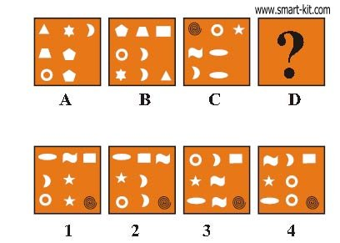
Question for the audience
A is to B as C is to
?

Slide 13
Answer
A is to B as C is to
1

Slide 14

Questions

