Slide 1




Getting Started With PGP
Digital Signature and Encryption for E-mail and Files

Slide 2
Problem: E-mail is insecure
More like a postcard than a letter
Can be read by any number of people in transit
If recipient’s account is compromised, may be read by unauthorized person(s)
Network sniffing may capture and reveal content to unauthorized person(s)

Slide 3
Problem: E-mail is easily forged
Current protocols date back to early 1970s
Headers, especially “From:” are ridiculously easy to forge
If sender account is compromised, may not actually have been sent by that person
How can you verify the sender’s identity?
A small demonstration (spoofmail.php)

Slide 4
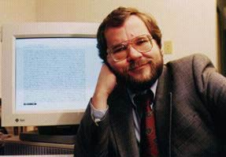

Solution: PGP (“Pretty Good Privacy”)
Developed in 1991 by Phil Zimmerman
Based on public/private key pair cryptography principle developed by Whitfield Diffie
Provides highly secure, portable encryption and signature for any digital data - including e-mail

Slide 5
PGP: Drawbacks
Not all that “user friendly”
Public/private key concepts take some getting used to
Doesn’t scale well to large user groups
If your private key is lost, corrupted or compromised, you have to generate a new one and start all over again

Slide 6
PGP: How Does It Work?
Let’s start with some basics of cryptography, and the high-level mathematics underneath it
Don’t worry, this is just to give you an idea of what’s going on.

Slide 7
Some Quick Definitions
Cryptography: encrypting and decrypting messages
Algorithm: a mathematical function used for encryption, decryption and verification
Key: a string used encryption and decryption

Slide 8
(Digital) Keys
In computer cryptography, a key is simply a binary number of varying length, depending on the type of cryptography being used
  “Symmetric” cryptography generally relies on keys of 128 bits or more (e.g. most web browser SSL sessions)
  “Asymmetric” cryptography requires keys of minimum 1024-bit length (2048 is typical these days)
A properly generated key can only be cracked by “brute force” - and only then after thousands of years (even at today’s processing speeds)

Slide 9
Keys: Encrypting/Decrypting
(A bit oversimplified)
One typical way keys are used to encrypt/decrypt is by use of “exclusive-OR” (XOR) logic:
If the bit to be encrypted is the same as the corresponding key bit, the encrypted bit is 0
If they are different, the resulting encrypted bit is 1
Without the key, you can’t be sure what the original bit was
Simple keys like this are vulnerable to “known text” attacks
TEXT KEY RESULT
0 0 0
0 1 1
1 0 1
1 1 0

Slide 10
“Symmetric” Cryptography
Relies on both sender and recipient having identical copies of the encryption key - or access to a “third party” that can verify that both have the correct key (e.g. online “certificate authority”)
Can use relatively low key lengths
  128 bits is more or less standard
  56 bits has been cracked
Problem: secure key distribution

Slide 11
“Asymmetric” Cryptography
(aka “Public/Private Key”)
Sender generates a “public/private” key pair
The “public” key can be freely given out
  Published on website, in e-mail sigs, etc.
  Some people put them on the back of their business cards
The “private” key is guarded at all costs
  If lost, corrupted or compromised, a new pair must be generated
  All your contacts must be notified and supplied with the new public key
Data encrypted to the public key can only be decrypted by the corresponding private key - and vice versa
PGP is based on “public/private” key cryptography

Slide 12
How are public/private key pairs generated?
Oversimplifying a bit again, but they are essentially based on mathematical operations involving two really, really large prime numbers
Prime numbers have been proven to have no known predictive pattern
Finding prime numbers is easy for small numbers
  14, 24, 49, etc
    Even?…divisible by 2
    Last digit is 5 or 0?…divisible by 5
    And so on...
  A LOT harder as the numbers get bigger - in fact, impossible

Slide 13
What is this number?
(2⁵⁷⁸⁸⁵¹⁶¹)-1
(To write it out in decimal form would require 17.425.170 digits - at 1 digit per second, it would take more than 200 days, non-stop)

Slide 14
The (Currently) Largest Known Prime Number
(2⁵⁷⁸⁸⁵¹⁶¹)-1
Source: primes.utm.edu/largest.html
(A really good site for “Stupid Number Tricks”)

Slide 15
PGP Public/Private Key Pair Strength
The public key is mathematically derived from the private key
The private key relies on the “computational difficulty” of deriving the large primes used to generate it
Private key lengths of 1024 bits are probably OK, but 2048 is the accepted standard for most users
Key lengths over 2048 bits are more secure, but tend to eat up processing power

Slide 16
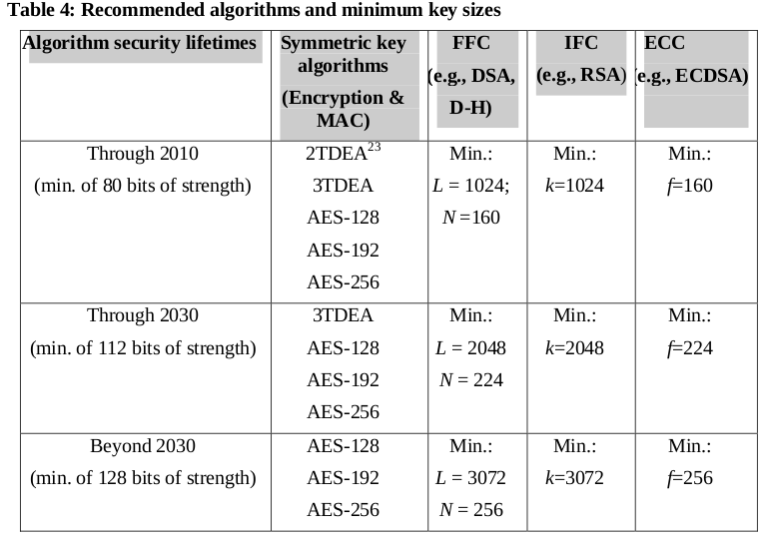
Recommended key size
From an archived publication:
Page 66: http://csrc.nist.gov/publications/nistpubs/800-57/sp800-57-Part1-revised2_Mar08-2007.pdf

Slide 17
Algorithms
Used to induce “randomness” in encoded message
Helps reduce “known text” vulnerability
“Encrypting” algorithms are designed to be reversible (they have to be, don’t they?)
  Some well-known ones: DSA, RSA
“Hashing” algorithms are “one-way”, i.e., irreversible
  Used to provide “signature”, or “shared secret” verification
  Used for password storage on most operating systems
  Well-known ones include SHA-1 or SHA-2 (used by PGP)

Slide 18
Example: SHA1
Input Output
1 356a192b7913b04c54574d18c28d46e6395428ab
2 da4b9237bacccdf19c0760cab7aec4a8359010b0
3 77de68daecd823babbb58edb1c8e14d7106e83bb
4 1b6453892473a467d07372d45eb05abc2031647a
5 ac3478d69a3c81fa62e60f5c3696165a4e5e6ac4

Slide 19
Well-known Algorithms
The best-known algorithms are used to remove patterns and predictability from encoded messages
They are not secret - in fact, they are made public and subjected to rigorous testing
Encryption algorithms are reversible - they have to be

Slide 20
Where’s the Security?
In a public/private key cryptography environment, the strength lies in the length and protection of the private key - and the algorithm

Slide 21
Digital Signatures
Usually applied to e-mail messages to verify the sender’s identity
Sender “signs” the message with his private key
  Hashing algorithm is applied as well
  Hashing also provides check on message integrity
Anyone who has sender’s public key can apply it to verify sender’s identity
  ONLY someone who has the corresponding private key could have sent it
  Hashing also verifies that the message was not altered in transit

Slide 22
What does a “Public Key” look like?
-----BEGIN PGP PUBLIC KEY BLOCK-----
Version: OpenPGP.js v0.9.0
Comment: http://openpgpjs.org
xo0EVOMXoAEEAM6uJZGrkiXd+bcjsrCs5JGUZo+SrqrnkevXL4a5oIUDWqG4
l/yf2s1VqfzTtci8uuKz0dVWWjZDLPLCCVWU6RXnr2+5F/VliaRkVRJ+FUzG
DWL3VKsX42L2+gsceOL3t+4rVIUGCA81AB/GRQ7Erm84UOGTrPCsLdrrUeSp
Z7pjABEBAAHNI0JhcnJ5IGRlIEdyYWFmZiA8YmdyYWFmZkBoaXZvcy5vcmc+
wrIEEAEIACYFAlTjF6AGCwkIBwMCCRBZYcp/r9V5bgQVCAIKAxYCAQIbAwIe
AQAA7bwEALX6EA6P8NnNlTRCBv1CZvmW43GpU7eA2wxg2Ym0NTaMOrXadcQe
anRIGahuaNRrhXWa9Lq5tDQAhy1OfZRnEPI8POOwmmX0EHO4jNveTUw38F17
kTkMPmGXp9W8piqAHvr+LXOs3ChIMpDeyBSvL9JCw3HK0BQcfIWsgqJfJ+7Y
zo0EVOMXoAEEALdeZkc1c24fhLgI7GCvMoKjm2oSnC3jHoJa/vgrT7Npy9jx
BfARB266dOGma9d2L9LVAnbPp/skInTUSlP+b08l2OlgxgZ41bXri29XLLQB
/CMbQU0Z2ARg6EWbmi5ugm0ZmGotkzbBhwbD0mRaIpdr2WPVAMUSTZetonyT
TGUZABEBAAHCnwQYAQgAEwUCVOMXoAkQWWHKf6/VeW4CGwwAAGtuBACqlIAt
ydWg7ctUvLkHxv8t8MX+uovAwBgwHa6XmXzYO4D2rXfXxRYPTaMpCGjW1qFN
601w01WHcT43zCSzbwZZy6zJ21Oq//vMS8BlXQ8f5EXh+dWmgH2GA/bLGywK
tqe0GJex5MH3z7WLtM7twXKB67Ya+iI+Zt+JoQizQllHRA==
=2Ojo
-----END PGP PUBLIC KEY BLOCK-----
Hashed “fingerprint”:
1bf440b445d85c2ba39fb1365961ca7fafd5796e
(Hexadecimal)

Slide 23
How do I know that’s really your public key?
Generating public/private key pairs does NOT require any authentication - you can associate any name and e-mail address with a key pair you choose
To be completely certain that a given public key actually belongs to the person it claims, you need to physically verify the person’s identity and key in person
Check the key fingerprint
Do not trust third parties (security by the weakest link)

Slide 24
Public Key Distribution
Published on a (personal) website
Via a CD/DVD or USB drive
Send as e-mail attachment
Send as e-mail attachment via internal mailserver ehhhmm.
Upload it to a “key server”
Use a QR code on the back of your business card with your key fingerprint
Print it out on a sheet of paper, along with the fingerprint not very practical...

Slide 25
Demonstration
Zimbra OpenPGP Zimlet

Slide 26
Training
Work with the
Zimbra OpenPGP Zimlet
Go to:
http://www.barrydegraaff.tk/training

Slide 27
Questions?

