Slide 1

Adequate Infosoft Pvt. Ltd.

Slide 2
The Ad-Tech Project Which We Built:
We worked on three Ad-tech projects:
One is for our Malaysian client’s Business Application so that he can promote his Hotel Business on Google.
Two are for our E-commerce websites project as per the client requirements from Denmark. We are under the NDA with the client so we can’t dhare the details here.

Slide 3
Mockup of Our project:
Google AdWords is Google's online advertising program which use to promote the business , help sell products or services, raise awareness, and increase traffic on website.
Sorry, we can not give you the access of the account because we are under the NDA with client.
But, we can provide you the walk through of our Ad-Teach project via Skype for Mockup.
It will good if we can discuss over the Skype for required Mockup.

Slide 4
What We Built:
First, as Adword is a media buying channel so we take the access of account from the client for access of Google API.
Then, we write a code to integrate Google Adword API to the client website so that client will be able to create advertisements which will appear on relevant Google search results pages and their network of partner sites.
Please go through the above slides for more details of our
work:-

Slide 5
Adequate Works On Below for the clients:
Account
Campaigns
ad groups
Matching Keywords
Bidding

Slide 6
Adequate Follow the following Account Structure :
Account is associated with a unique email address,
password, and billing information.
Account Structure
Ads
Keywords
Campaign 1
Campaign 2
Ads
Keywords
Ad Group 1
Ad Group 2
Ad Group 1
Ad Group 2
Ads
Keywords
Ads
Keywords
Ads
Keywords
Ads
Keywords
Ads
Keywords
Ads

Slide 7
Adequate Works on following types of Campaign Types:
*
Search Network with Display Select
Search Network Only
Online Video
Display Network Only
Shopping

Slide 8
Adequate Works on following types of Ad Types:
Text Ad
Image Ad
Video Ad
Dynamic Ad
Mobile Ad

Slide 9
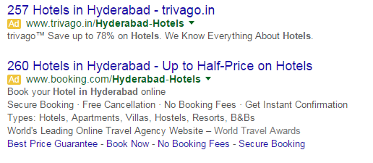
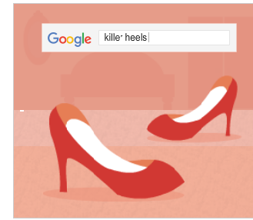
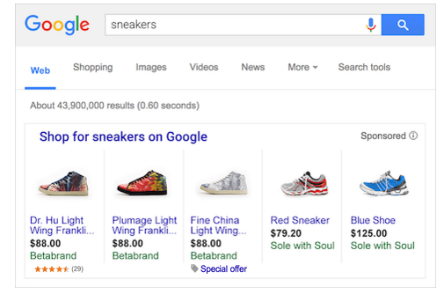
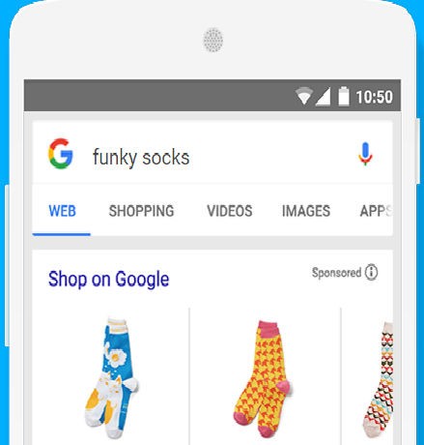
Example of Ad Types:

Slide 10
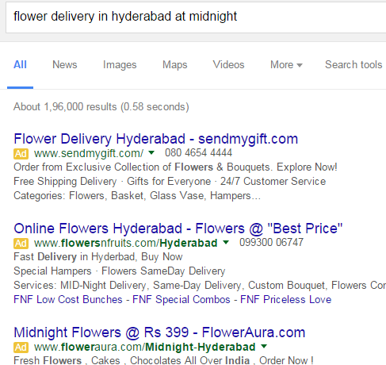
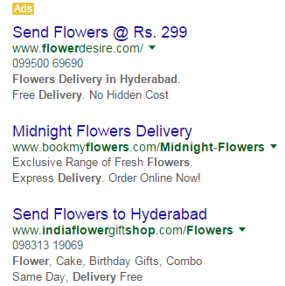
The Search Result Work as Follow:

Slide 11
Adequate Work On following Keywords Match Types
Keywords Types
Broad
Match
Phrase
Match
Exact
Match
Broad Match Modifier
- This ad automatically run on relevant variations of your keywords, even if these terms aren't in your keyword lists.
- The ad will show, if user query matches with your keyword in same manner.
- Denoted with double quotes ( “ “ ) symbol
- The ad will show, if the keyword matches exactly with your query.
- Denoted with square brackets ( [ ]) symbol
- Best match type to target many users, who use a combination of keywords.
- Denoted with plus ( + ) symbol

Slide 12
Adequate Work on Following Bidding Types:
CPM(Cost-per-thousand impressions)
CPC(Cost-per-click )
CPA(Cost-per-acquisition)

Slide 13
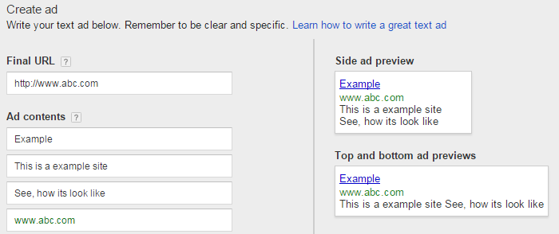
Adequate Create-Ads as Follow:

Slide 14
What it Did?
Promote the business.
Increase the sale of product or service.
Raise awareness
Increase traffic
Rest Shown in above slide:

Slide 15
Adequate work result:
Reach people searching for what you offer
Control your budget
Measurable, accountable, flexible
Cost Effective
Maximum Relevance
Highly Targeted
Remarketing

Slide 16
Adequate Exactly work on the Following for the Ad word API:
Create Account
Create Campaigns
Build ad groups
Work on Matching Keywords
Do Bidding
Work on Ad-Rank
Work with Ad-Extensions
Also Create Ads
Work on Editor Tool

Slide 17
Thank You….

