Slide 1
SFI Challenge
Solution Proposal
TEAM Karnex/Thunder Brain
John Rycca Belcina & Harkiran Deep Singh Panesar
GitHub repository link: https://github.com/Zimgo012/SFI-Challenge
Notes:
RPM =rate per mile
MLP = multilayer perception

Slide 2
The Business Problem

Slide 3
Trucks driving empty waste fuels, time, and money
Conflicting schedules cause double-booking and missed pickups.
Winning shipments does not guarantee profitable deliveries.
Expiring offers demand fast, informed decisions.

Slide 4
The Challenge Goal

Slide 5
Reduce empty miles by chaining compatible loads.
Match shipments with available trucks and conflict-free schedules.
Protect profit margins before accepting or bidding.
Use live data and guarded automation to capture worthwhile opportunities.

Slide 6
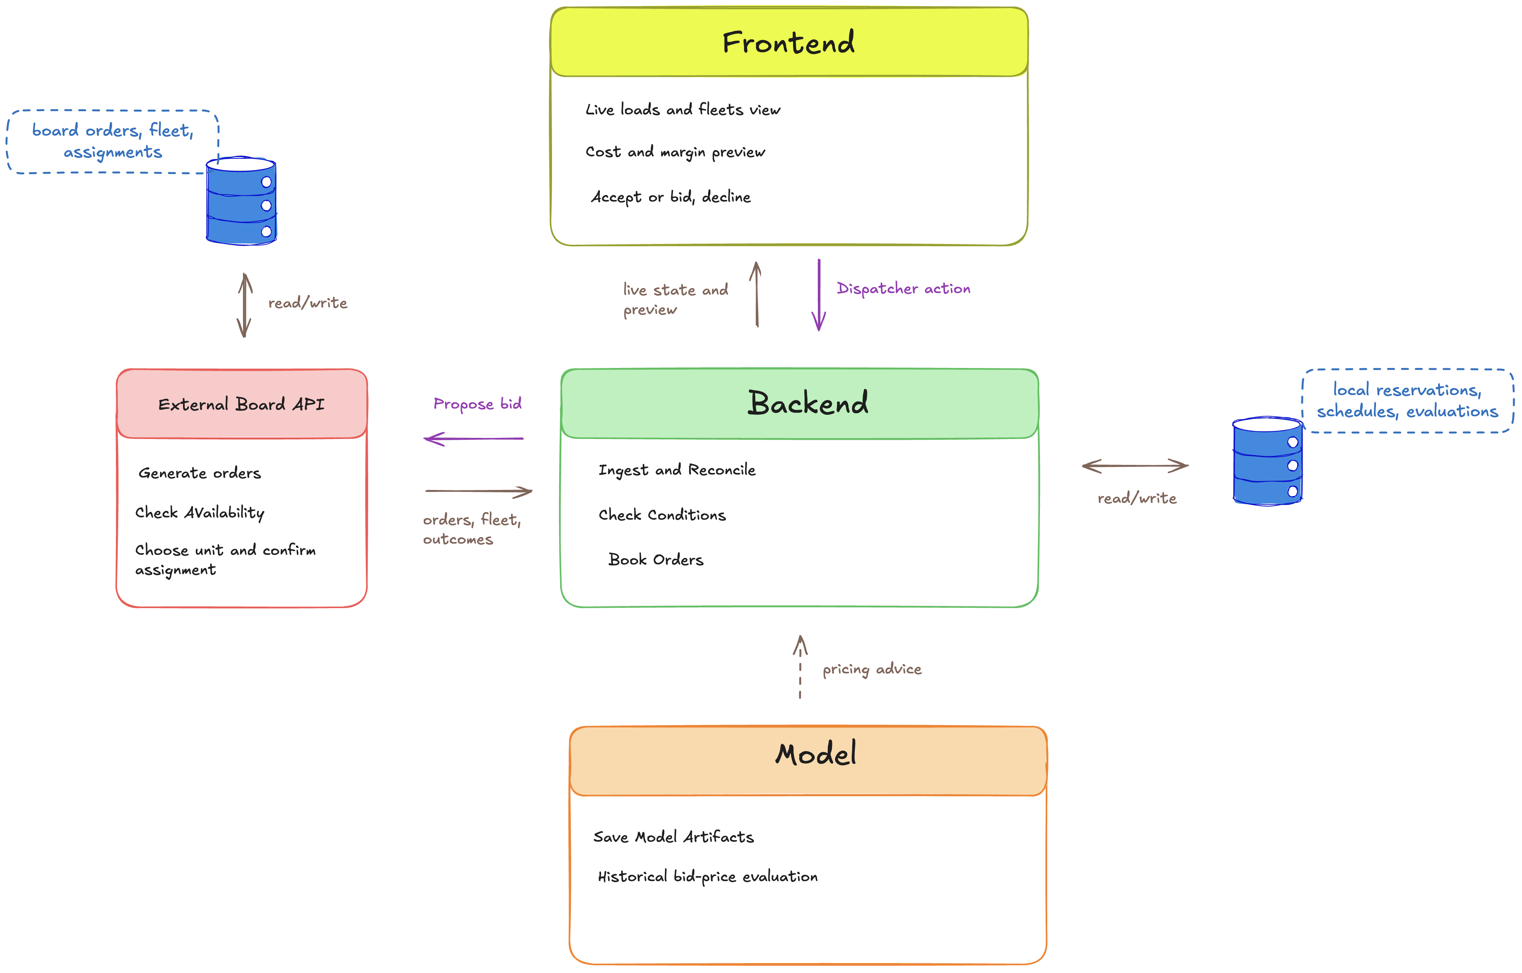
High-level System Architecture

Slide 7
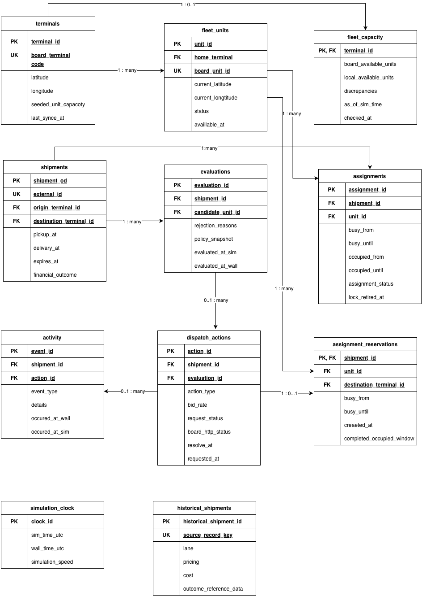
ERD

Slide 8
What the Backend Delivers

Slide 9
  Synchronize orders, fleet, terminals, and simulated time through WebSockets and REST reconciliation.
  Check truck availability and full occupied windows, then reserve capacity atomically to prevent double-booking.
  Project each truck’s position after delivery and calculate its empty travel to the next pickup.
  Calculate loaded and deadhead costs, expected profit, margin, and minimum profitable bids before booking.
  Support manual actions and model-selected automatic bookings, with fresh checks and configurable limits.
  Store assignments, evaluations, actions, and outcomes in our own database; reconcile missed events and preserve decision history.
1. Live Freight Visibility
2. Reliable Fleet Scheduling
3. Smarter Load Chaining
4. Profit-Aware Decisions
6. Persistent State and Auditability
5. Guarded Booking Autopilot

Slide 10
Backend workflow

Slide 11
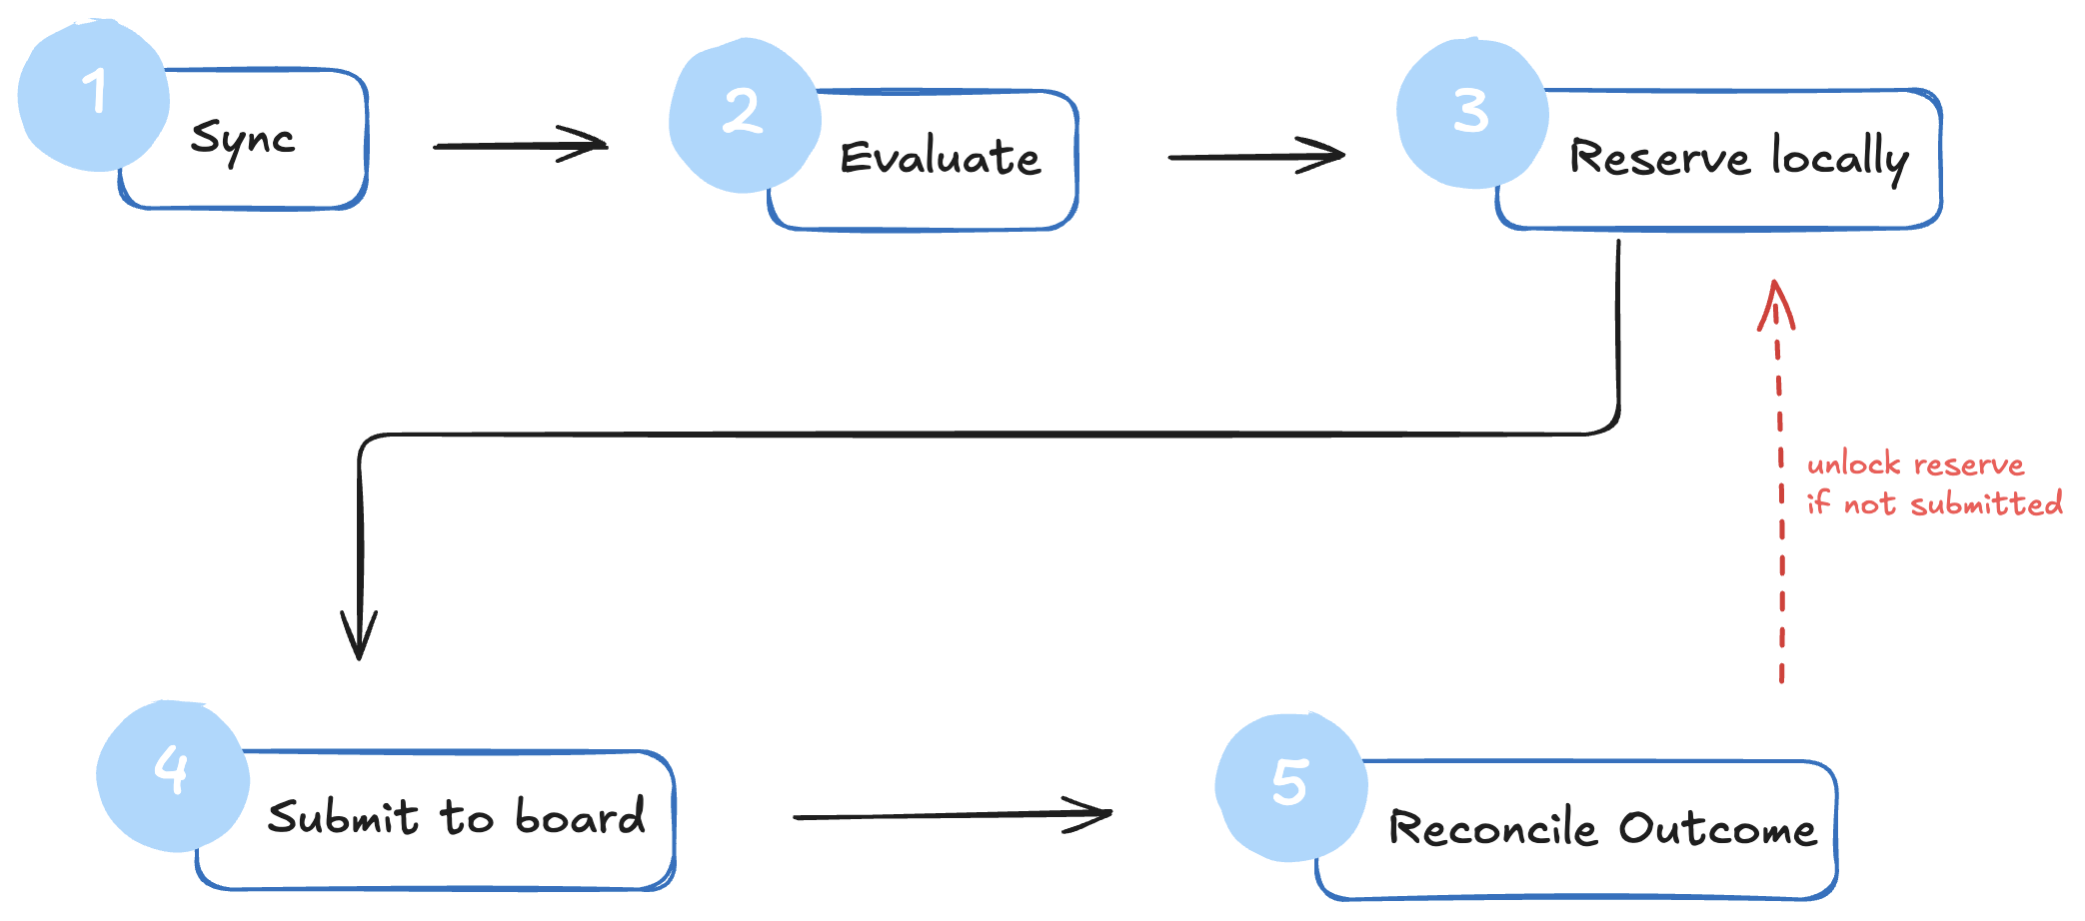
High-level Backend Workflow
Notes:
1. Capture Live Opportunities — Sync orders, fleet, terminals, and simulated time.
2. Check Operational Feasibility — Verify truck availability, schedules, weight, location, and expiry.
3. Calculate Expected Profit — Estimate selected-truck deadhead, total cost, margin, and bid floor.
4. Choose the Booking — Support a dispatcher’s decision or an authorized autopilot selection.
5. Reserve and Submit — Reserve capacity atomically, recheck applicable conditions, and call the board.
6. Track and Reconcile — Confirm awards, assignments, transit, and completion; update capacity and audit history.

Slide 12
Capture Live Opportunities
  Sync orders, fleet, terminals, and simulated time.
Check Operational Feasibility
  Verify truck availability, schedules, weight, location, and expiry.
Calculate Expected Profit
  Estimate selected-truck deadhead, total cost, margin, and bid floor.
Choose the Booking
  Support a dispatcher’s decision or an authorized autopilot selection.
Reserve and Submit
  Reserve capacity atomically, recheck applicable conditions, and call the board.
Track and Reconcile
  Confirm awards, assignments, transit, and completion; update capacity and audit history.

Slide 13
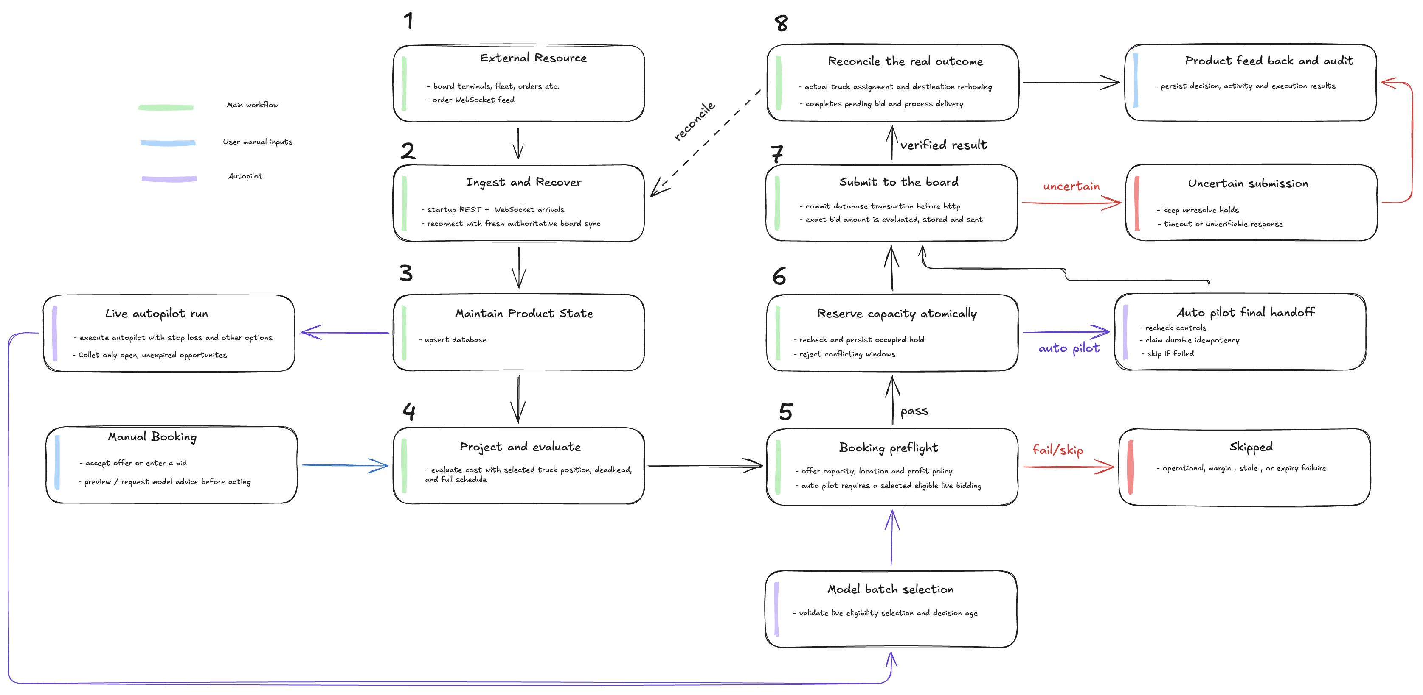
Backend detailed workflow

Slide 14
Price Analyzer

Slide 15
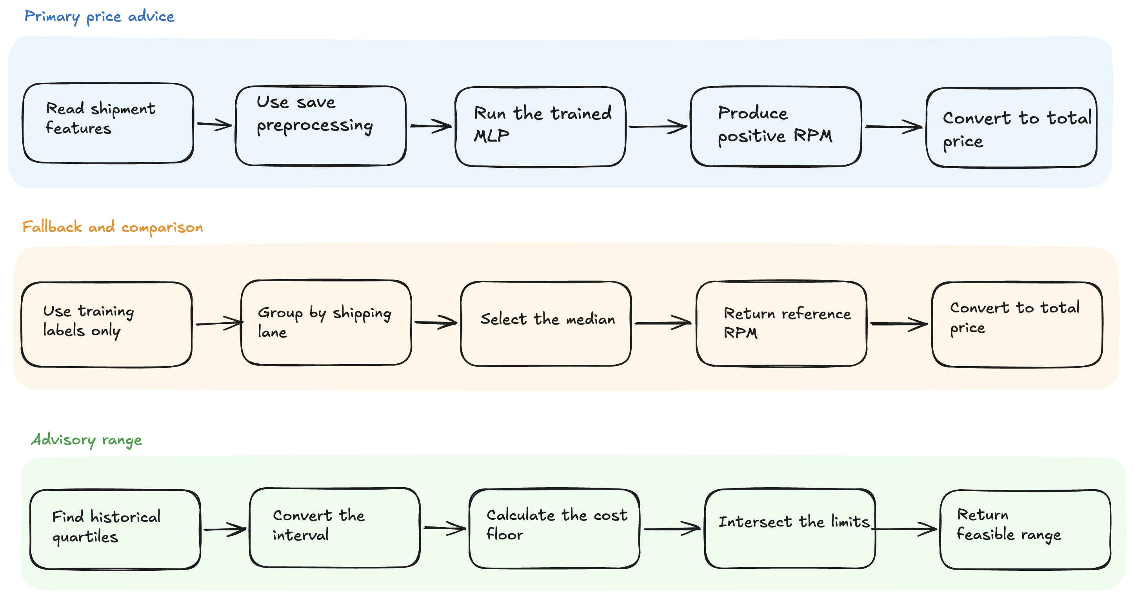
Model Analyzer Step

Slide 16
How the model train

Slide 17
Preparing shipment information
StandardScaler puts numeric values onto comparable scales.
One-hot encoding turns route and state names into numbers the model can understand.

Slide 18
Predicting Number
The model learns from shipment details and historical submitted bids to estimate dollars per loaded mile (RPM). Multiplying that by the shipment’s loaded miles gives the suggested total bid.

Slide 19
Ask the model to estimate a price using ReLU
Neural-network regression combines the shipment details to predict RPM.
Inside the network, ReLU helps it learn complex relationships.
For example, how distance and route together influence price. Softplus keeps the final predicted RPM positive.

Slide 20
Learn from the mistake
The historical answer is calculated as:
Submitted bid ÷ loaded miles = historical RPM
Huber loss measures the difference between the prediction and that answer, while preventing a few extreme errors from dominating the learning.
Repeat, check and save…

Slide 21
Live use of the model

Slide 22
Fleet matching
Inside the fleet matcher, successive shortest augmenting paths helps it choose the order truck combination with the highest total projected profit.

Slide 23
Calculate Bids

Slide 24
Frontend Pages

Slide 25
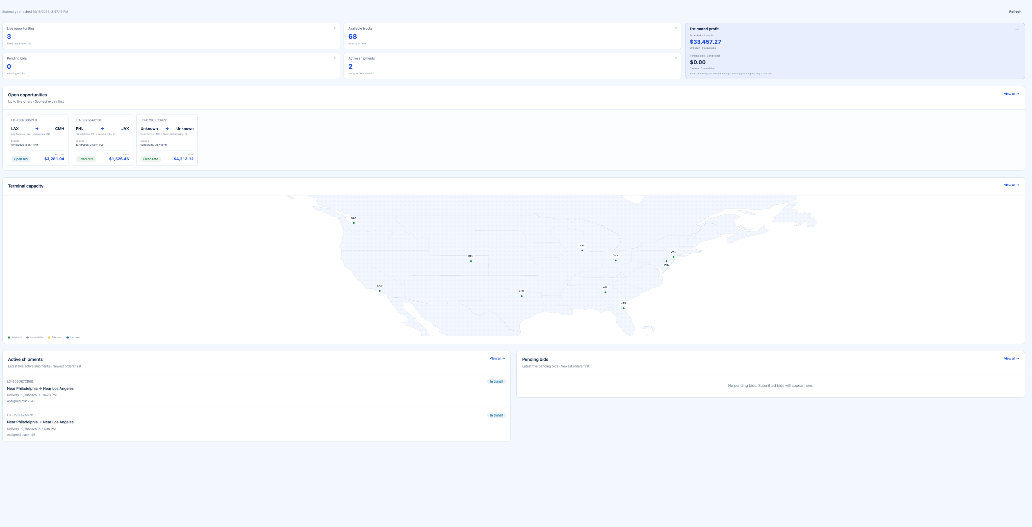
Dashboard
Notes:
Unnecessary

Slide 26
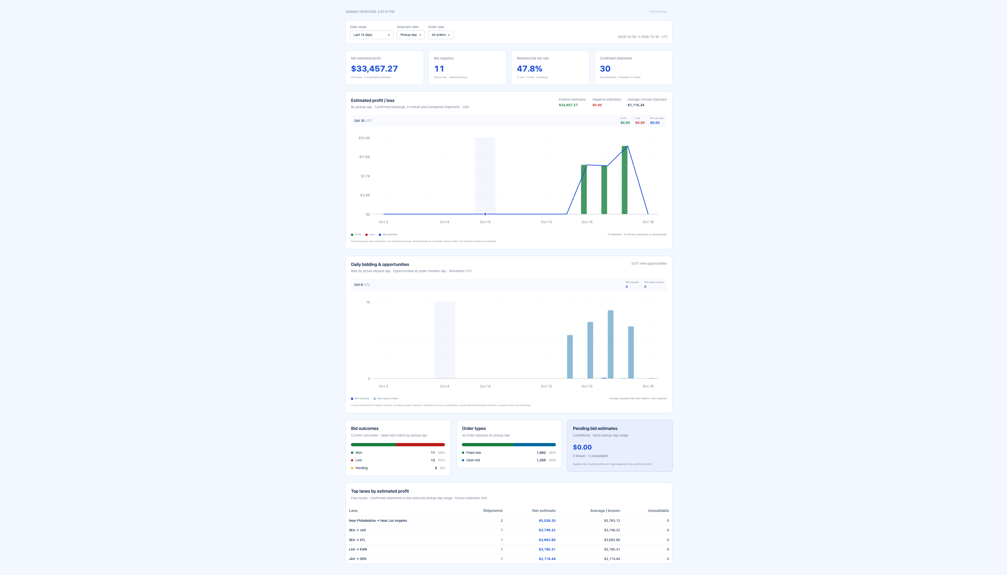
Analytics

Slide 27
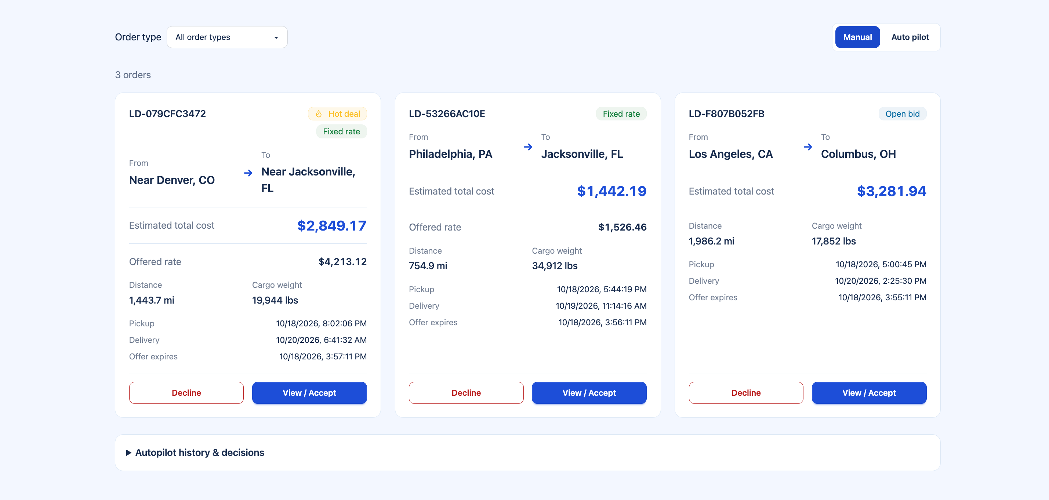
Load Board

Slide 28
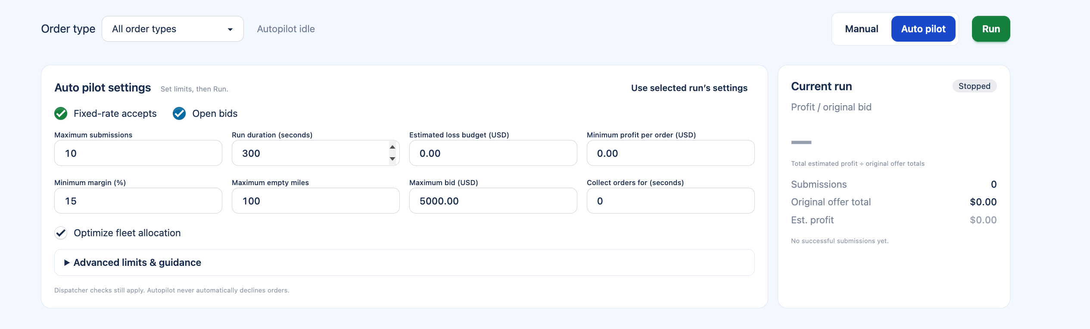
Auto-pilot limiter and settings

Slide 29
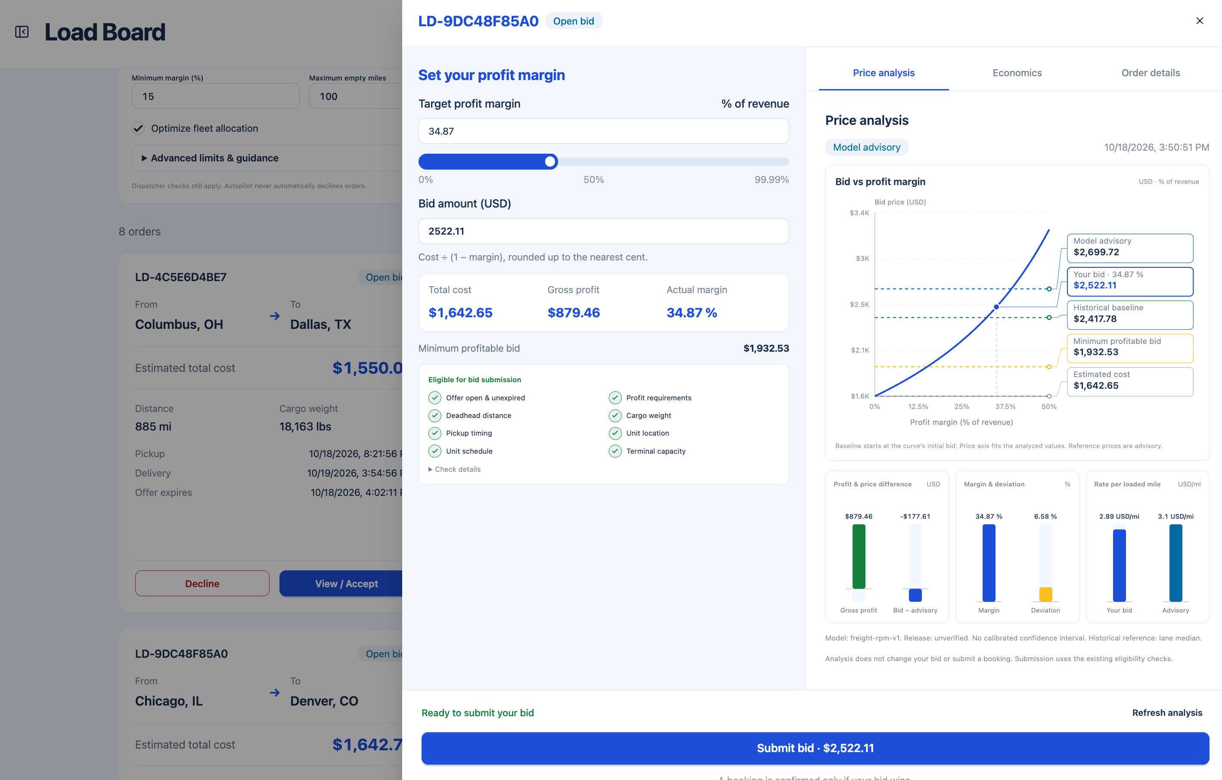
Price Analysis

Slide 30
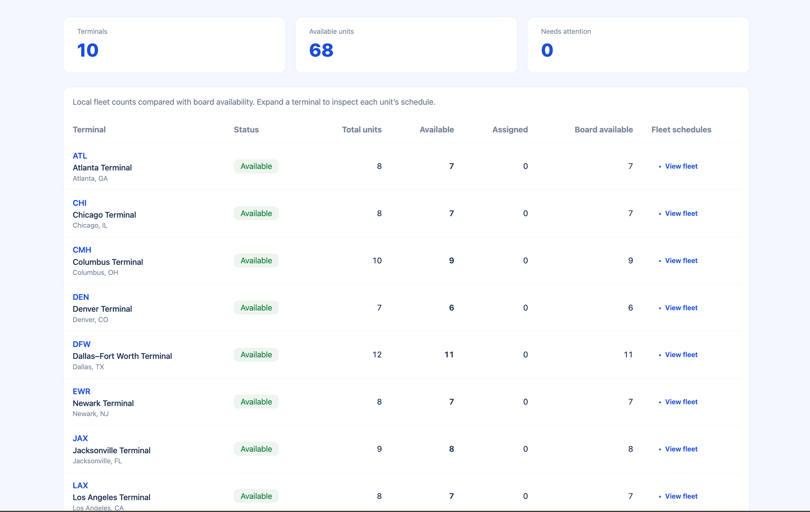
Terminals

Slide 31
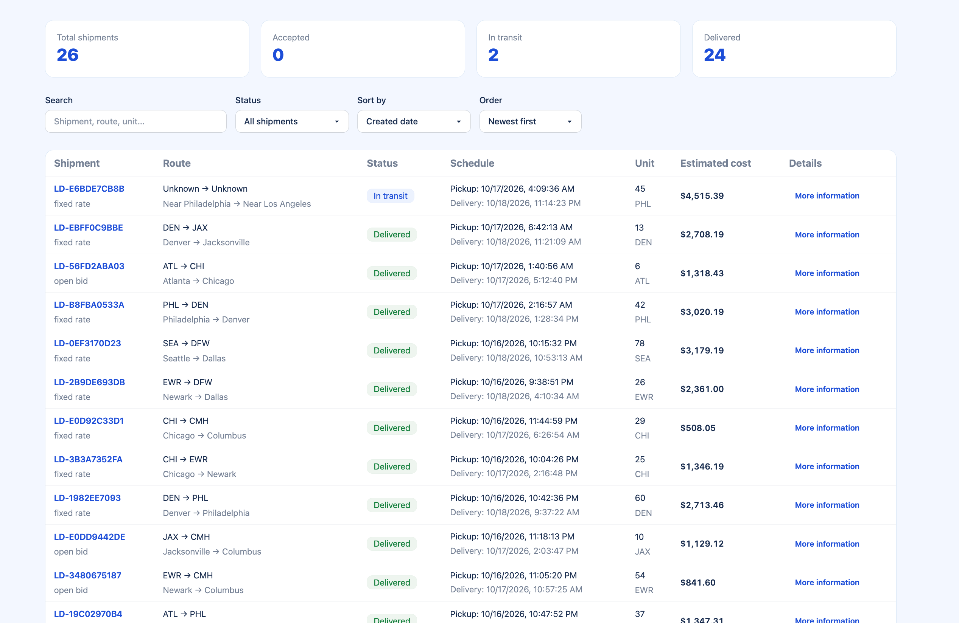
Shipments

