Slide 1
Updates on GraphSAGE
Presented by: Hanqing Zeng
Feb 8, 2017

Slide 2
Outline
Background
Problem on mini-batch sampling
Partitioning algorithm
Results

Slide 3
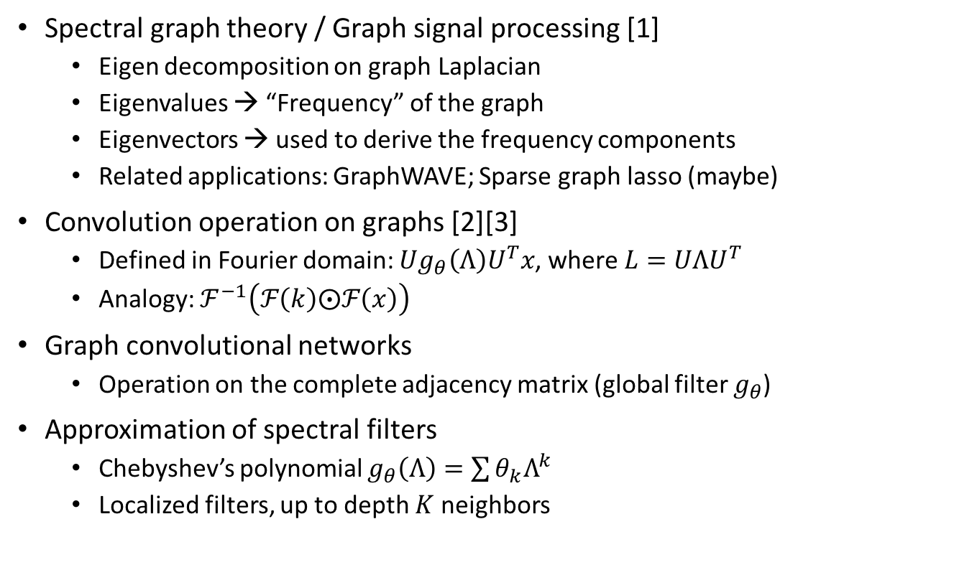
Background
Spectral graph theory / Graph signal processing [1]
Eigen decomposition on graph Laplacian
Eigenvalues → “Frequency” of the graph
Eigenvectors → used to derive the frequency components
Related applications: GraphWAVE; Sparse graph lasso (maybe)
Convolution operation on graphs [2][3]
Defined in Fourier domain: $Ug_{θ}\left(Λ\right)U^{T}x$, where $L=UΛU^{T}$
Analogy: $ℱ^{−1}\left(ℱ\left(k\right)⨀ℱ\left(x\right)\right)$
Graph convolutional networks
Operation on the complete adjacency matrix (global filter $g_{θ}$)
Approximation of spectral filters
Chebyshev’s polynomial $g_{θ}\left(Λ\right)=\sum{θ_{k}Λ^{k}}$
Localized filters, up to depth $K$ neighbors

Slide 4
GraphSAGE Review
Full batch algorithm [4]

Slide 5



Mini-Batch Algorithm
Current GraphSAGE assumption
Sampling trees within a batch do not overlap
True when randomly select a batch in very large graphs
Computation complexity ($S$ samples; $k$ layers; feature length $l$)
Full batch: $O\left(\left|V\right|⋅l^{3}\right)$
Mini batch: $O\left(\left|V\right|⋅l^{3}⋅S^{k−1}\right)$
Mini batch complexity can be reduced by intelligent partitioning
4
1
2
3
4
5
6
7
Layer 2
2
6
1
2
3
4
5
6
7
Layer 1
1
7
3
5
1
2
3
4
5
6
7
Layer 0
$$\left(1+γ⋅(1+S)\right)⋅l^{2}⋅l$$
$$\left(1+1+S\right)⋅l^{2}⋅l$$

Slide 6
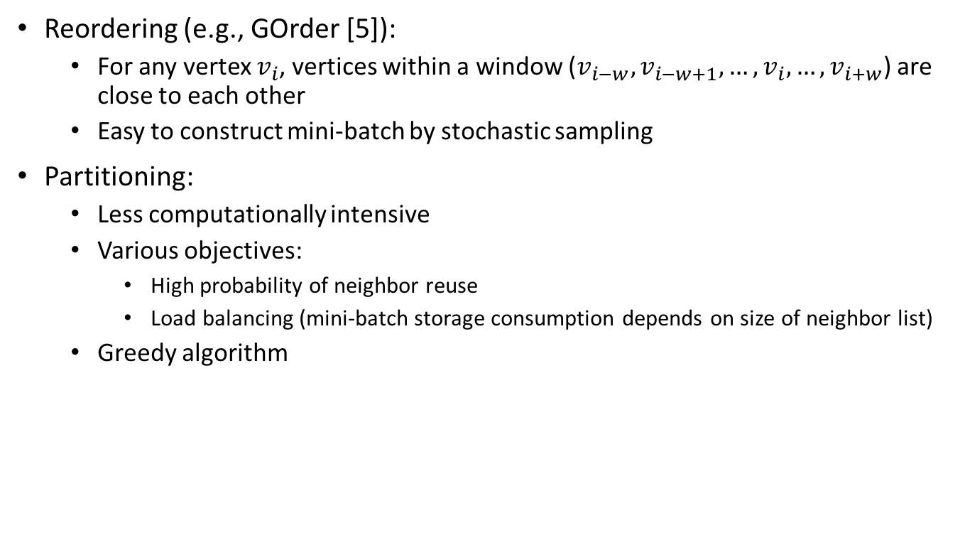
Partitioning / Reordering
Reordering (e.g., GOrder [5]):
For any vertex $v_{i}$, vertices within a window ($v_{i−w}, v_{i−w+1}, …, v_{i}, …, v_{i+w}$) are close to each other
Easy to construct mini-batch by stochastic sampling
Partitioning:
Less computationally intensive
Various objectives:
High probability of neighbor reuse
Load balancing (mini-batch storage consumption depends on size of neighbor list)
Greedy algorithm

Slide 7
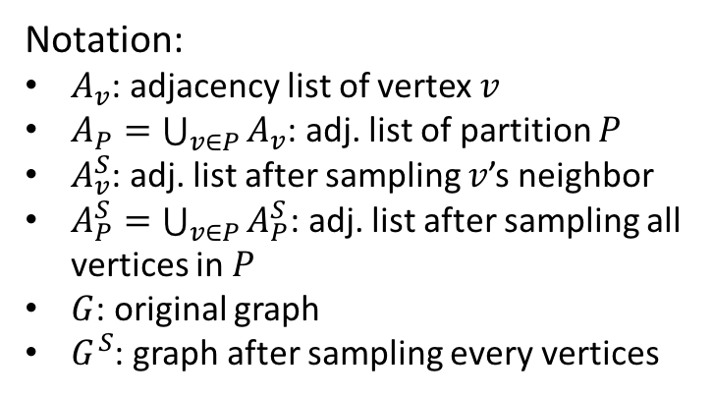
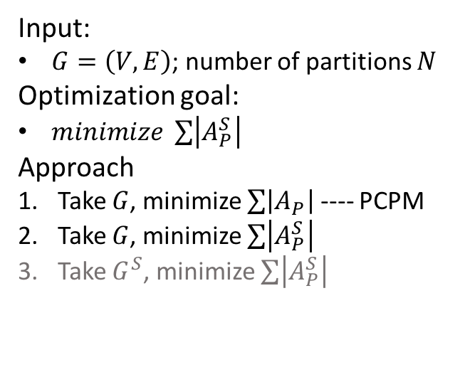
Greedy Partitioning Algorithm
Notation:
$A_{v}$: adjacency list of vertex $v$
$A_{P}=\bigcup_{v∈P}{A_{v}}$: adj. list of partition $P$
$A_{v}^{S}$: adj. list after sampling $v$’s neighbor
$A_{P}^{S}=\bigcup_{v∈P}{A_{P}^{S}}$: adj. list after sampling all vertices in $P$
$G$: original graph
$G^{S}$: graph after sampling every vertices
Input:
$G=\left(V,E\right)$; number of partitions $N$
Optimization goal:
$minimize \sum{\left|A_{P}^{S}\right|}$
Approach
Take $G$, minimize $\sum{\left|A_{P}\right|}$ ---- PCPM
Take $G$, minimize $\sum{\left|A_{P}^{S}\right|}$
Take $G^{S}$, minimize $\sum{\left|A_{P}^{S}\right|}$
f
P1
a
b
c
d
e
P2
a
b
c
d
e
f
g
h
Status table
P1
1
2
1
0
1
P2
2
3
1
1
2

Slide 8
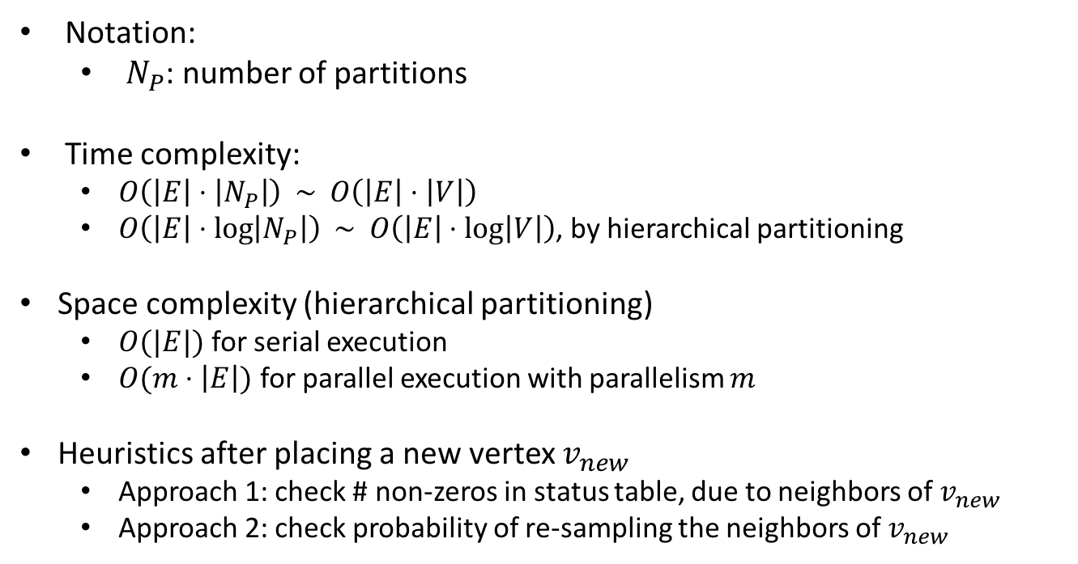
Greedy Partitioning Algorithm
Notation:
$N_{P}$: number of partitions
Time complexity:
$O\left(\left|E\right|⋅\left|N_{P}\right|\right) \sim O\left(\left|E\right|⋅\left|V\right|\right)$
$O\left(\left|E\right|⋅\log\left|N_{P}\right|\right) \sim O\left(\left|E\right|⋅\log\left|V\right|\right)$, by hierarchical partitioning
Space complexity (hierarchical partitioning)
$O(|E|)$ for serial execution
$O(m⋅\left|E\right|)$ for parallel execution with parallelism $m$
Heuristics after placing a new vertex $v_{new}$
Approach 1: check # non-zeros in status table, due to neighbors of $v_{new}$
Approach 2: check probability of re-sampling the neighbors of $v_{new}$

Slide 9
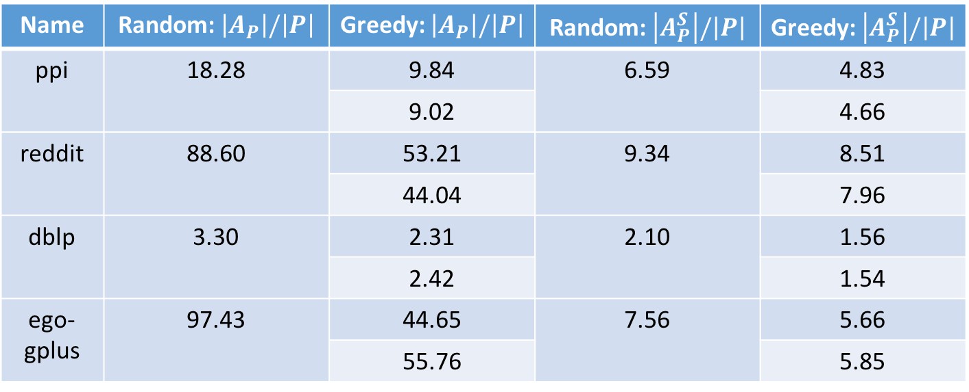
Greedy Partitioning Results (|P|=256; |S|=10)
Name | |V| | |E| | Category | Comment
ppi | 0.01 M | [U] 0.23 M | Biology | Used by GraphSAGE
reddit | 0.2 M | [U] 11.6 M | Social network | Used by GraphSAGE
dblp | 0.3 M | [U] 1.0 M | citation
ego-gplus | 0.1 M | [D] 12.2 M | Social network
Name | Random: $\left|A_{P}\right|/\left|P\right|$ | Greedy: $\left|A_{P}\right|/\left|P\right|$ | Random: $\left|A_{P}^{S}\right|/\left|P\right|$ | Greedy: $\left|A_{P}^{S}\right|/\left|P\right|$
ppi | 18.28 | 9.84 | 6.59 | 4.83
 |  | 9.02 |  | 4.66
reddit | 88.60 | 53.21 | 9.34 | 8.51
 |  | 44.04 |  | 7.96
dblp | 3.30 | 2.31 | 2.10 | 1.56
 |  | 2.42 |  | 1.54
ego-gplus | 97.43 | 44.65 | 7.56 | 5.66
 |  | 55.76 |  | 5.85

Slide 10
References
David I Shunman, et al. The Emerging Field of Signal Processing on Graphs. 2013
Michael Defferrard, et al. Convolutional Neural Networks on Graphs with Fast Localized Spectral Filtering. 2017
Thomas N. Kipf, et al. Semi-Supervised Classification with Graph Convolutional Networks
William L. Hamilton, et al. Inductive Representation Learning on Large Graphs. 2017
Hao Wei, et al. Speedup Graph Processing by Graph Ordering. 2016

Slide 11
^{Thank You}

