Slide 1

Hajee Mohammad Danesh Science and Technology University
ClubMS
University Club Management Platform
CSE 352 — Web and Mobile Application Development Sessional
Md Farhan Quadery — 2202015
Md Saddam Hosen Molla — 2202042
Department of Computer Science and Engineering

Slide 2
01 · MOTIVATION
Running a club still runs on paper and chat groups
01
No club directory
No single place to see which clubs exist.
02
Manual membership
Google Forms + spreadsheets; approvals unrecorded.
03
Lost announcements
WhatsApp posts scroll away; new members find nothing.
04
Unclear event ownership
Joint events announced separately; attendance splits.
05
No alumni record
Membership ends at graduation; history disappears.

Slide 3
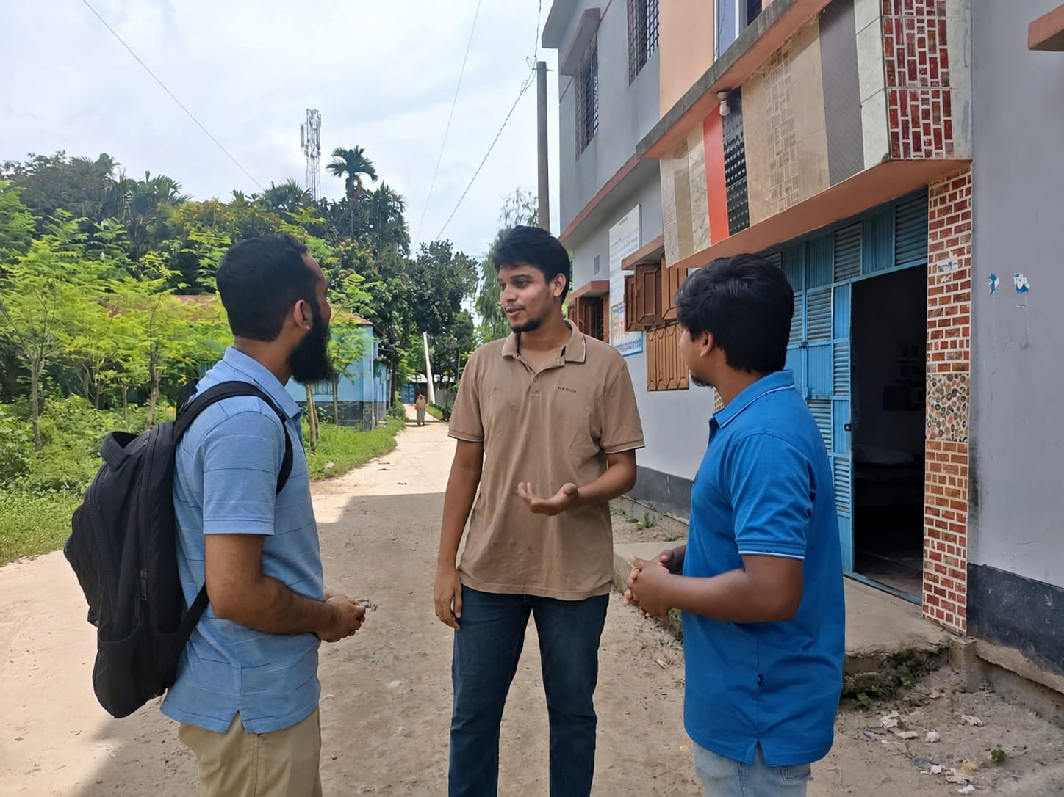
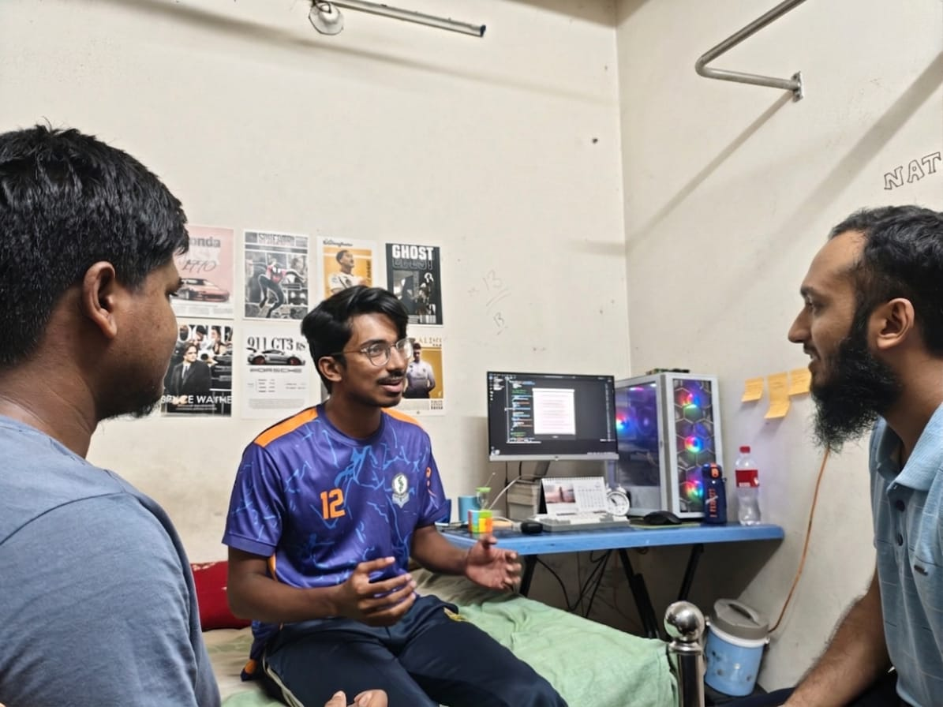
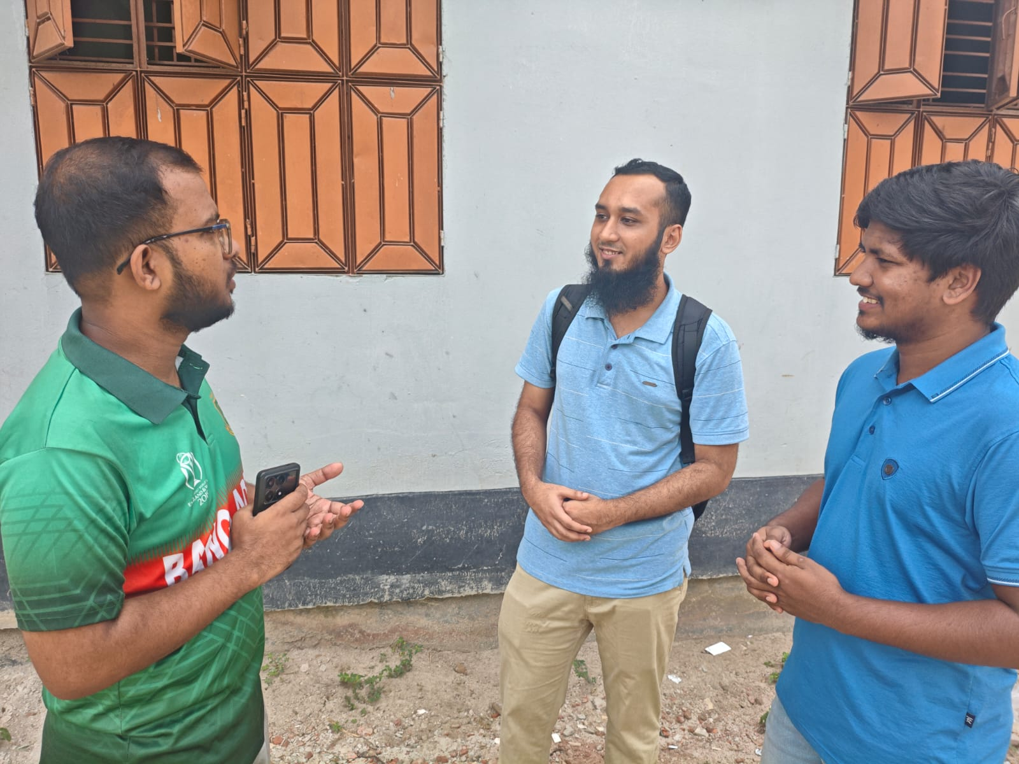
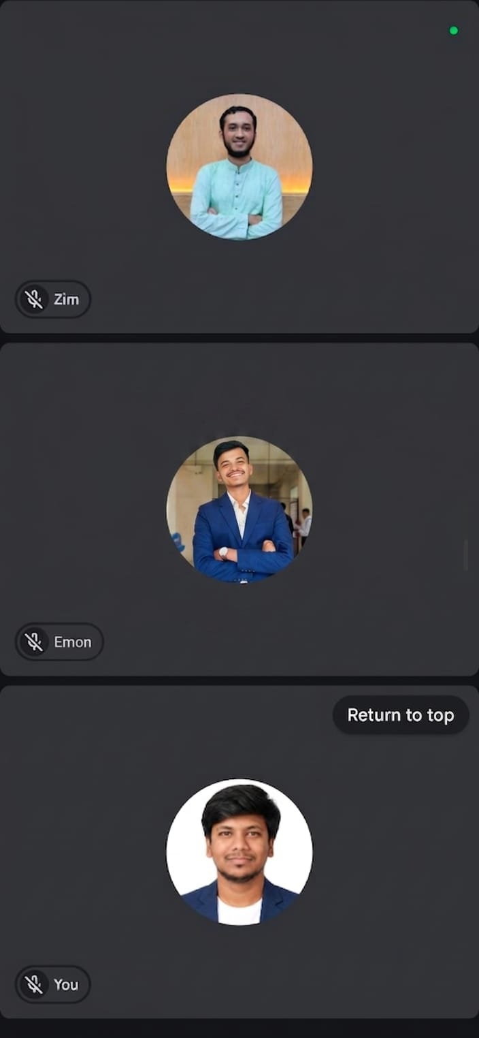
02 · REQUIREMENT ANALYSIS
Requirements grounded in field interviews
Face-to-face, semi-structured interviews with sitting officers of four HSTU student organizations
Interview photo 1
photo to be attached
WHAT WE HEARD → WHAT CLUBMS DOES
Join requests went stale
Visible PENDING state, officer approval, audit log
Eligibility unenforceable
Automatic department-based join rules
Paper attendance sheets
Per-event RSVP with attendee lists + CSV export
Notices buried in chat
Persistent, pinnable announcements + published rules

Slide 4
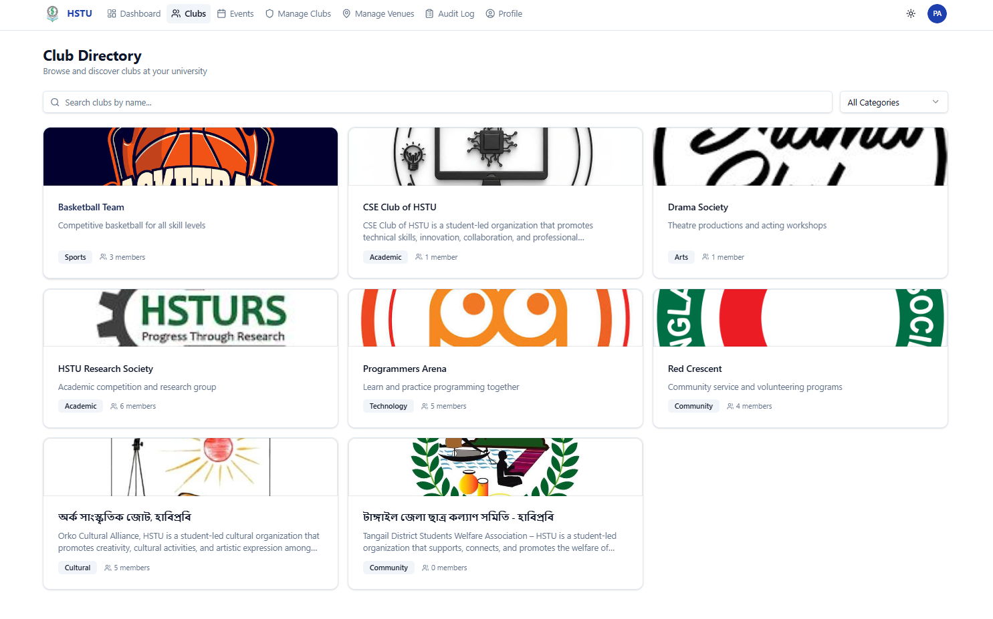
03 · WHAT WE BUILT
One platform for the whole club lifecycle
01
Club directory
Every club in one browsable, public list.
02
Member access
Join requests with approve / reject; member and officer roles.
03
Auto alumni
Members move to alumni status; club history is preserved.
04
Event list
Multi-club events with consent-based co-hosts.
Club directory — the public list of all clubs
05
RSVP
Per-event attendance, visible to officers, exportable.

Slide 5
04 · SYSTEM DESIGN
Three-tier architecture, containerized
Express REST API
Node.js — layered request pipeline
React SPA
Vite · Tailwind CSS · Radix UI
HTTPS
Helmet · CORS · rate limit
JWT authentication
SQL
PostgreSQL 16
via Prisma ORM 7
JSON
RBAC — role + ownership
Zod validation
Service layer · transactions
Prisma ORM
Three Docker Compose containers — frontend (nginx) · API · database
10
Database tables
345
automated tests
4
system roles
5
months of iteration

Slide 6
Thank you
Questions and discussion
Md Farhan Quadery · Md Saddam Hosen Molla
ClubMS · CSE 352 · Department of Computer Science and Engineering, HSTU

Slide 7
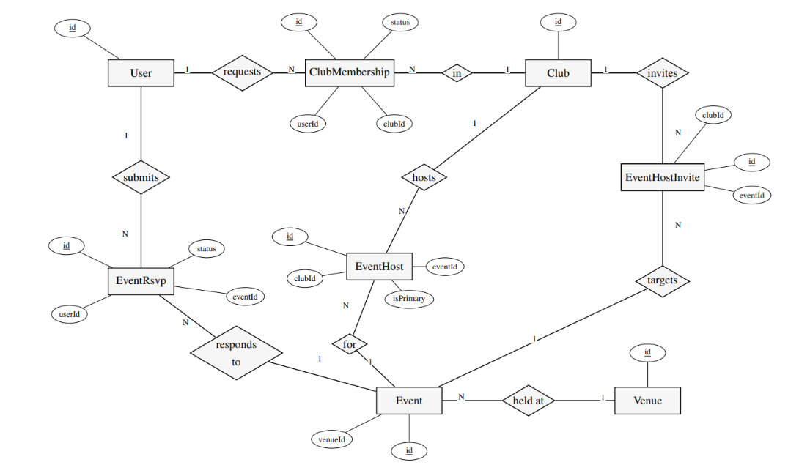
Appendix
E-R Diagram

Slide 8
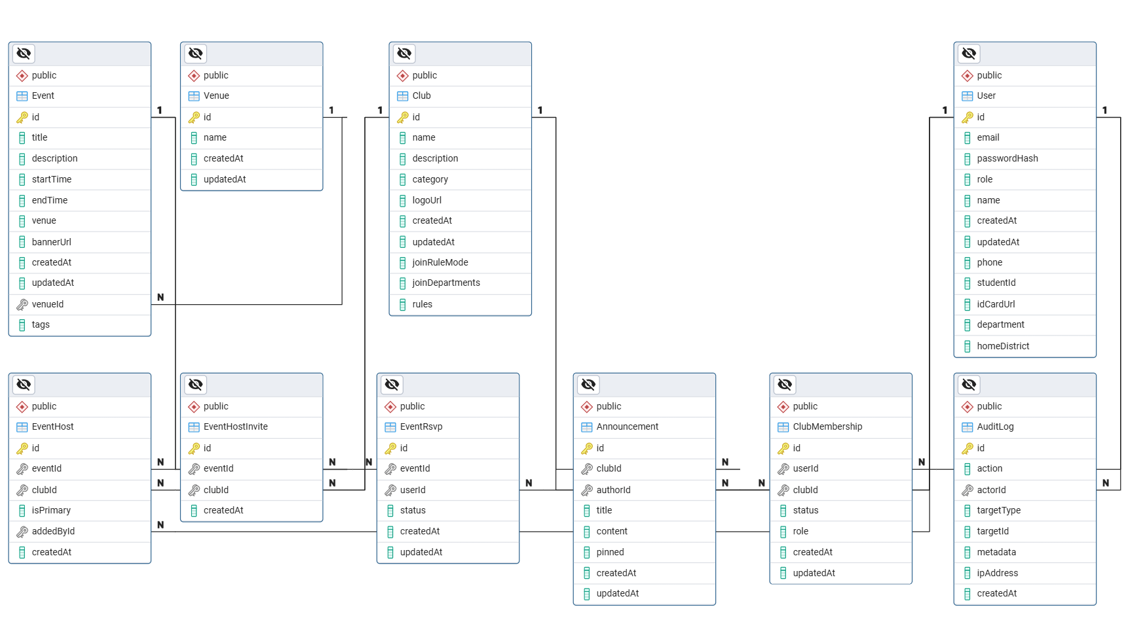
Appendix
E-R Diagram

