Slide 1
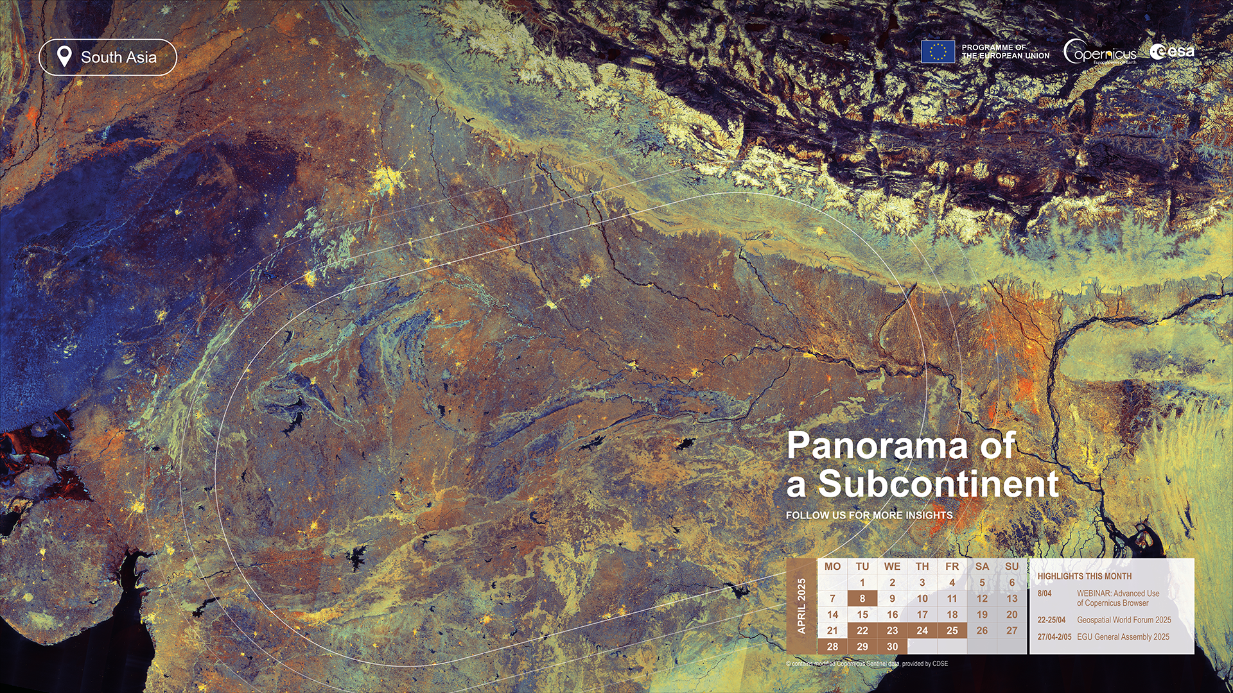
Satellite-Based Land-Cover Classification Using Transfer Learning
A Deep Learning Approach Using Sentinel-2 Satellite
Imagery
PRESENTED BY
Zimran Sohail
DEGREE
BS Computer Science
PROJECT DOMAIN
Machine Learning / Computer Vision

Slide 2




Understanding Land Cover Through Satellite Imagery
02 · PROBLEM STATEMENT AND MOTIVATION
Problem statement
Land-cover classification involves identifying and categorizing the physical material present on the Earth's surface using remotely sensed imagery.
Traditional approaches to land-cover identification can require extensive manual interpretation and are difficult to scale across large geographical areas.
Project motivation
Satellite imagery provides large-scale Earth observation data.
Automated classification can help process imagery more efficiently.
Deep learning can learn visual patterns from satellite images.
Transfer learning can leverage previously learned image features.
Satellite Image
Deep Learning Model
PROJECT OBJECTIVE
To develop a deep learning-based system that classifies Sentinel-2 satellite image patches into five land-cover categories using transfer learning.
Land-Cover Category

Slide 3
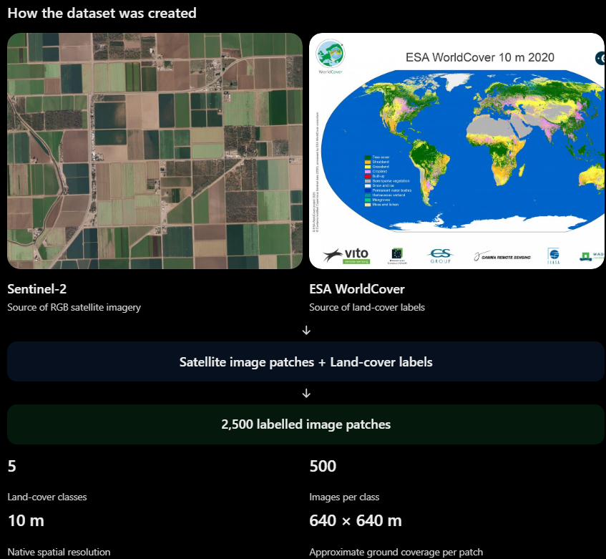
Dataset Overview
03 · DATASET AND DATA SOURCES
2,500
5
500
10 m
Total image patches
Land-cover classes
Images per class
Native spatial resolution
Dataset sources
Sentinel-2 satellite imagery.
ESA WorldCover land-cover maps.
Image information
RGB imagery constructed using Sentinel-2 bands: B4 (Red), B3 (Green), B2 (Blue).
Native spatial resolution: 10 metres.
Each image patch represents approximately 640 m × 640 m of ground area.

Slide 4
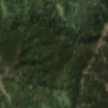
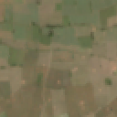
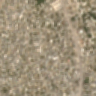
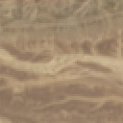
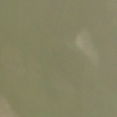
Five Land-Cover Classes
04 · LAND-COVER CATEGORIES
The dataset contains five categories based on ESA WorldCover class labels.
10 – Tree Cover
40 – Cropland
50 – Built-up
60 – Bare / Sparse Vegetation
80 – Permanent Water
Areas dominated by trees and forest vegetation.
Agricultural and cultivated land.
Urban and constructed environments.
Bare ground and areas with sparse vegetation.
Water bodies such as lakes and rivers.

Slide 5

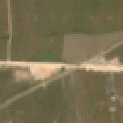
Dataset Preparation
05 · DATASET PREPARATION AND VERSIONS
Same location at 64 × 64
Same location at 128 × 128
Dataset construction
Selected image patches using ESA WorldCover labels.
Minimum class purity threshold: 70%.
Minimum centre-to-centre distance between selected locations: approximately 640 metres.
Geographic grouping and a canonical split manifest were used.
Each class contains 500 image patches.
Comparison of image representations at different input dimensions.
Three dataset configurations
Dataset version | Image dimensions
Original version | 64 × 64
Higher-resolution version | 128 × 128
Aligned version | 128 × 128
IMPORTANT TECHNICAL NOTE
The 128×128 images are resampled versions, not additional native spatial detail. Sentinel-2 imagery retains its native 10 m spatial resolution.
The 64×64 and 128×128 aligned datasets share the same geographical locations, class labels, purity values, geographic groups, and train/validation/test assignments.

Slide 6
Deep Learning Approach
06 · TRAINING AND EVALUATION METHODOLOGY
Model architecture: ResNet-18 · Three model configurations were evaluated:
1
ResNet-18
from scratch
2
Frozen pretrained
ResNet-18
3
Fine-tuned pretrained
ResNet-18
Model trained without pretrained weights.
All model parameters learned during training.
Initialized with pretrained weights.
Feature extraction layers frozen.
Classification head trained for the five target classes.
Initialized with pretrained weights.
Model parameters fine-tuned for the land-cover classification task.
WORKFLOW
Sentinel-2 RGB Image
Image Preprocessing
ResNet-18
Feature Extraction and Classification
Predicted Land-Cover Class
Evaluation: Validation accuracy, test accuracy, precision, recall, F1-score.

Slide 7
Model Performance Comparison
07 · EXPERIMENTAL RESULTS: MODEL COMPARISON
Results obtained using the aligned 128×128 dataset.
97.00%
Best test accuracy
Key observations
All three configurations achieved strong classification performance.
Pretrained models outperformed the scratch-trained model on validation accuracy.
Fine-tuning produced the highest validation and test accuracy.
Fine-tuned ResNet-18 achieved 97.00% test accuracy.
Accuracy axis starts at 90%.

Slide 8
Detailed Evaluation of the Fine-tuned Model
08 · CLASS-WISE PERFORMANCE
The fine-tuned ResNet-18 model achieved the following class-wise results:
Land-cover class | Precision | Recall | F1-score
Bare / Sparse Vegetation | 97.50% | 100.00% | 98.73%
Built-up | 98.55% | 100.00% | 99.27%
Cropland | 91.78% | 95.71% | 93.71%
Permanent Water | 98.73% | 97.50% | 98.11%
Tree Cover | 98.48% | 91.55% | 94.89%
Key observations
Built-up achieved the highest F1-score.
Bare / Sparse Vegetation achieved 100% recall.
Cropland had the lowest F1-score among the five classes.
Tree Cover had the lowest recall, indicating some missed tree-cover samples.
96.94%
97.00%
356 / 367
Macro F1-score
Weighted F1-score
Correct test predictions

Slide 9
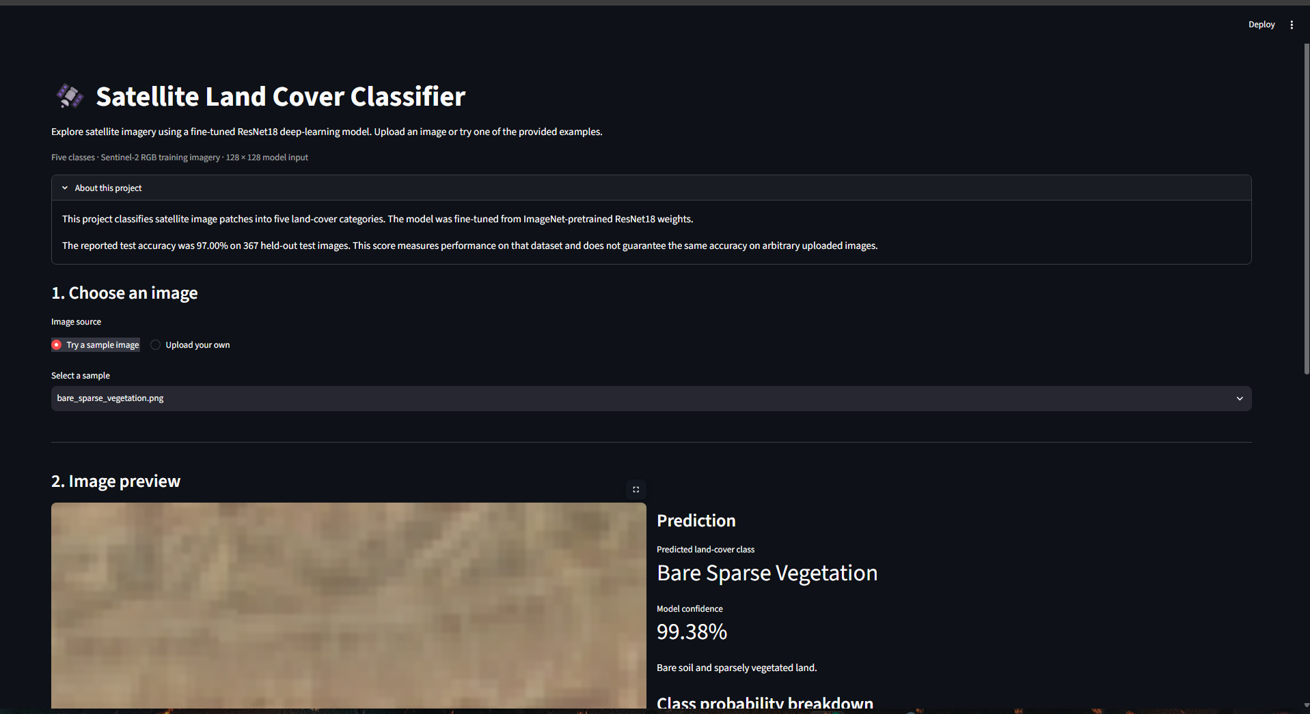
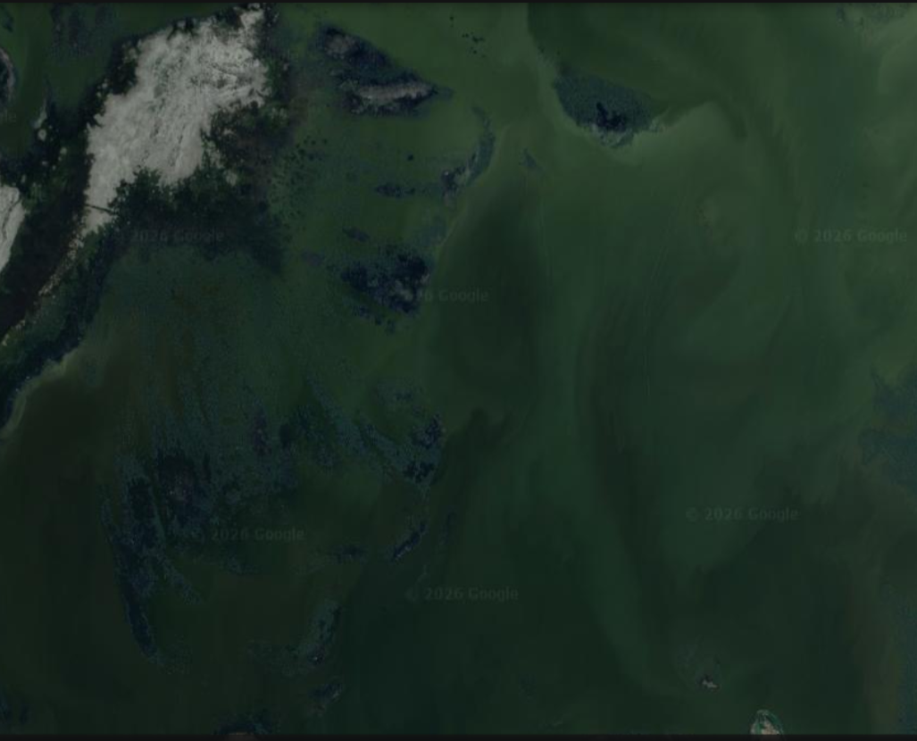
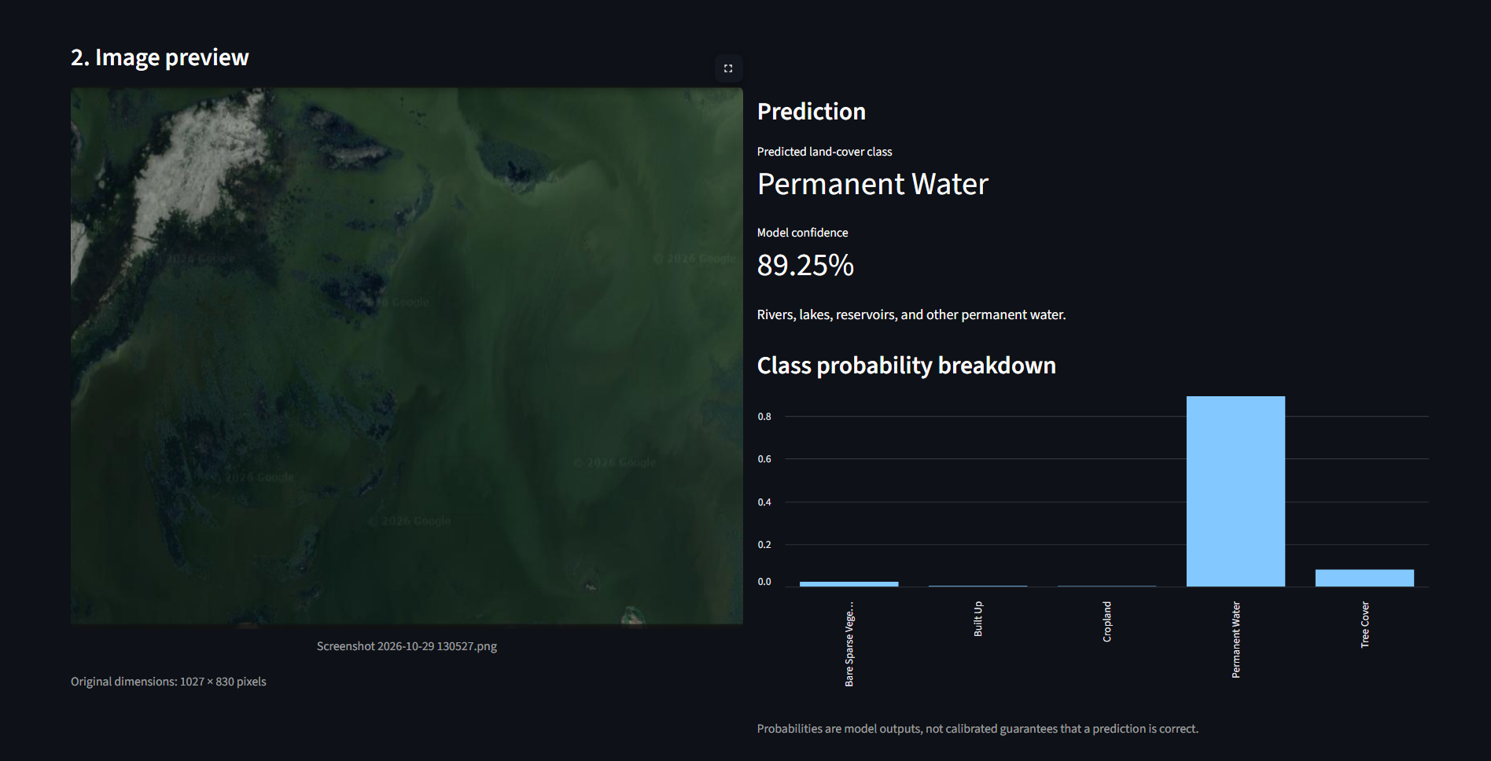
Interactive Land-Cover Classification Application
09 · APPLICATION AND DEMONSTRATION
Streamlit-based web application. The application provides an interface for users to submit satellite image patches and obtain land-cover predictions from the trained classification model.
Open Live Streamlit Application
View Project on GitHub

Slide 10
Conclusion and Future Directions
10 · APPLICATIONS, LIMITATIONS AND CONCLUSION
Potential applications
Limitations
Future work
Land-use and land-cover monitoring.
Agricultural land assessment.
Urban expansion analysis.
Environmental monitoring.
Water-body identification.
Classification is restricted to five land-cover categories.
The dataset contains 2,500 selected image patches.
Resampling to 128×128 does not increase native spatial detail.
The model's performance may vary on geographical regions or imagery not represented in the dataset.
Further evaluation on independent geographical areas would help assess generalization.
Expand the dataset with more geographical locations.
Introduce additional land-cover categories.
Evaluate generalization on unseen regions.
Explore more advanced deep learning architectures.
Improve the interactive application.
These are potential applications of the classification approach, not claims that the system has already been deployed for these purposes.
CONCLUSION
This project demonstrates the use of transfer learning with ResNet-18 for Sentinel-2 land-cover classification. The fine-tuned pretrained model achieved 97.00% test accuracy across five land-cover categories, demonstrating the potential of deep learning for automated satellite-image interpretation.
Streamlit application: Live Demo
GitHub repository: Source Code
Kaggle dataset: Dataset
Google Drive: Dataset Files

