Slide 1
Colour Selection
B2B Textile Inventory and Sales Management System
Data Management 1 | Course Work | Diploma in Software Engineering 26.1F
S.R.R Moulana
CODSE261F-036
Lecturer: Mr. Shashika Bandara
A.M.A Zimthi
CODSE261F-033
04th October 2026
S.W Ekanayake
CODSE261F-040
K.P.H Dilruwan
CODSE261F-055
Notes:
Introduce the group, the module and the organization: Colour Selection, a B2B textile trading and reselling company. Outline the talk: introduction, objectives, database design, advantages and conclusion.

Slide 2








Introduction and problem statement
Colour Selection is a B2B textile trading and reselling company. It buys bulk fabrics, thread and raw materials, stores them in regional warehouses and sells them to manufacturers, boutiques and clothing brands.
Suppliers
Warehouses
Colour Selection
Customers
Billing
Cotton, silk, linen, thread
Regional stock locations
Buys, stores and resells
Manufacturers and brands
Orders, invoices, payments
The problem: fragmented spreadsheets and manual ledgers
Inventory blind spots
Disconnected billing
Supplier mismanagement
Stock across warehouses cannot be seen in one place, so items are oversold or run out.
Orders, invoices and payments are recorded separately, so unpaid invoices are hard to find.
No central link between a product and its supplier delays reordering.
Need: one centralized, consistent relational database
Notes:
Explain what Colour Selection does and the two workflows: supply chain (suppliers to warehouses) and sales and billing (customers, orders, invoices, payments). Then the three problems: inventory blind spots, disconnected billing and supplier mismanagement. A relational database solves all three by storing each fact once and linking facts through keys.

Slide 3



Aim, objectives and scope
Aim: design and implement a centralized relational database in Microsoft SQL Server that supports the core trading workflow of Colour Selection.
Model at least eight entities in an ER diagram with cardinality and participation
Map the ER model to a relational schema in 3NF
Build the database and tables in SQL Server with constraints
1
2
3
Populate every table with at least ten records
Answer business questions with basic, advanced and join queries
Secure the data with role-based database users
4
5
6
In scope
Out of scope
Tools
9 entities across the supply chain and the sales and billing cycle
HR and employees, sales representatives and a front-end application
SQL Server, SSMS and T-SQL; ER diagram on Bristol board; Word and PowerPoint
Notes:
Read the aim, then the six objectives, which match the coursework parts: conceptual design, logical design, physical design, data, queries and security. Scope: nine entities. HR and a front-end are intentionally excluded. Tools: SQL Server, SSMS and T-SQL for the database, Bristol board for the ER diagram.

Slide 4
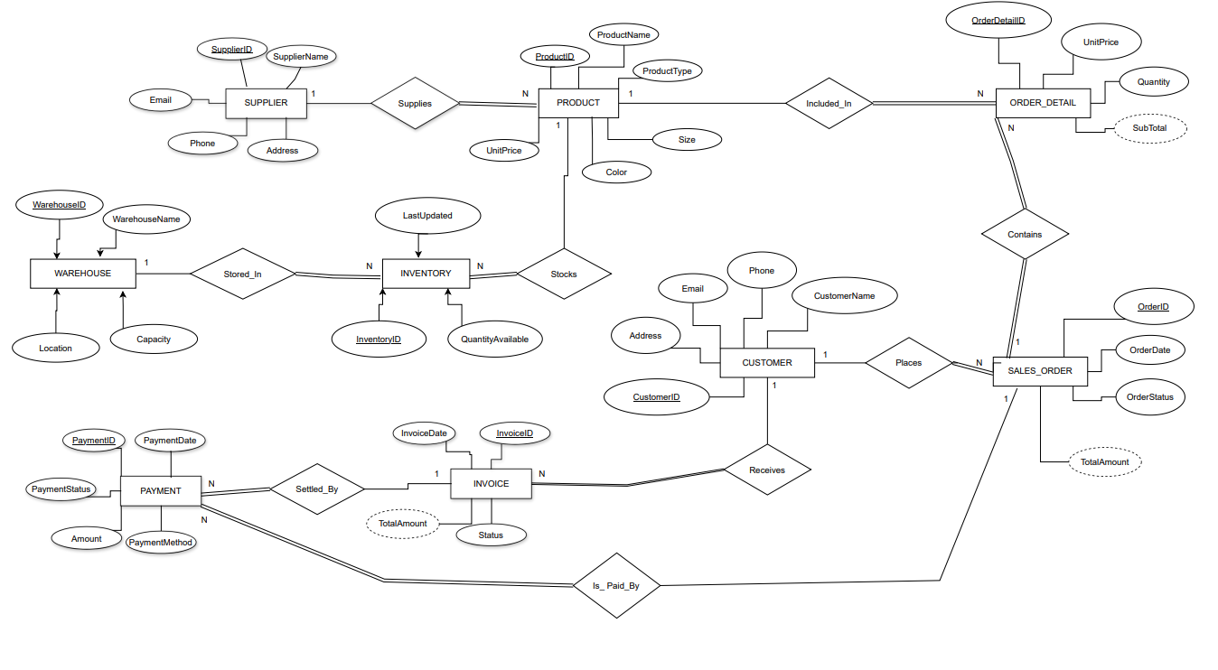
Conceptual design: ER diagram
Notes:
Nine entities drawn in Chen notation. Rectangles are entities, diamonds are relationships, ovals are attributes. Primary keys are underlined, dashed ovals are derived values (SubTotal and TotalAmount). Numbers 1 and N show cardinality; a double line means total participation. INVENTORY and ORDER_DETAIL are associative entities.

Slide 5
Relationships, cardinality and participation
Relationship | Entity A | Entity B | Cardinality | Participation (A : B)
Supplies | SUPPLIER | PRODUCT | 1 : N | Partial : Total
Stored_In | WAREHOUSE | INVENTORY | 1 : N | Partial : Total
Stocks | PRODUCT | INVENTORY | 1 : N | Partial : Total
Places | CUSTOMER | SALES_ORDER | 1 : N | Partial : Total
Contains | SALES_ORDER | ORDER_DETAIL | 1 : N | Total : Total
Included_In | PRODUCT | ORDER_DETAIL | 1 : N | Partial : Total
Receives | CUSTOMER | INVOICE | 1 : N | Partial : Total
Is_Paid_By | SALES_ORDER | PAYMENT | 1 : N | Partial : Total
Settled_By | INVOICE | PAYMENT | 1 : N | Partial : Total
9
relationships, all one-to-many (1 : N)
2
associative entities (INVENTORY, ORDER_DETAIL) resolve the many-to-many links
N side
always holds the foreign key
Notes:
Every relationship is one-to-many, so the foreign key sits on the many side. Participation: a supplier, warehouse, product, customer or invoice can exist before it takes part (partial). Every product, inventory record, order, order line, invoice and payment must belong to its parent (total).

Slide 6
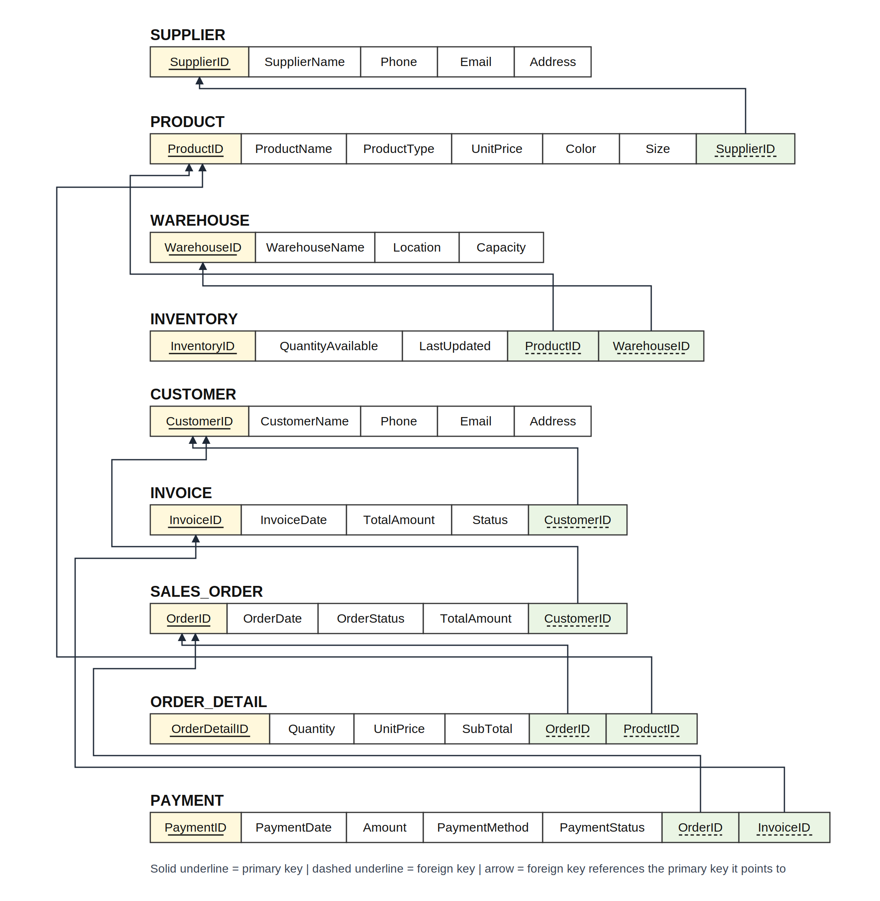
Logical design: relational schema
Step 1
The 9 entities become 9 relations, each with a primary key.
Step 4
The 9 one-to-many relationships become 9 foreign keys on the N side.
Steps 2, 3, 5, 6, 7
Nothing to map: no weak entities, 1:1, M:N, multivalued or n-ary links.
Reading the schema
Solid underline = primary key, dashed underline = foreign key. Each arrow runs from a foreign key to the primary key it references.
Notes:
The ER diagram was mapped to relations using the standard seven steps. Only steps 1 and 4 apply: entities to relations and 1:N relationships to foreign keys. The arrows show each foreign key pointing to its parent primary key.

Slide 7

Normalization to Third Normal Form
UNF
1NF
2NF
3NF
One wide sales record with repeating groups: payments, product lines and warehouse stock.
Repeating groups become rows. Every column holds one atomic value and every table has a primary key.
Single-column primary keys, so no attribute depends on only part of a key.
Attributes depend only on the key. Supplier and customer details are stored once. Result: 9 tables.
Deliberate exception: SubTotal and TotalAmount are derived values. They are stored on purpose for faster reporting and to preserve the billed figure, and they are drawn as dashed ovals in the ER diagram.
Notes:
Start from the unnormalized sales record with repeating groups. 1NF removes repeating groups. 2NF: every table has a single-column key, so no partial dependencies. 3NF: details such as supplier and customer are stored once and referenced by key. Mention the deliberate denormalization of SubTotal and TotalAmount.

Slide 8
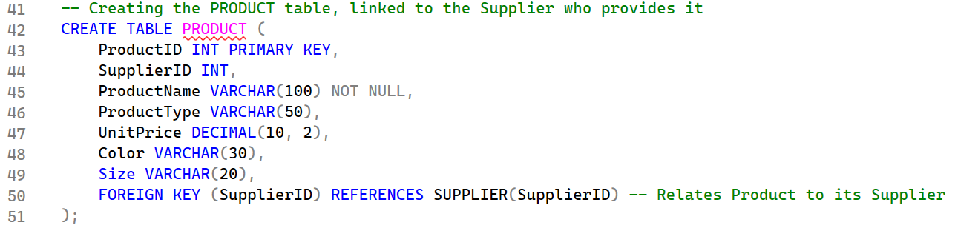
Physical design and SQL queries
CREATE TABLE PRODUCT (
ProductID INT PRIMARY KEY,
SupplierID INT NOT NULL,
ProductName VARCHAR(100) NOT NULL,
ProductType VARCHAR(50),
UnitPric DECIMAL(10,2),
Color VARCHAR(30),
Size VARCHAR(30),
CONSTRAINT FK_Product_Supplier
FOREIGN KEY (SupplierID)
REFERENCES SUPPLIER(SupplierID),
CONSTRAINT CK_Product_UnitPrice
CHECK (UnitPrice >= 0)
);
5
Basic SELECT queries
Customer list, fabric products, pending orders, warehouse capacity, unpaid invoices
5
Advanced queries
GROUP BY, HAVING and ORDER BY: high-value customers, average price by type, stock per warehouse, units sold
3
JOIN queries
9
10
3
Several tables joined: stock by warehouse, customer orders with items, invoice and payment status
tables
records per table
constraint types
Notes:
Physical design: nine tables created parent-first in ColourSelectionDB, with primary keys, NOT NULL foreign keys and CHECK constraints (example: PRODUCT). Every table holds ten records. Thirteen queries answer frequently asked business questions: five basic, five advanced and three joins. Show one live result for each category if time allows.

Slide 9



Database security: least privilege
Manager
Clerk
SELECT, INSERT, UPDATE and DELETE on all 9 tables
The only user who may delete business records
Read-only on PRODUCT, WAREHOUSE and SUPPLIER
SELECT, INSERT and UPDATE on orders, invoices, payments and customers
INVENTORY: SELECT and UPDATE only
DENY DELETE on CUSTOMER, SALES_ORDER, INVOICE and PAYMENT
In SQL Server a DENY always overrides a GRANT, so the Clerk can never delete these records.
Notes:
Two logins and two database users. The Manager has full rights. The Clerk processes daily transactions but cannot change master data and is explicitly denied deleting customers, orders, invoices and payments. DENY overrides GRANT.

Slide 10





Advantages of the system
Single source of truth
No redundancy
Data integrity
Suppliers, stock, orders, invoices and payments live in one database.
In 3NF every fact is stored once, so updates stay consistent.
Primary keys, foreign keys and CHECK constraints block invalid records.
Controlled access
Faster decisions
Easy to grow
Manager and Clerk roles protect business-critical data.
Ready-made queries show unpaid invoices, pending orders and stock levels.
New products, warehouses and customers need no change to the structure.
Notes:
Link each advantage back to a problem: one database fixes the blind spots, 3NF removes redundancy, constraints protect accuracy, roles protect sensitive data, and queries give fast answers.

Slide 11
Conclusion
Designed 9 entities and mapped them to a relational schema in 3NF
Future work
Built ColourSelectionDB in SQL Server with 10 records in every table
A front-end application for staff
Link each invoice directly to its sales order
Stored procedures and triggers to maintain derived totals
Answered business questions with 13 SQL queries
Secured the data with Manager and Clerk roles
Thank you Questions?
S.R.R Moulana | A.M.A Zimthi | S.W Ekanayake | K.P.H Dilruwan
Notes:
Summarize what was delivered and tie it back to the problem statement. Mention the future work, then invite questions. Be ready to explain: why INVENTORY and ORDER_DETAIL exist, why SubTotal and TotalAmount are stored, how DENY overrides GRANT, and why invoices link to orders through PAYMENT.

