Slide 1

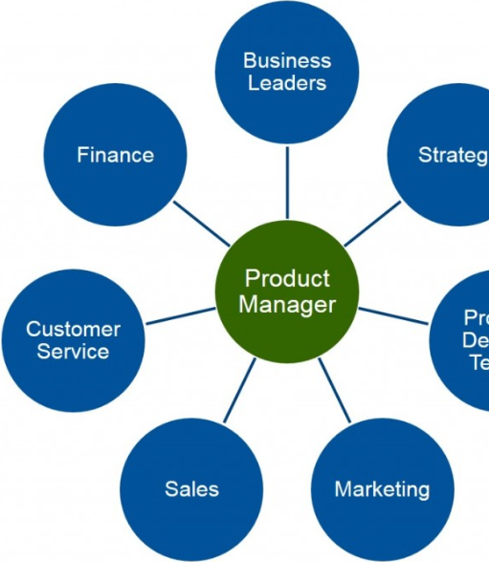
Modern PM

Slide 2

Roadmaps

Slide 3
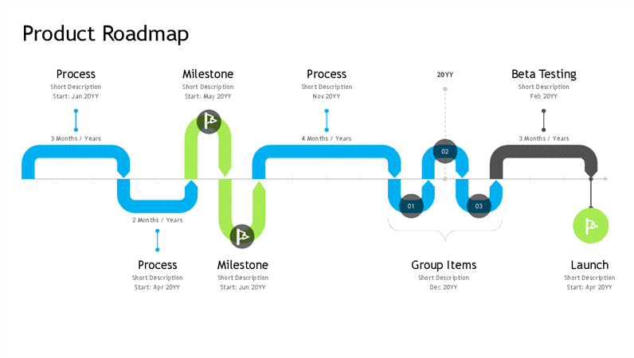

Slide 4
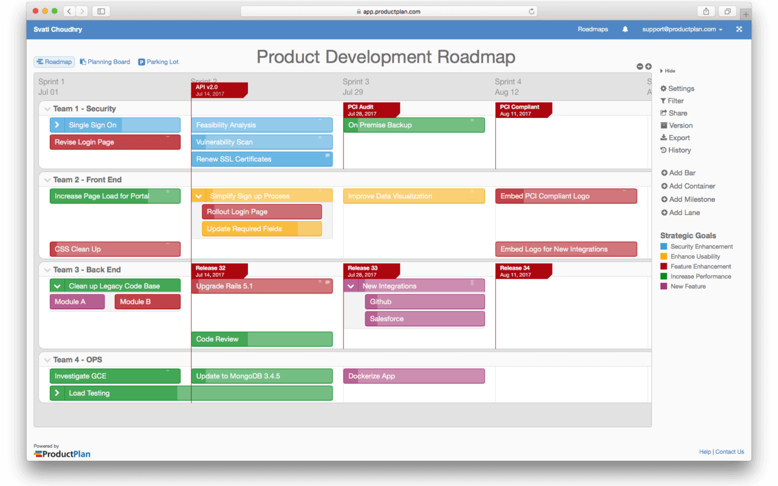

Slide 5
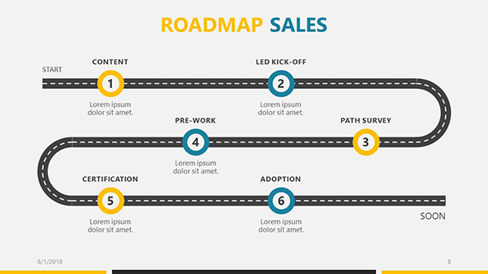

Slide 6
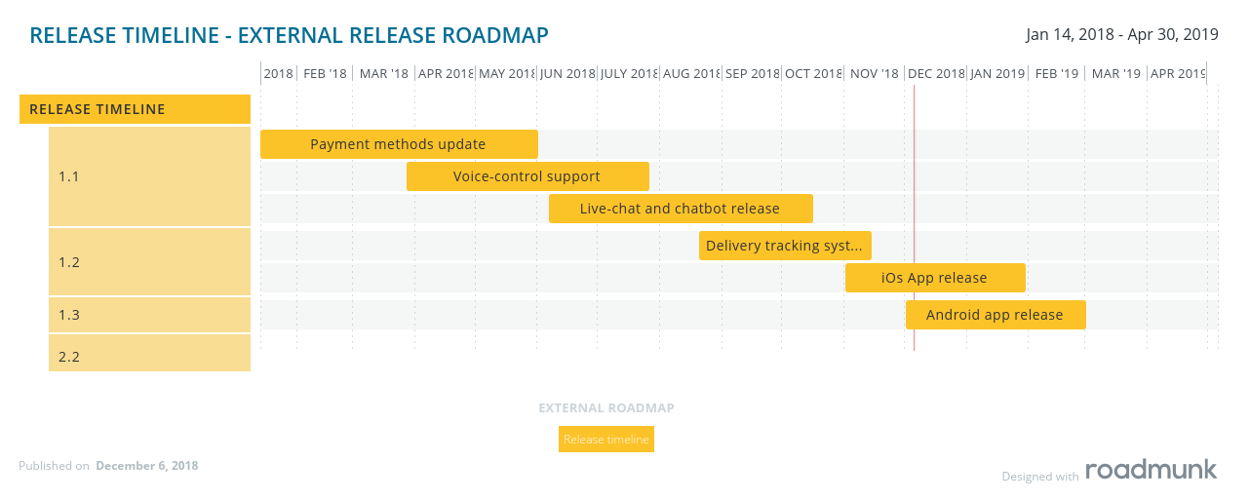
External

Slide 7

Methods

Slide 8
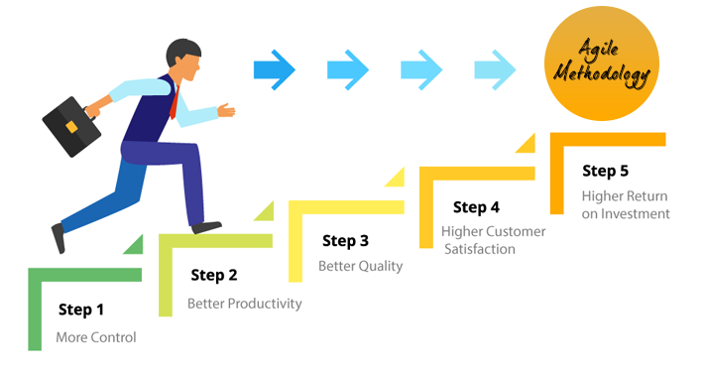

Slide 9
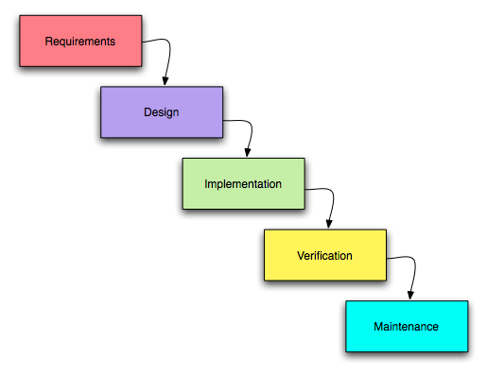
Waterfall

Slide 10
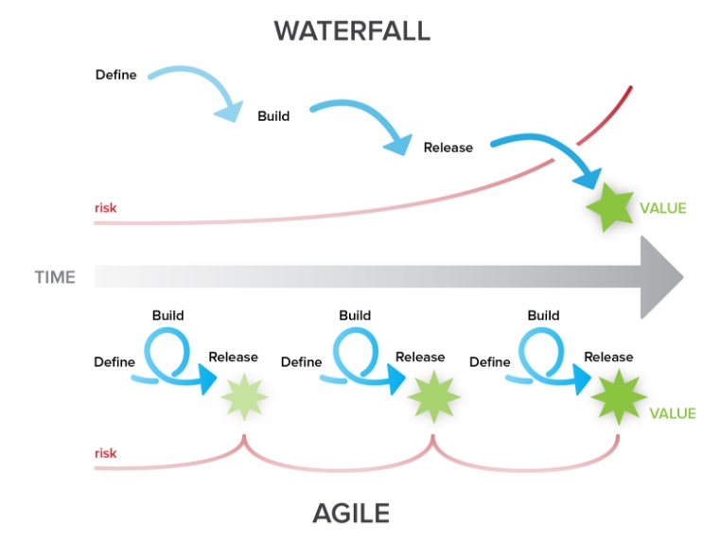

Slide 11

Tools

Slide 12
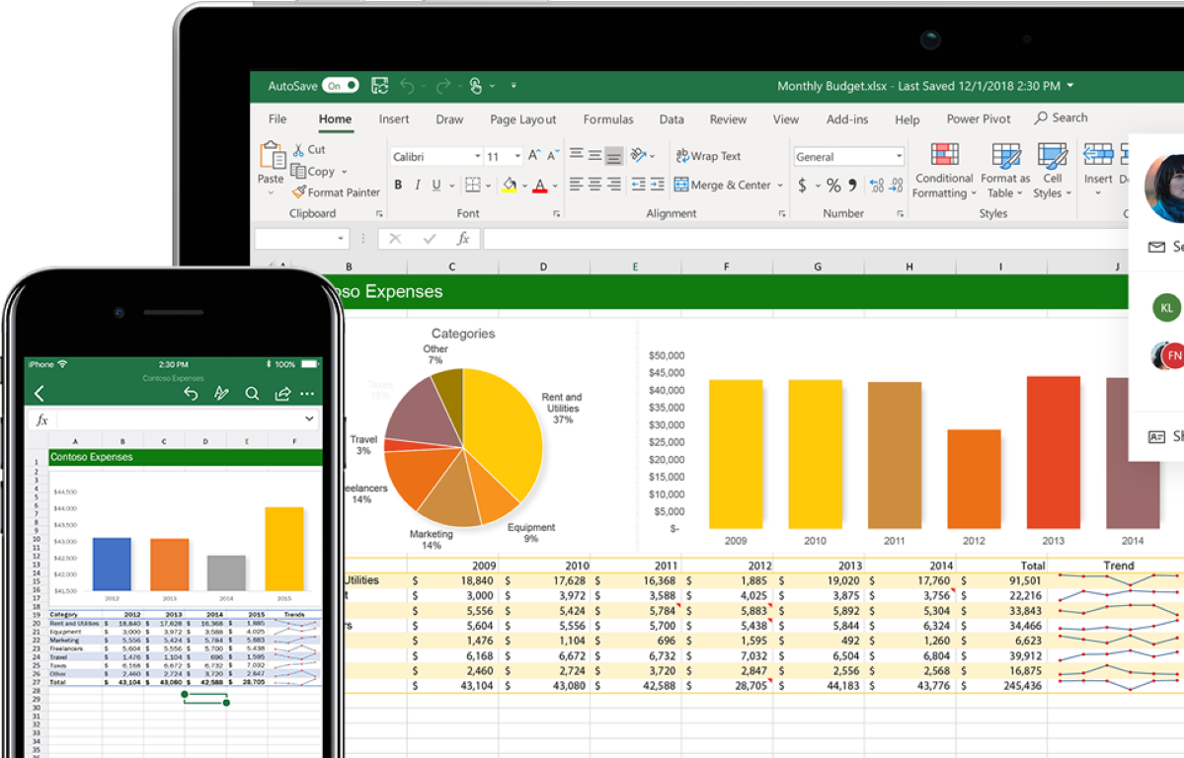
Table

Slide 13
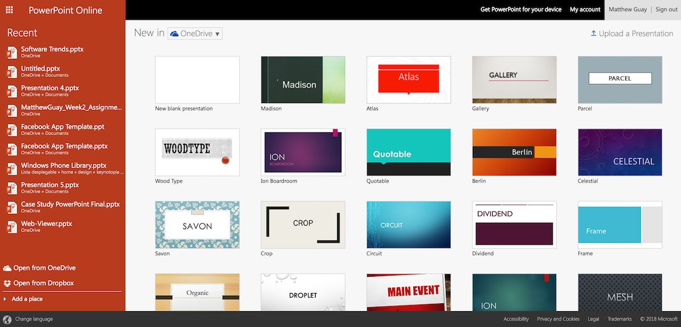
Presentation

Slide 14

Services or default tools?

Slide 15
Differents
Roadmap view
Definition and mark of idea
Team work
Continuous integration

Slide 16

Steps

Slide 17

Strategic definition

Slide 18

Release customization

Slide 19

Feature priority

Slide 20

Team work

Slide 21
Conclusion

