Slide 1
BUSA3021 PACE Business Analytics Project
S2 2024
Week 13 Expo
Group No: 8
Group Members:
Anisha Nawar Hoque 46738258
Aye Chan Soe 47462736
Jan Calimquim 46635394
Ye Lin Soe 47462825
Zin Zin Aye Chan 46866531

Slide 2
Persona Description
Persona 1 ( Farida )
Persona 1 | Farida <BA graduate and Impact100 enthusiast>
Role | A recent BA graduate form MQ University
Context of their work/role | Passionate about Social impact and Sustainable Development Goals Has advanced skills in visual data exploration Interested in engaging with Impact100 Sydney and/or other chapters of Impact100
Key activities/ decision making needs and interests | Has an idea to contribute their BA skills and time by developing a publicly available visual data exploration environment to enable different stakeholders to explore the current chapters of Impact100 and their projects in a visual and interactive way, rather than searching the list currently provided at Chapters - Impact100 Global. These stakeholders could be interested in learning about the existing projects funded by different Impact100 Chapters, proposing a new project to Impact100 Sydney, and/or start their own Impact100 Chapter in Sydney.

Slide 3
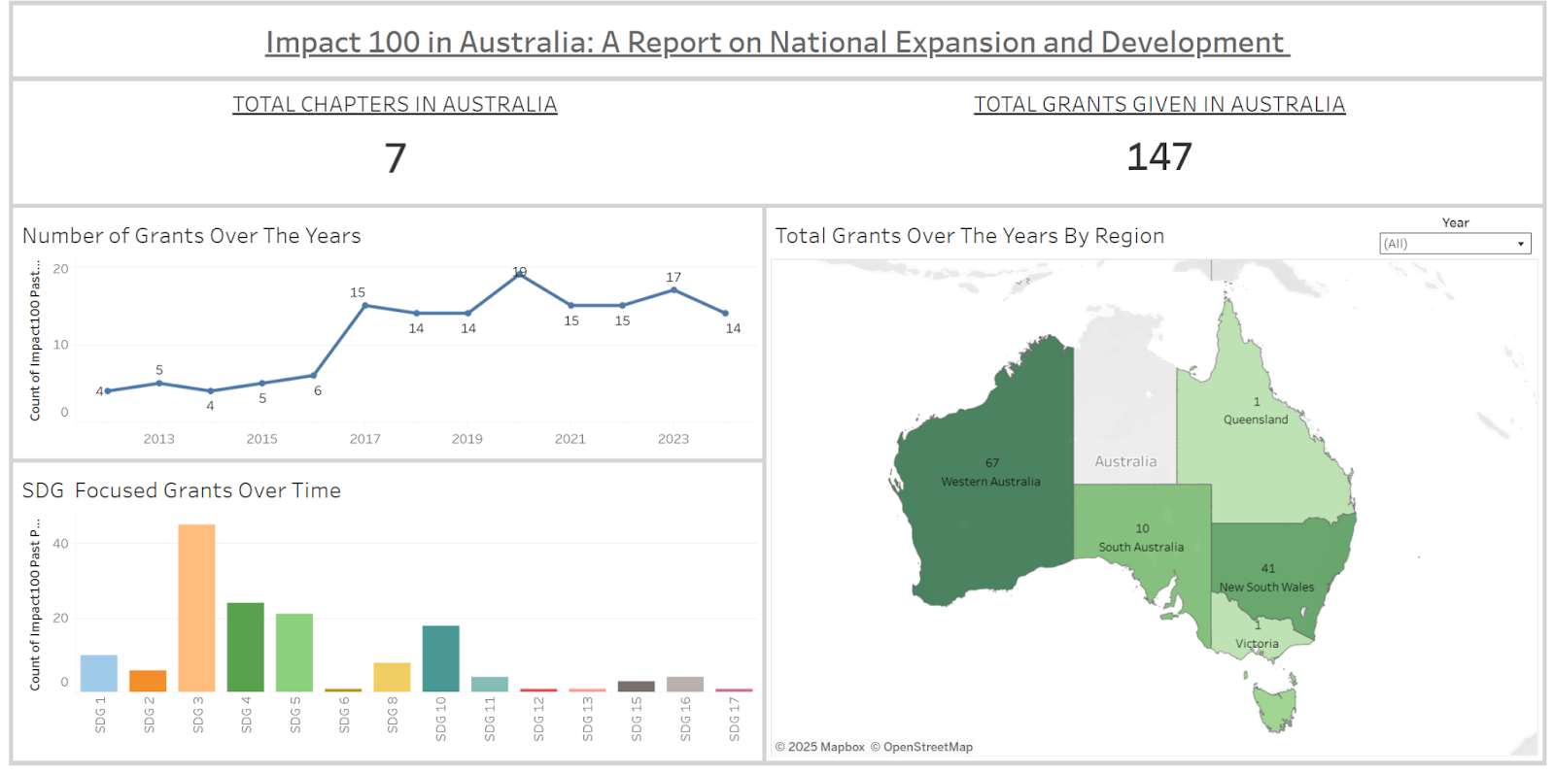
Persona 1: Farida
DV 1
Question 1: What trends of Impact100 can be observed in Australia’s grant-making and regional contributions, and how have its focus areas evolved over time?

Slide 4



Persona 1: Farida
DV 1
Question 1: What trends of Impact100 can be observed in Australia’s grant-making and regional contributions, and how have its focus areas evolved over time?
Number of grants increased from 4 in 2012 to 14 in 2024.
Significant jump between 2016 and 2017: from 6 to 15 grants, marking a pivotal growth phase.
Peak year: 2020 with 19 grants, the highest to date.
Post 2017, grants consistently range between 14–17 annually, indicating sustained maturity.
Western Australia leads with 67 grants, followed by New South Wales with 41. South Australia (10) and Queensland (1) show limited grant activity.
Early years targeted only 2-3 SDGs; now almost all 17 SDGs are supported, indicating increased thematic
SDG 3 - Good Health and Wellbeing received the most support. While there is growing support to SDG 4 (Quality Education), SDG 5 (Gender Equality) and SDG 10 (Reduced Inequality)

Slide 5
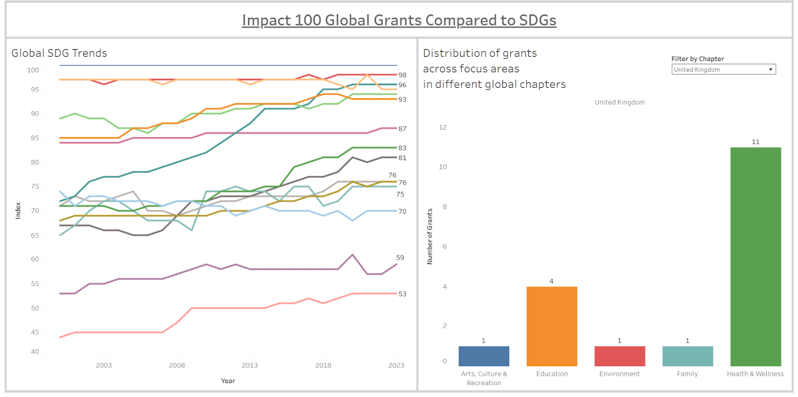
Persona 1: Farida
DV 2
Question 2: What can Impact100 Australia learn from Impact100 global?

Slide 6



Persona 1: Farida
DV 2
Question 2: What can Impact100 Australia learn from Impact100 global?
New Zealand:
Most grants go to arts, health & wellness, and environment.
Some supported areas (e.g., SDG 6, 7, 9, 13) already perform well on the SDG index — showing funding is not only based on need.
United Kingdom:
Heavy grant focus on health & wellness, despite strong SDG performance in that area.
Education and environment, where SDG performance is lower, receive fewer grants, indicating a possible mismatch between community needs and funding allocation.
United States:
Education is also a key area of funding and aligns with low SDG index — a better match between need and support.
Environment remains underfunded despite weak SDG performance — a consistent global gap.

Slide 7
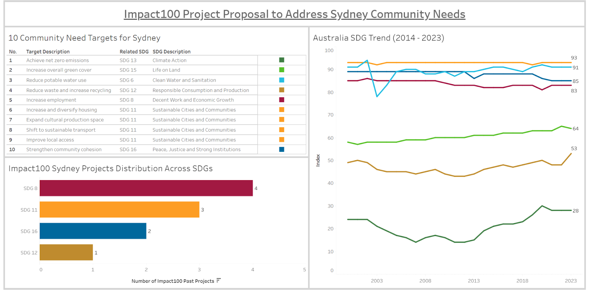
Persona 1: Farida
DV 3
Question 3: What future projects can Impact100 focus on to address Sydney’s community needs?

Slide 8



Persona 1: Farida
DV 3
Question 3: What future projects can Impact100 focus on to address Sydney’s community needs?
10 community need targets mapped to specific SDGs (e.g., SDG 13, SDG 11).
SDG 13 (Climate Action) has the lowest national index (28), showing critical underperformance.
SDG 12 (Responsible Consumption) and SDG 6 (Clean Water) also show weak national progress.
Impact100 Sydney projects focus mostly on SDG 8 and SDG 11.
Only 1 project addresses SDG 12, despite its relevance to community needs.
SDG 13 and SDG 6 have zero project representation, indicating a gap in support.
Strong alignment exists for employment and housing, but gaps remain in environmental and climate-focused SDGs

Slide 9
Persona Description
Persona 2 ( Lee )
Persona 2 | Lee – CSR Manager of a large company in Australia
Role | Manager of the Corporate Social Responsibility department for a large commercial company in Australia
Context of their work/role | Committed to developing opportunities for social impact investment and corporate philanthropy Interested in exploring opportunities for social investment on behalf of their organisation
Key activities/ decision making needs and interests | Interested in learning more about the organisations currently seeking funding support. Discovered the funding platform provided by the Australian Community Foundation (ACF) Funding Platform Australian Communities Foundation. Would like to explore the organisations seeking funding support in a more interactive visual way, in order to select those that could be supported/funded this year or in the future.

Slide 10
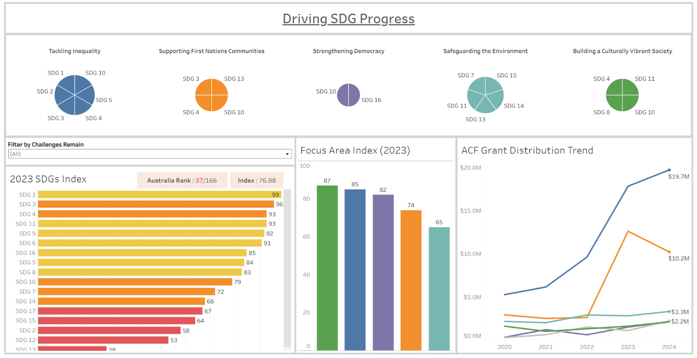
Persona 2: Lee
DV 1
Question 1: Which focus areas may need greater funding support based on respective SDG index and recent grant distribution trends?

Slide 11



Persona 2: Lee
DV 1
Question 1: Which focus areas may need greater funding support based on respective SDG index and recent grant distribution trends?
SDG 13 (Climate Action) has the lowest national performance (Index: 28).
“Safeguarding the Environment” includes 4 SDGs (7, 13, 14, 15) — all ranked in the lower half.
Focus areas like "Supporting First Nations Communities" and "Safeguarding the Environment" are most affected by SDG 13.
“Tackling Inequality” continues to receive increased funding over recent years.
Grant funding for “Supporting First Nations Communities” dropped in recent year.
Focus Area Index shows lowest score (65) for Safeguarding the Environment, indicating underinvestment.
SDG coverage shows funding imbalance across goals vs national need.

Slide 12
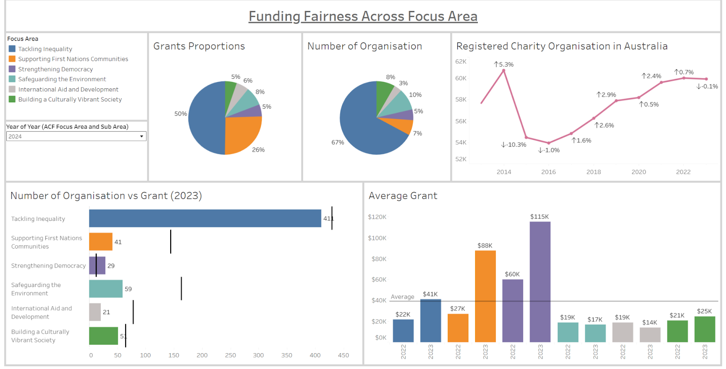
Persona 2: Lee
DV 2
Question 2: Which types of organisations under ACF are most likely to receive funding in near future, and how does the average grant size vary across different focus areas?

Slide 13
Persona 2: Lee
DV 2
Question 2: Which types of organisations under ACF are most likely to receive funding in near future, and how does the average grant size vary across different focus areas?
Grant distribution and number of organizations are not proportionate for blue, tackling inequality ( organization number > fund size ) and orange, supporting first nations communities ( fund size < organization number )
Stable growth is seen in number of charity organizations in Australia.
Recent notable changes - increase of 2.4% in (2021) and decrease of just 0.1% in (2023).
Assumed that ACF organization numbers remains the same, calculated average grant distribution for 2022 and 2023.
Average grant for areas such as blue orange and purple are on the growth trend.
Frequency of grants for focus area purple (Strengthening Democracy) is not high but the amount of grant seems to be big when they receive grants.
Focus area teal ( Safeguarding the Environment ) receives multiple grants a year but we can assume that the grant amount is not significant.

Slide 14
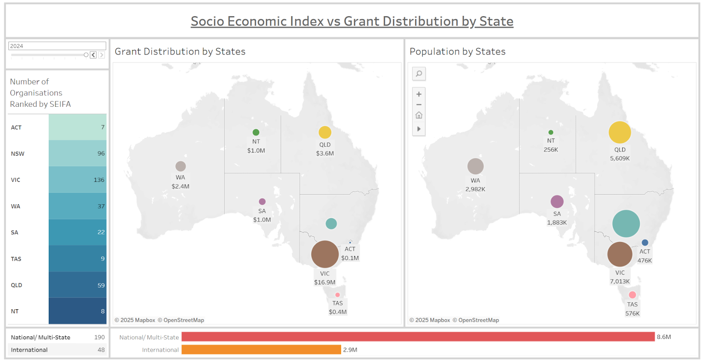
Persona 2: Lee
DV 3
Question 3: How is grant distribution balanced across Australian states, and which regions may require more equitable support?

Slide 15
Persona 2: Lee
DV 3
Question 3: How is grant distribution balanced across Australian states, and which regions may require more equitable support?
Shows the number of ACF-listed charity organisations in each state, ranked by their socioeconomic index (highest at the top to lowest at the bottom).
Lee can explore which states need funding.
Grant Distribution is seen to be the highest in Victoria in 2024, and this has been the case for the past five years.
Victoria have the largest number of organisations.
ACT, NT and TAS have smallest number of organizations.

Slide 16
Persona Description
Persona 3 ( Anisha )
Persona 3 | Anisha <Socio-Economics Student and Community Impact Advocate>
Role | A final-year student from Macquarie University
Context of their work/role | Studying socio economics with a strong interest in social equity, community development, and sustainability. Motivated by a desire to make a tangible impact, they are exploring how academic knowledge can be applied beyond the classroom, particularly through involvement with mission-driven organizations like Impact100 and the Australian Communities Foundation (ACF). Her focus is on understanding the intersection of data, community needs, and local solutions.
Key activities/ decision making needs and interests | Actively researching the 50+ organizations listed under or collaborating with Impact100 and ACF to identify those that align with their academic interests and career goals. Looking for internship or volunteering opportunities that allow them to contribute to impact evaluation, community outreach, or program design. This persona is seeking visibility into how Macquarie University students can partner with or contribute to the mission of Impact100 and ACF, in ways that align with MQ’s commitment to solving real-world problems through student engagement, social responsibility, and collaborative innovation.

Slide 17
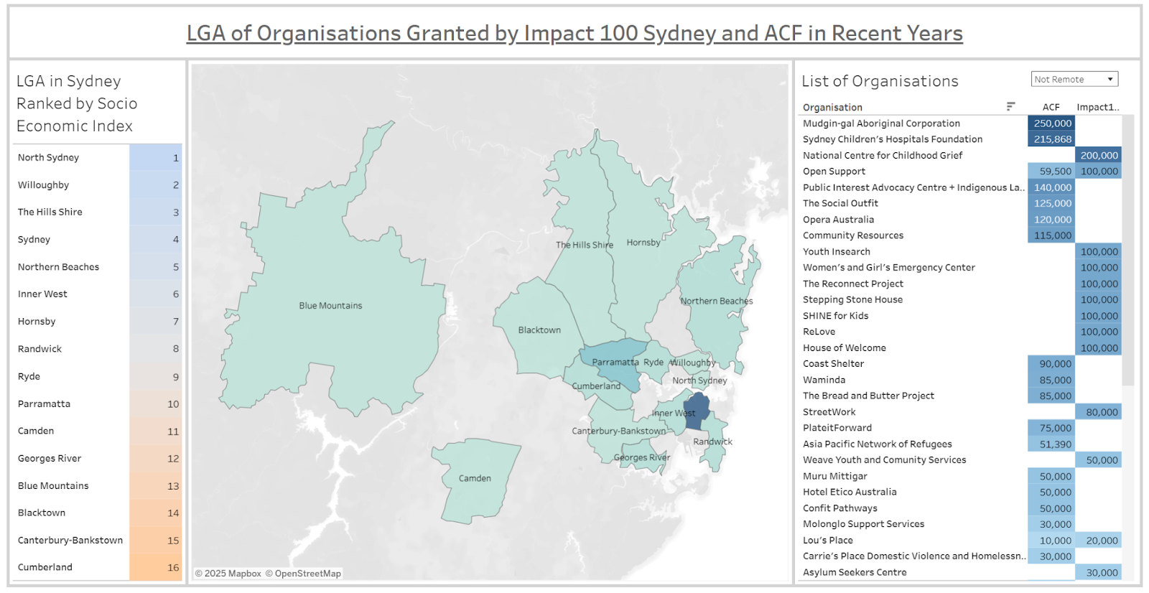
Persona 3: Anisha
DV 1
Question 1: Which Sydney LGAs show gaps between socio-economic need and grant-supported organizations, and what local organizations may offer opportunities for volunteering or engagement?

Slide 18
Persona 3: Anisha
DV 1
Question 1: Which Sydney LGAs show gaps between socio-economic need and grant-supported organizations, and what local organizations may offer opportunities for volunteering or engagement?
Canterbury-Bankstown, Blue Mountains, Blacktown LGAs display high levels of socio-economic need
Cumberland LGA – most socially disadvantaged
Minimal amount of organizations/grants given in underserved LGAs – 1-2 organizations per LGA
Sydney LGA gathers the most organizations and grants, despite relatively higher SEI – 19 organizations across Impact100 and ACF initiatives
Organizations under the higher-need LGAs offer volunteering opportunities
Volunteering/engagement opportunities typically present in organizations that received substantial grant amounts
Well-established organizations, structured programs
Opportunities catered to interests or skillset

Slide 19
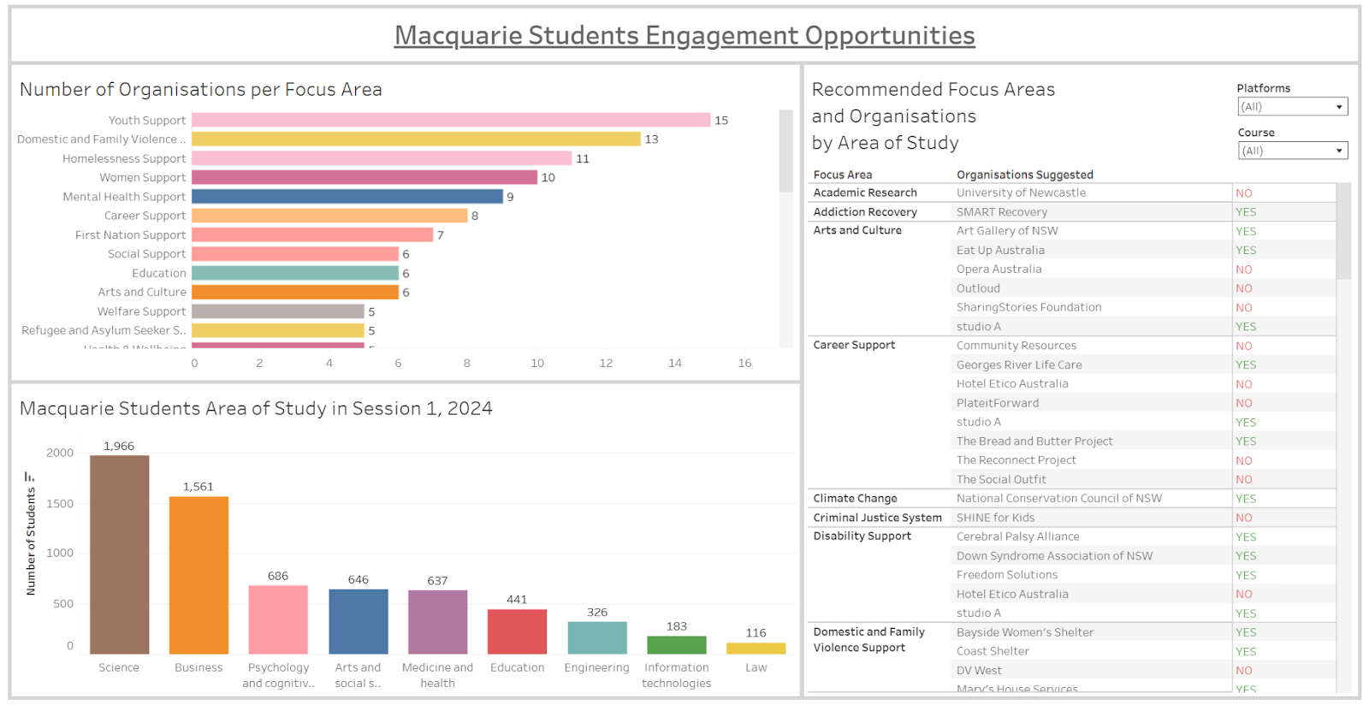
Persona 3: Anisha
DV 2
Question 2: Which focus areas and organisations offer the most relevant engagement opportunities for Macquarie students based on their field of study?

Slide 20



Persona 3: Anisha
DV 2
Question 2: Which focus areas and organisations offer the most relevant engagement opportunities for Macquarie students based on their field of study?
Anisha can identify key trends in:
Which focus areas organisations are contributing to
Which study areas Macquarie students are studying
Students can filter the table by major to view:
Relevant organisations
Linked focus areas
Availability of volunteering opportunities
Which platform they belong to (Impact 100 or ACF)
Students can also select a specific focus area or study area to view a list of relevant organisations, making the entire dashboard connected, and easy to navigate.

Slide 21
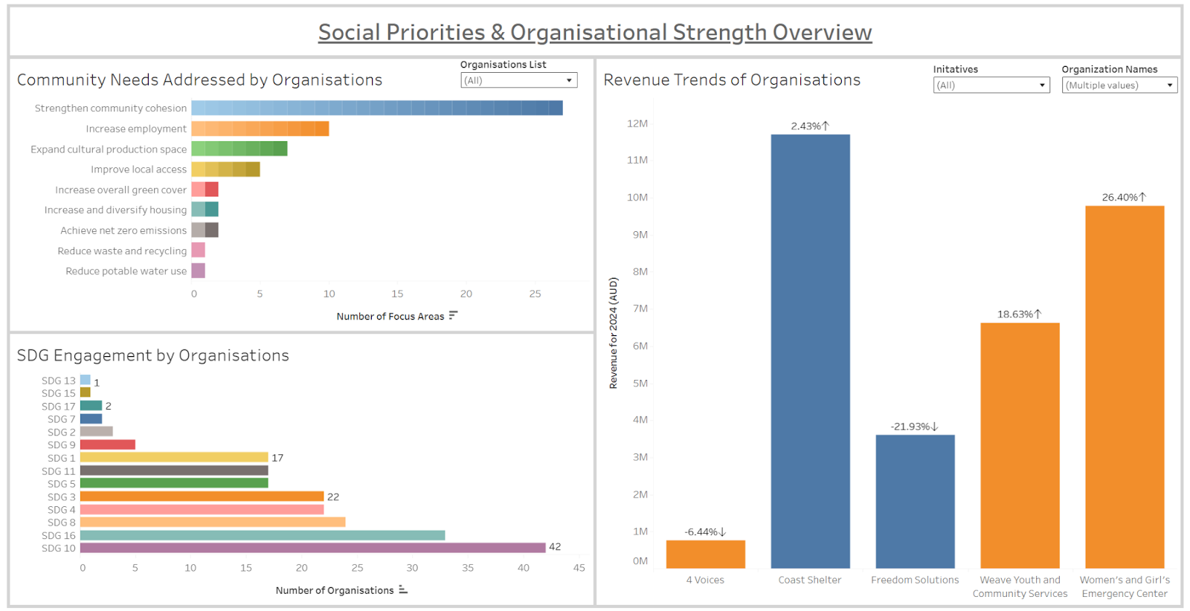
Persona 3: Anisha
Dv 3
Question 3: Which social needs are the organisations addressing and how can Macquarie students observe their revenue reinvestment abilities?

Slide 22



Persona 3: Anisha
Dv 3
Question 3: Which social needs are the organisations addressing and how can Macquarie students observe their revenue reinvestment abilities?
Anisha can view trends showing:
How well organisations are addressing community needs
Which SDGs they are aligned with
Students can filter specific organisations they’re interested in to see:
The community needs each organisation addresses
The SDGs they contribute to
After identifying organisations of interest, students can:
Review revenue trends (i.e. funding received) by making comparison
Understand how financial support is being used to benefit the community

Slide 23
Responsible Data Use & Design
FOR ALL 3 PERSONAS
Data Quality Standardised formats (e.g., dates, categories) Added labels and create relationships between variables Handled missing values and used recent data. Consistent structure to support accurate visualisation. Used all syntactic, semantic, pragmatic qualities | Data Ethics (PAPA Framework) Privacy: No personal data used Accuracy: Cleaned/filter data for relevant insights Property: Sourced from public and client-approved datasets. Accessibility: For all users, clear visuals, easy to understand
Visual Ethics Used simple charts with clear labels and legends Accurate scales, colour contrast, and filters for interactivity Avoided bias or overload in presentation | “Do No Harm” Principles Combined qualitative & quantitative insights Avoided biased framing or emotional influence. Ensured transparency and ethical storytelling.

Slide 24
Data sources used in this project
FOR ALL 3 PERSONAS
https://www.acnc.gov.au/tools/reports/australian-charities-report-10th-edition
https://www.abs.gov.au/statistics/people/people-and-communities/socio-economic-indexes-area-seifa-australia/latest-release.
https://communityfoundation.org.au/philanthropic-services/acf-advisory/.
https://www.acnc.gov.au/charity/charities.
https://www.cityofsydney.nsw.gov.au/policy-planning-changes/have-your-say-updated-community-strategic-plan
https://www.ibm.com/think/topics/data-quality#:~:text=Data%20quality%20measures%20how%20well,governance%20initiatives%20within%20an%20organization
https://impact100global.org/
https://fpt.org.au/wp-content/uploads/2021/02/Impact100-Media-Family-Planning-Tasmania-Wins-Inaugural-Grant-1117.pdf
https://www.mq.edu.au/study/admissions-and-entry/pathways/requirements/student-profiles.
https://dashboards.sdgindex.org/downloads
https://www.mromagazine.com/features/digitalization-operations-technology-and-the-importance-of-data-quality/

Slide 25
Thank you! Thank you for taking the time to attend and listen to our presentation. We truly appreciate this opportunity and feel honoured to present our work to you. We hope it offered new insights and perspectives to support your mission.

