Slide 1
Data Analysis with R
Notes:
Today we are going to do some data analysis with R. I would like it to be quite conversational. Because most of the work I did was so long ago that I am having to relearn a lot of the basics. We will look at some data and play with it. I have a set of steps to go through but that is very much a baseline. We can take it at our pace and just try to make sense of the data.

Slide 2
R
Pros
Ease of access, extensibility and community support
Cons
Security, memory management, and speed are the biggest pitfalls
Notes:
As we are going to use R as our tool, I guess it would be worthwhile spending a few minutes on the language.
Are we all familiar with R? Are we at all familiar with R?
Lack of security makes it unusable for server
Still, you can create models and export to other languages
Makes it more of a tool for solving data problems rather than a full blown programming language
Makes it really dear to statisticians who are trying their hands at programming for the first time
As opposed to python, it does one thing and does it really well.

Slide 3
CRAN
Comprehensive R Archive Network
Notes:
One of the biggest rocks in the R ecosystem is CRAN. If you have set of R functions that you have developed over time and you think that they will be useful to others or maybe useful to you in future, you can fulfill some criteria that is required by CRAN and upload these functions as a package. From then on, it is CRAN’s responsibility to maintain version compatibility of that package and it will be available for everybody’s usage.

Slide 4
RStudio cloud
Great way to get familiar
Show and tell
Notes:
Let’s have a look at RStudio cloud. This is where we will do our analysis today. This is a relatively new addition in the R ecosystem. But it is great. You don’t have to install anything in your computer.

Slide 5
Tidyverse
?tidyverse
??tidyverse
Notes:
Opinionated collection of packages for data science
“The packages in the tidyverse share a common philosophy of data and R programming, and are designed to work together naturally.”
Let’s install tidyverse

Slide 6
Data
OECD - Organisation for Economic Co-operation and Development
https://github.com/ZinatWali/R-prep
pisa <- read_csv("https://raw.githubusercontent.com/ZinatWali/R-prep/master/pisa_small.csv")
Notes:
What they do is look at social and economic situation in countries and help policy makers take decision for improving standards of life.
The particular dataset we will look at is called PISA. (Programme for International Student Assessment).
The do student interviews across the globe and build a database to get a comparative view of how students are doing under varying socio economic countries.

Slide 7
Explore
female <- filter(pisa, Gender == ‘Female’)
view(female)
sci <- filter(pisa, !is.na(EnjoysScience))
view(sci)

Slide 8
%>%
countries_only <- pisa %>% filter(OECD == "No") %>% select(CNT) %>% distinct() %>% print(n=Inf)
pisa <- pisa %>%
mutate(CNT = forcats::fct_reorder(CNT, PV1SCIE))
Notes:
“The pipe, %>%, comes from the magrittr package by Stefan Milton Bache. Packages in the tidyverse load %>% for you automatically, so you don’t usually load magrittr explicitly.”

Slide 9
summary of functions used:
filter
group_by
distinct
summarise
median
arrange
print

Slide 10
functions used in plotting:
ggplot
geom_point
aes
coord_flip
geom_boxplot
facet_wrap
theme_bw
theme
element_text
scale_fill_brewer
xlab
ylab
geom_point
geom_smooth

Slide 11
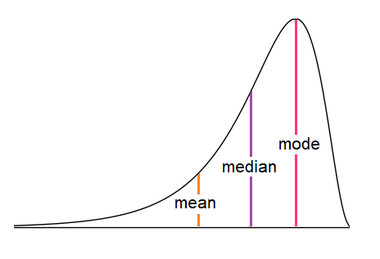
Mean Median Mode

Slide 12
Some plots…
Notes:
pisa <- pisa %>% mutate(CNT = forcats::fct_reorder(CNT, PV1SCIE))

Slide 13
Box plot
Complex ☹
But gives a more holistic view of data
Data scientists’ favourite

