Slide 1

Stock Price Prediction with TensorFlow
A Deep Learning-Based Time Series Forecasting System
Name: Nagaram Manoj Kumar.
Enrollment Number: 2203031240893. Division: 7Ai-16
Department/Branch: CSE-AI/DS
Notes:
1

Slide 2
Section 1: Introduction & Problem Statement
Forecasting Volatility: The Challenge of Stock Price Prediction
Introduction
Stock market forecasting is challenging due to its volatility and complex patterns. Traditional models often fall short in capturing non-linear trends. This project leverages LSTM networks in TensorFlow to predict Apple stock prices (2013–2018) using historical data. The workflow includes data loading, EDA, model training, and prediction. The LSTM model effectively captures time-based dependencies and is evaluated using MSE and RMSE, showcasing the strength of deep learning in financial forecasting.
Notes:
2

Slide 3
Problem Statement
Predicting stock prices is a complex task due to the highly volatile and non-linear nature of the stock market.
Traditional statistical models fail to capture long-term dependencies and patterns in time-series financial data.
The objective is to build a deep learning-based forecasting system using TensorFlow and LSTM networks.
The model should accurately predict the daily closing stock prices (e.g., Apple – AAPL) using historical data from 2013 to 2018.
The goal is to develop a robust model that minimizes prediction error (MSE/RMSE) and generalizes well on unseen data.
This approach aims to enhance the forecasting accuracy and demonstrate the effectiveness of deep learning in financial domains.

Slide 4







Section 2: System Architecture
Data Pipeline: From Input to Insight
Data Collection
CSV Dataset (all_stocks_5yr.csv) loaded using pandas.read_csv()
Preprocessing
Datetime conversion, handling missing lines, normalization using MinMaxScaler.
Feature Engineering
Creation of time sequences (60-day windows) for training data (x_train, y_train)
Model Training
LSTM-based Sequential Model using TensorFlow
Layers: Stacked LSTMs → Dense → Dropout → Output
Evaluation
Metrics: Mean Squared Error (MSE), Root Mean Squared Error (RMSE)
Prediction
Forecasting daily closing prices on test data using trained model
Inverse transformation to get actual predicted values
Visualization
Matplotlib plots of Train, Test, and Predicted stock prices
Focus: Apple (AAPL) stock trends from 2013 to 2018
This flowchart illustrates the end-to-end system, from raw data ingestion to model prediction and visualization. Each step plays a critical role in transforming historical stock data into meaningful future price insights using deep learning.
Notes:
3

Slide 5
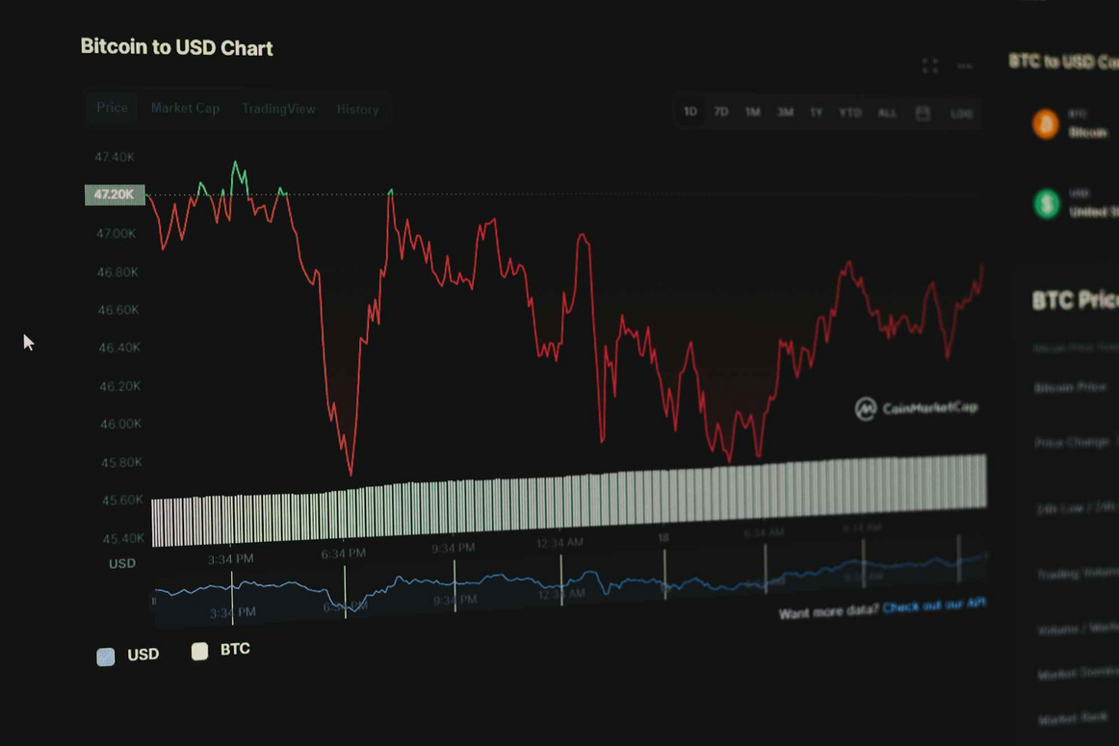
Section 3: Data Analysis
Unveiling Patterns: Exploratory Data Analysis (EDA)
Time-Series Plot: Visualize closing prices over time to identify trends, seasonality, and anomalies.Use Matplotlib.
Company-wise Trend Analysis: Compare Open vs Close prices using subplots to observe market trends.
Volume Analysis: Plot trading volume using time-series plots to analyze activity levels and investor interest over time.
Feature Correlation Heatmap: Understand relationships between different financial indicators.
Data Distribution: Analyze structure of the dataset using .info(), .sample(), and .shape()
Verify date formatting, missing values, and data quality.
Exploratory Data Analysis provides critical insight into the stock data's behavior, trends, and quality. It helps guide preprocessing steps and model design by uncovering key patterns and anomalies in historical stock performance.
Notes:
4

Slide 6
Section 4: Requirements & Design
Defining the System: Functional and Non-Functional Requirements
Functional Requirements
Non-Functional Requirements
FR1: Load and read stock data using pandas.read_csv().
NFR1: Predict closing price within 2 seconds per input.
FR2: Filter specific stock data (e.g., AAPL) based on company name and date range.
NFR2: Prediction error (RMSE) below defined threshold (e.g., 0.02).
FR3: Preprocess and normalize raw data using MinMaxScaler.
NFR3: Visualizations should be clear and easy to interpret.
FR4: Build and train an LSTM model using TensorFlow.
NFR4: Code should follow modular design with reusable functions(e.g., for preprocessing, training).
FR5: Generate predictions and evaluate using metrics like MSE and RMSE.
NFR5: System deployable on local or cloud platforms.
FR6: Visualize actual vs predicted prices using matplotlib plots.
Notes:
5

Slide 7
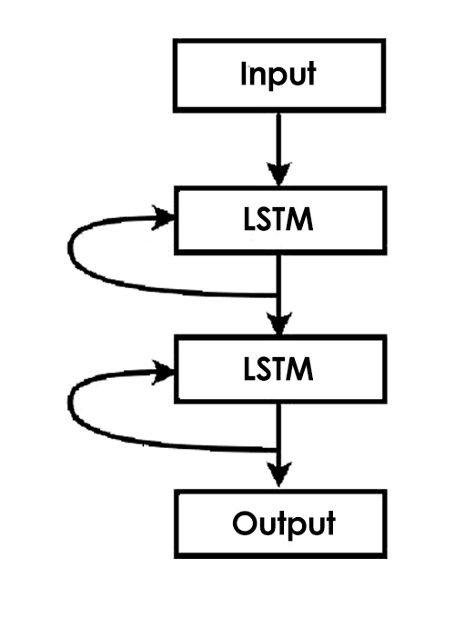
Section 6: Deep Learning Model
Core Intelligence: LSTM-Based Sequential Architecture
Our deep learning model is built using a stacked LSTM architecture in TensorFlow. It is designed to learn from historical stock data (e.g., AAPL) and capture temporal dependencies for accurate next-day price prediction.
Input Layer: 60-day sequence of historical data.
LSTM Layers (x2): 64 units each, capturing long-term dependencies.
Dropout Layer: Dropout rate of 0.5 for regularization and to prevent overfitting.
Dense Layer: Final Dense layer with 1 unit for price output.
Optimizer: Adam optimizer for fast and adaptive learning.
Loss Function: Mean Squared Error (MSE) for minimizing prediction error.
Evaluation Metrics: RMSE, MAE used to assess model accuracy.
Training Epochs: Trained over 10 epochs (can be extended to 50–100 for improved accuracy).
Notes:
6

Slide 8
Conclusion & Future Work
Key Takeaways & Strategic Directions
Key Takeaways
Future Work
Implemented a deep learning model using TensorFlow and LSTM for stock price prediction.
Integrate sentiment analysis from financial news and social media.
Preprocessed and visualized stock data (e.g., AAPL) to capture time-based trends.
Explore advanced Transformer models (Time2Vec, Temporal Fusion Transformer).
Used a stacked LSTM architecture, which outperformed traditional models in capturing sequential patterns.
Develop capabilities for multi-stock prediction using multivariate inputs.
Achieved meaningful results with low RMSE, demonstrating the model’s forecasting capability.
Implement a real-time dashboard for live data visualization and prediction.
Visualizations clearly showed the model's ability to track historical price behavior and predict future values.
Incorporate auto-retraining mechanisms for continuous model improvement.
Notes:
7

Slide 9
References - Paper’s:
Sr. No. | Paper Title | Publisher | Year | ML Models Used | Take-away Points
1 | Stock price prediction with optimized deep LSTM network (LSTM‑ARO) | Knowledge‑Based Systems (Elsevier) | 2023 | Optimized Deep LSTM w/ Metaheuristics | Hyperparameter tuning with artificial rabbit optimization improves forecasting on DJIA stocks.
2 | Stock Price Prediction Using a Hybrid LSTM‑GNN Model | arXiv (preprint) | 2025 | Hybrid LSTM + Graph Neural Network | Combines temporal and relational modelling, yielding 10.6% MSE improvement over standard LSTM.
3 | Advanced Stock Price Forecasting using a 1D‑CNN‑GRU‑LSTM Model | JAIDM Journal (Shahrood Univ.) | 2024 | 1D‑CNN + GRU + LSTM | Hybrid model captures both short‑ and long‑term patterns; achieves ~93.7% classification accuracy.
4 | Research on Improved GRU-Based Stock Price Prediction Method | Applied Sciences (MDPI) | 2023 | GRU with reconstructed dataset | Combats overfitting by augmenting industry-wide stock data; shows strong generalization and improved accuracy
5 | A Comprehensive Study on Stock Prediction Using GRU Models | Lecture Notes in Networks and Systems (Springer) | 2025 | GRU / ConvGRU | Compares GRU and ConvGRU; GRU outperforms ARIMA and conventional ML in stock forecasting.

