Slide 1
Building a Unified Fitness Tracker System▾ Part 1
Sam Baranov
Project
The project is focused on creation of a unified fitness app that combines automated planning, all-encompassing metrics tracking, and gamification elements for user retention
The goal is to publish the fitness app on Google Play Store in a state that implements at least the baseline functionality in all three fields.
Artifact
Figma Medium Fidelity Prototype
Plans out the UI design for MVP Stage
80% - Revision after UI Expert Meeting

Slide 2
Building a Unified Fitness Tracker System▾ Part 1
Sam Baranov
Artifact
UI Expert Meeting
Got initial feedback from a UI designer about prototype and next steps
Complete
Artifact
Drift Database Setup
Started implementation of the Database layer in Flutter Drift
50% - Revisions following Figma Prototype

Slide 3
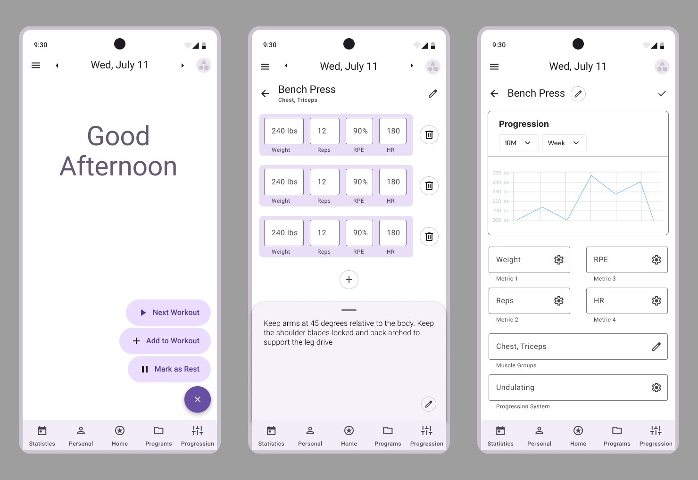
Building a Unified Fitness Tracker System ▾ Part 2
Best screens pertaining to the most immediate functionality to be implemented

Slide 4
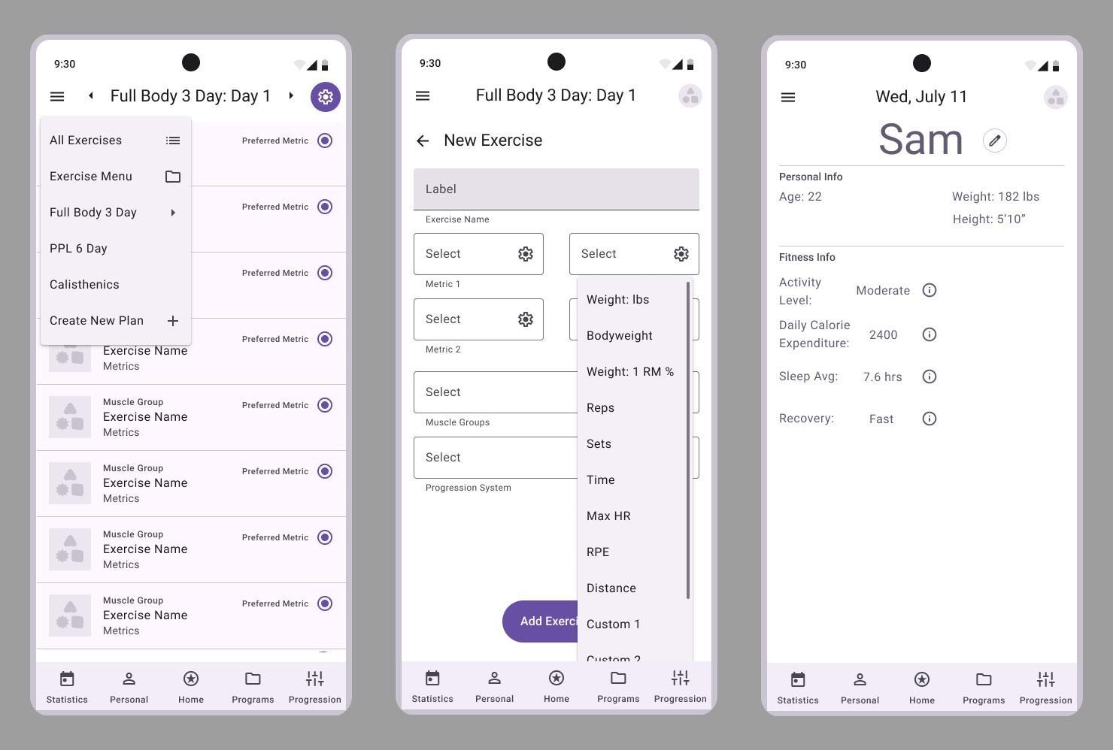
Building a Unified Fitness Tracker System ▾ Part 3
Some secondary screens that are either connected to core ones or will be easy to implement

Slide 5
Building a Unified Fitness Tracker System ▾ Part 4
Next Steps
Begin implementation of basic UI – expert suggestion was to isolate the very core functionality first, let it inform actual visual style, and iterate
Use Figma prototype for freeform design – use actual prototype for real feedback
Finish implementing Drift SQLite Schema
Questions
During the development, do you opt in for populating your databases, or do you avoid bothering until the testing phase?
How do you process real-world design feedback?

Slide 6
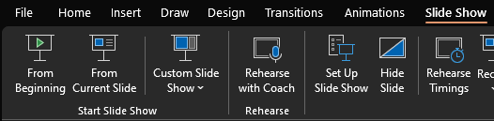
How to view
From the Slide Show tab, in the Start Slide Show section, click From Current Slide
Click next to advance through the animations

Slide 7
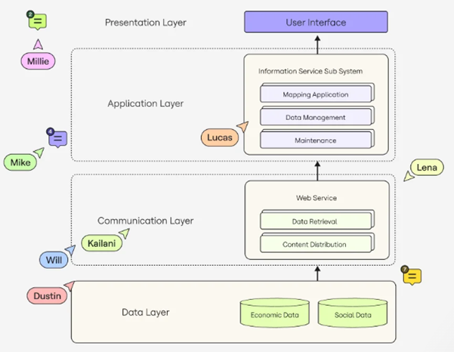
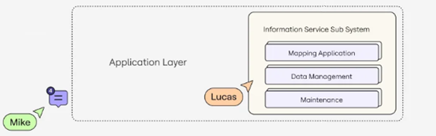
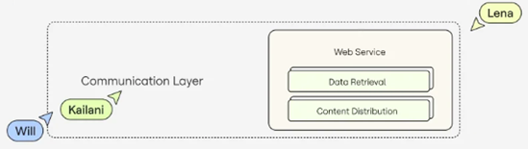
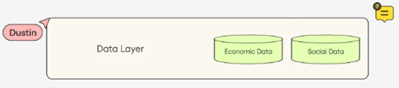
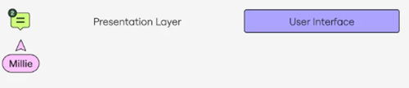
Project Poodles▾ Part 2
Use shapes and text boxes in your animations to draw attention to what you are focusing on
System architecture diagram showing the planned layers

Slide 8
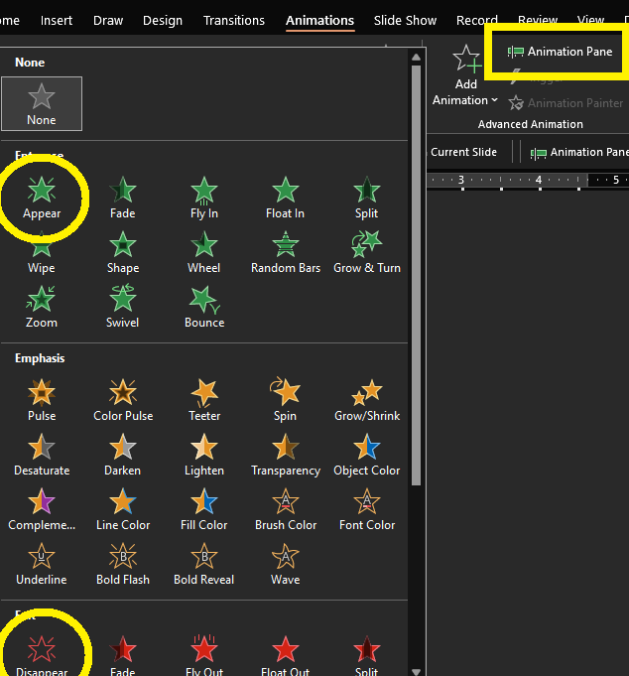
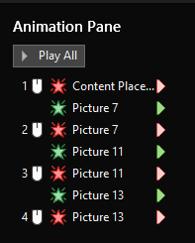
How to create animations
Use the Animations tab; green animations make things appear, red make disappear
Click Animation Pane to see the effects added to a slide
Use Start with previous/Start on click to make things happen together (for an example, go look at the Animation Pane for slide 11)
Use the tools from the Arrange section of the Shape Format tab to align images, or bring them forward/send them backwards to work with them
Clean up cropped images (I just use MS Paint)
Try not to overlap slide background elements (like the slide number)
Practice using your slide before the showcase meeting

