Slide 1
Building a Unified Fitness Tracker System▾ Part 1
Sam Baranov
Project
The project is focused on creation of a unified fitness app that combines automated planning, all-encompassing metrics tracking, and gamification elements for user retention
The goal is to publish the fitness app on Google Play Store in a state that implements at least the baseline functionality in all three fields.
Artifact
Prototype Presentation Layer
Started implementing the prototype UI based on Figma screens, currently learning BLoC for UI state management in Flutter
30% Complete

Slide 2
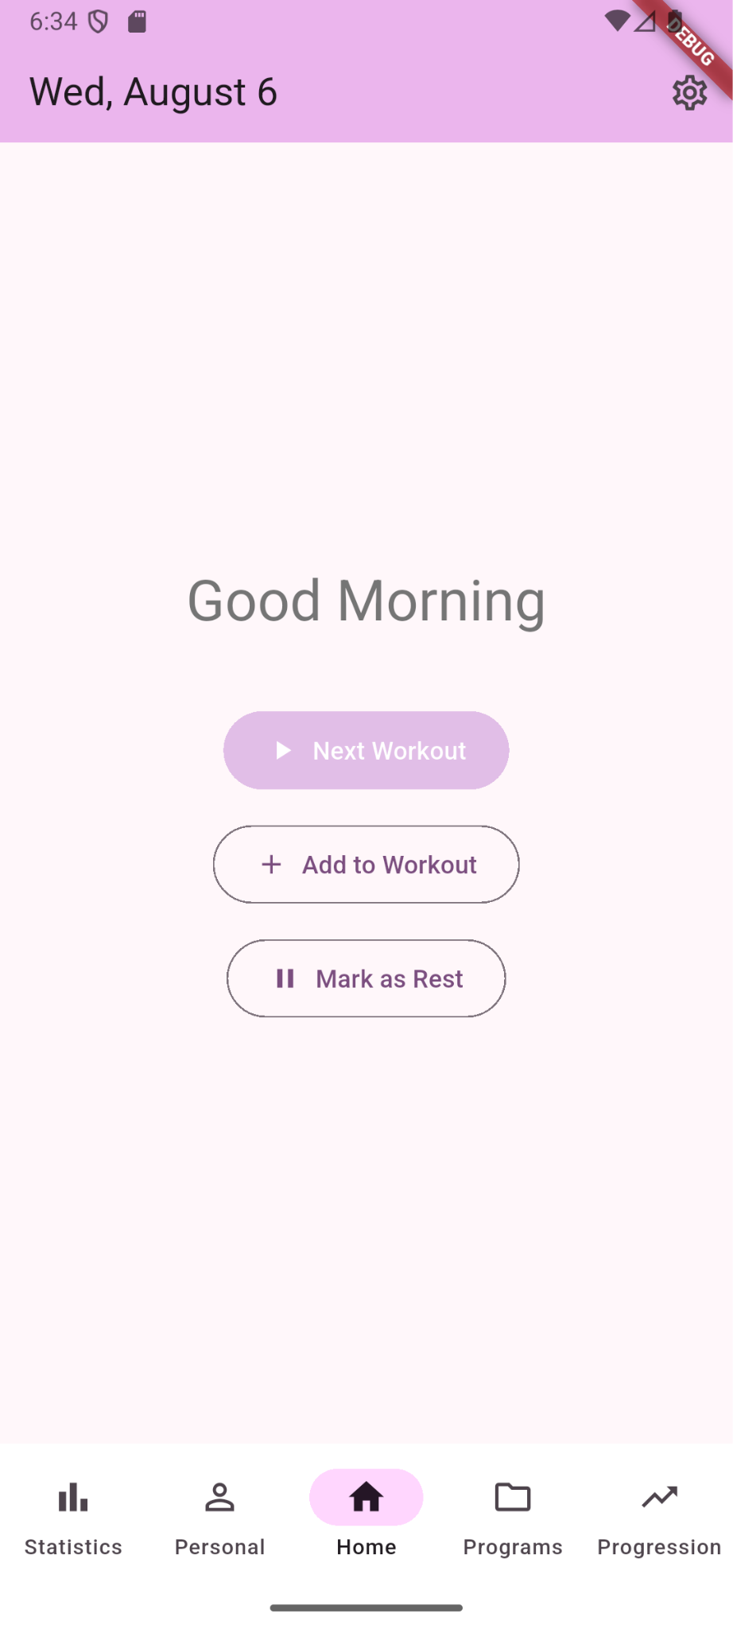
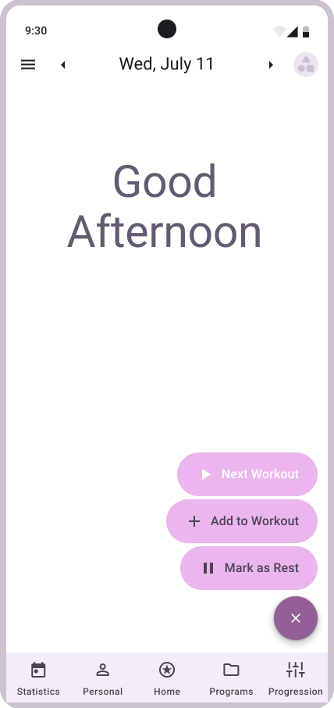
Building a Unified Fitness Tracker System ▾ Part 2
Basic Implementation of UI for Home Screen, for now greatly simplified from Figma

Slide 3
Building a Unified Fitness Tracker System▾ Part 3
Sam Baranov
Artifact
Domain Layer
Implemented entities and use cases needed to establish basic exercise creation and manipulation
40% Complete for prototype
Artifact
Database Setup
Completely revised and simplified for the prototype version
Complete for basic prototype, will require revisions for anything more

Slide 4
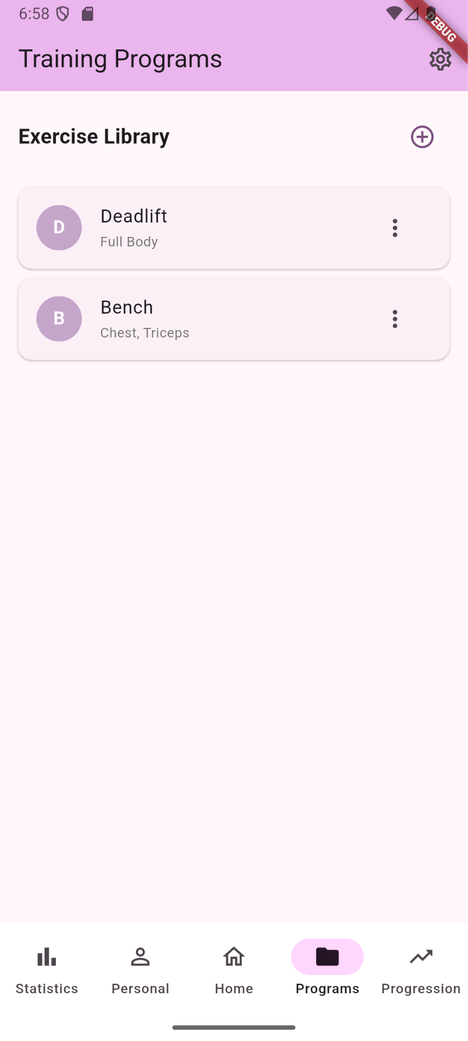
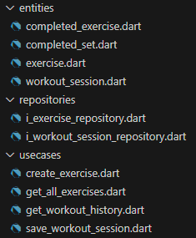

Building a Unified Fitness Tracker System ▾ Part 4
Exercise library screen so far, as well as some of the domain/UI state connection through BLoC

Slide 5
Building a Unified Fitness Tracker System ▾ Part 5
Next Steps
Continue implementing the UI. Main issue is figuring out how to get it to actually mimic the clean style of Figma prototype
Implement full set of CRUD actions to perform through UI
Begin working on workout plan creation UI from present exercises, and workout selection.
Questions
For those who designed a Figma prototype before implementation, did you manage to get it to look like your originally planned screens?

