Slide 1
Saint Petersburg Electrotechnical University
(ETU)
Biotechnical systems Department
MASTER THESIS
Topic:
Алгоритм Анализа Фетальной ЭКГ для Выявления Тревожных Состояний
(Algorithmic Analysis of ECG for Discovering Fetal Critical Conditions)
student Tokarchuk T. S.
Research supervisor Anisimov A. A.
Advisor Bobrova Y. O.
2021

Slide 2
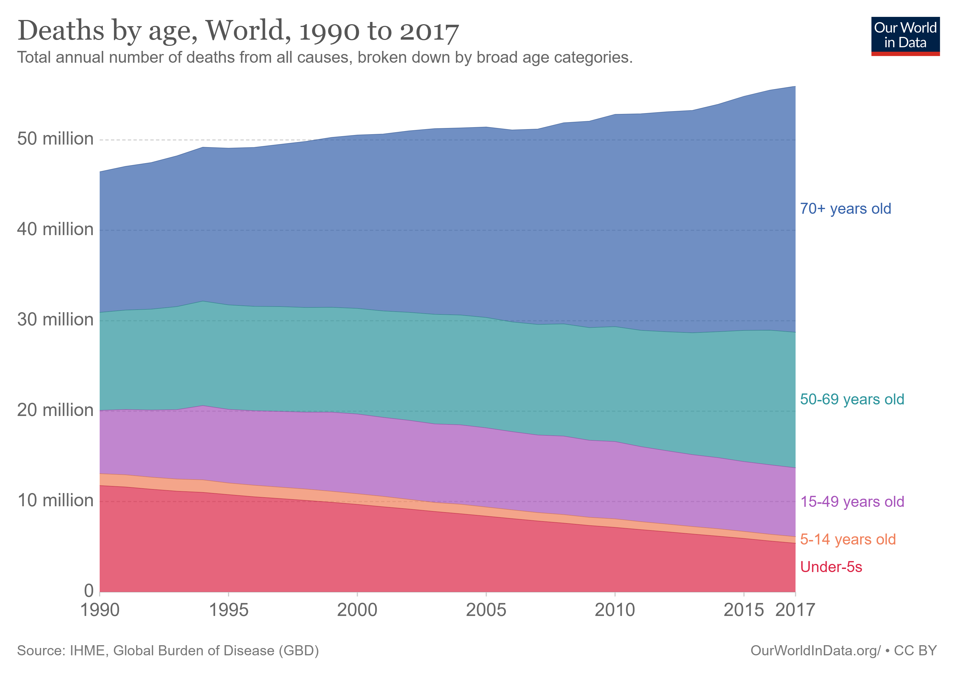
The Relevance of Fetal Monitoring

Slide 3
The Relevance of Fetal Monitoring
Diagnostic ways:
Biochemical samples
Biotechnical analysis
Ultrasound
Cardiotocography
Fetal ECG monitoring

Slide 4
The Relevance of Fetal Monitoring
Diagnostic ways:
Biochemical samples
Biotechnical analysis
Ultrasound
Cardiotocography
Fetal ECG monitoring

Slide 5
Goals and tasks
Goal: The Development of algorithm based on fetal ECG analysis for discovering fetal critical conditions.
Tasks:
Development of the preprocessing chain.
Development and improvement of the Fetal ECG extraction algorithm.
Development of the fetal heart rate analysis algorithm.
Fetal ECG extraction and FHR analysis algorithm evaluation

Slide 6
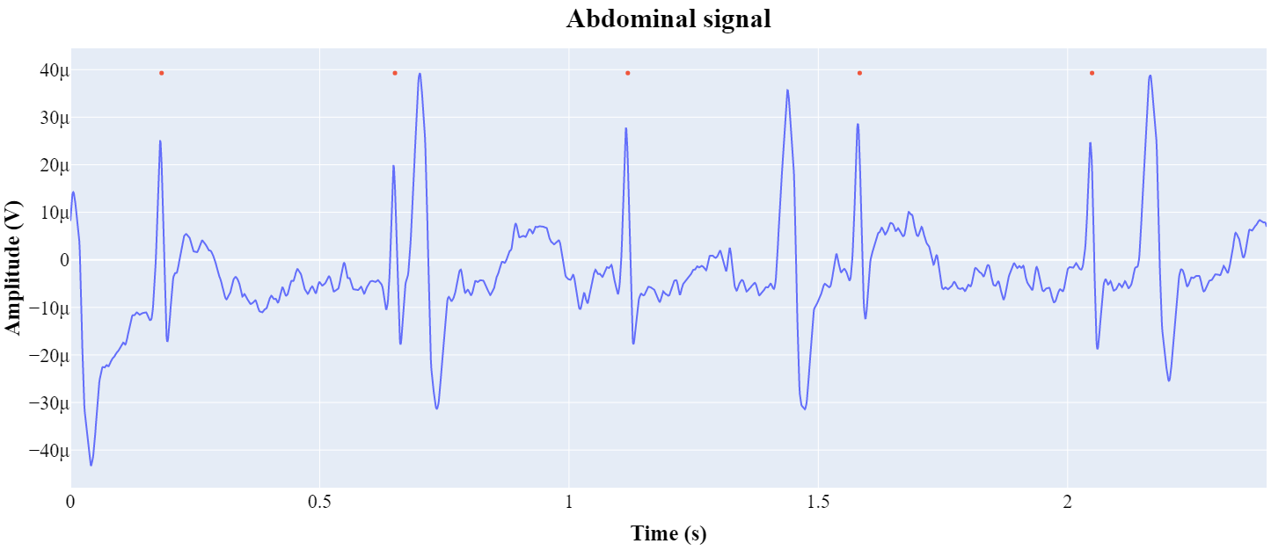
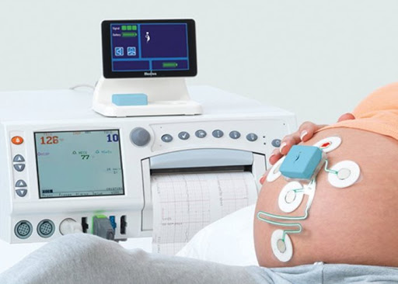
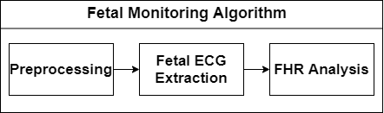
Fetal ECG Monitoring

Slide 7
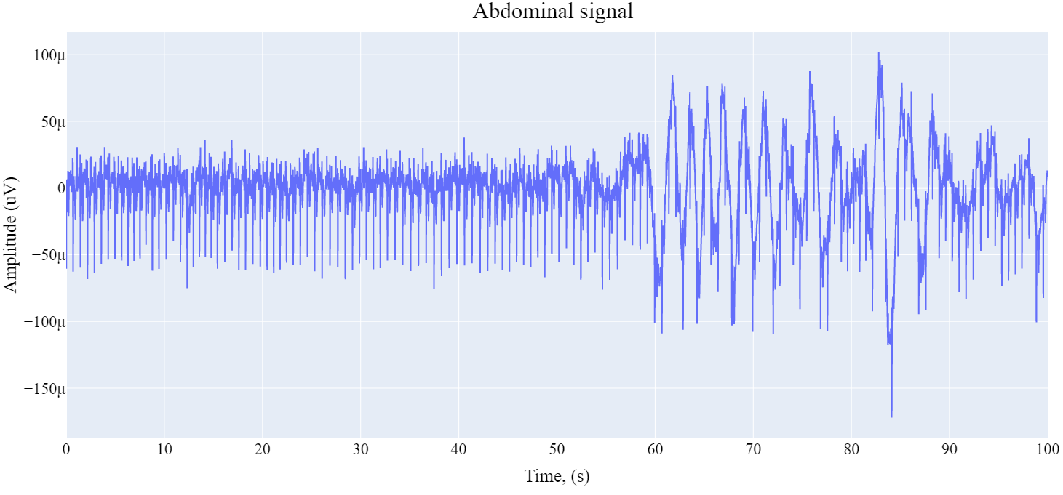
Preprocessing Stage
Signal noises:
Powerline interference.
Baseline drift.
High frequency noises.
Artefacts.

Slide 8
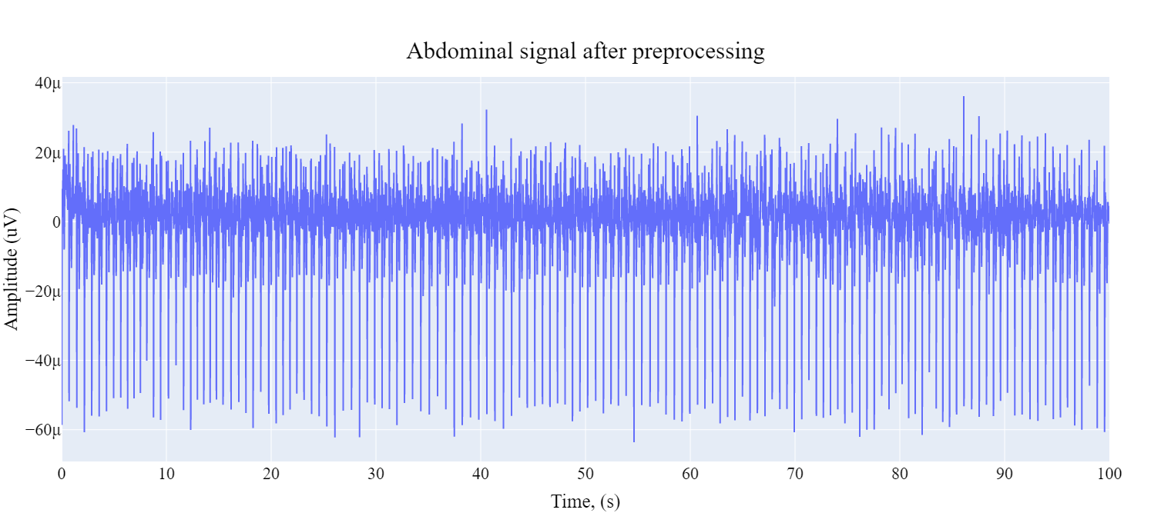
Preprocessing Stage
Methods to cope with noises:
Notch filtering
Wavelet decomposition
Bandpass filtering

Slide 9
Fetal ECG Extraction
Extraction steps:
FastICA
QRS Detection
Peak Enhancement
Template Subtraction
Advantages:
High computational speed.
Low memory usage.
Sustainability to additive noise.
Disadvantages:
Only one gaussian source allowed.
High number of channels required.

Slide 10
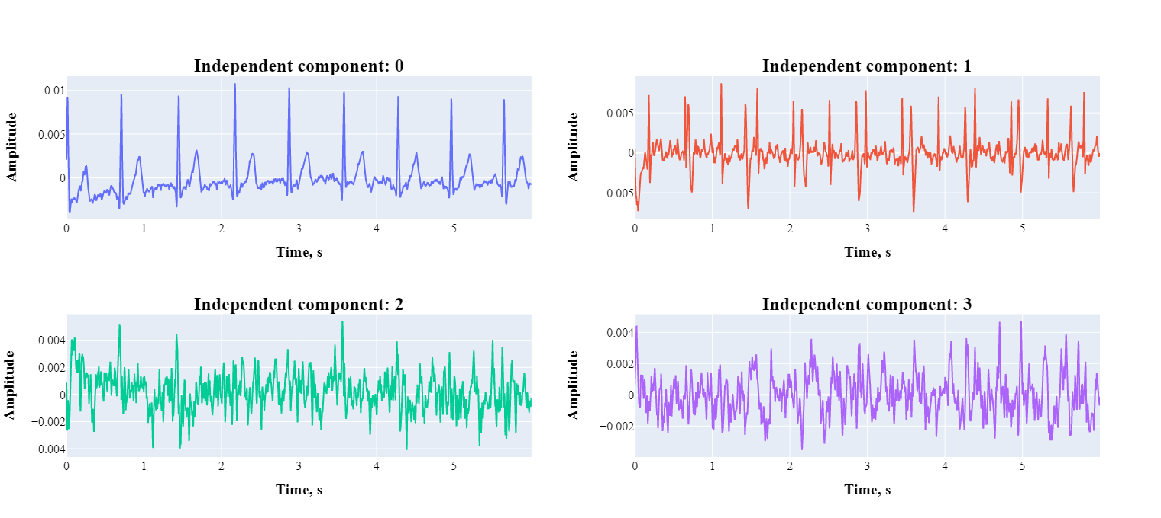
Independent component analysis

Slide 11
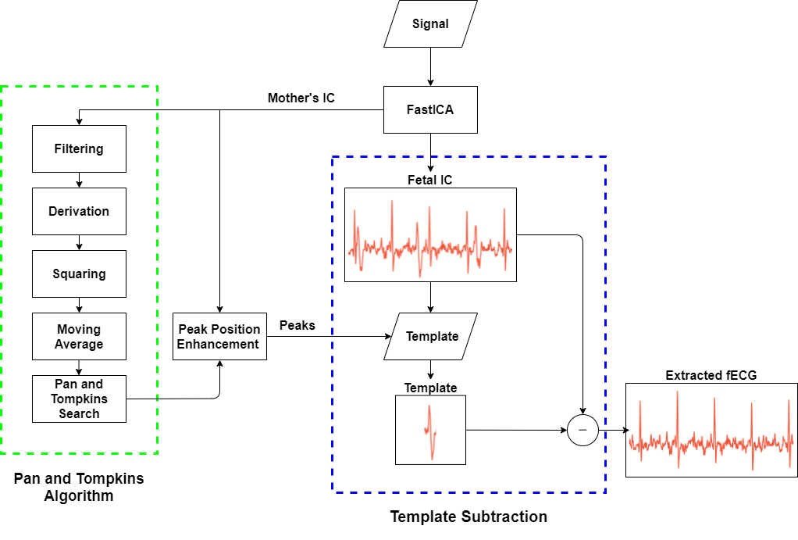
Fetal ECG Extraction Algorithm

Slide 12
Fetal extraction algorithm evaluation
 | R01 | R04 | R07* | R08** | R10**
TP | 609 | 372 | 438 | 296 | 268
FP | 36 | 253 | 203 | 31 | 55
FN | 35 | 260 | 189 | 33 | 55
TPR | 0.95 | 0.59 | 0.70 | 0.90 | 0.83
PPV | 0.95 | 0.59 | 0.68 | 0.91 | 0.83
Acc | 0.90 | 0.42 | 0.53 | 0.82 | 0.71
F1 | 0.94 | 0.59 | 0.69 | 0.90 | 0.83

Slide 13
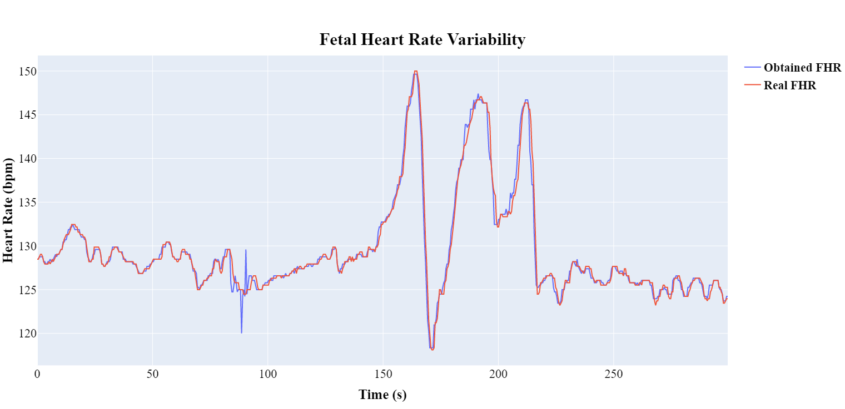
Fetal heart rate analysis
Processing:
Median filtration
Features used:
Baseline
AmpStd
Number of accelerations
Number of decelerations
Mild
Prolonged
Severe

Slide 14
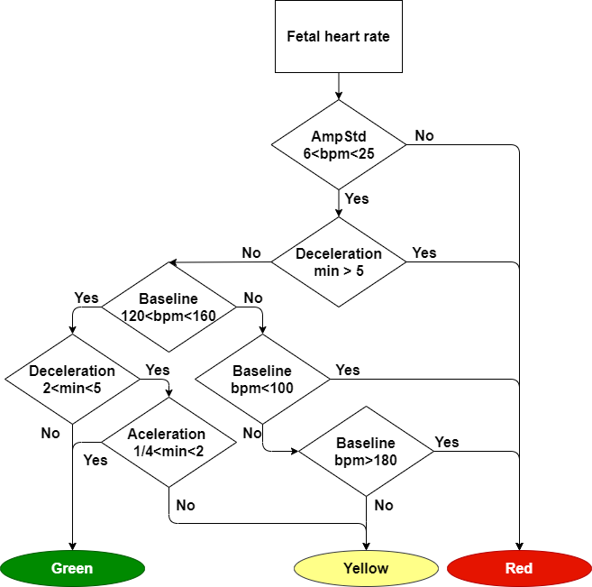
Fetal Heart Rate Decision Algorithm
Green – Safe
Yellow – Attention
Red – Danger

Slide 15
Fetal heart rate algorithm evaluation
 | trace 1 | trace 2 | trace 10 | trace 26 | trace 28
Level | 1 | 1 | 1 | 0 | 0
Baseline, bpm | 170 | 161 | 177 | 118 | 139
AmpStd, bpm | 7.4 | 7.0 | 5.3 | 6.2 | 8
Acc_num | 0 | 0 | 0 | 13 | 17
Dec_Mild | 29 | 19 | 8 | 0 | 38
Dec_Prolonged | 1 | 2 | 0 | 0 | 0
Dec_Severe | 0 | 0 | 0 | 0 | 0

Slide 16
Conclusion
Project include:
Development of the preprocessing chain
Development of the FHR Extraction algorithm.
Modification of Pan and Tompkins Processing and Search algorithms.
Development of the Enhance Peak Position method.
Modification of the Template Subtraction method.
The Development of FHR analysis and decision making algorithms.
Future investigations should include the development of electrode positioning system, appropriate for obtaining at least two channels with mECG and fECG, and algorithm optimization and adaptation for a concrete acquisition system.

Slide 17
Thanks for attention

