Slide 1
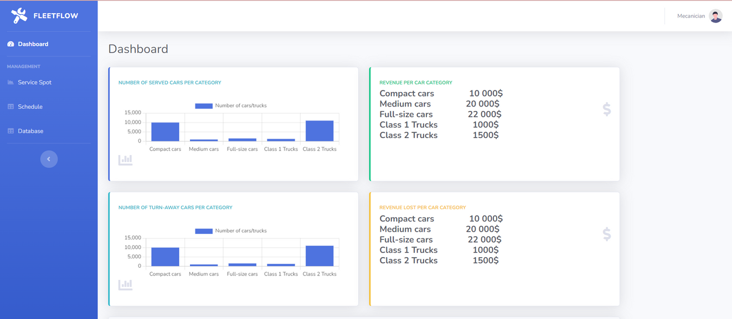

FLEETFLOW
By: Bhavya Mehta
Haifaa Janoudi
Hawa-Afnane Said
Zineb Alaoui

Slide 2





Programming Languages Used
HTML
CSS
JAVASCRIPT
NODEJS
SQL
FRONTEND
FRONTEND
FRONTEND
BACKEND
BACKEND

Slide 3
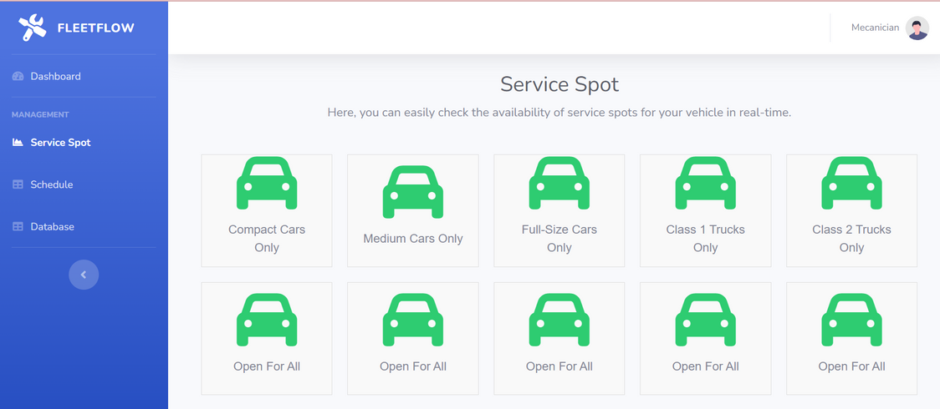
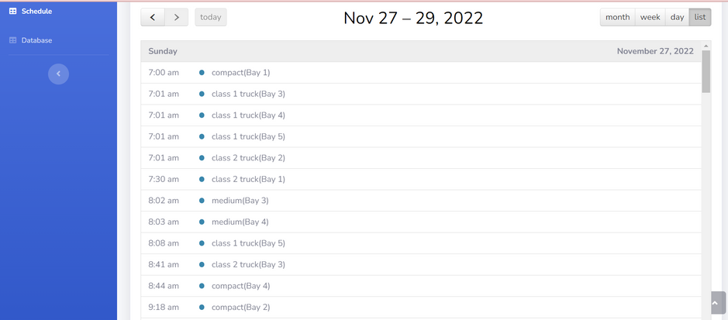
Main Components
Dashboard
Service Spot
Schedule
We implemented a dashboard with detailed insights. It stands out as it not only tracks operational performance but also directly ties it to financial outcomes. This level of detailed breakdown is invaluable for strategic planning, identifying growth opportunities, and making informed decisions to enhance service quality and profitability.
The feature offering a live view of each bay's occupancy. It's particularly beneficial for managing walk-ins, as staff can quickly see if a bay is available and appropriate for a walk-in's vehicle type and service needs. This capability greatly reduces wait times and enhances customer satisfaction.
Our scheduling software stands out by providing a clear, real-time visual representation of the day's appointments, allowing employees to easily see which clients they have at specific times. This feature streamlines workflow, improves time management, and enhances overall service efficiency, ensuring a smoother and more organized operation in the tire change shop.

