Slide 1

Real Time Object Detection for autonomous cars using Deep Learning
Harkati Chiraz Rayene & Zineb Senane
Supervised by: Pr Marios Kountouris

Slide 2
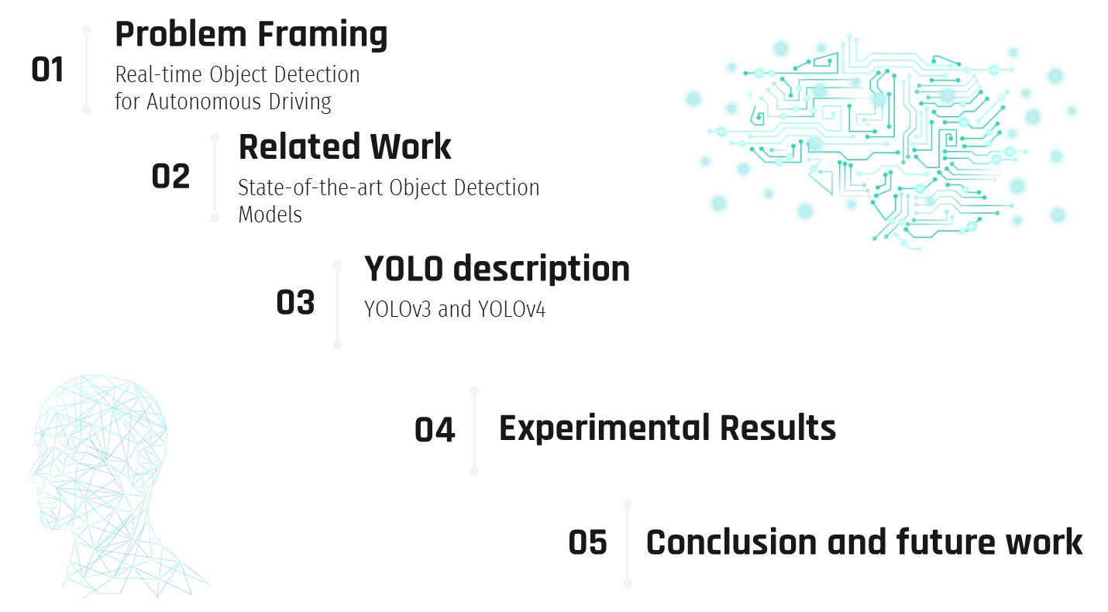

Slide 3



Slide 4
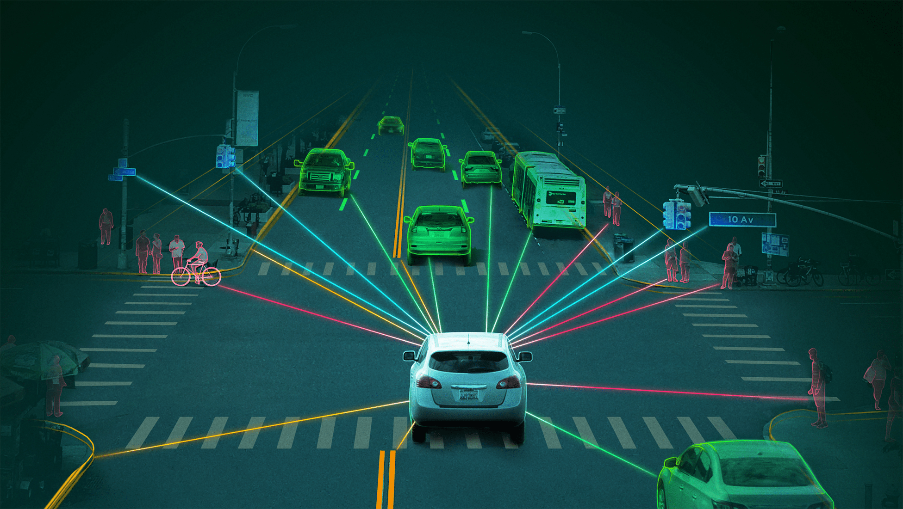
Motivation

Slide 5
Problem
How to perform a real time object detection in self driving or autonomous cars using the YOLO model ?

Slide 6
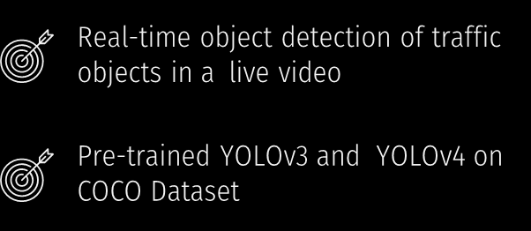
Approach

Slide 7



Why pre-trained models on COCO dataset?

Slide 8


Slide 9
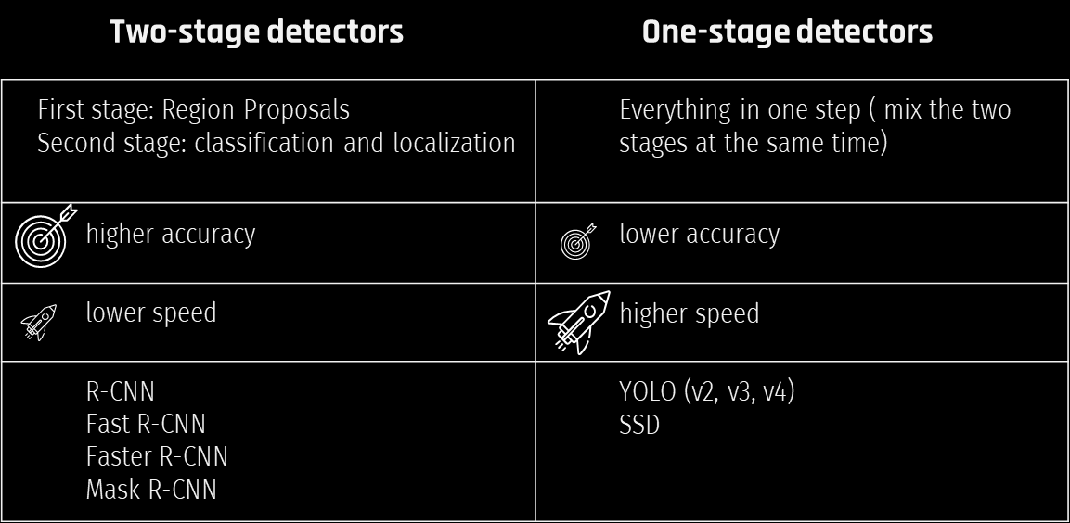
Recent object detectors

Slide 10


Slide 11
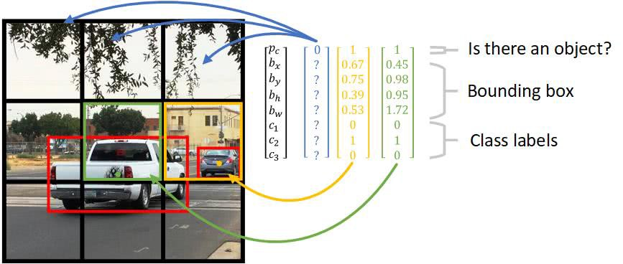
Main idea

Slide 12

YOLO main idea

Slide 13
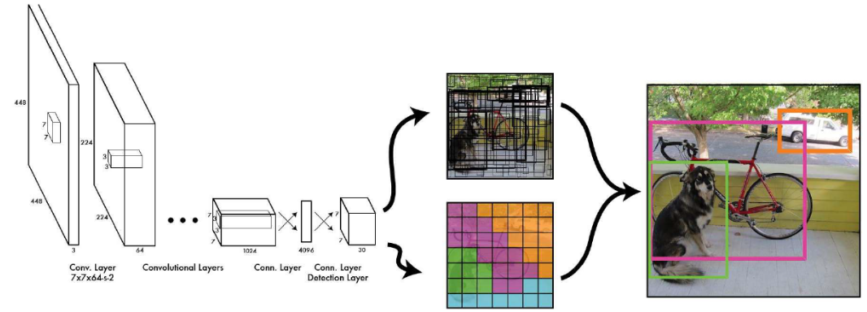
You Look Only Once (YOLO) architecture

Slide 14
Yolo mechanism
Divide the image into a SxS grid.
If the center of an object fall into a grid cell, it will be the responsible for the object.
Each grid cell predict: B bounding boxes; B confidence scores as C=Pr(Obj)*IOU; Confidence Prediction is obtained as IOU of predicted box and any ground truth box.

Slide 15
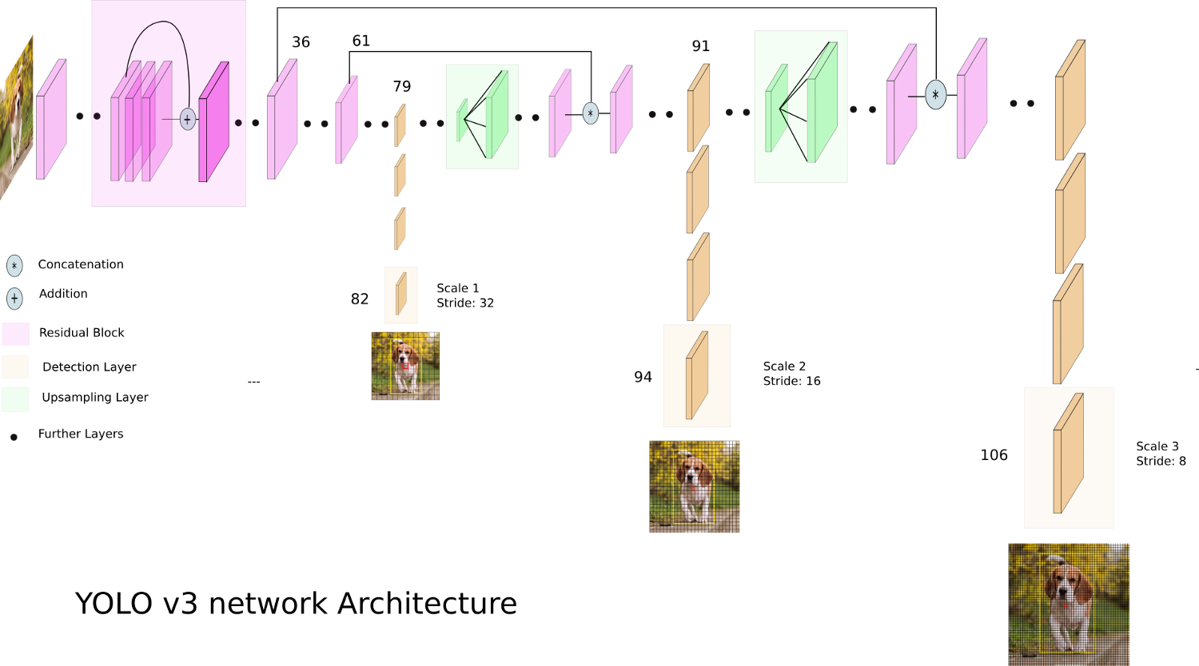
YOLOv3 Architecture

Slide 16
YOLO v3 mechanism
Its main idea is residual skipconnections and upsampling
makes detections at three different scales. using 1x1 kernel on the feature maps and fully connected layers]
uses independent logistic classifiers and binary cross-entropy loss instead of softmax and mean squared error.

Slide 17
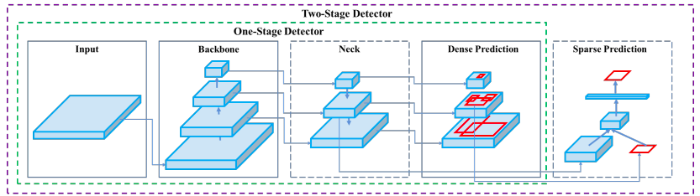
YOLOv4 Architecture

Slide 18
YOLOv4 mechanism
Different architecture composed of four different blocks which are :the backbone, the neck, the dense prediction, and the sparse prediction.
Compared to YOLO v3 , YOLO v4 improved the mean average precision(mAP) by as much as 10% and the number of frames per second by 12%
backbone : neural network composed of convolutional layers to extract the essential features
neck : it collects feature maps from different stage to improve accuracy
Head : perform dense prediction which is a vector containing the coordinates of the predicted bounding box (center, height, width), the confidence score of the prediction and the label

Slide 19


Slide 20
Datasets
BDD100K: different images in different circumstances with ones challenging the deep learning models in such tasks
Our own images
Live camera for videos

Slide 21
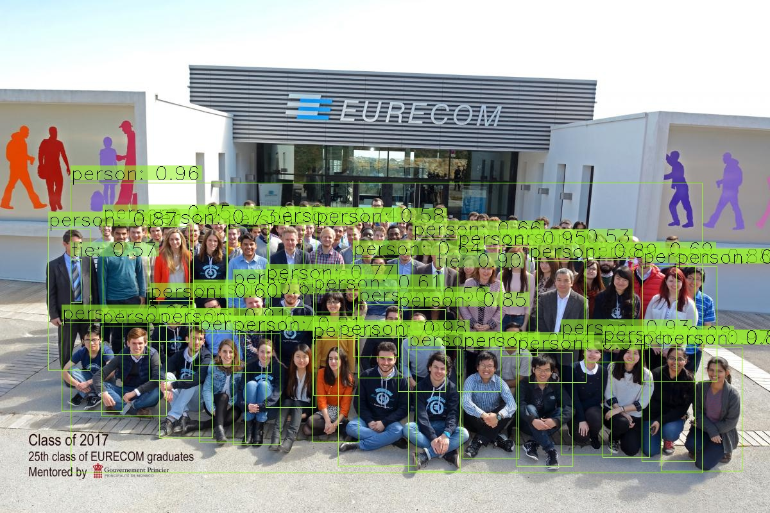
YOLOv3

Slide 22
DEMO for real-time detection

Slide 23


Slide 24
Conclusion
Future work
Good accuracy
easy and fast
But …
Struggles to detect objects grouped together
Struggles to detect small objects
Test two-stage detectors for higher accuracy
To think about: how to achieve a good tradeoff between speed and accuracy since we’re dealing with autonomous cars driving

Slide 25


