Slide 1
Object-Oriented Programming (OOP) Concepts in Python

Slide 2
Introduction to OOP
Object-Oriented Programming is based on objects
Organizes code by grouping data and behavior
Python supports full OOP capabilities

Slide 3
Key Concepts of OOP
1. Class
2. Object
3. Inheritance
4. Abstraction
5. Encaplusation
6. Polymorphism

Slide 4
Class and Object
Class: A class is like a blueprint or template for creating object. It defines the structure and behaviour(data and functions) that the created object will have.
Object: Object is a instance of the class

Slide 5
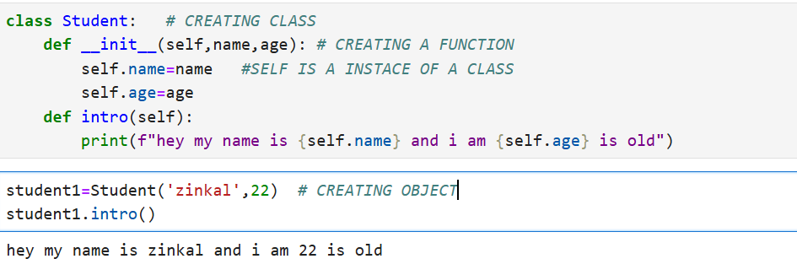
EXAMPLE

Slide 6
INHERITANCE
Inheritance is a feature that allows one class (child class) to reuse the properties and methods of another class(parent class).
There are three types of inheritance.
1) Single inheritance
2) Multiple inheritance
3) Multilevel inheritance

Slide 7
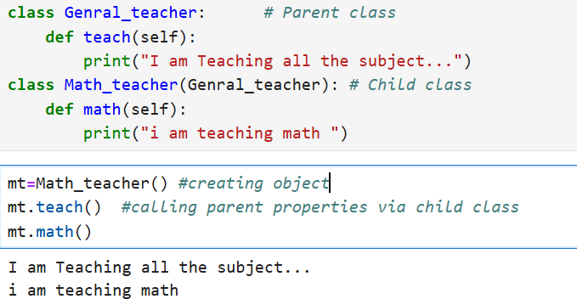
Single Inheritance

Slide 8
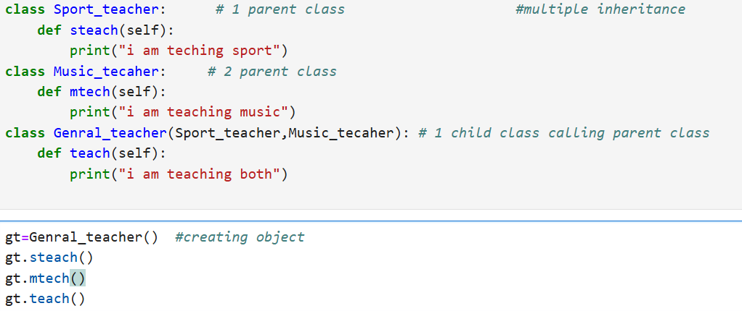
Multiple Inheritance

Slide 9
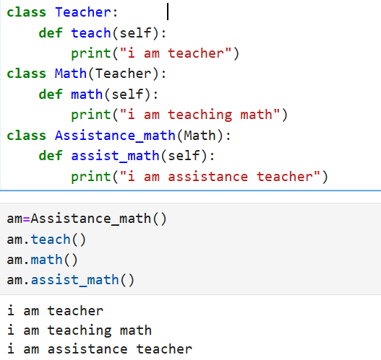
Multilevel Inheritance

Slide 10
Abstraction
Abstraction means hiding the internal details and showing inly the essential features.
It is imported from abc import ABC, abstractmethod
class Animal(ABC):
@abstractmethod

Slide 11
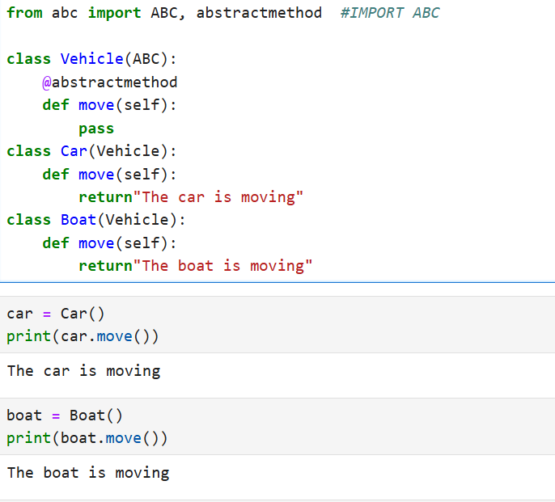
EXAMPLE

Slide 12
ENCAPSULATION
Encapsulation refers to bundling data (attributes) and methods (functions) that operate on that data into a single unit, usually a class. It also restricts direct access to some components of an object, which is a way of implementing data hiding.
Private attribute (using _ or__)to restrict direct access
Access is controlled through getter and setter methods.

Slide 13
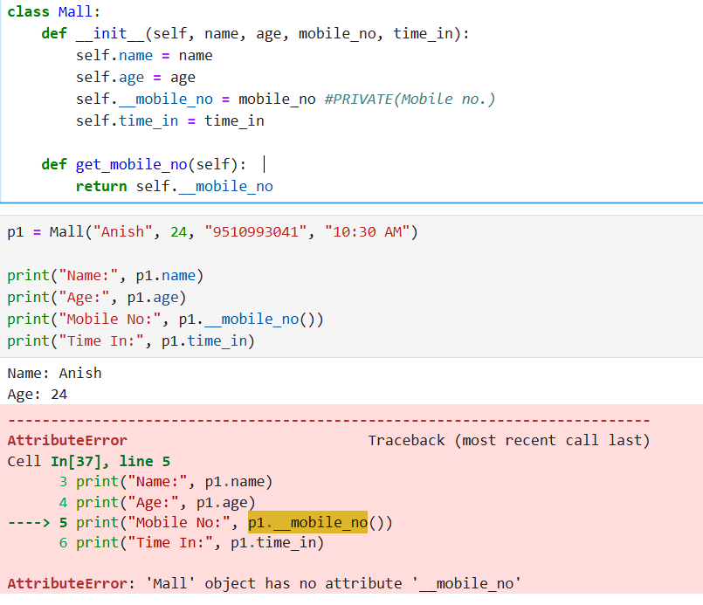
EXAMPLE

Slide 14
Polymorphism
Polymorphism is the ability of different class to use the same method name but perform different task.
Same method behaves differently in different classes

Slide 15
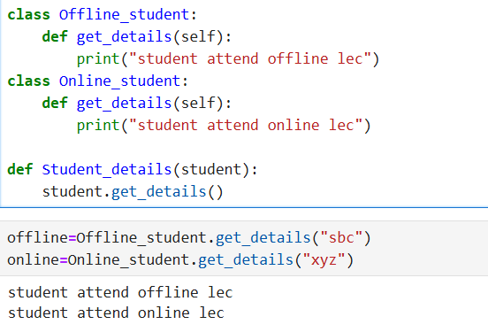
EXAMPLE

Slide 16
THANKYOU!!

