Slide 1
Neural Networks Implementation : Flower Recognition using a neural network on Iris Database

Slide 2
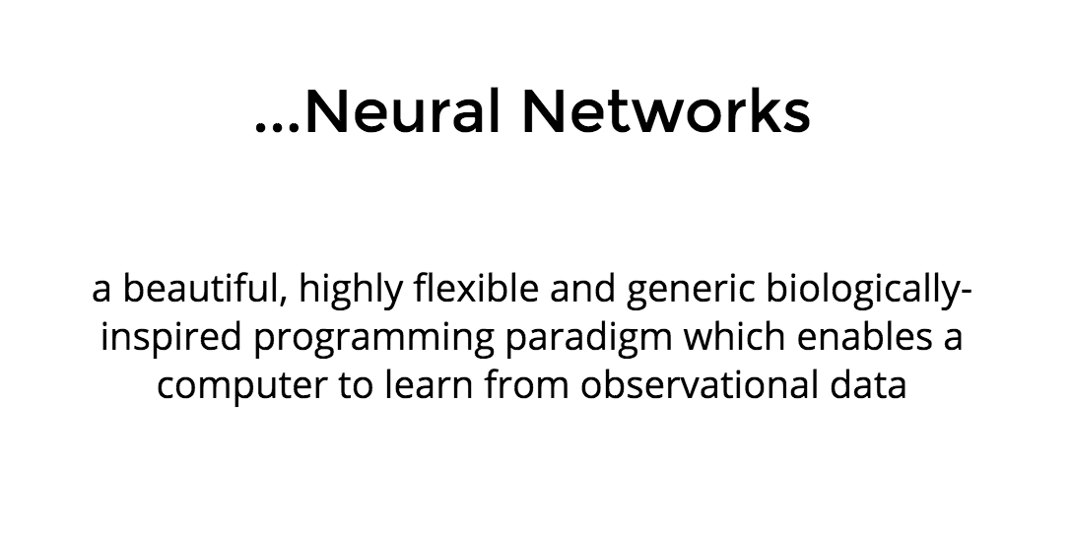

Slide 3
Neural Networks Characteristics
contains sets of adaptive weights, i.e. numerical parameters that are tuned by a learning algorithm, and
capability of approximating non-linear functions of their inputs.

Slide 4
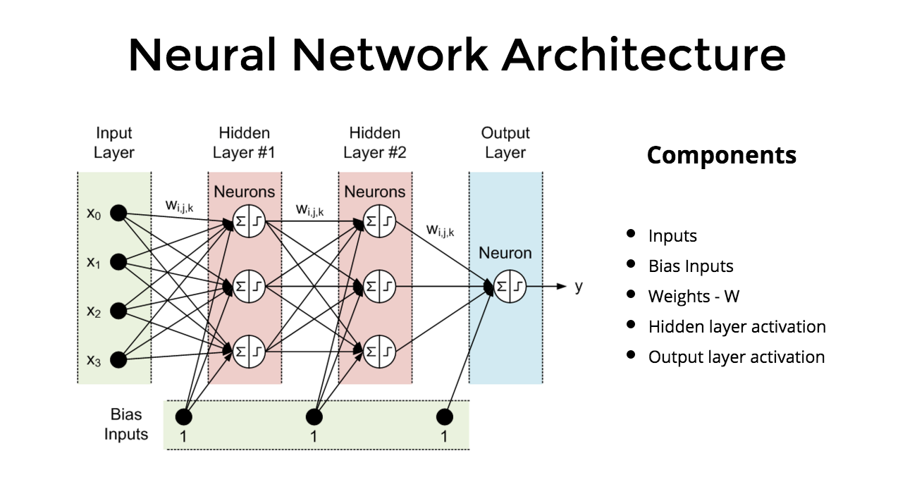
Architecture

Slide 5
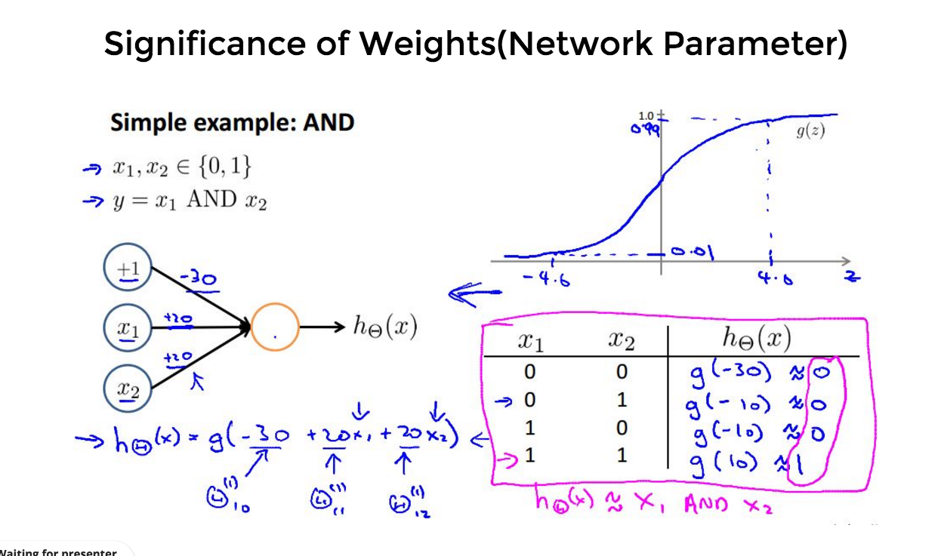
AND Gate Visualisation

Slide 6
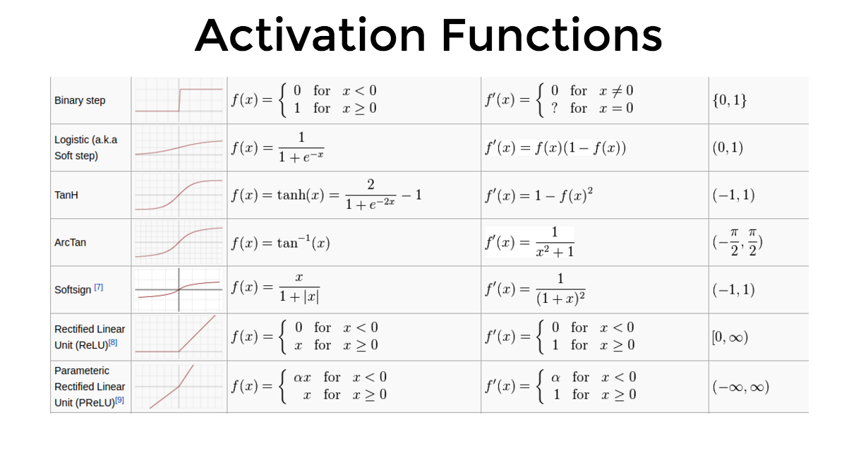

Slide 7
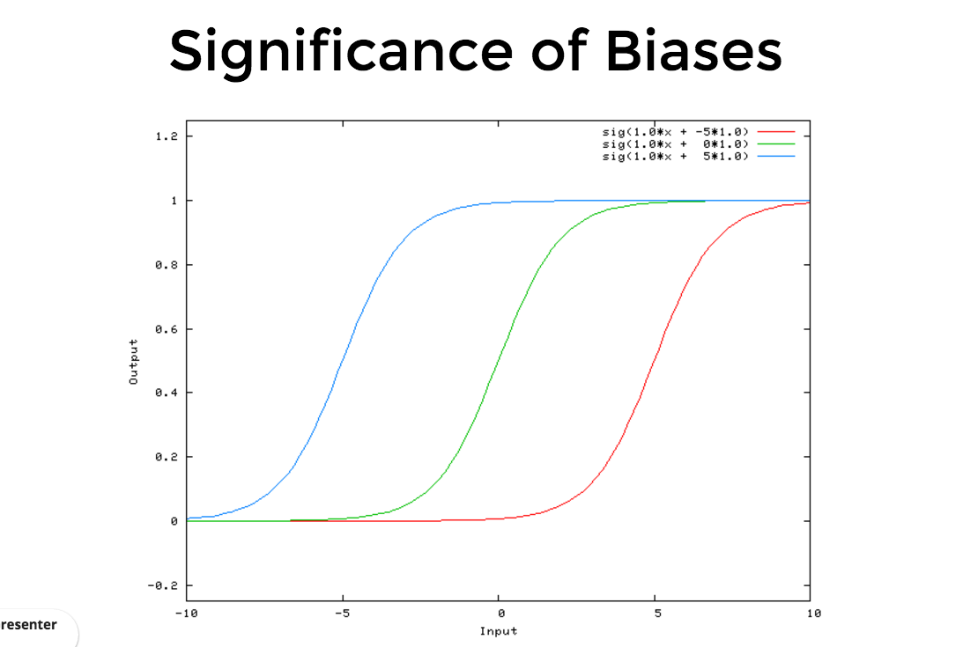

Slide 8
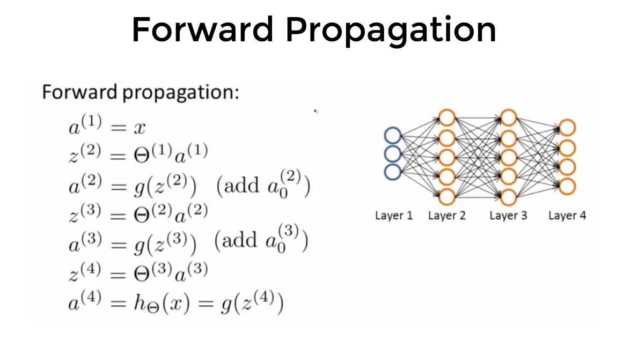

Slide 9
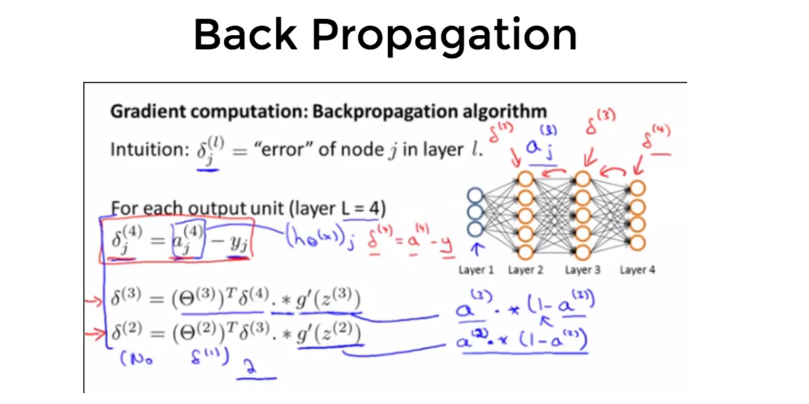

Slide 10
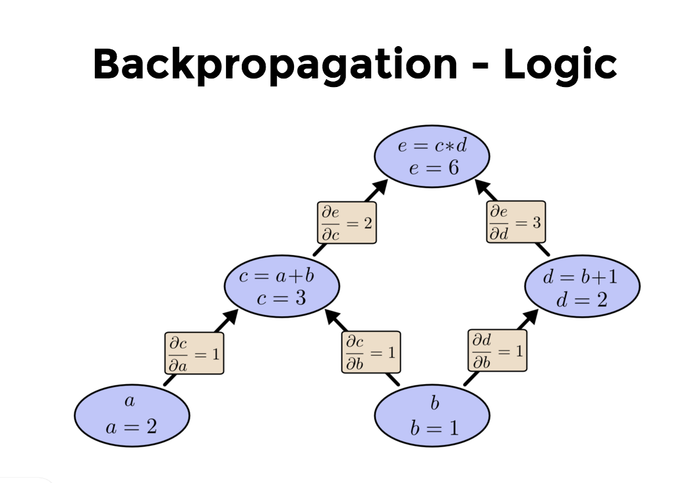

Slide 11
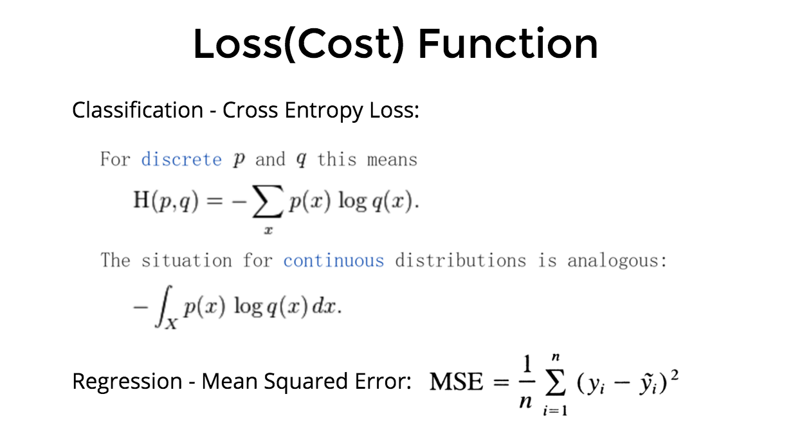

Slide 12
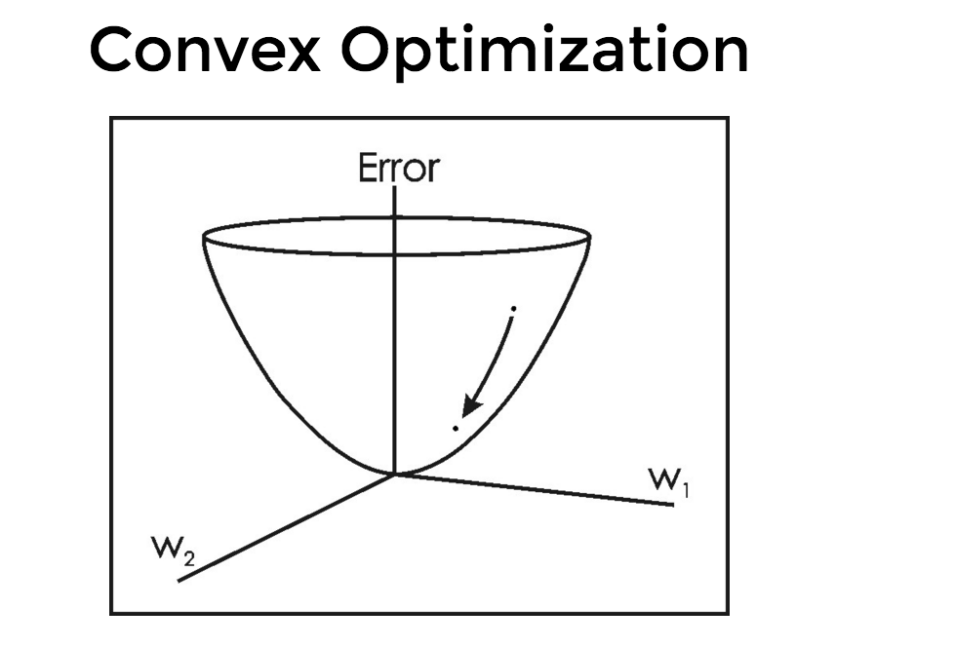
Learning Rate

Slide 13
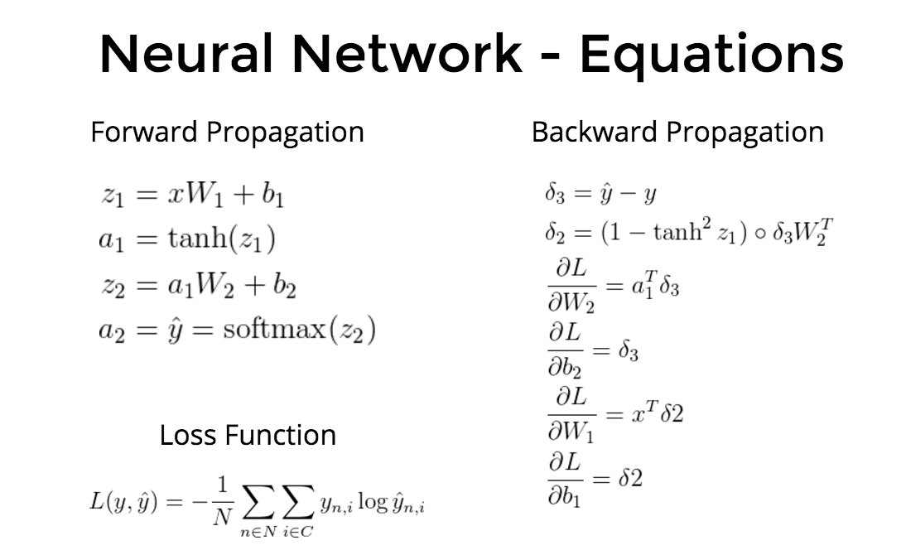

Slide 14
Using ANN’s (Artificial Neural Networks)
Choice of model: This will depend on the data representation and the application. Overly complex models tend to lead to challenges in learning.
Learning algorithm: There are numerous trade-offs between learning algorithms. Almost any algorithm will work well with the correct hyperparameters for training on a particular fixed data set. However, selecting and tuning an algorithm for training on unseen data require a significant amount of experimentation.
Robustness: If the model, cost function and learning algorithm are selected appropriately, the resulting ANN can be extremely robust.

Slide 15
References :
http://playground.tensorflow.org/
https://en.wikipedia.org/wiki/Artificial_neural_network
http://neuralnetworksanddeeplearning.com/chap1.html
https://www.doc.ic.ac.uk/~nd/surprise_96/journal/vol4/cs11/report.html

